Slide 1
NYC Taxi Performance — January 2024
Generated July 13, 2026 · Source: NYC TLC Yellow Taxi trip records

Slide 2
Executive Summary — January 2024
2,723,370
Total Trips
$74,626,484
Total Revenue
$18.43
Avg Fare
15.8 min
Avg Duration
✈ Airport trips: 10.1% of total volume
Source: NYC TLC trip records → dbt/DuckDB pipeline

Slide 3
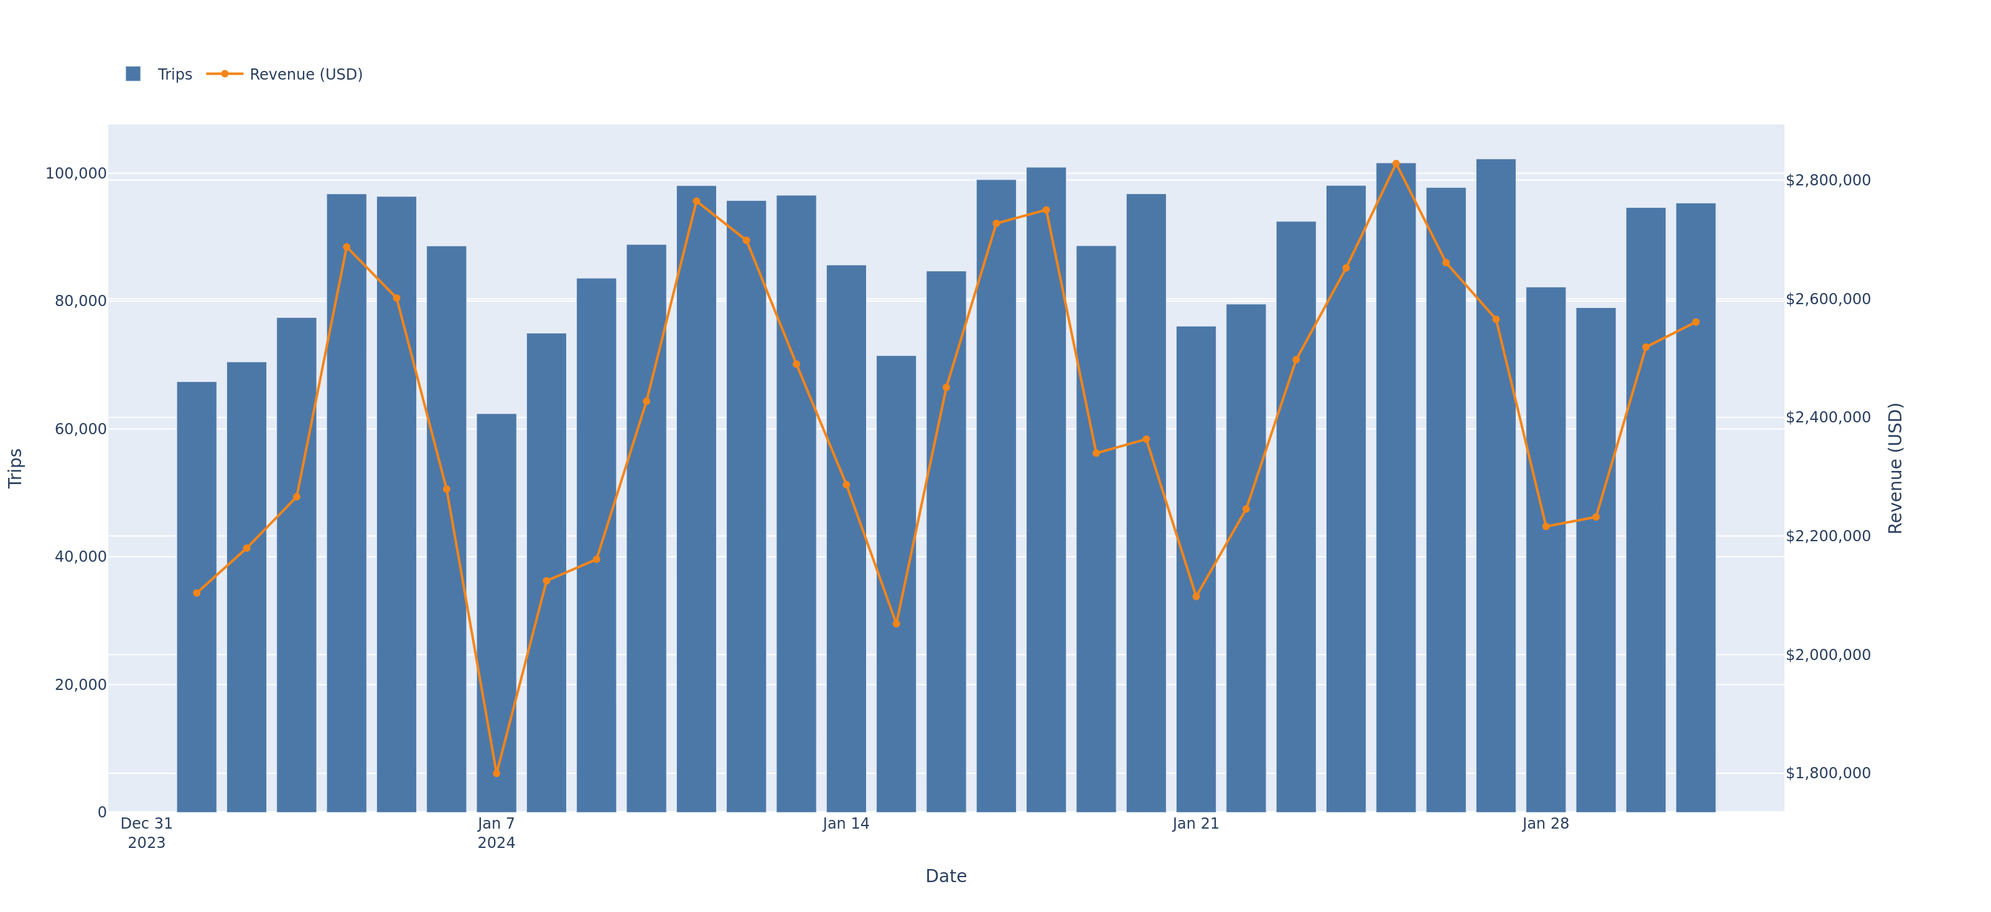
Daily Trend
Daily trip volume and revenue across the month

Slide 4
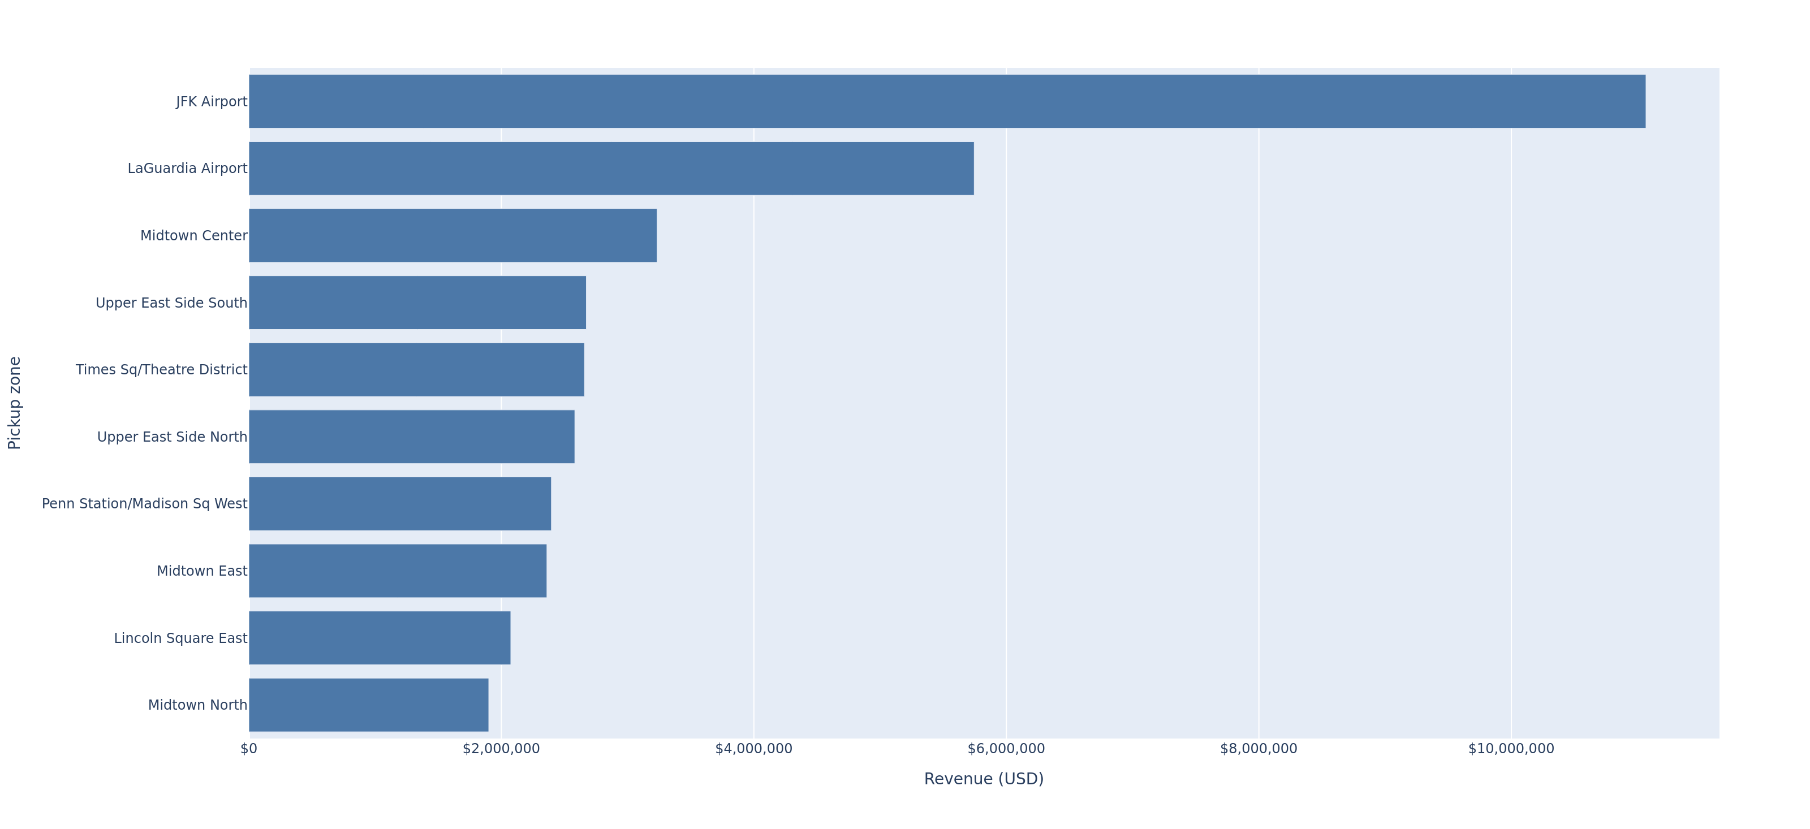
Top 10 Zones by Revenue
Pickup zones ranked by total revenue

Slide 5
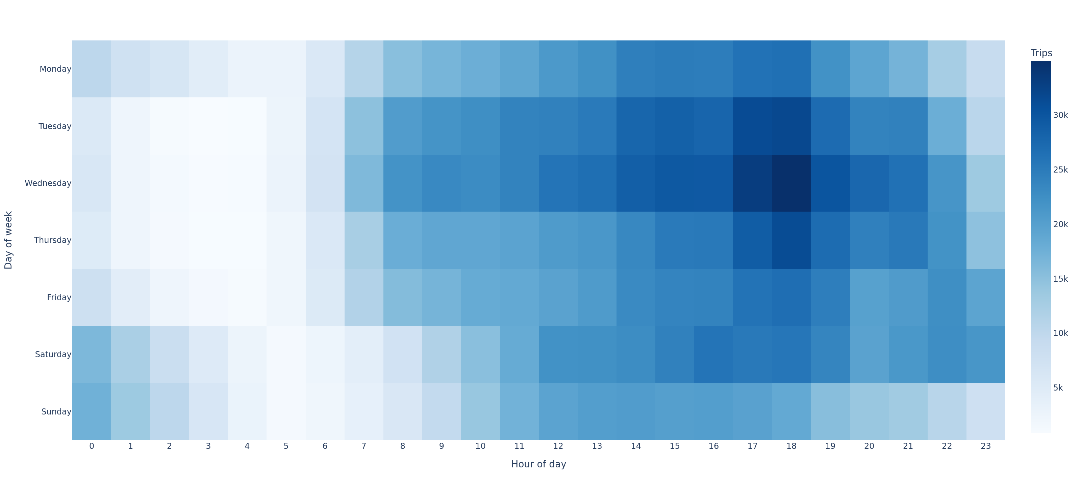
Demand Heatmap
Trip volume by day of week and pickup hour

Slide 6
Methodology & Sources
Pipeline: TLC trip records → dbt/DuckDB → automated deck
Repository: <repo-url-placeholder>

