Slide 1
CSE 170 - Technical Teamwork and Emotional Intelligence
Architects of Learning – Spring 2024
Quinn Briggs

Slide 2
Overview
CSE 170 – Technical Teamwork is a core, required course for Computer Science and Software Engineering degrees
This aligns with the “Skilled Collaborators” institutional learning outcome.
The emphasis of this course is on applying “power skills” within the context of technical projects.
The course lead revised the course last year to focus more on project specific skills by incorporating a month-long project into the course.
When I was asked to teach it Fall 2023, I was uncomfortable with the course because it had several key deficiencies.

Slide 3
Key Deficiencies
Unknown model for power skills
Multidimensional Influence Model
Vague project instructions
Difficult for incoming Freshmen to understand
Missing important technical teamwork concepts such as:
Team Charter
Scrum methodology
Agile roles and responsibilities
Team retrospectives
Remote work perspectives
Missing incentive to participate in classroom activities
No peer evaluation
Lacking specific technical component
No attendance requirement

Slide 4
Course Organization
Unit 1 – Overview
Unit 2 – Self-Improvement
(Power Skills Overview)
Unit 3 – Commitment and Conflict
(Project Definition)
Unit 4 – Leadership
(Project Execution)

Slide 5
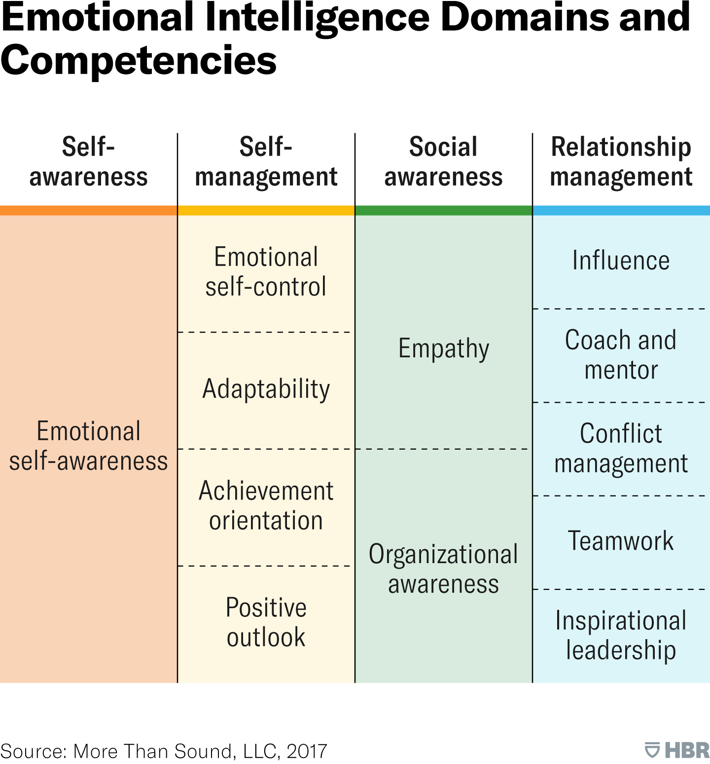
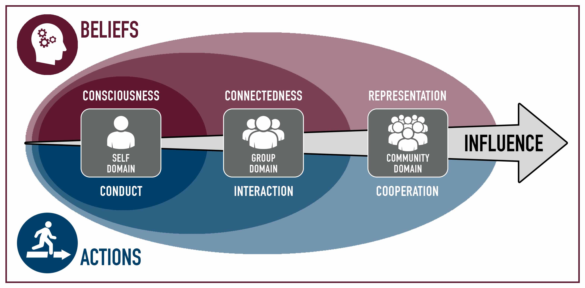
Old Model vs. New Model
Multidimensional Influence Model
Emotional Intelligence (HBR)

Slide 6
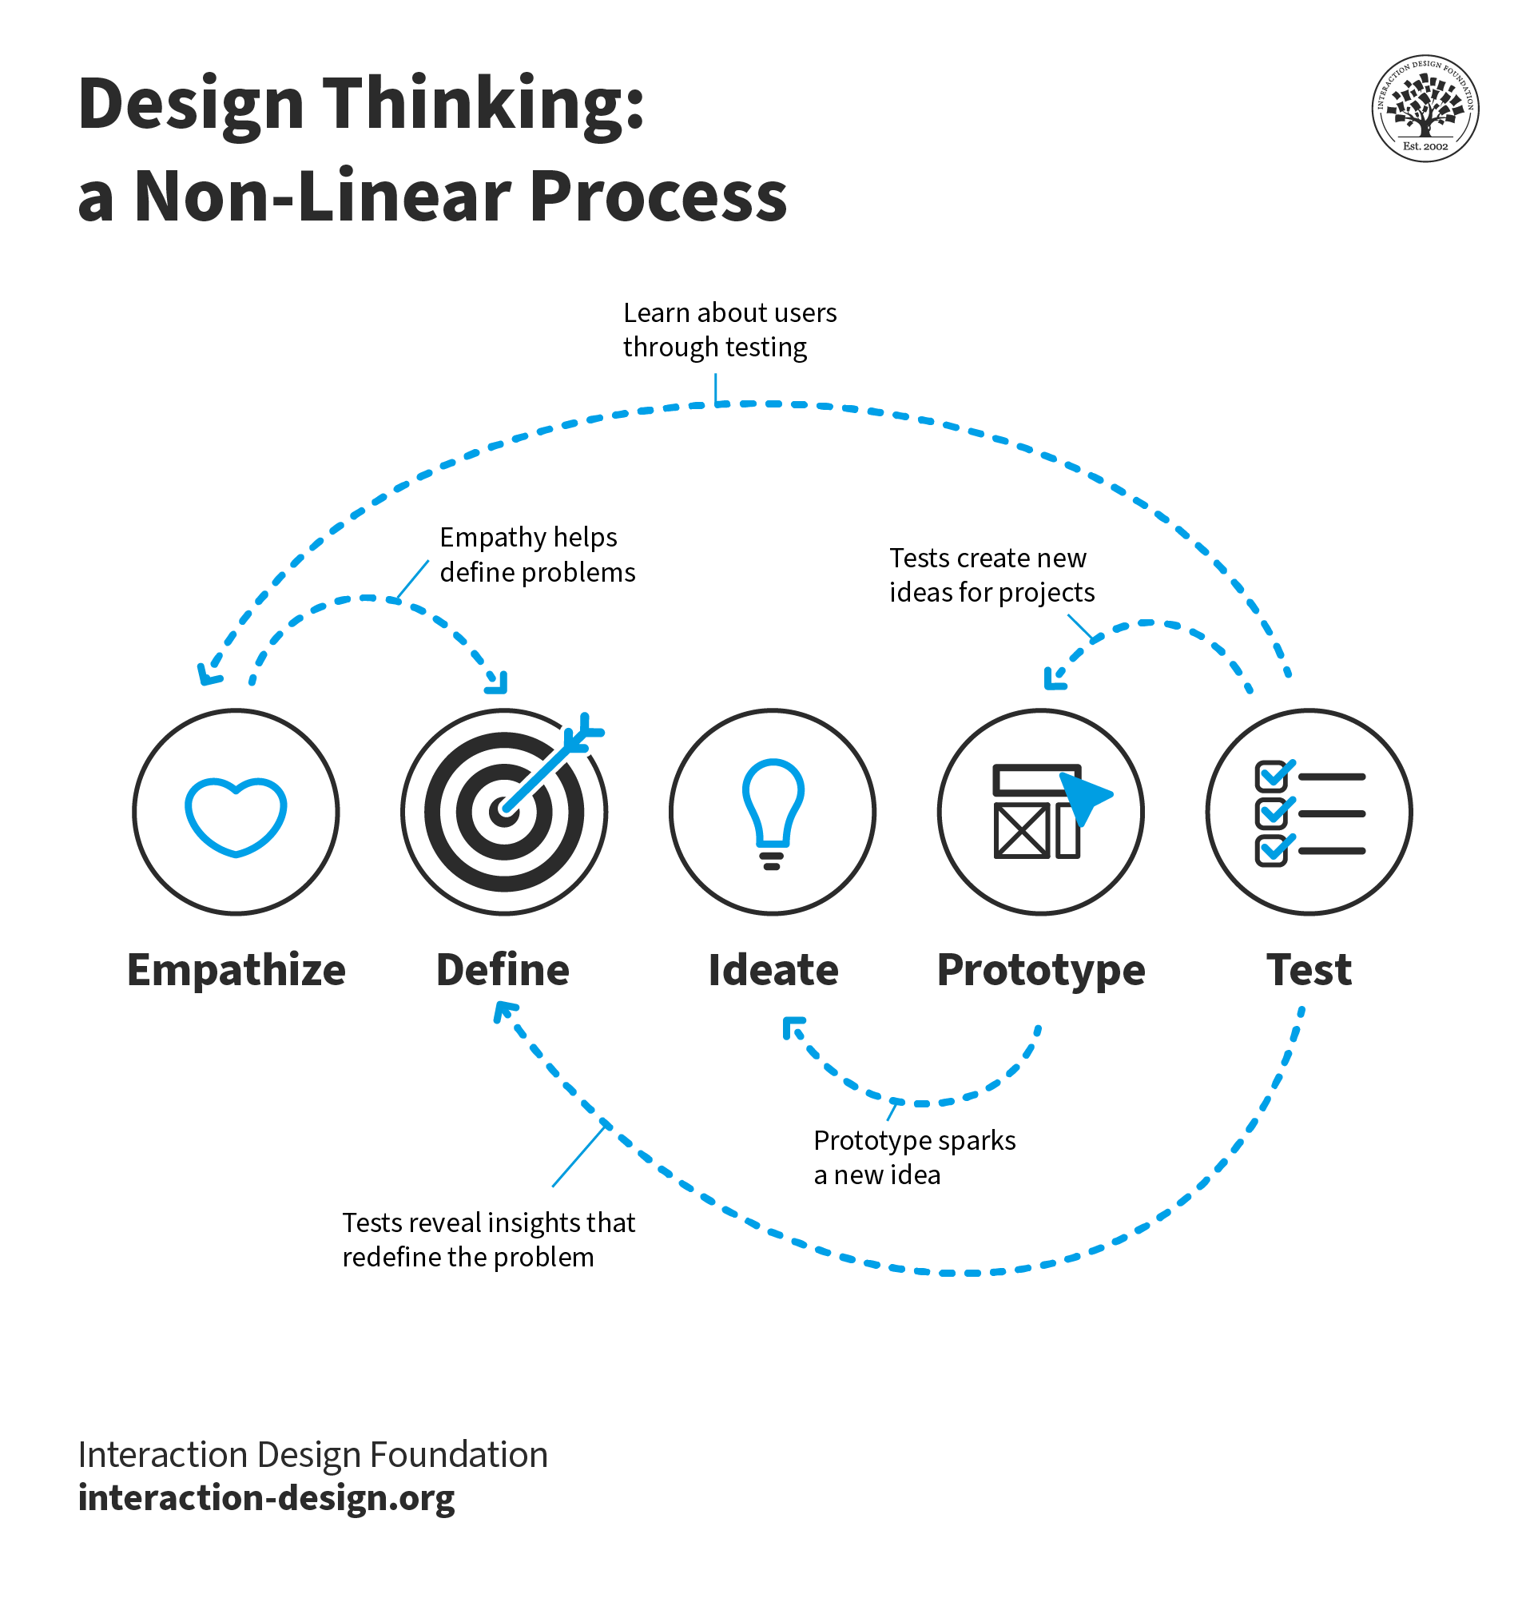
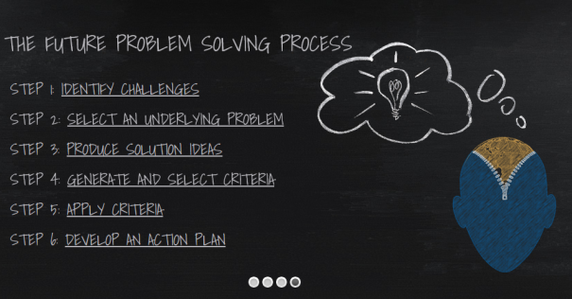
Old Project Planning vs. New Project Planning

Slide 7
Additions/Updates in Fall 2023
Week 1 | U01 Prepare: Self Assessment
Week 1 | U01 Prepare: Teamwork Overview
Week 2 | U02 Prepare: Articulate Self (Awareness & Discipline)
Week 2 | U02 Prepare: Teamwork Skills
Week 2 | U02 U02 Teach: Analyze Case Study 1
Week 3 | U02 Prove: User Manual
Week 4 | U02 Prepare: Attendance/Participation
Week 4 | U02 Prove: Activity Log
Week 4 | U02 Prove: Vision Board
Week 5 | U03 Prepare: Articulate Team (Commitment & Conflict)
Week 5 | U03 Teach: Analyze Case Study 2
Week 6 | U03 Prepare: Team Charter
Week 6 | U03 Prove: Team Problem Statement Workbook
Week 6 | U03 Teach: Problem Statement Individual Accountability
Week 7 | U03 Prove: Team Solution Workbook
Week 7 | U03 Teach: Solution Individual Accountability
Week 8 | U03 Prepare: Attendance/Participation
Week 8 | U03 Prove: Project Selection
Week 8 | U03 Prove: Team Presentation
Week 8 | U03 Teach: Team Member Evaluation
Week 9 | U04 Prepare: Articulate Community (Leadership)
Week 9 | U04 Teach: Analyze Case Study 3
Week 10 | U04 Prepare: Project Planning Responsibilities
Week 10 | U04 Teach: Project Responsibilities
Week 11 | U04 Teach: Remote Work Training
Week 12 | U04 Teach: Team Retrospective
Week 13 | U04 Prepare: Attendance/Participation
Week 13 | U04 Prove: Final Self Retrospective
Week 13 | U04 Prove: Team Presentation
Week 13 | U04 Teach: Team Member Evaluation

Slide 8
CSE 170 Course Council
The course counsel reviewed my version of the class and agreed to add those to the official course master.
The course counsel also suggested I revise the course further with learnings from the Architects of Learning course.
Specially, they want more emphasis on Emotional Intelligence concepts

Slide 9
Course Map – Emotional Intelligence Domains to Weekly Assignments
Assignment | Emotional Intelligence Domains
U01 Prepare: Self Assessment
U01 Prepare: Teamwork Overview
U02 Prepare: Articulate Self (Awareness & Discipline) | Emotional Self-Awareness
U02 Prepare: Teamwork Skills | Emotional Self-Awareness
U02 Teach: Analyze Case Study 1 | Emotional Self-Awareness
U02 Prove: User Manual | Emotional Self-Awareness
U02 Prepare: Attendance/Participation
U02 Prove: Activity Log | Emotional Self-Control
U02 Prove: Vision Board | Positive Outlook, Achievement Orientation
U03 Prepare: Articulate Team (Commitment & Conflict) | Conflict Management
U03 Teach: Analyze Case Study 2 | Conflict Management
U03 Prepare: Team Charter | Organizational Awareness
U03 Teach: Problem Statement Individual Accountability | Empathy
U03 Prove: Team Problem Statement Workbook | Empathy
U03 Teach: Solution Individual Accountability | Adaptability
U03 Prove: Team Solution Workbook | Adaptability
U03 Prepare: Attendance/Participation
U03 Teach: Team Member Evaluation | Influence
U03 Prove: Project Selection | Organizational Awareness
U03 Prove: Team Presentation | Teamwork
U04 Prepare: Articulate Community (Leadership) | Inspritational Leadership
U04 Teach: Analyze Case Study 3 | Inspritational Leadership
U04 Prepare: Project Planning Responsibilities | Organizational Awareness
U04 Teach: Project Responsibilities | Organizational Awareness
U04 Teach: Remote Work Training | Teamwork
U04 Teach: Team Retrospective | Coach and Mentor
U04 Prepare: Attendance/Participation
U04 Teach: Team Member Evaluation | Influence
U04 Prove: Final Self Retrospective
U04 Prove: Team Presentation | Teamwork
U05 Prepare: Self Assessment Revisited | Self-Awareness
U05 Prove: Self Assessment & Wrap-up | Self-Awareness

Slide 10
Assignment | Course Level Outcome | BYU Learning Model | Unit or Module | Unit Level Outcome | Week | Weekly Outcome | Emotional Intelligence Domains
U01 Prepare: Self Assessment | 1.0 Articulate the principles of teamwork. | Prepare | Unit 1 | Teamwork Overview and Baseline Assessment | 1 | Understand personal strengths and weaknesses
U01 Prepare: Teamwork Overview | 1.0 Articulate the principles of teamwork. | Prepare | Unit 1 | Teamwork Overview and Baseline Assessment | 1 | Understand personal strengths and weaknesses
U02 Prepare: Articulate Self (Awareness & Discipline) | 1.0 Articulate the principles of teamwork. | Prepare | Unit 2 | Self Awareness and Self Management | 2 | Articulate Self awareness | Emotional Self-Awareness
U02 Prepare: Teamwork Skills | 1.0 Articulate the principles of teamwork. | Prepare | Unit 2 | Self Awareness and Self Management | 2 | Articulate Self awareness | Emotional Self-Awareness
U02 Teach: Analyze Case Study 1 | 2.0 Analyze work situations using the principles of teamwork. | Teach One Another | Unit 2 | Self Awareness and Self Management | 2 | Articulate Self awareness | Emotional Self-Awareness
U02 Prove: User Manual | 3.0 Demonstrate the principles of teamwork. | Ponder and Prove | Unit 2 | Self Awareness and Self Management | 3 | Demonstrate Self Awareness | Emotional Self-Awareness
U02 Prepare: Attendance/Participation | 1.0 Articulate the principles of teamwork. | Prepare | Unit 2 | Self Awareness and Self Management | 4
U02 Prove: Activity Log | 3.0 Demonstrate the principles of teamwork. | Ponder and Prove | Unit 2 | Self Awareness and Self Management | 4 | Demonstrate emotional self-control | Emotional Self-Control
U02 Prove: Vision Board | 3.0 Demonstrate the principles of teamwork. | Ponder and Prove | Unit 2 | Self Awareness and Self Management | 4 | Demonstrate achievement orientation and positive outlook | Positive Outlook, Achievement Orientation
U03 Prepare: Articulate Team (Commitment & Conflict) | 1.0 Articulate the principles of teamwork. | Prepare | Unit 3 | Social Awareness | 5 | Articulate conflict management | Conflict Management
U03 Teach: Analyze Case Study 2 | 2.0 Analyze work situations using the principles of teamwork. | Teach One Another | Unit 3 | Social Awareness | 5 | Analyze conflict management | Conflict Management
U03 Prepare: Team Charter | 1.0 Articulate the principles of teamwork. | Prepare | Unit 3 | Social Awareness | 6 | Demonstrate organizational awareness | Organizational Awareness
U03 Teach: Problem Statement Individual Accountability | 2.0 Analyze work situations using the principles of teamwork. | Teach One Another | Unit 3 | Social Awareness | 6 | Demonstrate empathy | Empathy
U03 Prove: Team Problem Statement Workbook | 3.0 Demonstrate the principles of teamwork. | Ponder and Prove | Unit 3 | Social Awareness | 6 | Demonstrate empathy | Empathy
U03 Teach: Solution Individual Accountability | 2.0 Analyze work situations using the principles of teamwork. | Teach One Another | Unit 3 | Social Awareness | 7 | Demonstrate adaptability | Adaptability
U03 Prove: Team Solution Workbook | 3.0 Demonstrate the principles of teamwork. | Ponder and Prove | Unit 3 | Social Awareness | 7 | Demonstrate adaptability | Adaptability
U03 Prepare: Attendance/Participation | 1.0 Articulate the principles of teamwork. | Prepare | Unit 3 | Social Awareness | 8
U03 Teach: Team Member Evaluation | 2.0 Analyze work situations using the principles of teamwork. | Teach One Another | Unit 3 | Social Awareness | 8 | Demonstrate influence | Influence
U03 Prove: Project Selection | 3.0 Demonstrate the principles of teamwork. | Ponder and Prove | Unit 3 | Social Awareness | 8 | Demonstrate organizational awareness | Organizational Awareness
U03 Prove: Team Presentation | 3.0 Demonstrate the principles of teamwork. | Ponder and Prove | Unit 3 | Social Awareness | 8 | Demonstrate teamwork | Teamwork
U04 Prepare: Articulate Community (Leadership) | 1.0 Articulate the principles of teamwork. | Prepare | Unit 4 | Relationship Management | 9 | Articulate inspirational leadership | Inspritational Leadership
U04 Teach: Analyze Case Study 3 | 2.0 Analyze work situations using the principles of teamwork. | Teach One Another | Unit 4 | Relationship Management | 9 | Analyze inspirational leadership | Inspritational Leadership
U04 Prepare: Project Planning Responsibilities | 1.0 Articulate the principles of teamwork. | Prepare | Unit 4 | Relationship Management | 10 | Demonstrate organizational awareness | Organizational Awareness
U04 Teach: Project Responsibilities | 2.0 Analyze work situations using the principles of teamwork. | Teach One Another | Unit 4 | Relationship Management | 10 | Demonstrate organizational awareness | Organizational Awareness
U04 Teach: Remote Work Training | 2.0 Analyze work situations using the principles of teamwork. | Teach One Another | Unit 4 | Relationship Management | 11 | Demonstrate teamwork | Teamwork
U04 Teach: Team Retrospective | 2.0 Analyze work situations using the principles of teamwork. | Teach One Another | Unit 4 | Relationship Management | 11 | Demonstrate coaching/mentoring | Coach and Mentor
U04 Prepare: Attendance/Participation | 1.0 Articulate the principles of teamwork. | Prepare | Unit 4 | Relationship Management | 12
U04 Teach: Team Member Evaluation | 2.0 Analyze work situations using the principles of teamwork. | Teach One Another | Unit 4 | Relationship Management | 12 | Demonstrate influence | Influence
U04 Prove: Final Self Retrospective | 3.0 Demonstrate the principles of teamwork. | Ponder and Prove | Unit 4 | Relationship Management | 12 | Summative Assessment
U04 Prove: Team Presentation | 3.0 Demonstrate the principles of teamwork. | Ponder and Prove | Unit 4 | Relationship Management | 12 | Demonstrate teamwork | Teamwork
U05 Prepare: Self Assessment Revisited | 1.0 Articulate the principles of teamwork. | Prepare | Unit 5 | Reflection and Self-Analysis | 13 |  | Self-Awareness
U05 Prove: Self Assessment & Wrap-up | 3.0 Demonstrate the principles of teamwork. | Ponder and Prove | Unit 5 | Reflection and Self-Analysis | 13 |  | Self-Awareness

Slide 11
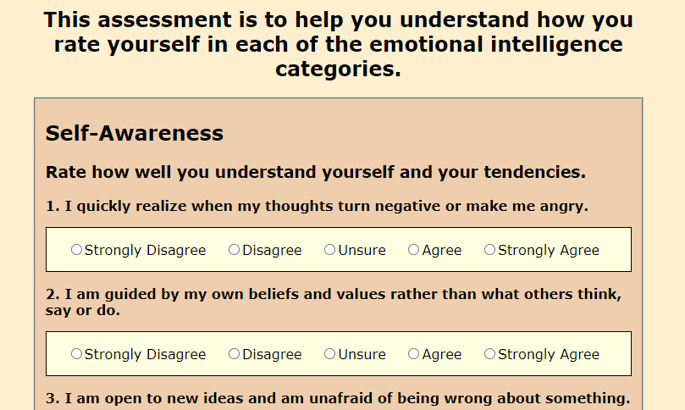
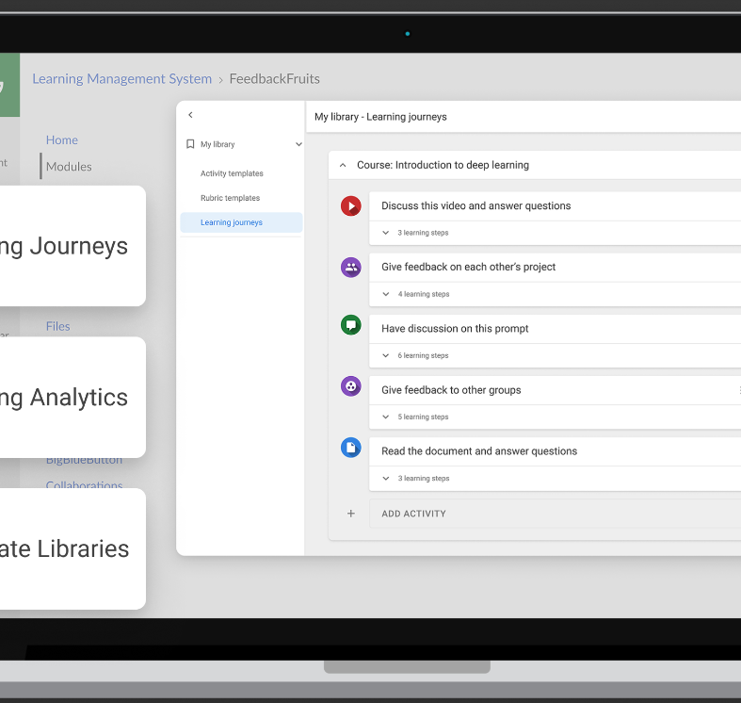
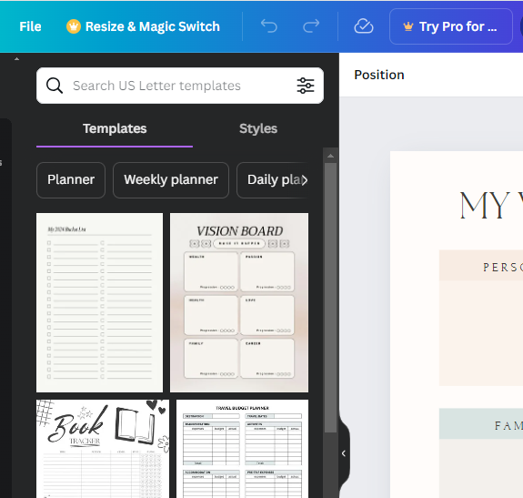
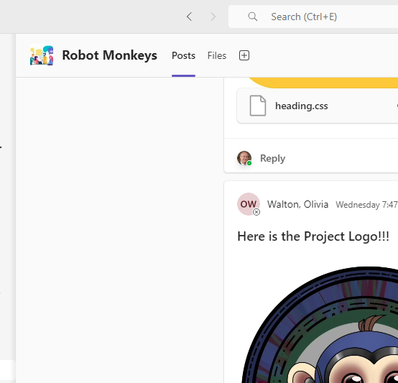
Technology Usages
Replaced paper form with website for self-evaluation
Replaced Excel spreadsheet with Feedback Fruits tool for peer evaluation
Using Canva for Vision Boards Goal Setting Project
Use MS Teams for project updates and remote work assignments

Slide 12
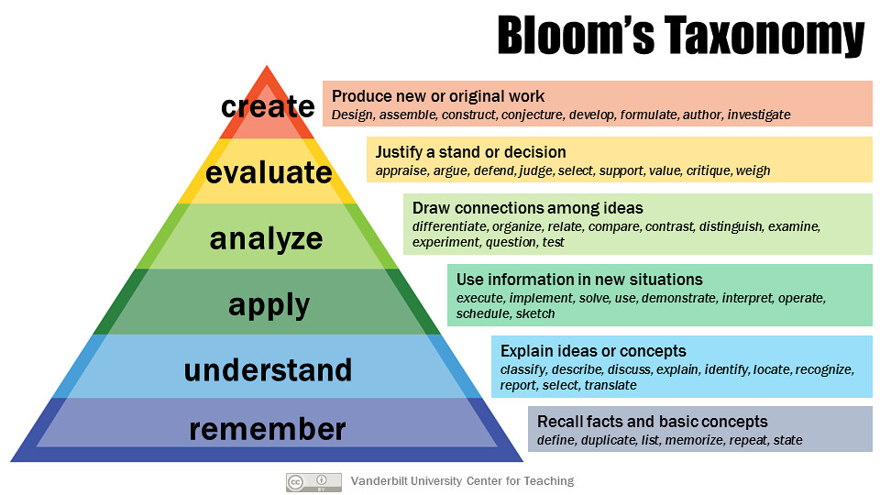
U04 Prove: Final Self Retrospective
Old example questions: Understand
Explain what teamwork means. In particular, describe the benefits of teamwork in the workplace and how you've demonstrated good teamwork practices while working on the project.
Self: Explain why self discipline is important in a team setting and how you've demonstrated self discipline in this class.
New example question: Analyze
What were the clearly defined roles on your team and within your project or were roles ambiguous? What is the importance of clearly defined roles within a team or broader project?
On your project was the labor effectively distributed between teams? What problems arose because of the division of labor, or if there were no problems what made the division of labor effective?

Slide 13
Updates Spring 2024
Week 2 | U02 U02 Prepare: Teamwork Skills | Changed from Canvas Quiz to Google Form to allow better analytics
Week 4 | U02 Prove: Vision Board | Added clarifications to instructions
Week 5 | U03 Prepare: Articulate Team (Commitment & Conflict) | Added content about passive aggression. Updated reflection questions.
Week 6 | U03 Prove: Team Problem Statement Workbook | Simplified instructions removing reading about "Design Thinking"
Week 8 | U03 Prove: Team Presentation | Encouraged other formats besides PDF
Week 8 | U03 Teach: Team Member Evaluation | Introduced Feedback Fruits instead of Excel evaluation
Week 9 | U04 Prepare: Articulate Community (Leadership) | Introduced new content about transformational leadership and updated questions.
Week 10 | U04 Prepare: Project Planning Responsibilities | Introduced the scrum roles in the question. Updated the question to account for new content.
Week 13 | U04 Prove: Final Self Retrospective | Completely revised this quiz to allow students to reflect on learnings from Unit 4. Combined unit 5 wrap up tasks with this as well.
Week 13 | U04 Prove: Team Presentation | Tweaked the final questions for the presentation.
Week 13 | U04 Teach: Team Member Evaluation | Updated Feedback Fruits setup so peer evaluations have more weight

Slide 14
Possible Additional Revisions
Adapt course for online modality
Add an example case study to help students prepare
Add content about personal bias and microaggression

