Slide 1
Tiddlywiki
tc-body
Browser Page
Html
div
dropzone
head
div
tc-page-container
tc-page-container
body
div
styleArea
div
tc-dropzone
tc-alert
noscript
tc-story-river
tc-sidebar
div
storageArea
tc-dropzone
div
libraryModule
div
tc-sidebar
div
bootKernalPrefix
section
tc-story-river
div
bootKernal
div
tc-alerts
div
tc-password
tc-story-river
tc-story-river
Tiddlywiki breakdown
section
story-backdrop
tc-tiddler-frame*
div
tc-tidder-frame
section
Story-frontdrop
tc-tiddler-frame
tc-tidder-frame
tc-tiddler-title
div
tc-tiddler-title
div
tc-reveal (hidden)
tc-tiddler-reveal (hidden)
div
tc-reveal (subtitle)
div
tc-reveal(tag-list
tc-tiddler-reveal(subtitle)
div
tc-tiddler-body
tc-tiddler-reveal (tag-list)
Html
tc-tidder-frame
tc-tiddler-body
div
tc-table-of-contents
Html
ol
tc-toc toc-selective-expandable
li
toc-item*
a
tc-tiddlylink
tc-table-of-contents
span
tc-reveal
button
tc-btn-invisible
>\/
Item*
svg
tc-image-right-arrow
Html tag
Html - item
class=“name”
/a
toc-selective-expandable 'Settings'

Slide 3
Patient Monitor
Patient Monitor
Patient Monitor
Dr. Mobile
Home Base
Transportation Services
Supply Chain
Services
Database
Services
Dr. Mobile

Slide 4
Dr. Mobile
Camera
Barometer
Mic
Fingerprint
FM/AM
Spectograph
Proximeter
Sound Meter
User Input
Cellular
Color detection
Magnet Meter
Tone Detector
Tap
Wireless
Light Meter
GPS
Bluetooth
Compass
Solar
Battery
LED Flash
Vibrator
Speaker
Vibrator
EM
Screen
Buttons

Slide 5
Add Patient
Enter Info
Connect Monitor
Diagnosis
Monitor
Enter Info
Name
Description
Connect to Monitor ID
Register Monitor ID
Save Data
P
Wrist Monitor
Diagnosis
Get Temperature
Surface Scan
ID: Get Heart Beat
ID: Get O2 level
ID: Get Pressure
Wrist Monitor
Treat Patient
Use
Supplies
S
Monitor
ID: Get Heartbeat
ID: Get O2 Level
ID: Get Pressure
Overview of Dr. Mobile Capabilities
Wrist Monitor
Surface Scan
UV Scan
UV Sensor
Comm HomeB
Oral Comms
Comms
Order Supplies
Supply Needs
Order Supplies
Request Dropoff
S
Comms
Transport Services
Request Dropoff
Comms
Request Pickup
Comms
P
Send Data
Get Data
Update
Data
Database
Pull
Data
Comms

Slide 6
Login
userName
DrMobileHome
_H_
userPassword
Actions
SettingTOC
Enter button
_H_
Functions
Patients
Settings
Communicate
Settings
Power
Settings
Setting
Power
Communication
Battery
Power
SolarSensor
Communicate
Sensors
________
UserInformation
HomeBase
OrderSupplies
Patients
PickupTransport
________
DatabaseSnyc
AddPatient
Diagnosis
Elements of Dr. Mobile found in Tiddlewiki
Monitor
Search Rescue
________
HomeBase
OrderSupplies
PickupTransport
Capabilities
Tags
Html tag

Slide 7
Macro
Operators
Widget
Filters []
$:/
Modules – popup tiddlers
<$transclude
<$reveal

Slide 8
IndieWeb - http://indiewebcamp.com/
Smallest Federated Wiki – http://fed.wiki.org/
Offline First! – http://offlinefirst.org/
noBackend – http://nobackend.org/
Fargo – http://fargo.io/
Substance.io Composer – http://substance.io/composer/
Hoodie – http://hood.ie/

Slide 9
Add Patient
Enter Info
Connect Monitor
Diagnosis
Monitor
Enter Info
Name
Description
Connect to Monitor ID
Register Monitor ID
Save Data
P
Wrist Monitor
Diagnosis
Get Temperature
Surface Scan
ID: Get Heart Beat
ID: Get O2 level
ID: Get Pressure
Wrist Monitor
Treat Patient
Use
Supplies
S
Monitor
ID: Get Heartbeat
ID: Get O2 Level
ID: Get Pressure
Overview of Dr. Mobile Capabilities
Wrist Monitor
Tiddlywiki breakdown
Surface Scan
UV Scan
UV Sensor
Comm HomeB
Oral Comms
Comms
Order Supplies
Supply Needs
Order Supplies
Request Dropoff
S
Comms
Transport Services
Request Dropoff
Comms
Request Pickup
Comms
P
Send Data
Get Data
Update
Data
Database
Pull
Data
Comms

Slide 10
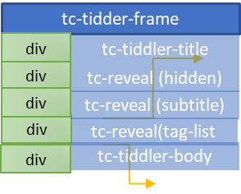
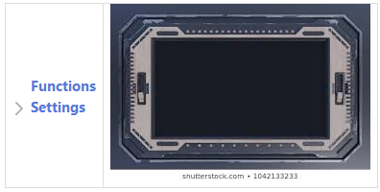
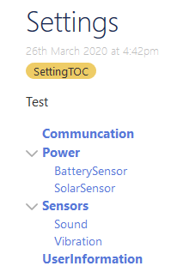
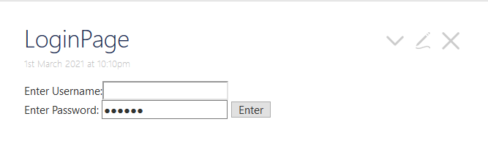
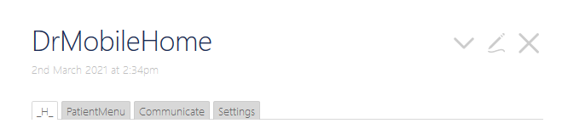
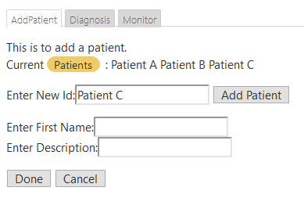
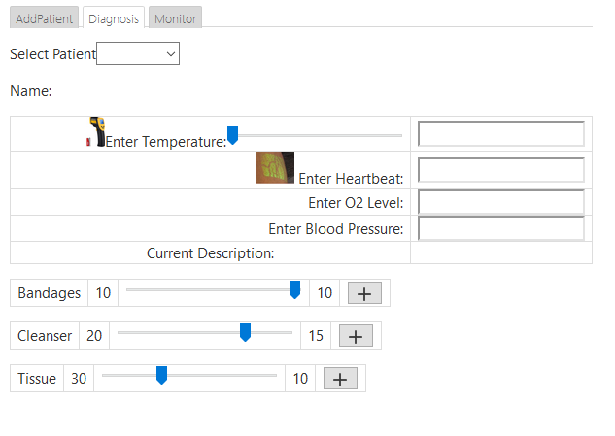
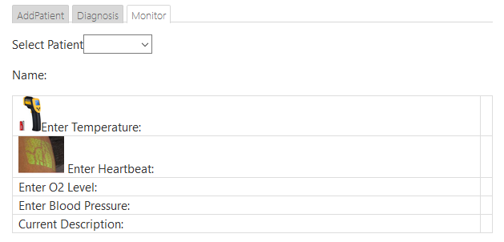
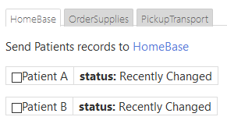
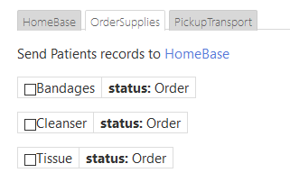
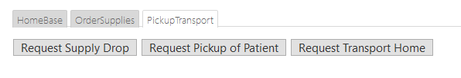
TiddlyWiki Structure
Login
userName
DrMobileHome
_H_
Settings
userPassword
Point B
Actions
SettingTOC
Setting
Enter button
_H_
Functions
Communication
Patients
Settings
Power
Communicate
Sensors
Settings
Patients
UserInformation
________
Elements of Dr. Mobile found in Tiddlewiki
AddPatient
AddPatient
Diagnosis
Diagnosis
________
________
Monitor
Monitor
Enter New ID
Select Patient
________
Button: Add Patient
Temperature
Select Patient
Monitor
Heartbeat
Enter Temperature
Enter First Name
O2 Level
Enter Heartbeat
Enter Description
Blood Pressure
Enter O2 Level
Button:Done/Cancel
Supplies
Enter Blood Pressure
Description
Supplies
Power
Power
Communicate
Battery
________
HomeBase
OrderSupplies
PickupTransport
SolarSensor
HomeBase
________
________
________
OrderSupplies
Patient Update
Bandages
Req Supply
Search Rescue
PickupTransport
Cleanser
Req Pickup Pat.
________
Tissue
Req Tx Home
HomeBase
OrderSupplies
PickupTransport
Capabilities
Tags
Html tag

Slide 11
TiddlyWiki Structure
Login
userName
DrMobileHome
_H_
Settings
userPassword
Point B
Actions
SettingTOC
Setting
Enter button
_H_
Functions
Communication
Patients
Settings
Power
Communicate
Sensors
Settings
Patients
UserInformation
________
Elements of Dr. Mobile found in Tiddlewiki
AddPatient
AddPatient
Diagnosis
Diagnosis
________
________
Monitor
Monitor
Enter New ID
Select Patient
________
Button: Add Patient
Temperature
Select Patient
Monitor
Heartbeat
Enter Temperature
Enter First Name
O2 Level
Enter Heartbeat
Enter Description
Blood Pressure
Enter O2 Level
Button:Done/Cancel
Supplies
Enter Blood Pressure
Description
Supplies
Communicate
HomeBase
OrderSupplies
PickupTransport
________
________
________
________
HomeBase
Patient Update
Bandages
Req Supply
OrderSupplies
Cleanser
Req Pickup Pat.
PickupTransport
Tissue
Req Tx Home
Capabilities
Tags
Html tag

Slide 12
Tiddlywiki
tc-body
Browser Page
Html
div
dropzone
head
div
tc-page-container
tc-page-container
body
div
styleArea
div
tc-dropzone
tc-alert
noscript
tc-story-river
tc-sidebar
div
storageArea
tc-dropzone
Point A
div
libraryModule
div
tc-sidebar
div
bootKernalPrefix
section
tc-story-river
div
bootKernal
div
tc-alerts
div
tc-password
tc-story-river
tc-story-river
Tiddlywiki breakdown
section
story-backdrop
tc-tiddler-frame*
div
tc-tidder-frame
section
Story-frontdrop
tc-tiddler-frame
tc-tidder-frame
tc-tiddler-title
div
tc-tiddler-title
div
tc-reveal (hidden)
tc-tiddler-reveal (hidden)
div
tc-reveal (subtitle)
div
tc-reveal(tag-list
tc-tiddler-reveal(subtitle)
div
tc-tiddler-body
tc-tiddler-reveal (tag-list)
Html
tc-tiddler-body
tc-tiddler-body
div
tc-table-of-contents
Html
ol
tc-toc toc-selective-expandable
Point B
li
toc-item*
a
tc-tiddlylink
tc-table-of-contents
span
tc-reveal
button
tc-btn-invisible
>\/
Item*
svg
tc-image-right-arrow
Html tag
Html - item
class=“name”
/a
toc-selective-expandable 'Settings'

Slide 13
Tiddlywiki
TiddlyWiki Structure
tc-tidder-frame
Html
div
tc-tiddler-title
tc-tiddler-body
head
div
tc-reveal (hidden)
Html
body
div
tc-reveal (subtitle)
Point A
div
tc-reveal(tag-list
Point B
div
tc-tiddler-body
Test | Name | Test_Element | Variable | Command | Parameter | Input | Results | variable |  | value
Init |  |  | tc-tiddler-frame |  |  |  |  | frame | = | contents of tc-tiddler-frame html

Slide 14
Test Structure
Test List
Test dictionary
name
Id test dictionary
test_element
Ids state of Action/Step, Results, Verify
variable
Stores the results of the step/action
command
Test dictionary
Results {variable: output}
parameter
Test dictionary
input
Test dictionary
Test_elements
commands
parameter
Description
step
attribute
Html attribute
Returns a list of HTML tags with that attribute
className
Html class id
Returns a list of html tags with that class=“parameter”
tagName
Html tag type
Returns a list of html tags with that class=“parameter”
getListItem
List index
Returns the <list index> value of a list
click
className
Simulate User clicking button with html class=“name”
click_single
N/A
Simulate User clicking button tag
sendkeys
text
Sends text value to html form text box

Slide 15
Test Structure
Test List
Test dictionary
name
Id test dictionary
test_element
Ids state of Action/Step, Results, Verify
variable
Stores the results of the step/action
command
Test dictionary
Results {variable: output}
parameter
Test dictionary
input
Test dictionary
Test_elements
commands
parameter
Description
results
equal
input variable
Compare command input with another parameter input
exists
N/A
Determines if input variable exists in Results
compare
text
Checks to see if parameter text is found input results
verify
equal
input variable
Compare command input with another parameter input
exists
N/A
Determines if input variable exists in Results
compare
text
Checks to see if parameter text is found input results
debug
text
N/A
Converts html to text

Slide 16
Tiddlywiki
tc-tidder-frame
Html
div
tc-tiddler-title
tc-tiddler-body
head
div
tc-reveal (hidden)
Html
body
div
tc-reveal (subtitle)
div
tc-reveal(tag-list
div
tc-tiddler-body
Test | Name | Test_Element | Variable | Command | Parameter | Input | Results | variable |  | value
Init |  |  | tc-tiddler-frame |  |  |  |  | frame | = | contents of tc-tiddler-frame html
Login
userName
userPassword
Enter button
Test | Name | Test_Element | Variable | Command | Parameter | Input | Results | variable |  | value
Test_Verify_Login
 | Get UserName | step | Name | className | userName | frame |  | Name | = | <input type="text" class="userName">
 | Enter User Name Text | step | "" | sendKeys | "William" | Name |  | "" | = | N/A
 | Get Enter button | step | Enter | className | "Enter" | frame |  | Enter | = | <button class="Enter">Enter </button>
 | Click Enter button | step | clickEnter | click_single | 0 | "Enter" |  | clickEnter | = | ""

Slide 17
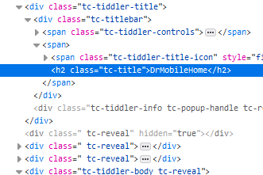
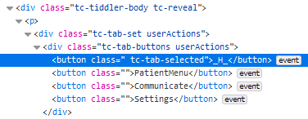
Tiddlywiki
TiddlyWiki Structure
tc-tidder-frame
Html
div
tc-tiddler-title
tc-tiddler-body
head
div
tc-reveal (hidden)
Html
body
div
tc-reveal (subtitle)
div
tc-reveal(tag-list
div
tc-tiddler-body
Test | Name | Test_Element | Variable | Command | Parameter | Input | Results | variable |  | value
Init |  |  | tc-tiddler-frame |  |  |  |  | frame | = | contents of tc-tiddler-frame html
tc-tidder-frame
div
tc-tiddler-title
div
tc-reveal (hidden)
div
tc-reveal (subtitle)
Test | Name | Test_Element | Variable | Command | Parameter | Input | Results | variable |  | value
Test_Verify_Home_Function_Link
 | Get Title | step | title | attribute | data-tiddler-title | frame |  | title | = | <div class="tc-tiddler-title">…</div>
 | Check Title | results | title_results | equal | DrMobileHome | title |  | title_results | = | TRUE
 | Get Tiddler Body | step | body | className | tc-tidder-body | frame |  | body | = | <div class="tc-tiddler-body tc-reveal">…<div>
 | Check Body | results | body_results | exists | "" | body |  | body_results | = | TRUE
 | Get tc-tab-buttons | step | tab_buttons | className | tc-tab-buttons | body |  | tab_buttons | = | <div class="tc-tab-buttons userActions"> <button class=" tc-tab-selected">_H_</button> <button class="">PatientMenu</button> <button class="">Communicate</button> <button class="">Settings</button> </div>
 | Get tc-tab-content | step | tab_contents | className | tc-tab-conent | body |  | tab_contents | = | <div class="tc-tab-content userActions">..<div>
 | Get tabs | step | buttons | tagName | button | tab_buttons |  | buttons | = | <button class=" tc-tab-selected">_H_</button> <button class="">PatientMenu</button> <button class="">Communicate</button> <button class="">Settings</button>
 | Get click Home | step | click_H_ | click | 0 | buttons |  | click_H_ | = | <button class=" tc-tab-selected">_H_</button>
 | Debug tab content | debug | "" | text | 0 | tab_content | Print text version of tab_content
 | Verify Functions | verify | verifyFunctionResults | exists | Functions | tab_content | Print "VERIFY" or "NOT VERIFY" to output
 | End of Tests
div
tc-reveal(tag-list
div
tc-tiddler-body

Slide 18
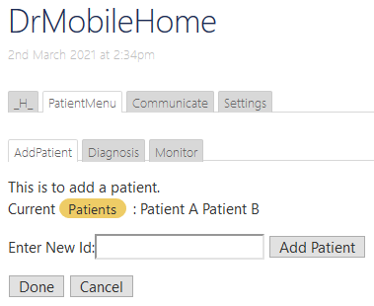
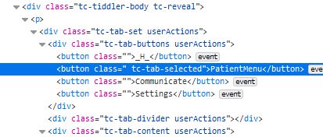
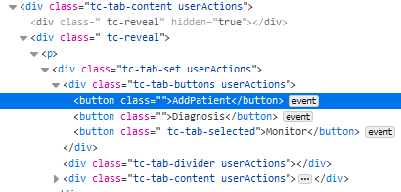
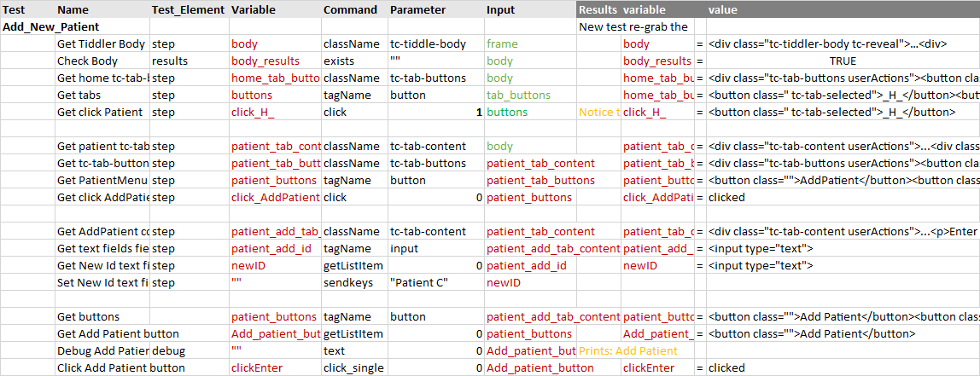
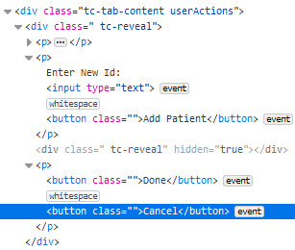

Tiddlywiki
TiddlyWiki Structure
tc-tidder-frame
tc-tidder-frame
Html
div
tc-tiddler-title
tc-tiddler-body
div
tc-tiddler-title
head
div
tc-reveal (hidden)
Html
div
tc-reveal (hidden)
body
div
tc-reveal (subtitle)
div
tc-reveal (subtitle)
div
tc-reveal(tag-list
div
tc-reveal(tag-list
div
tc-tiddler-body
div
tc-tiddler-body
Test | Name | Test_Element | Variable | Command | Parameter | Input | Results | variable |  | value
Init |  |  | tc-tiddler-frame |  |  |  |  | frame | = | contents of tc-tiddler-frame html
tc-tiddler-body(Patient)
div
tc-tab-buttons
div
tc-tab-divider
div
tc-tab-content
tc-tab-content
(AddPatient)
div
tc-tab-buttons
div
tc-tab-divider
div
tc-tab-content
tc-tab-content
p
InputText (New Id)
p
buttons

Slide 19
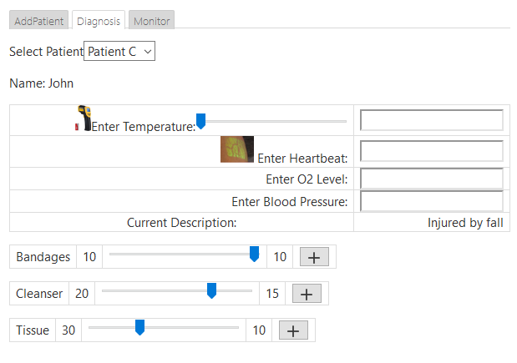
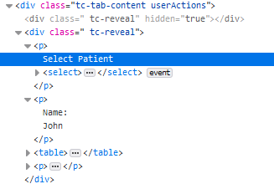
Tiddlywiki
TiddlyWiki Structure
tc-tidder-frame
tc-tidder-frame
Html
div
tc-tiddler-title
tc-tiddler-body
div
tc-tiddler-title
head
div
tc-reveal (hidden)
Html
div
tc-reveal (hidden)
body
div
tc-reveal (subtitle)
div
tc-reveal (subtitle)
div
tc-reveal(tag-list
div
tc-reveal(tag-list
div
tc-tiddler-body
div
tc-tiddler-body
Test | Name | Test_Element | Variable | Command | Parameter | Input | Results | variable |  | value
Init |  |  | tc-tiddler-frame |  |  |  |  | frame | = | contents of tc-tiddler-frame html
tc-tiddler-body(Patient)
div
tc-tab-buttons
div
tc-tab-divider
div
tc-tab-content
tc-tab-content
(AddPatient)
div
tc-tab-buttons
div
tc-tab-divider
div
tc-tab-content

Slide 20
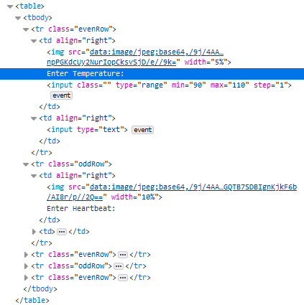
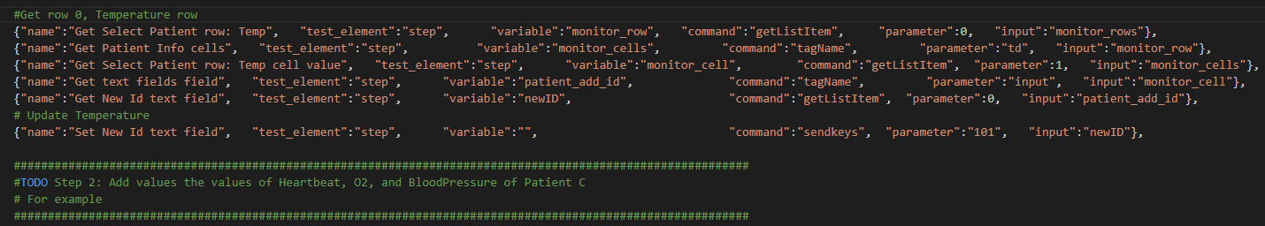
Row 0: Temperature
Column 0
Column 1
TextField 0
Row 1: Heartbeat
Row 2: O2
Row 3: Blood Pressure
Row 4: Description
Copy and paste this section of code.
Update Row Number
0 = Temperature
1 = Heartbeat
2 = O2 Level
3 = Blood Pressure
Update Text Field value.
Row
Column 1
TextField 0
Value in Text Field

Slide 21
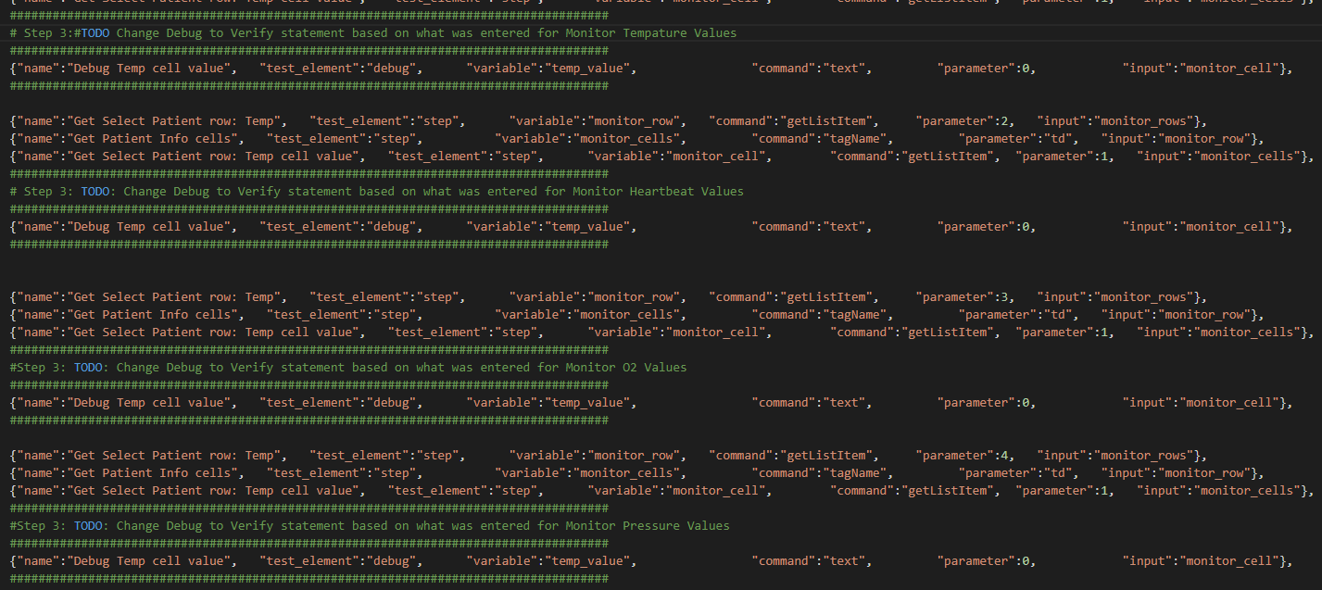
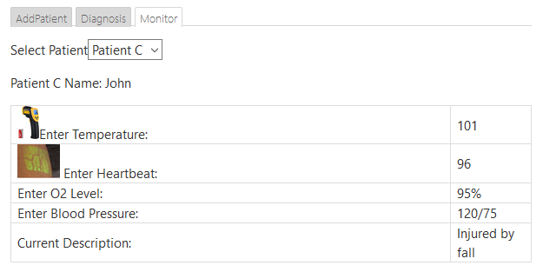
Test_elements
commands
parameter
Description
verify
equal
input variable
Compare command input with another parameter input
exists
N/A
Determines if input variable exists in Results
compare
text
Checks to see if parameter text is found input results
debug
text
N/A
Converts html to text
Change the test_elements from debug to verify
You need to update the commands and parameters.
Command: you can use equal or compare
Parameter values are the same as what was entered.

Slide 22
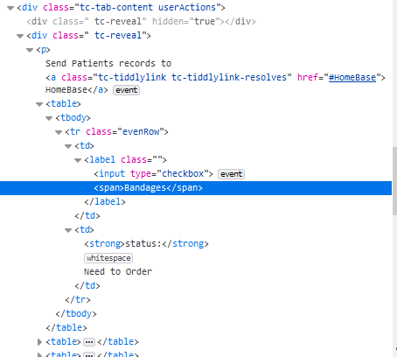
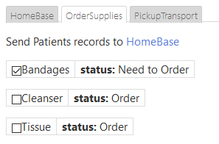
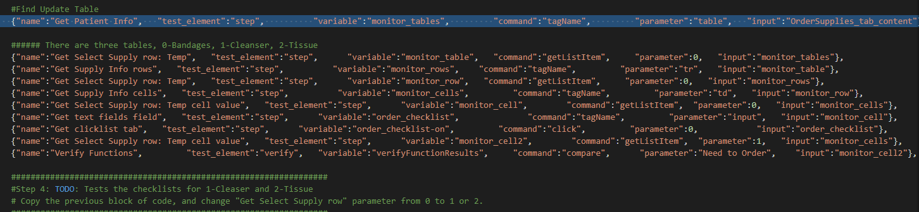
Column 0
Column 1
Table 0
Table 1
Table 2
Step 4: Copy and paste code, update for different tables.
Table 0
Row 0
Column 1
After click, changes from “Order” to “Need to Order”

