Slide 1
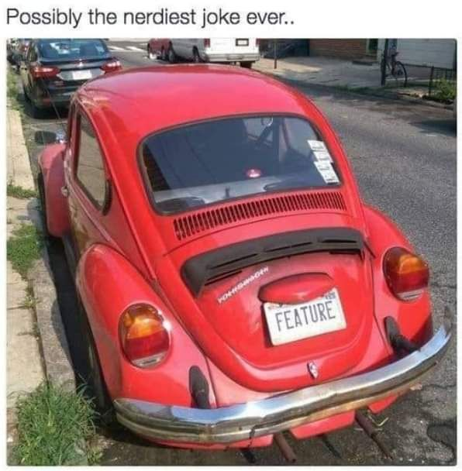
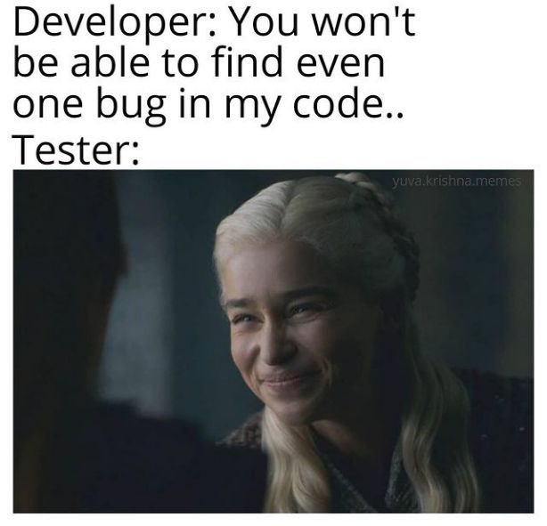

Slide 3
CSE 270 QA-Testing
Project Management
W. Clements

Slide 4
Weekly Agenda
Reading
CMM Level 5 Draft
W13 Plan: CMM Level 5

Slide 5
Reading
Capability Mature Model
M. Paulk et al., "Capability Mature Model for Software, Version 1.1," IEEE Software, vol. 10, no. 4, pp. 18-27, Jul. 1993. [Online] Available: http://dx.doi.org.byui.idm.oclc.org/10.1109/52.219617
Additionally, download the full version of the CMM document. You will not need to read it, but will need it for a reference for the lesson this week: Capability Maturity Model for Software, Version 1.1.
The Capability Im-Maturity Model
T. Schorsch, "The Capability Im-Maturity Model (CIMM)," [Online] Available: http://www.grisha.ru/cmm/cimm.htm
Planning your Test Effort
Please open Ron Patton's Software Testing, Second Edition:
Software Testing, Second Edition by Ron Patton, Published by Sams, 2005
Chapter 17: Planning your Test Effort

Slide 6
CMM Level 5 Draft
You and your partner(s) are to come up with plans to progress to Level 2, then Level 3, then Level 4, then Level 5.
Research these goals and provide a single paragraph plan per goal as to how they can be integrated into your project.
Finally, provide a one-paragraph summary of how these different levels built upon each other. In other words, how does Level 2 help you with Level 3 and so on?
Your team will submit a single document for your plan. The document needs to be in the PDF format.

Slide 7
W13 Plan: CMM Level 5
The final activity this week is to fix defects in our previous submission. If a perfect grade was received in the draft, then re-submit it and make a note that nothing changed. Otherwise, address the defects and resubmit.
Please add an appendix at the end of your document detailing what changed from your initial draft.
Your team will submit a single document for your risks. The document needs to be in the PDF format.

Slide 8
Reading
Capability Mature Model
M. Paulk et al., "Capability Mature Model for Software, Version 1.1," IEEE Software, vol. 10, no. 4, pp. 18-27, Jul. 1993. [Online] Available: http://dx.doi.org.byui.idm.oclc.org/10.1109/52.219617
Additionally, download the full version of the CMM document. You will not need to read it, but will need it for a reference for the lesson this week: Capability Maturity Model for Software, Version 1.1.
The Capability Im-Maturity Model
T. Schorsch, "The Capability Im-Maturity Model (CIMM)," [Online] Available: http://www.grisha.ru/cmm/cimm.htm
Planning your Test Effort
Please open Ron Patton's Software Testing, Second Edition:
Software Testing, Second Edition by Ron Patton, Published by Sams, 2005
Chapter 17: Planning your Test Effort

Slide 9

Capability Mature Model for Software, Version 1.1 – Outline
IMMATURITY VERSUS MATURITY
Immaturity
Maturity
FUNDAMENTAL CONCEPTS
Five maturity levels
Behavioral characterization
Predicting performance
Skipping levels
CMM OPERATIONAL DEFINITION
Internal structure
Key process areas.
Goals
Common Features
Key Practices
FUTURE DIRECTIONS
Summary of Differences Between CMM Version 1.0 and Version 1.1
General Changes
Language Changes
Level 2 Changes
Level 3 Changes
Level 4 Changes
Level 5 Changes

Slide 10
Capability Mature Model for Software, Version 1.1 IMMATURITY VERSUS MATURITY
Summary
Immaturity
Maturity
software processes are generally improvised by practitioners
not rigorously followed or enforced.
software organization is reactionary
Focused on solving immediate crises /fire fighting
Schedules and budgets are routinely exceeded
not based on realistic estimates
When hard deadlines are imposed, product functionality and quality are often compromised to meet a schedule
product quality is difficult to Predict
no objective way to judge product quality or solve product or process problems
Activities intended to enhance quality, such as reviews and testing, are often curtailed or eliminated when projects fall behind schedule.
organization-wide ability to manage development and maintenance
Managers can accurately communicate the software process to staff and new employees
work activities are carried out according to the planned process
mandated processes are usable and consistent with the way the work actually gets done
defined processes are updated when necessary
Improvements developed through controlled pilot tests and cost-benefit analyses.
Roles and responsibilities are clear within a project and across an organization
Managers monitor the quality of products and the process that produced them
objective, quantitative basis for judging product quality and analyzing problems with the product and process
Schedules and budgets are based on historical performance and are realistic; expected results for cost, schedule, functionality, and quality are usually achieved

Slide 11
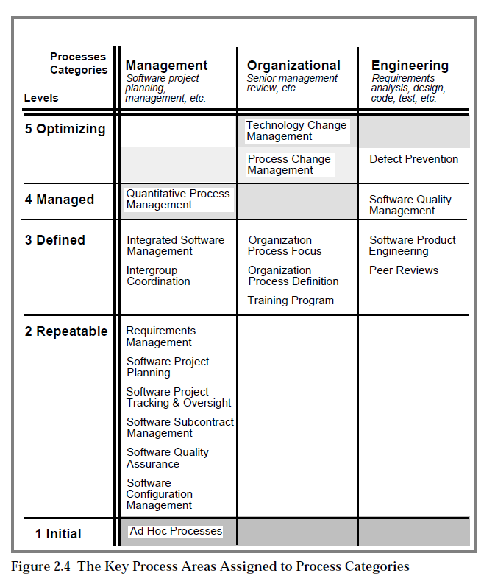
Capability Mature Model for Software, Version 1.1 FUNDAMENTAL CONCEPTS
Software-process capability
Software-process performance
Software-process maturity
Five maturity levels
Behavioral characterization
Level 1: Initial
Level 2: Repeatable
Level 3: Defined
Level 4: Managed
Level 5: Optimizing
Predicting performance
Skipping levels
Trying to skip maturity levels is counterproductive because each level is a necessary foundation from which to achieve the next level
Level 1->2: Ad Hoc to Process in place at Project Level

Slide 12
Capability Mature Model for Software, Version 1.1 IMMATURITY VERSUS MATURITY
organization-wide ability to manage development and maintenance
Managers can accurately communicate the software process to staff and new employees
work activities are carried out according to the planned process
mandated processes are usable and consistent with the way the work actually gets done
defined processes are updated when necessary
Improvements developed through controlled pilot tests and cost-benefit analyses.
Roles and responsibilities are clear within a project and across an organization
Managers monitor the quality of products and the process that produced them
objective, quantitative basis for judging product quality and analyzing problems with the product and process
Schedules and budgets are based on historical performance and are realistic; expected results for cost, schedule, functionality, and quality are usually achieved

Slide 13
The four levels of software immaturity
Level Characteristic
0. Negligent Indifference | Failure to allow successful development process to succeed. All problems are perceived to be technical problems. Managerial and quality assurance activities are deemed to be overhead and superfluous to the task of software development process. Reliance on silver pellets.
-1. Obstructive Counter Productive | Counterproductive processes are imposed. Processes are rigidly defined and adherence to the form is stressed. Ritualistic ceremonies abound. Collective management precludes assigning responsibility. Status quo
-2. Contemptuous Arrogance | Disregard for good software engineering institutionalized. Complete schism between software development activities and software process improvement activities. Complete lack of a training program
-3. Undermining Sabotage | Total neglect of own charter, conscious discrediting of peer organizations software process improvement efforts. Rewarding failure and poor performance

Slide 14
Capability Mature Model for Software, Version 1.1 FUNDAMENTAL CONCEPTS
Software-process capability
Software-process performance
Software-process maturity
Five maturity levels
Behavioral characterization
Level 1: Initial
Level 2: Repeatable
Level 3: Defined
Level 4: Managed
Level 5: Optimizing
Predicting performance
Skipping levels
Trying to skip maturity levels is counterproductive because each level is a necessary foundation from which to achieve the next level
Level 1->2: Ad Hoc to Process in place at Project Level

Slide 15
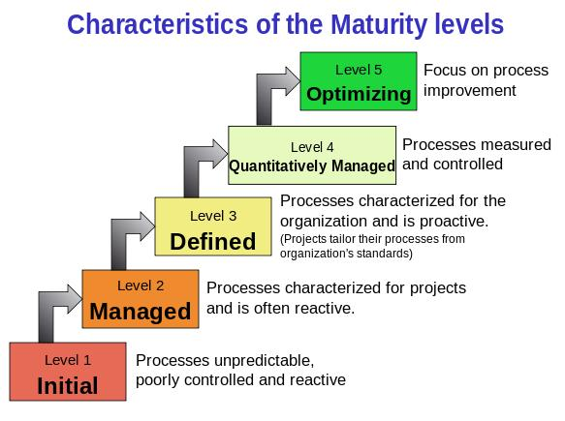
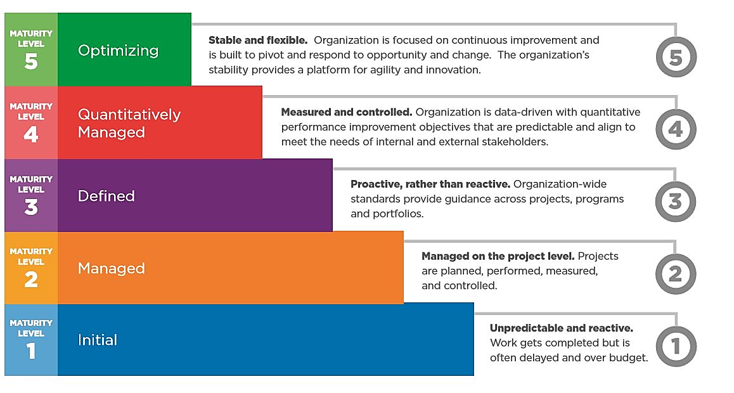
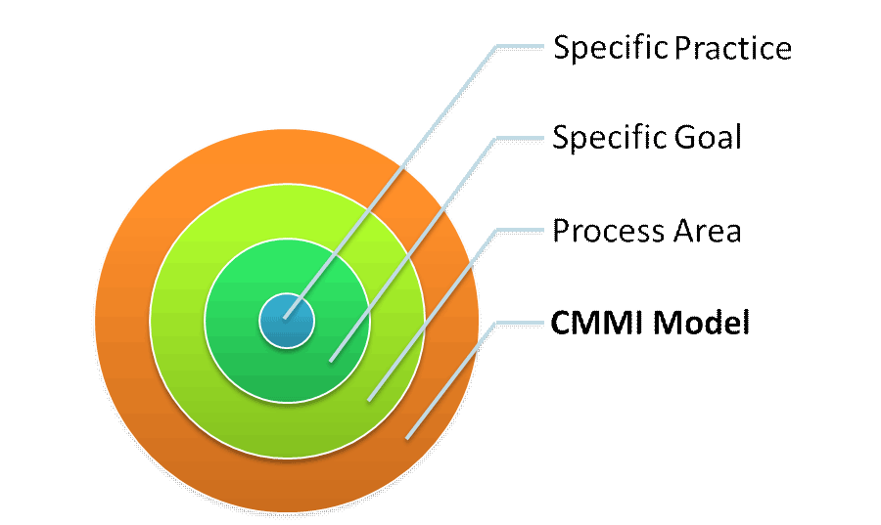
CMM OPERATIONAL DEFINITION - Answers
Internal structure
Key Process Areas
Common Features
Key process areas: Level 2-5
What are the different key process areas for each level?
Goals
Scope, Boundaries, intent
Common Features
Commit to perform
Ability to perform
Activities performed
Measurement and analysis
Verifying implementation
Key Practices
What to do
How to do it

Slide 16
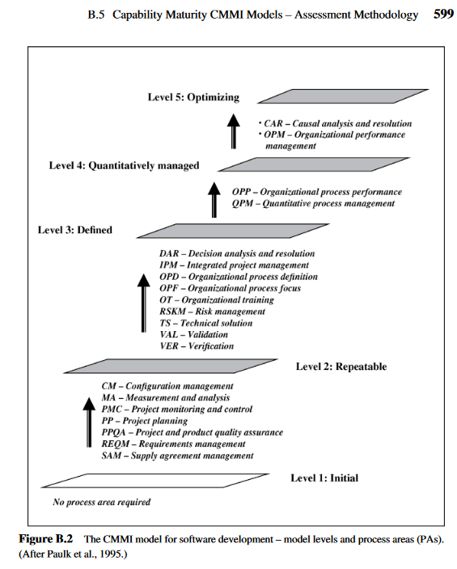
CMM
Notes:
https://onlinelibrary.wiley.com/doi/pdf/10.1002/9781119134527.app2

Slide 17
The key process areas at Level 2
Requirements Management p 91
Software Project Planning p 101
Software Project Tracking and Oversight p 121
Software Subcontract Management p 135
Software Quality Assurance p 153
Software Configuration Management p 165
Level 1->2: Ad Hoc to Process in place at Project Level

Slide 18
Level 2
Plan & Design
Execute
Test &Procedure
Revise
Requirements Management
Software Project Planning
Goal 1 System requirements allocated to software are controlled to establish a baseline for software engineering and management use.
Goal 2 Software plans, products, and activities are kept consistent with the system requirements allocated to software.
Goal 1 Software estimates are documented for use in planning and tracking the software project.
Goal 2 Software project activities and commitments are planned and documented.
Goal 3 Affected groups and individuals agree to their commitments related to the software project

Slide 19
Level 2
Plan & Design
Execute
Test &Procedure
Revise
Software Project Tracking and Oversight
Software Subcontract Management
Goal 1 Actual results and performances are tracked against the software plans.
Goal 2 Corrective actions are taken and managed to closure when actual results and performance deviate significantly from the software plans.
Goal 3 Changes to software commitments are agreed to by the affected groups and individuals
Goal 1 The prime contractor selects qualified software subcontractors. Goal 2 The prime contractor and the software subcontractor agree to their commitments to each other. Goal 3 The prime contractor and the software subcontractor maintain ongoing communications. Goal 4 The prime contractor tracks the software subcontractor's actual results and performance against its commitments.

Slide 20
Level 2
Plan & Design
Execute
Test &Procedure
Revise
Software Quality Assurance
Software Configuration Management
Goal 1 Software quality assurance activities are planned. Goal 2 Adherence of software products and activities to the applicable standards, procedures, and requirements is verified objectively. Goal 3 Affected groups and individuals are informed of software quality assurance activities and results. Goal 4 Noncompliance issues that cannot be resolved within the software project are addressed by senior management.
Goal 1 Software configuration management activities are planned. Goal 2 Selected software work products are identified, controlled, and available. Goal 3 Changes to identified software work products are controlled. Goal 4 Affected groups and individuals are informed of the status and content of software baselines.

Slide 21
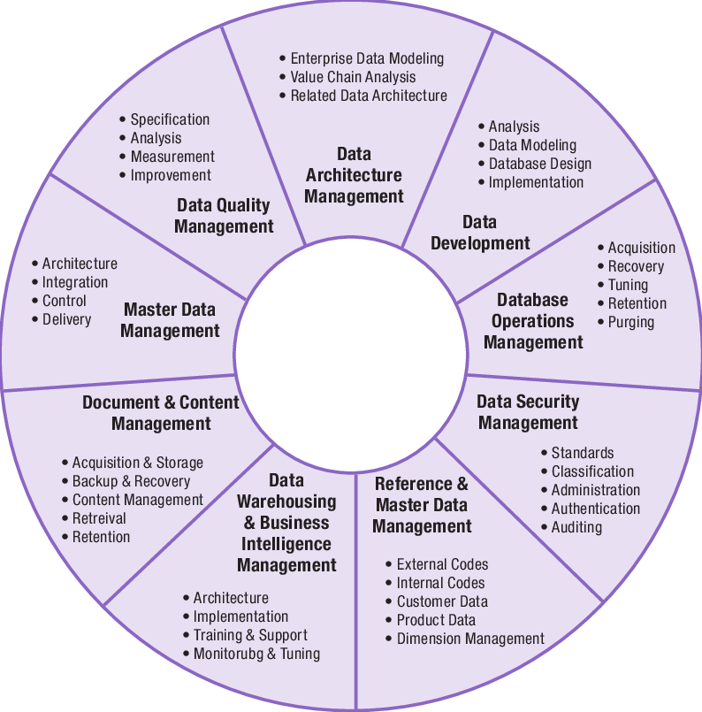
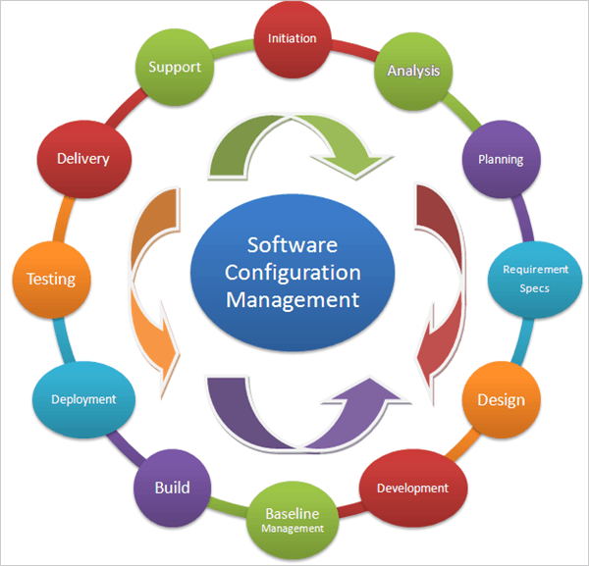
CM vs DM
Why is this important to Testing?

Slide 22
Project Management Additional Roles
Configuration Managements consists of legal accounting of 3rd party software (COTS, FOSS), project development software, integrated software as part of the delivery, and delivery constraints and scenarios.
Data Managements consists of document control and versioning, software development folders, tests & test data, and licensing issues.
Software Management consists of code repositories, versioning and patching software, delivery scheduling and peer reviews.

Slide 23
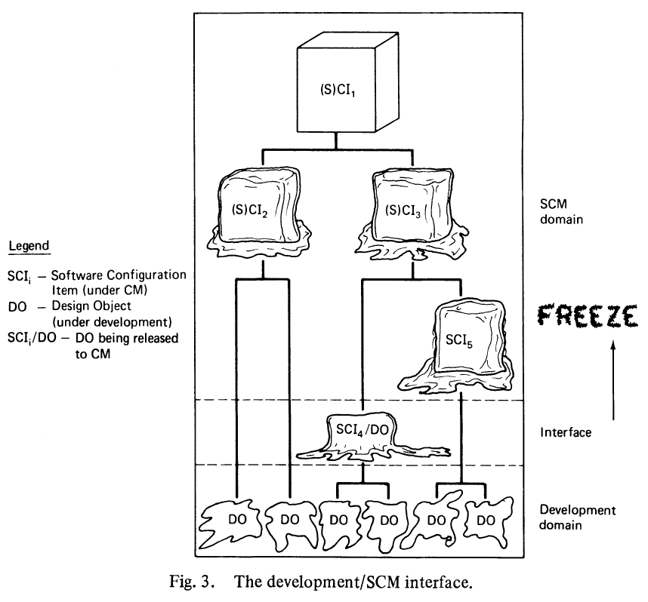
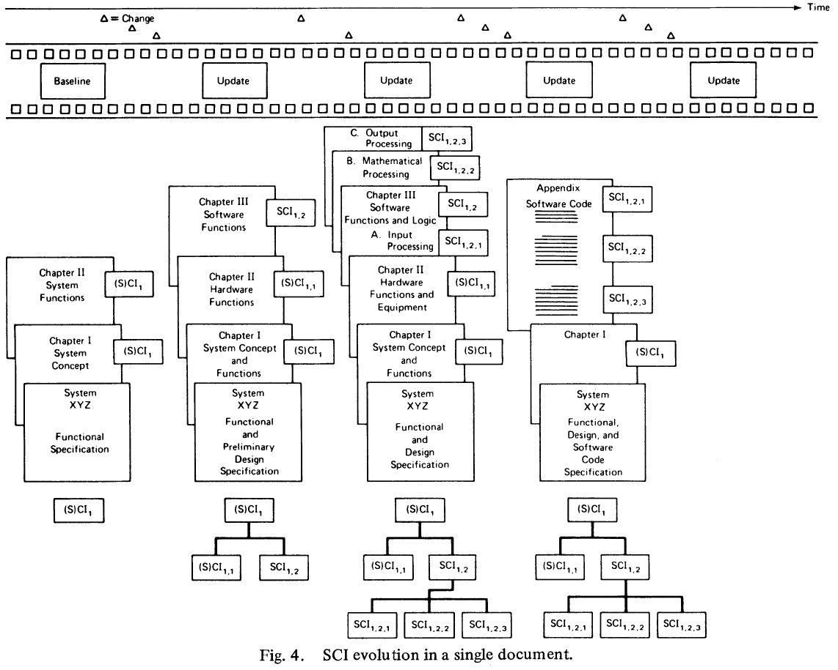
TLA (Thee letter acronyms) Definitions
SCI, ECP, SCCB, DO, and CCC
SCI - S/W Configuration Item
ECP - Engineering Change Proposal
Request for Change
SCCB - Software Configuration Control Board
PSL – Program Support Libraries (Test Data, SW, etc)
Repositories
https://www.joelonsoftware.com/2000/08/09/the-joel-test-12-steps-to-better-code/
DO - Design Object in Development Domain
Version Control - #, Change cntrl, SW Dev Folder
CCC – Change & Configuration Control Environment p 84 2P.
JIRA – Scrum, Clearcase

Slide 24
The key process areas at Level 3
Organization Process Focus p 188
Organization Process Definition p 198
Training Program p 212
Integrated Software Management p 223
Software Product Engineering p 246
Intergroup Coordination p 272
Peer Reviews p 284
Level 2->3: Process are used at Organizational Level

Slide 25
Level 3
Plan & Design
Execute
Test &Procedure
Revise
Organization Process Focus
Organization Process Definition
Goal 1 Software process development and improvement activities are coordinated across the organization.
Goal 2 The strengths and weaknesses of the software processes used are identified relative to a process standard.
Goal 3 Organization-level process development and improvement activities are planned.
Goal 1 A standard software process for the organization is developed and maintained.
Goal 2 Information related to the use of the organization's standard software process by the software projects is collected, reviewed, and made available.

Slide 26
Level 3
Plan & Design
Execute
Test &Procedure
Revise
Training Program
Integrated Software Management
Goal 1 Training activities are planned.
Goal 2 Training for developing the skills and knowledge needed to perform software management and technical roles is provided.
Goal 3 Individuals in the software engineering group and software-related groups receive the training necessary to perform their roles.
Goal 1 The project's defined software process is a tailored version of the organization's standard software process.
Goal 2 The project is planned and managed according to the project's defined software process

Slide 27
Level 3
Plan & Design
Execute
Test &Procedure
Revise
Software Product Engineering
Intergroup Coordination
Goal 1 The software engineering tasks are defined, integrated, and consistently performed to produce the software.
Goal 2 Software work products are kept consistent with each other
Goal 1 The customer's requirements are agreed to by all affected groups.
Goal 2 The commitments between the engineering groups are agreed to by the affected groups.
Goal 3 The engineering groups identify, track, and resolve intergroup issues.

Slide 28
Level 3
Plan & Design
Execute
Test &Procedure
Revise
Peer Reviews
Goal 1 Peer review activities are planned. Goal 2 Defects in the software work products are identified and removed.

Slide 29
The key process areas at Level 4
Quantitative Process Management p 299
Software Quality Management p 317
Level 3->4: Process & Products are Quality Control

Slide 30
Level 4
Plan & Design
Execute
Test &Procedure
Revise
Quantitative Process Management
Software Quality Management
Goal 1 The quantitative process management activities are planned.
Goal 2 The process performance of the project's defined software process is controlled quantitatively.
Goal 3 The process capability of the organization's standard software process is known in quantitative terms
Goal 1 The project's software quality management activities are planned.
Goal 2 Measurable goals for software product quality and their priorities are defined.
Goal 3 Actual progress toward achieving the quality goals for the software products is quantified and managed.

Slide 31
The key process areas at Level 5
Defect Prevention p 334
Technology Change Management p 352
Process Change Management p 366
(Process improvement)
Optimizing 6-sigma
Level 4->5: Process are improved The Process becomes a product

Slide 32
Level 5
Plan & Design
Execute
Test &Procedure
Revise
Defect Prevention
Technology Change Management
Goal 1 Defect prevention activities are planned.
Goal 2 Common causes of defects are sought out and identified.
Goal 3 Common causes of defects are prioritized and systematically eliminated.
Goal 1 Incorporation of technology changes are planned.
Goal 2 New technologies are evaluated to determine their effect on quality and productivity.
Goal 3 Appropriate new technologies are transferred into normal practice across the organization.

Slide 33
Level 5
Plan & Design
Execute
Test &Procedure
Revise
Process Change Management
Goal 1 Continuous process improvement is planned.
Goal 2 Participation in the organization's software process improvement activities is organization-wide.
Goal 3 The organization's standard software process and the projects' defined software processes are improved continuously.

Slide 34
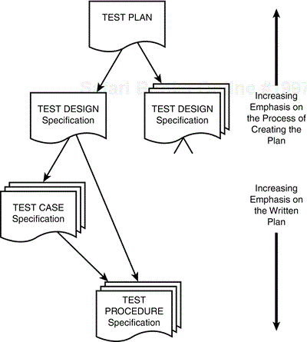
Chapter 17. Planning Your Test Effort
The Goal of Test Planning
To prescribe the scope, approach, resources, and schedule of the testing activities. To identify the items being tested, the features to be tested, the testing tasks to be performed, the personnel responsible for each task, and the risks associated with the plan. - EEE Standard 829–1998 for Software Test Documentation
Test Planning Topics
High-Level Expectations
People, Places, and Things
Definitions
Inter-Group Responsibilities
What Will and Won't Be Tested
Test Phases
Test Strategy
Resource Requirements
Tester Assignments
Test Schedule
Test Cases
Bug Reporting
Metrics and Statistics
Risks and Issues

Slide 35
Evidence of Quality
Legal
Regulations
Due Care
Policies
Due Process
Evidence
Law
Ethics
Practices
Procedures
Reviews
Audits
Process
Standards
Baselines
Guidelines
Implementation
Last week: Risks
This week: PM & Testing
CSE 474: QA

Slide 36
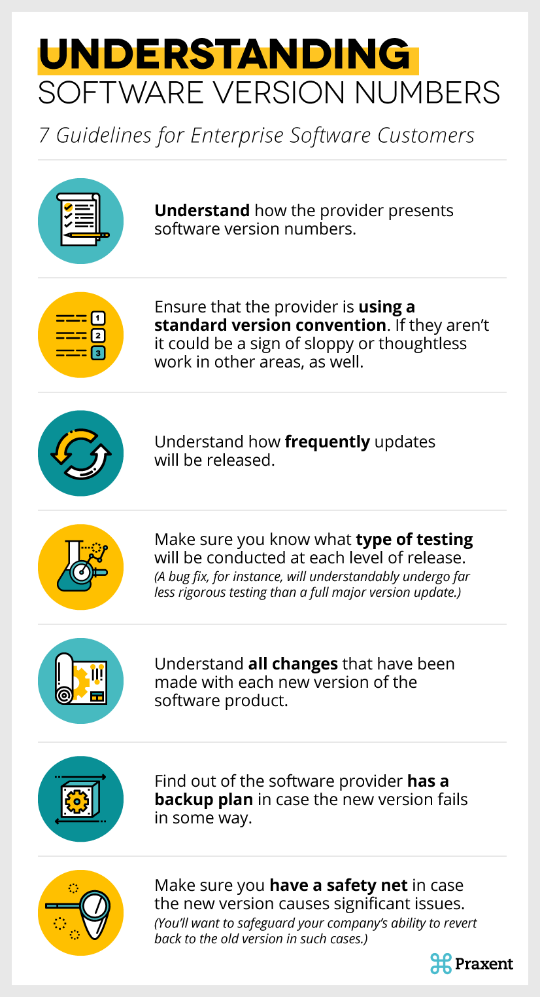
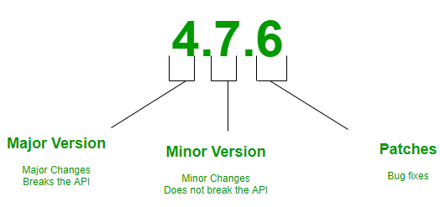
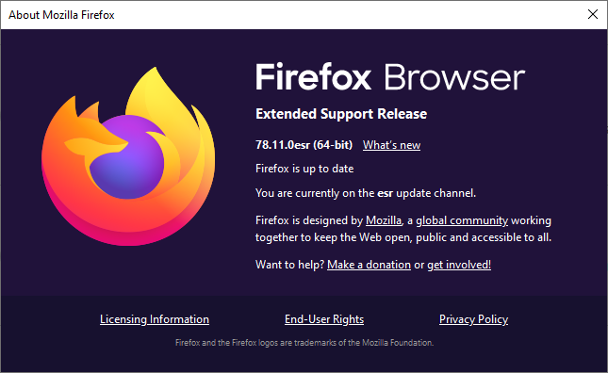
Version #

Slide 37
Stakeholders
Report to
Work with
Customer – the one who pays the bill
If you got something for free, you will not the intended customer
Product Owner – the who owns the product
Distributors - those that buy the produce for the user.
User – the one who uses the product
Suppliers – those that you buy from to make what you sell
Security Admin – Information Technology
CEO/Boss – the one who pays you
Finance/Advertising – in charge of the budget
Legal – make sure you are within the legal limit and conform to regulations
Auditors – CMM, Customer’s, V&V, CM, etc
Manager – the one who plans the product and manages the process, Program/Project Manager, Lead, Functional, Scrum Master, etc
QA – Quality Assurance – the one who make sure the stakeholders gets what they want.
IT – Information Technology – make sure the environment works
Data/Configuration Management – makes sure the process works
I&T – Integration and Test – the team the make sure it fulfills the requirements
Implementer/SW Engineers – the team the implements the design
Architect/System Eng – the one who created the design, knows full-stack
Front/Backend – ie.UX Designer – Front End, DBA – Database Manager
Tech Writers/Trainers – delivers the documentation
Process – what you follow
You are in the business of solving people’s problems.
What are the problems? Solution?

Slide 38
ISTQB – Configuration Management
To properly support testing, configuration management may involve ensuring the following:
All test items are uniquely identified, version controlled, tracked for changes, and related to each other
All items of test-ware are uniquely identified, version controlled, tracked for changes, related to each other and related to versions of the test item(s) so that traceability can be maintained throughout the test process
All identified documents and software items are referenced unambiguously in test documentation

Slide 39
Testing and Project Management
It has been said that if you do not know where you are going, any road will get you there. – Alice in Wonderland

Slide 40
Continuous Improvement
Quality Assurances
(Built the Product Right)
Process ->
Q-Contrl/HMI
Value/Cost
Audit/Review/Std
Integrity/Sec
Testing
<- Product
Software Development
QA vs
Test vs
DevOp vs
Cont. Improvement
Support Roles (CM, DM, Code Mngr, etc)
Program/Project Manager
Development
QA-Tester
Acceptance Tester
System Tester
Integration Tester
Regression Tester
Unit Tester
(Sometime Developer)
Concept of Operations
Acceptance Test
Validation
Requirements
System Test
Verification
Architecture
Integration Test
Design
Regression Test
Implementation
Implementation
Unit Test
(Built the Right Product)
Dev Ops
Environment
Software Tools
Hardware
Network
Infrastructure
Test Zone (sandboxes)
Operation

Slide 41
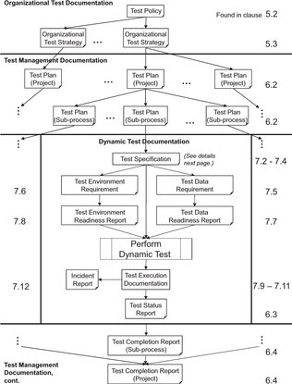
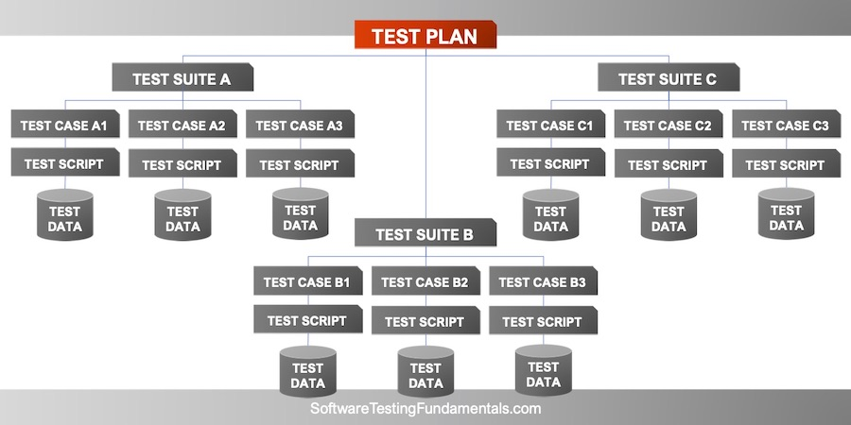
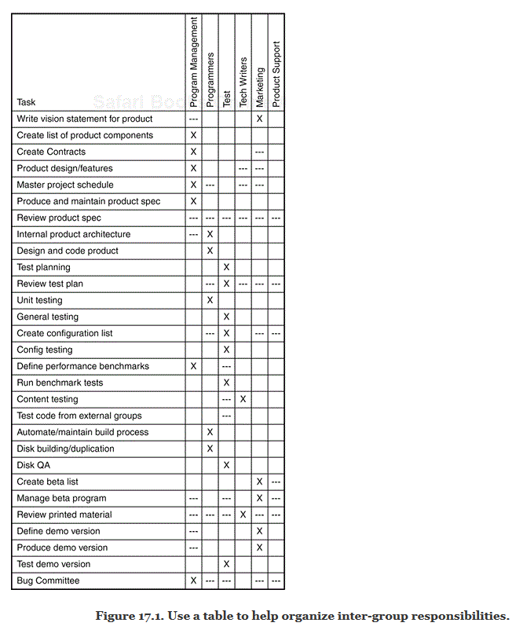
Notes:
https://www.iso.org/obp/ui/#iso:std:iso-iec-ieee:29119:-3:ed-1:v1:en

Slide 42
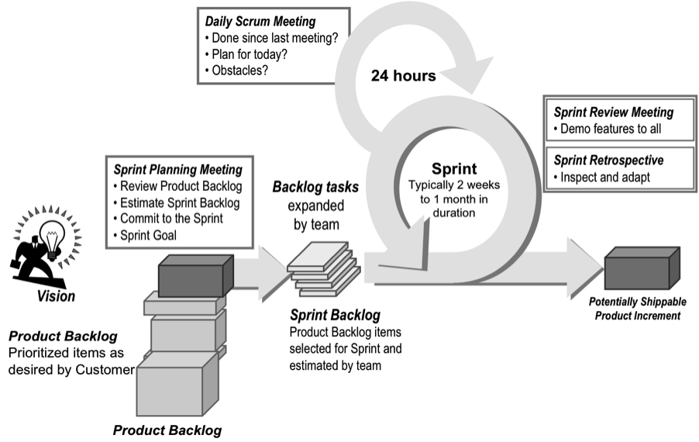
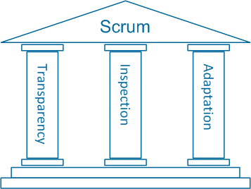
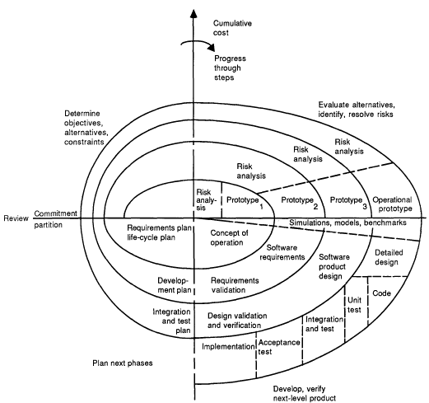
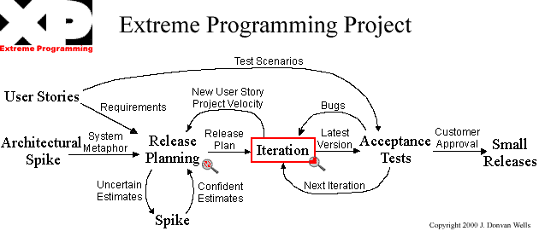
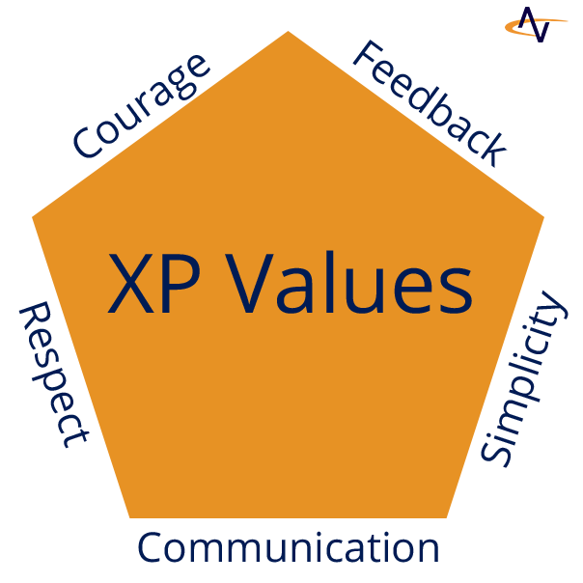
Review – SW Methodologies & Testing

Slide 43
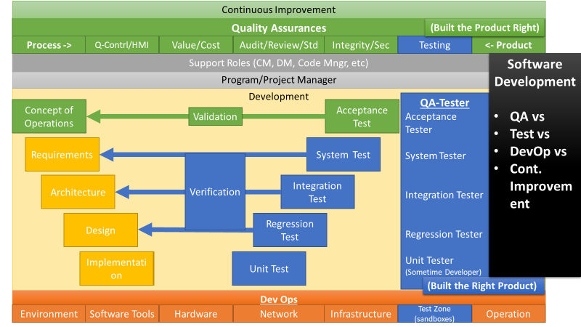
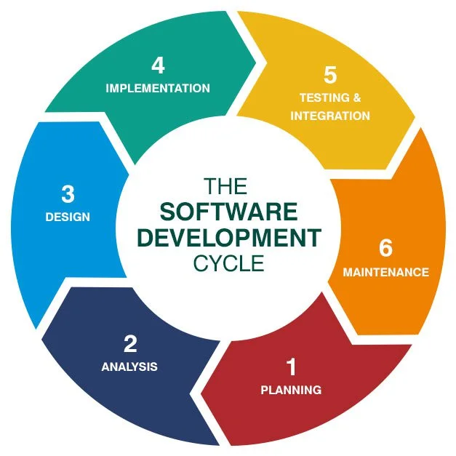

Lifecycle Phases | Methodology Phases
CON OP | Objectives
 | Risk
Requirements | System Requirements
 | Software Requirements
 | Requirements Validation
Design | Analysis
 | Program, Product, and Detailed Design
 | Prototyping
 | Product Validation and Verification
Implementation | Coding, Implementation and Paired Programming
 | Build and Integrate
Testing | Unit Testing
 | Sim
 | Integration Testing
 | System Testing
 | Acceptance Testing
 | QA
Deployment Release | Deployment Release
Operations | Operations
Maintenance | Maintenance

Slide 44
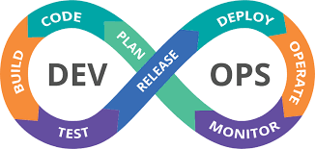
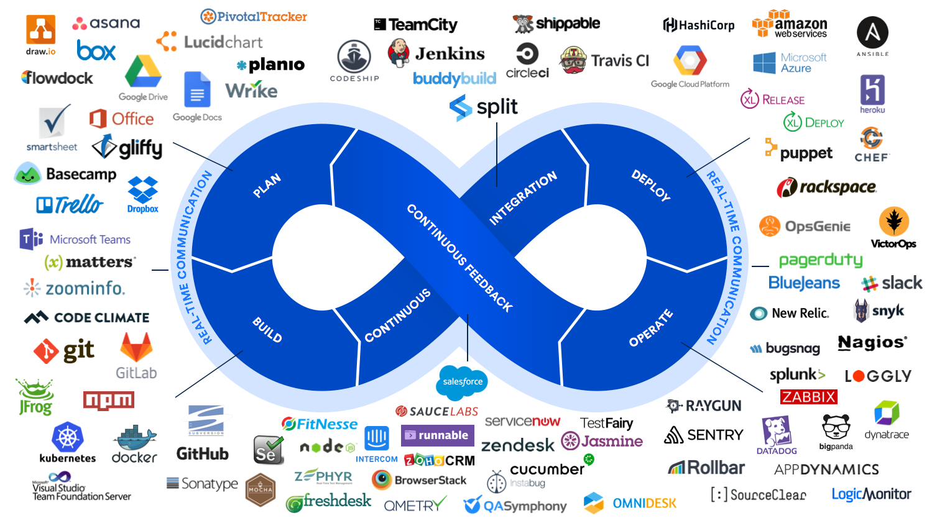
DevOps

Slide 45
Quality Attributes – Non Functional Req.
Acceptance | Compatibility | Interoperability | Robustnesss
Accountability | Confidentiality | Learnability | Scalability
Accuracy | Configurability | Maintainability | Security
Adaptability | Compliance | Modifiability | Supportability
Affordability | Correctness | Modification Stability | Self-contained
Analyzability | Ease of use | Modularity | Testability
Appropriateness | Efficiency | Nonrepudiation | Technical accessibility
Appropriateness recognisability | Fault Tolerance | Performance efficiency | Time behavior
Attractiveness | Flexibility | Recoverability | Transferability
Authenticity | Functionality | Reliability | Understandability
Availability | Helpfulness | Reusability | Usability
Changeability | Installability | Replaceability
Co-existence | Integrity | Resource utilization

Slide 46
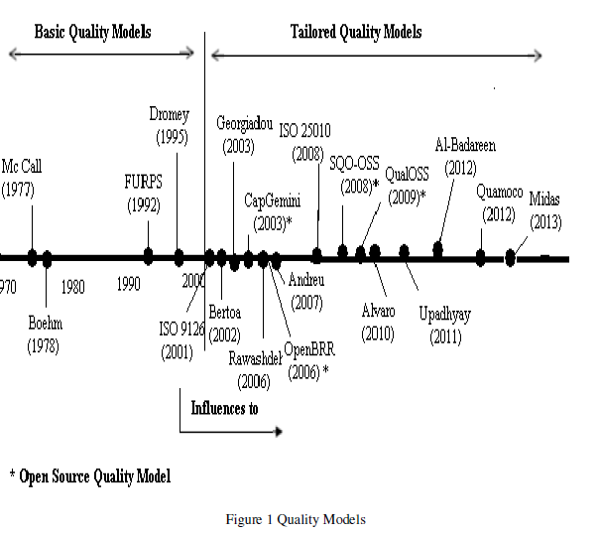
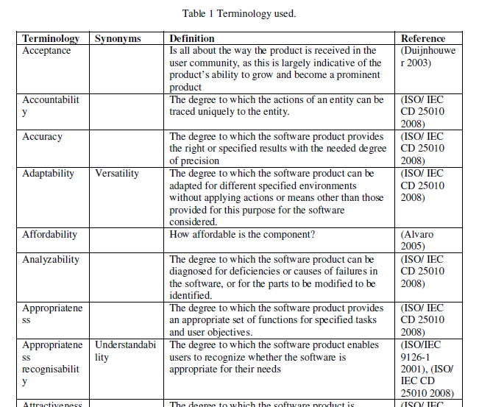
A review of software quality models for the evaluation of software products
1. Introduction
2. Methodology
2.1 Search strategies
2.2 Inclusion and exclusion criteria
3. Basic quality models
3.1 Mc Call Model
3.2 Boehm Model
3.3 Dromey Model
3.4 FURPS Model
3.5 ISO 9126 Model
3.6 ISO 25010Model
4. Tailored Quality Models
4.1 Bertoa Model
4.2 GEQUAMO
4.3 Alvaro Model
4.4 Rawashdeh Model
5. Open Source Models
5.1 CapGemini Open Source Maturity Model
5.2 OpenBRR Model
5.3 SQO-OSS Model.
5.4 QualOSS Model
6. Model Comparison
7. Conclusions
Expert Judgement Tool #3: Quality Models
Notes:
Additional Resources
http://www.professionalqa.com/comparison-quality-models

