Slide 1
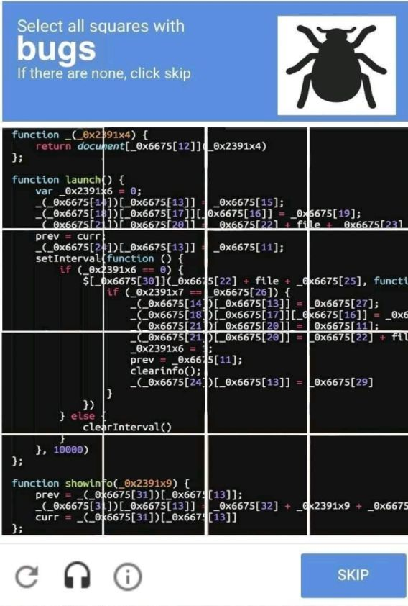
Verification and Validation Testing
Notes:
Text: Read IEEE SWEBoK Chap 1 & 2
Class: Discuss Systems Acceptance Plan
Group Work: Create a Systems Acceptance Plan

Slide 2
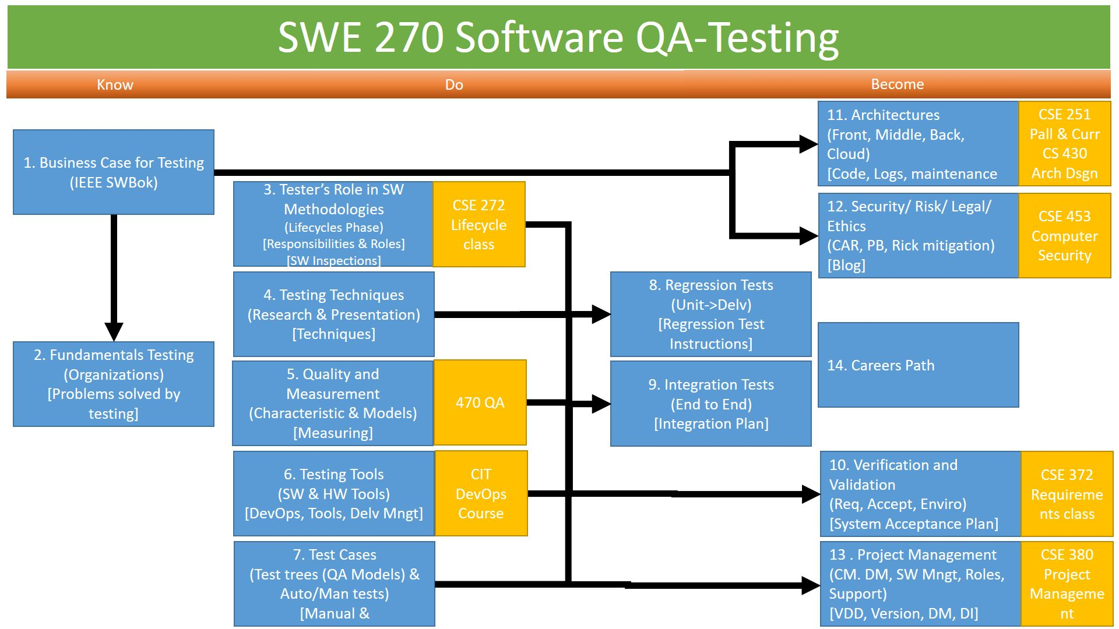
Overview
Preview week review
Reading
Assignments
Defect Selection Create Bug Report Template
W09 Report: Bug Report
Class Discussion
Bugs and how to report them
Integration – Paths, Workflows, Business Logic

Slide 3
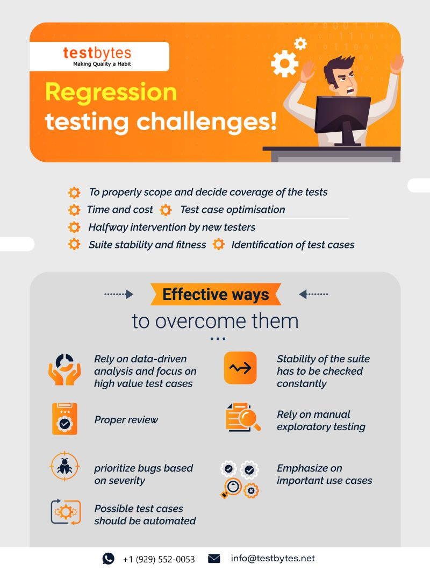

Slide 4
Reading
Software Testing, Second Edition
Chapter 16: Bug Bashes and Beta Testing.
Chapter 19: Reporting What You Find.
How to Write a Good Bug Report by Rajkumar, Septemer 2017
IEEE Standard for Software and System Test Documentation by IEEE Computer Society, (IEEE Std 829-2008), 2008
Chapter 14: Anomaly Report.

Slide 5
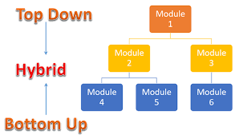
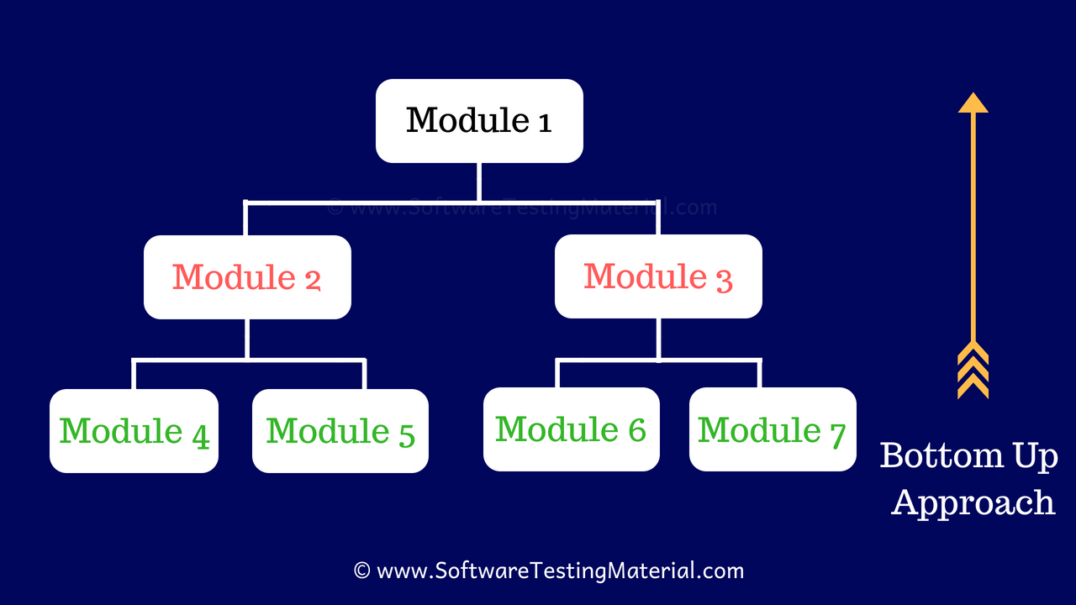
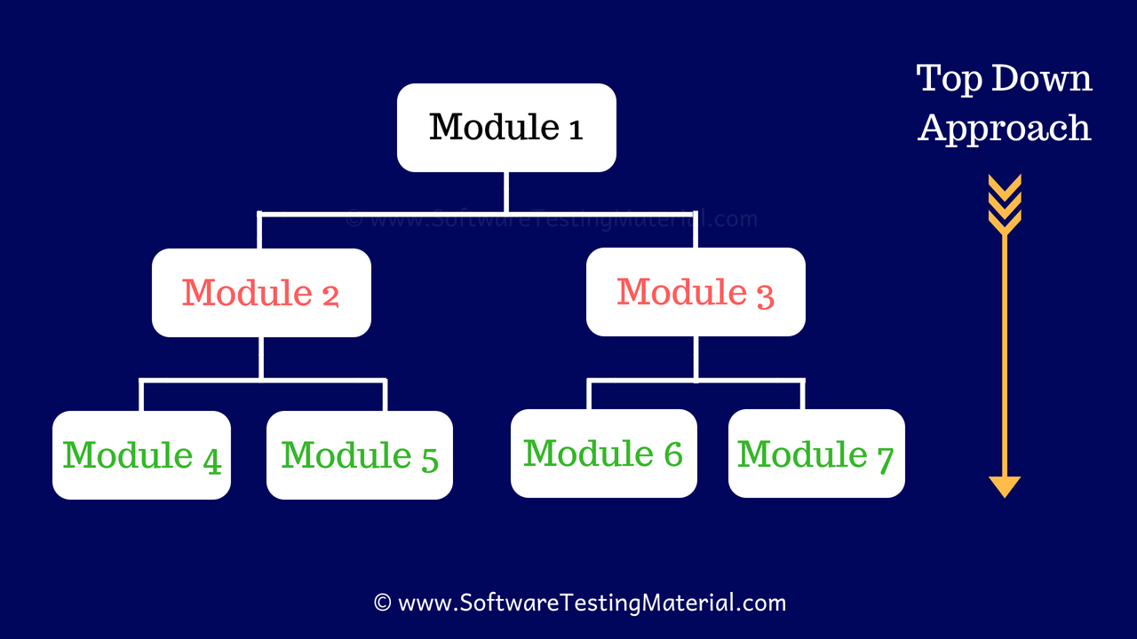
Top-Down vs Bottom-Up Test Design
Requirements &
Design
sandwich, and the vividly named “big bang.”
Quality Models
Quality Characteristics

Slide 6
Software Testing, 4th Edition by Paul C. Jorgensen Published by Auerbach Publications, Strategies of Development Testing
functional decomposition tree of the procedural software
top–down, bottom–up, sandwich, and the vividly named “big bang.”
Waterfall and Spiral Centric
Use of stubs and drivers to provide workflow testing.
Graph calling: State machine
Path-Based: Workflow, Data
The whole mechanism is that units are integrated with respect to structure;

Slide 7
Defect Selection Create Bug Report Templates
Login: The user was unable to enter a password
Login: Username and password was not validated
Login: Username and password was not verified
Setting: Software is unable to detect Battery values from BatterySensor
Setting: Software is unable to see Solar deals from SolarSensor
Setting: Sound Sensors are not working
Setting: Vibration Sensors are not working
Setting: User information is not displayed
Setting: Communication features are not installed
PatientMenu's AddPatient does not allow the user to input the Last Name
PatientMenu's AddPatient Add button does not clear previous NewID
PatientMenu's Diagnosis: Enter Temperature does not validate input
PatientMenu's Diagnosis: Enter Heartbeat does not validate input
PatientMenu's Diagnosis: Enter O2 Level does not validate input
PatientMenu's Diagnosis Enter Blood Pressure inputs both values but should be two fields
PatientMenu's Monitor does not display O2 Level
PatientMenu's AddPatient Cancel button clears/deletes Patients information if Enter New Id contains the Patient ID
PatientMenu's Diagnosis Bandages feature does not update Communicate Order Supplies when usage exceeds threshold settings
PatientMenu's Diagnosis Cleanser feature does not update Communicate Order Supplies when usage exceeds threshold settings
PatientMenu's Diagnosis Tissue feature does not update Communicate Order Supplies when usage exceeds the threshold in settings
PickupTransport: The request Supply Drop feature is not implemented
PickupTransport: Request Pickup of Patient feature is not implemented
PickupTransport: Request Transport Home feature is not implemented
With your partner(s), open the Dr. Mobile application. This application has several defects. Some of the defects are the following:
With your partner(s), investigate these defects and choose five you will use for your bug reports due on Saturday.
Bug Report Format
Investigate different bug report formats presented in the reading and from the internet. Based on these findings, present them to your partner(s). When you have agreed on a format, present a sample bug report here.

Slide 8
W09 Report: Bug Report
Based on the bug report template previously submitted, and based on feedback from the instructor, create bug reports for each of the five defects you have previously submitted.
First, locate each defect in the Dr. Mobile application. Make sure you fully understand the defect, including how to make the bug manifest itself and what the expected behavior should be.
Next, make sure you understand all the variations in the defect. Is there more than one way to make the defect occur? Does this defect appear in more than one place in the application? Have you selected the minimal number of steps necessary to manifest the defect?
Finally, fill out the bug template with precision. Make sure that all your writings are professional. Every piece of information must be presented in an unambiguous way; there is nothing extra and nothing missing.

Slide 9


Slide 10
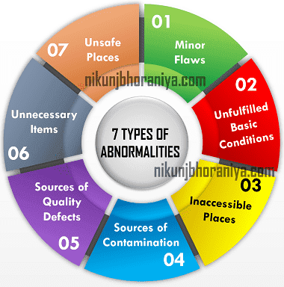

Slide 11
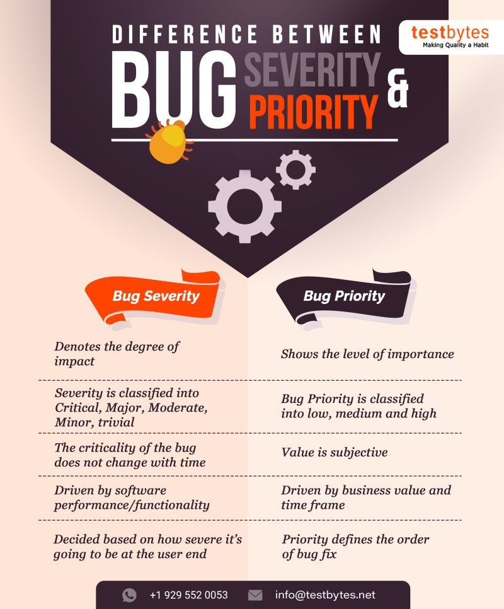

Slide 12
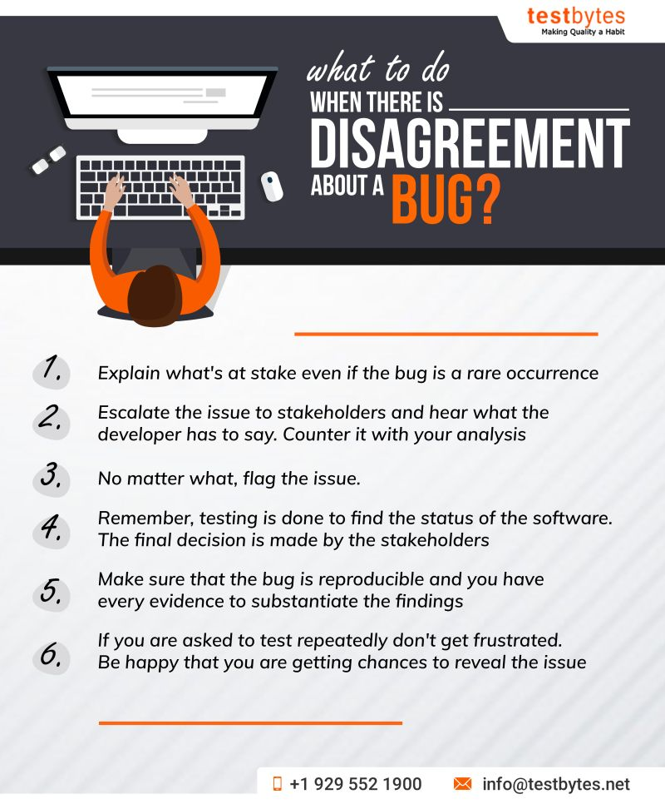

Slide 13
Skill: Full Stack Front End Middle Back End Back End
Most us have heard of full stack developer.
Here I am going to break up the full stack in to:
Front End: HMI, GUI or Terminal
Middle: Business Logic, Server
Back End: Database or File System

Slide 14
Skill: Full Stack Front End Middle Back End Back End
Design Pattern (MVC)
View Control Model
HMI, GUI, Terminal, Logs
Servers, Peer-to-Peer, Cloud (PaaS, SaaS, etc)
Databases, Files, etc
Controller
View
Model
Another way of thinking about it
Is using the MVC Design Pattern

Slide 15
Skill: Full Stack Front End Middle Back End Back End
Design Pattern (MVC)
View Control Model
Model
File System
Database
Controller
Controller
Controller
View
View
View
View
View
Model
Model
Each of MVC can have a MVC.
Where the views of the components MVCs
Connect the Architectures MVCs.
HMI, GUI, Terminal, Logs
©2019 W. Clements – BYU-Idaho v190206

Slide 16
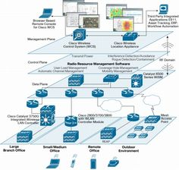
Skill: Full Stack Front End Middle Back End Back End
Design Pattern (MVC)
View Control Model
Model
N-Tier Capabilities
File System
Database
View
Controller
Controller
Controller
View
View
View
View
View
Model
The Architecture Control can also have addition views
If the control is talking to other processes in a N-tier architecture
If the control is using 3 party Interfaces
View
Model
HMI, GUI, Terminal, Logs
3-Party Interfaces
©2019 W. Clements – BYU-Idaho v190206

Slide 17
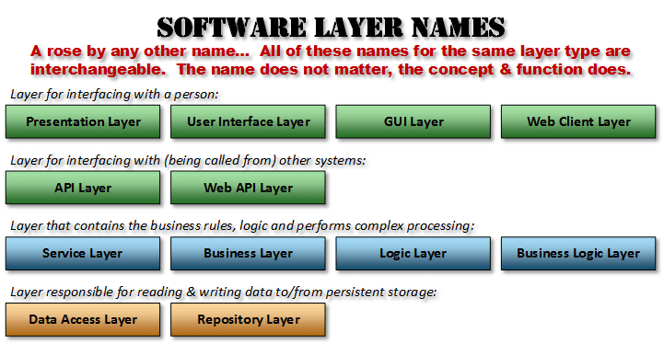
Skill: Full Stack Front End Middle Back End Back End
Design Pattern (MVC)
View Control Model
Model
Public API
Library Interface
Coupling
View
Controller
Cohesion
Controller
Controller
View
View
View
View
Interfaces
Interfaces
View
Coupling
Cohesion
Coupling
Model
View
Model
Coupling
Cohesion
The Views are where interfaces are established.
3 Party API/Interfaces
3 Party Pkg/Libraries
©2019 W. Clements – BYU-Idaho v190206

Slide 18
Skill: Full Stack Front End Middle Back End Back End
Design Pattern (MVC)
View Control Model
This is a good time to identify the difference between code that process data and code that is data.
Code that is data usually has three states:
Data in Process – At the Control
Data in Motion/Transit – Between the Views
Data at Rest – is usually found in the Model
Model
Public API
Library Interface
Data at Rest
View
Data in Process
Controller
Data in Process
Controller
Data in Process
Controller
View
View
View
View
Interfaces
Interfaces
Data at Motion/Transit
Data at Motion/Transit
View
Model
View
Model
Data at Rest
3 Party API/Interfaces
3 Party Pkg/Libraries
Data at Rest
©2019 W. Clements – BYU-Idaho v190206

Slide 19
Skill: Full Stack Front End Middle Back End Back End
Design Pattern (MVC)
View Control Model
Look at Controller, is can be more than one process. Each process handles one or more algorithms. Many times other Design Patterns can be used like Observer, Chain of Command, etc.
Model
Public API
Library Interface
Data at Rest
View
Data in Process
Controller
Events
Data in Process
Controller
Data in Process
Processes
Processes
Controller
View
View
View
View
DBMS
Processes
Processes
Observer
Algorithms
Interfaces
Interfaces
Data at Motion/Transit
Data at Motion/Transit
View
Model
View
Model
Data at Rest
3 Party API/Interfaces
3 Party Pkg/Libraries
Data at Rest
©2019 W. Clements – BYU-Idaho v190206

Slide 20
Skill: Full Stack Front End Middle Back End Back End
Design Pattern (MVC)
View Control Model
Look at Model, usually contains Class, Structures, Types along with Data Structures.
In the back end, the model would be in the form of tables and files.
Model
Public API
Library Interface
Class/Struct/Types
Data Structures
Data at Rest
View
Data in Process
Controller
Events
Data in Process
Controller
Data in Process
Processes
Processes
Controller
View
View
View
View
DBMS
Processes
Processes
Observer
Algorithms
Interfaces
Interfaces
Data at Motion/Transit
Data at Motion/Transit
View
Model
Class/Struct/Types
View
Data Structures
Model
Data at Rest
Tables
Data at Rest
Files
3 Party API/Interfaces
3 Party Pkg/Libraries
Data at Rest
©2019 W. Clements – BYU-Idaho v190206

Slide 21
Skill: Full Stack Front End Middle Back End Back End
Design Pattern (MVC)
View Control Model
Model
Public API
Library Interface
Class/Struct/Types
Data Structures
Data at Rest
View
Interfaces
Data in Process
Adaptors
Controller
Facades
Events
Data in Process
Controller
Data in Process
Processes
Processes
Controller
View
View
View
View
DBMS
Facades
Facades
Processes
Processes
Facades
Facades
Adaptors
Adaptors
Observer
Algorithms
Adaptors
Adaptors
Interfaces
Messaging
Interrupts
Notifications
Remote Function
Interfaces
Data at Motion/Transit
Data at Motion/Transit
SQL
View
Control used algorithms
HMI
HCI
UI
States/Session(Stateless):
New/Init.
Modify/Edit
Inactive
Delete/Destroy
HMI
HCI
UI
Model
HMI
HCI
UI
Class/Struct/Types
Models hold data structures
View
Data Structures
Model
Web (HTML, CSS, JS)
Mobil Apps
OS Applications
?
Facades
Data at Rest
Tables
Adaptors
Files
Interfaces
3 Party API/Interfaces
3 Party Pkg/Libraries
Data at Rest
©2019 W. Clements – BYU-Idaho v190206

Slide 22
Skill: Full Stack Front End Middle Back End Back End
A task in a program is the process of action and results.
Design Pattern (MVC)
View Control Model
Model
Controller
Controller
Processes
Controller
View
View
View
View
View
Model
Model
©2019 W. Clements – BYU-Idaho v190206

Slide 23
Skill: Full Stack Front End Middle Back End Back End
Design Pattern (MVC)
View Control Model
Model
Controller
View
View
Controller
Processes
Model
Controller
View
View
View
Model
Lets make some room
©2019 W. Clements – BYU-Idaho v190206

Slide 24
Skill: Full Stack Front End Middle Back End Back End
Design Pattern (MVC)
View Control Model
View
Model
Controller
View
View
Controller
Controller
View
Processes
Model
Model
View
©2019 W. Clements – BYU-Idaho v190206

Slide 25
Skill: Full Stack Front End Middle Back End Back End
Simplified UML Process Flow diagram
Design Pattern (MVC)
View Control Model
View
Model
Controller
View
View
Controller
Controller
View
Processes
Model
Model
View
©2019 W. Clements – BYU-Idaho v190206

Slide 26
Skill: Full Stack Front End Middle Back End Back End
Design Pattern (MVC)
View Control Model
View
Model
Controller
View
View
Controller
Controller
View
Processes
Model
Model
View
Link being click
Control sending request to server
Control sending request to server
Request being received by server
Request being processed
Request state being stored
Request’s parameters being pulled from Model
Parameters received
Data retrieved
From file
©2019 W. Clements – BYU-Idaho v190206

Slide 27
Skill: Full Stack Front End Middle Back End Back End
Design Pattern (MVC)
View Control Model
View
Model
Controller
View
View
Controller
Controller
View
Processes
Model
Model
View
Link being click
Control sending request to server
Control sending request to server
Request being received by server
Request being processed
Request state being stored
Request’s parameters being pulled from Model
Parameters received
Data retrieved
From file
Results data returned
Return data received
Data processed into information
Information returned
Information received
Results displayed
©2019 W. Clements – BYU-Idaho v190206

Slide 28
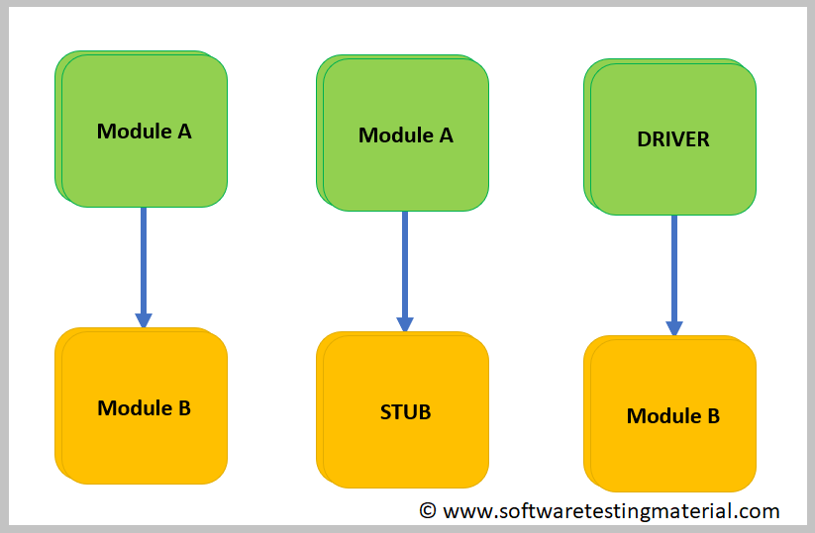
Stubs and Drivers
STUBS | DRIVERS
Stubs used in Top Down Integration Testing | Drivers used in Bottom Up Integration Testing
Stubs are used when sub programs are under development | Drivers are used when main programs are under development
Top most module is tested first | Lowest module is tested first
It can simulate the behavior of lower level modules that are not integrated | It can simulate the behavior of upper level modules that are not integrated
Stubs are called programs | Drivers are the calling programs

Slide 29
Skill: Full Stack Front End Middle Back End Back End
Going back to the basic diagram, a workflow is the process of a tasks being completed to solve business logic.
Design Pattern (MVC)
View Control Model
View
Model
Controller
View
View
Controller
Controller
View
Processes
Model
Model
View
Bring up Home Webpage
Click on Login
Workflow
Fill out Username and Password
Success Login, bring up Home Login Page
Examples of Workflows:
Logging in
Sending email
Submitting homework assignment
©2019 W. Clements – BYU-Idaho v190206

Slide 30
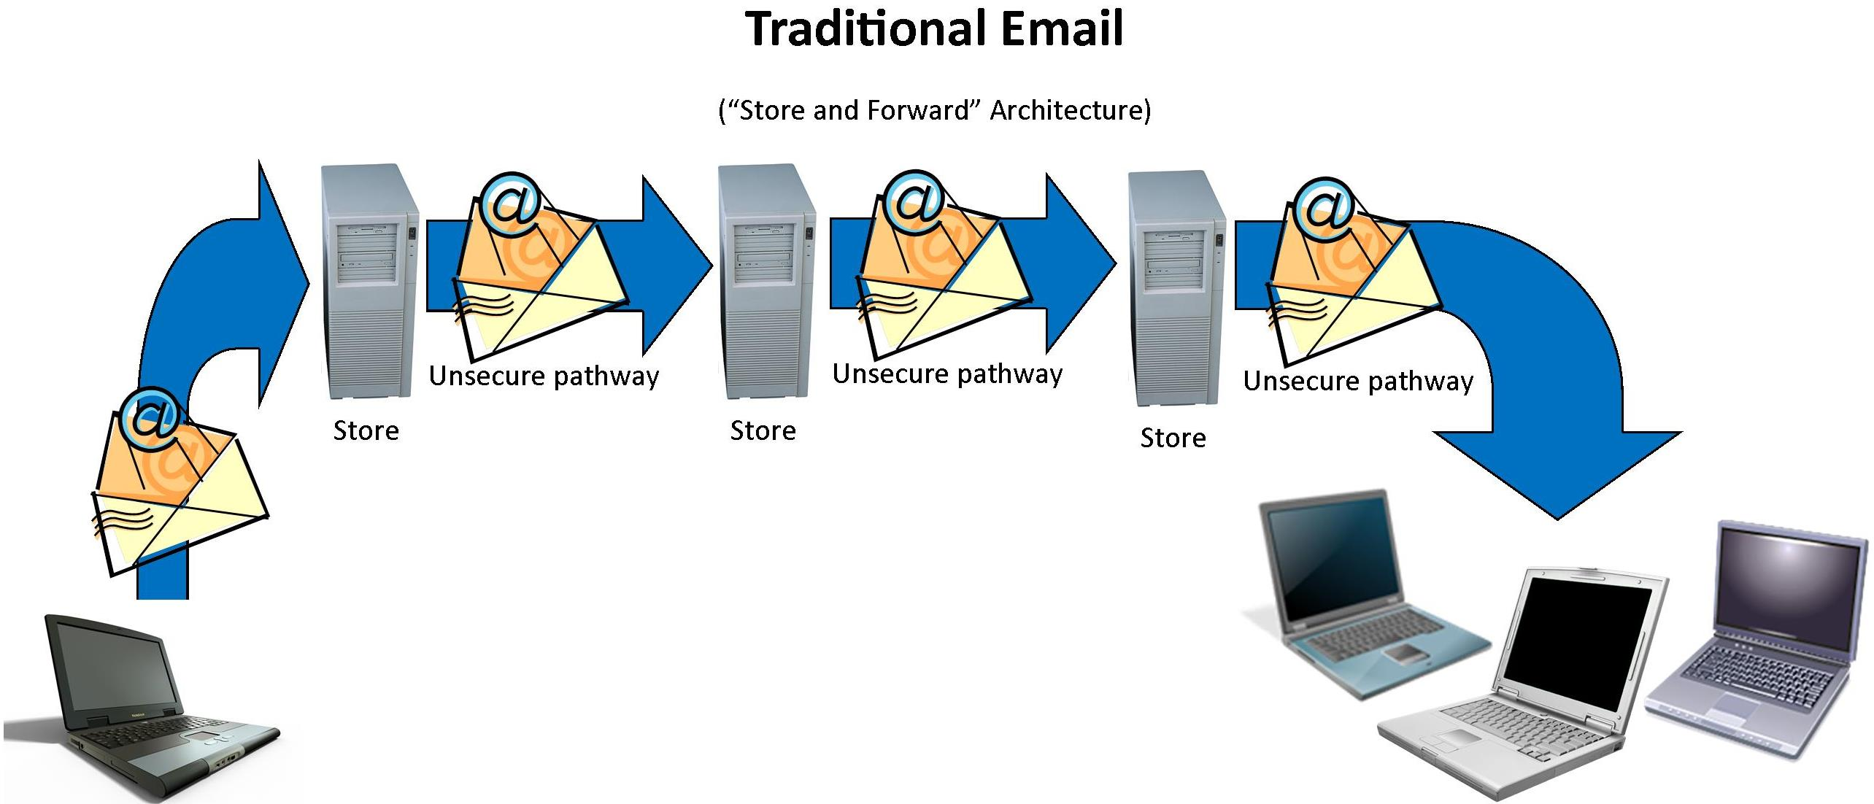
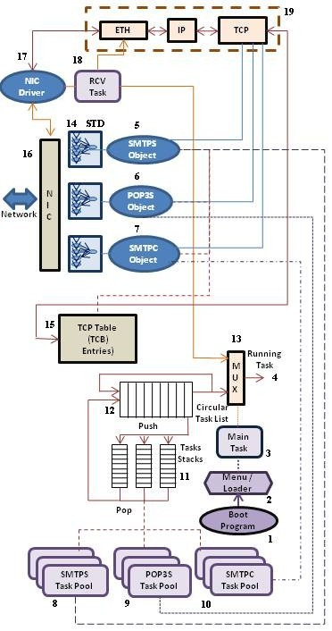
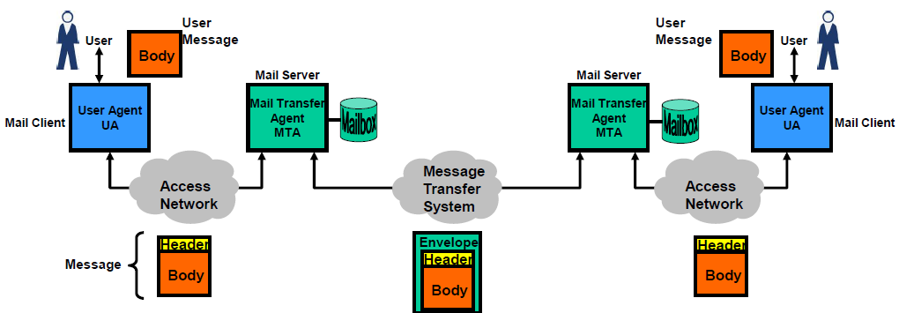
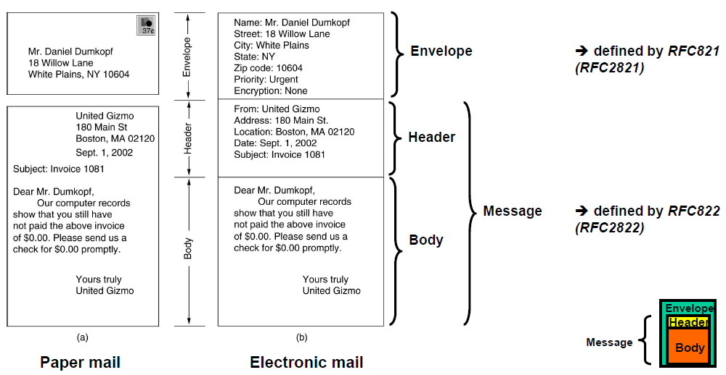
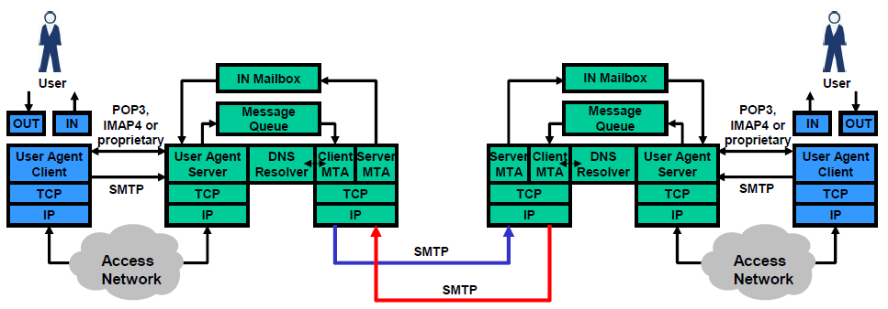
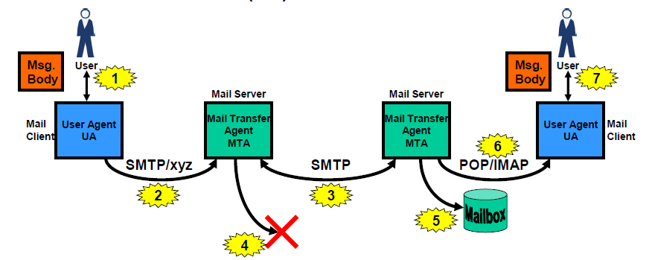
https://www.slideshare.net/PeterREgli/email-6106131

Slide 31
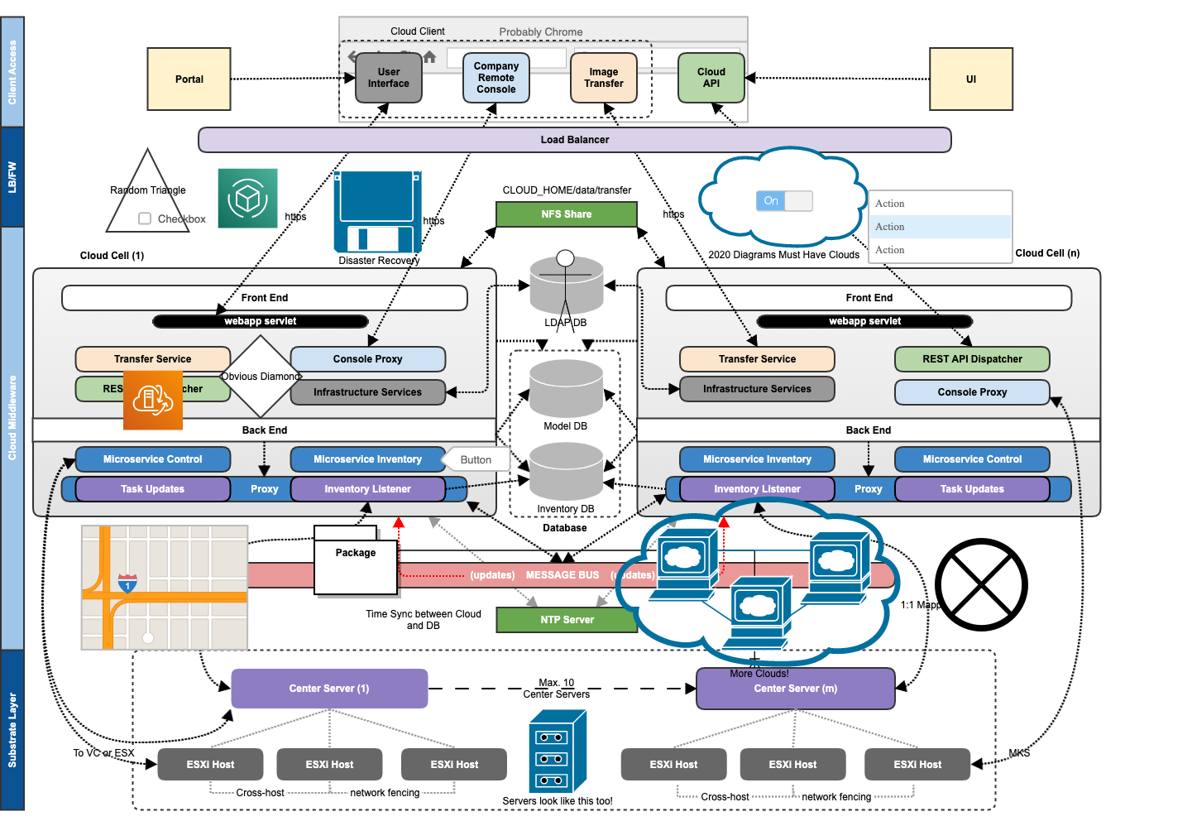

Slide 32
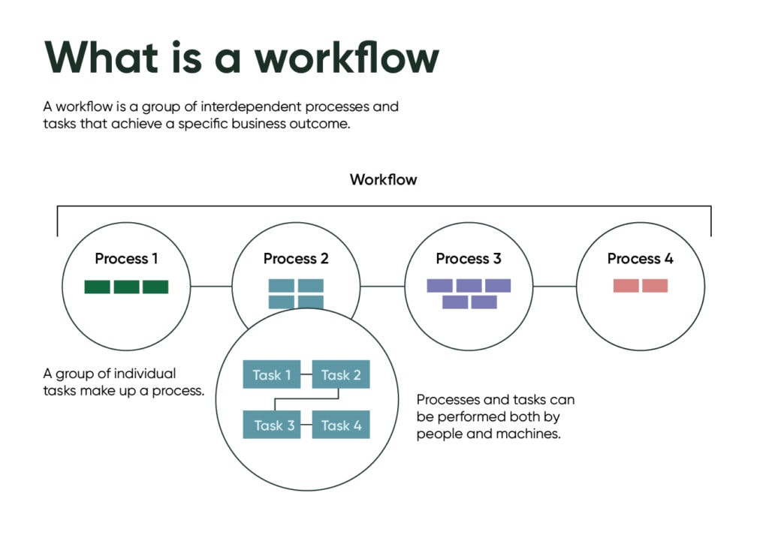
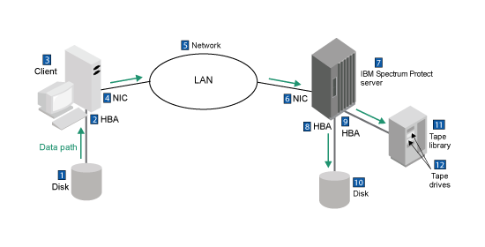
Path-Based: Workflow, Data
Author mentioned MM-path – covers every conceivable path, lots of overhead.
Workflow: This is the normal, expect path for accomplishing a goal
Data Flow Path: Follow the data.
Process flow:

Slide 33
Software Testing, 4th Edition by Paul C. Jorgensen Published by Auerbach Publications, Strategies of Development Testing
The whole mechanism is that units are integrated with respect to structure;
Fundamental uncertainty exists in any structural form of testing
As part of Integration You are testing
Data Paths
Workflows
Business Logic

