Slide 1
Week 05 Testing and Quality Assurance
CSE 270
W. Clements
BYU-Idaho

Slide 2
Reading
J. Miguel et al. "A Review of Software Quality Models for the Evaluation of Software Products," International Journal of Software Engineering & Applications, vol. 5, no. 6, pp. 31-54, Nov. 2014, [Online] Available: http://airccse.org/journal/ijsea/papers/5614ijsea03.pdf

Slide 3
Sensor App
Download a sensor app that will show the different sensor available on your phone.
Android: On Google Play, search for Sensor Lab, Phone Check and Test, or TestM.
iOS: On the Apple app store, search for Phone Diagnostics or TestM.
Any of these apps will work for this week's lab.

Slide 4
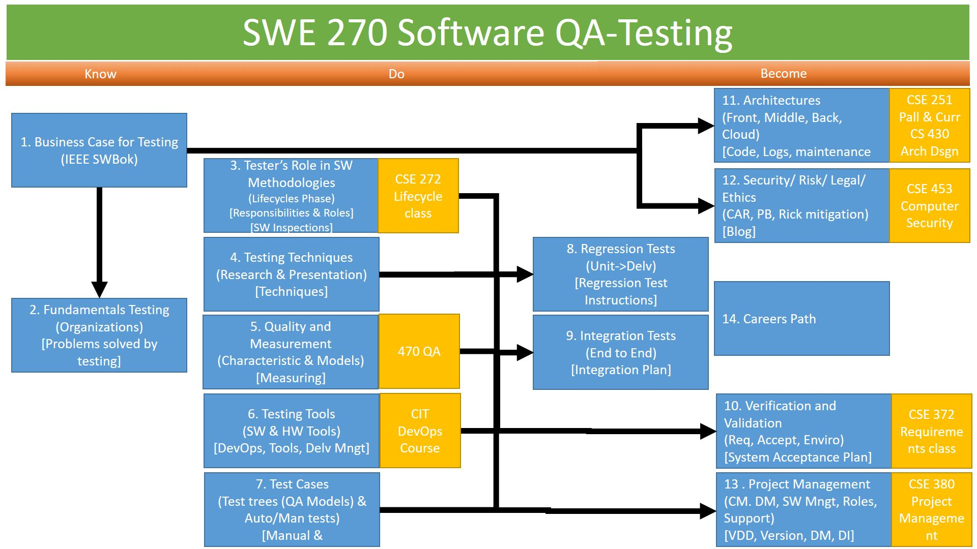
Agenda
Assignments
Research a SW Methodology
How does a QA-Tester role play in the Methodology?
Overview of Software Lifecycle (CSE 272) & Methodologies
Work on Testing Methodology Plan

Slide 5
Quality Assurance
Agenda
Day 1: Quality Assurance Models and Metrics
Day 2: CMM
Day 3: Teach Activity
Teach Lab
Prove

Slide 6
What is quality?
How do I evaluate?
Flaws vs Failures
Perceptions
Why is it hard to define?

Slide 7
Continuous Improvement
Quality Assurances
(Built the Product Right)
Process ->
Q-Contrl/HMI
Value/Cost
Audit/Review/Std
Integrity/Sec
Testing
<- Product
Software Development
QA vs
Test vs
DevOp vs
Cont. Improvement
Support Roles (CM, DM, Code Mngr, etc)
Program/Project Manager
Development
QA-Tester
Acceptance Tester
System Tester
Integration Tester
Regression Tester
Unit Tester
(Sometime Developer)
Concept of Operations
Acceptance Test
Validation
Requirements
System Test
Verification
Architecture
Integration Test
Design
Regression Test
Implementation
Implementation
Unit Test
(Built the Right Product)
Dev Ops
Environment
Software Tools
Hardware
Network
Infrastructure
Test Zone (sandboxes)
Operation

Slide 8
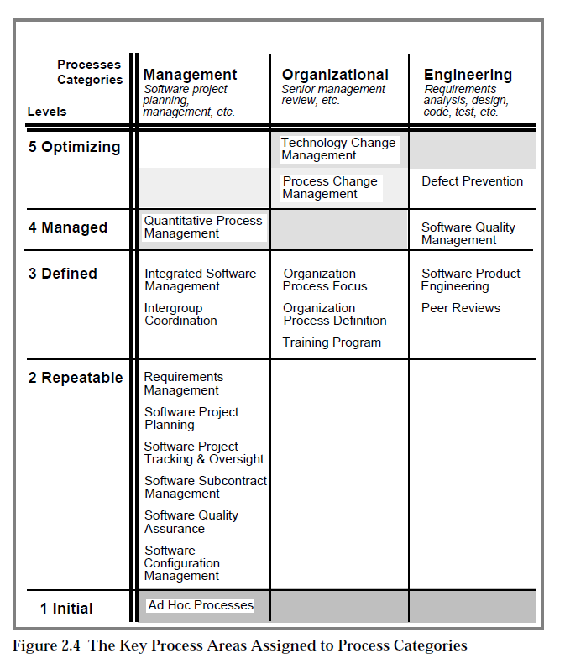
Quality Management
CMM
Lifecycle

Slide 9
What is “Software Quality”
The degree to which a system, component, or process meets
specified requirements: “conformance to requirements”
customer or user needs or expectations: “fitness for use”
IEEE Standard Glossary of Software Engineering Terminology IEEE Std 610.12-1990
These are not necessarily the same thing

Slide 10

Who is responsible for quality?
Limitations: Dijkstra aphorism that “program testing can be used to show the presence of bugs, but never to show their absence
“If you want more effective programmers, you will discover that they should not waste their time debugging, they should not introduce the bugs to start with.”
- Edsger W. Dijkstra
Founder of Quality

Slide 11
Quality Assurance (QA)
What is “Quality Assurance?”
A planned and systematic pattern of all actions necessary to provide adequate confidence that an item or product conforms to established technical requirements.
A set of activities designed to evaluate the process by which products are developed or manufactured. Contrast with: quality control.
IEEE Std 610.12-1990
quality control (QC). (1) A set of activities designed to evaluate the quality of developed or manufactured products.

Slide 12
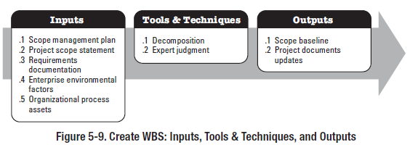
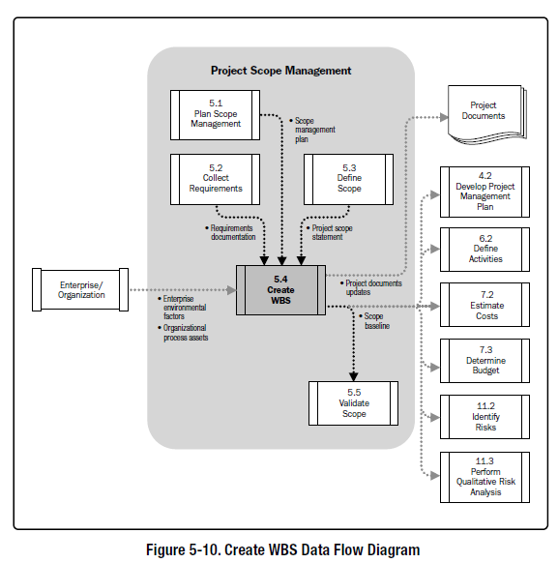
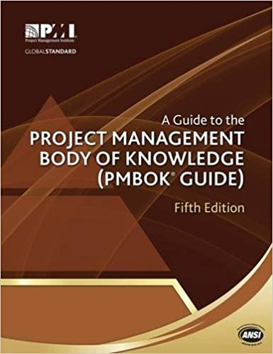
5.4 Create WBS
5.4.1 Create WBS: Inputs
5.4.1.2 Project Scope Statement
5.4.1.3 Requirements Documentation
5.4.1.4 Enterprise Environmental Factors
5.4.1.5 Organizational Process Assets
5.4.2 Create WBS: Tools and Techniques
5.4.2.1 Decomposition
5.4.2.2 Expert Judgment
5.4.3 Create WBS: Outputs
5.4.3.1 Scope Baseline
5.4.3.2 Project Documents Updates

Slide 13
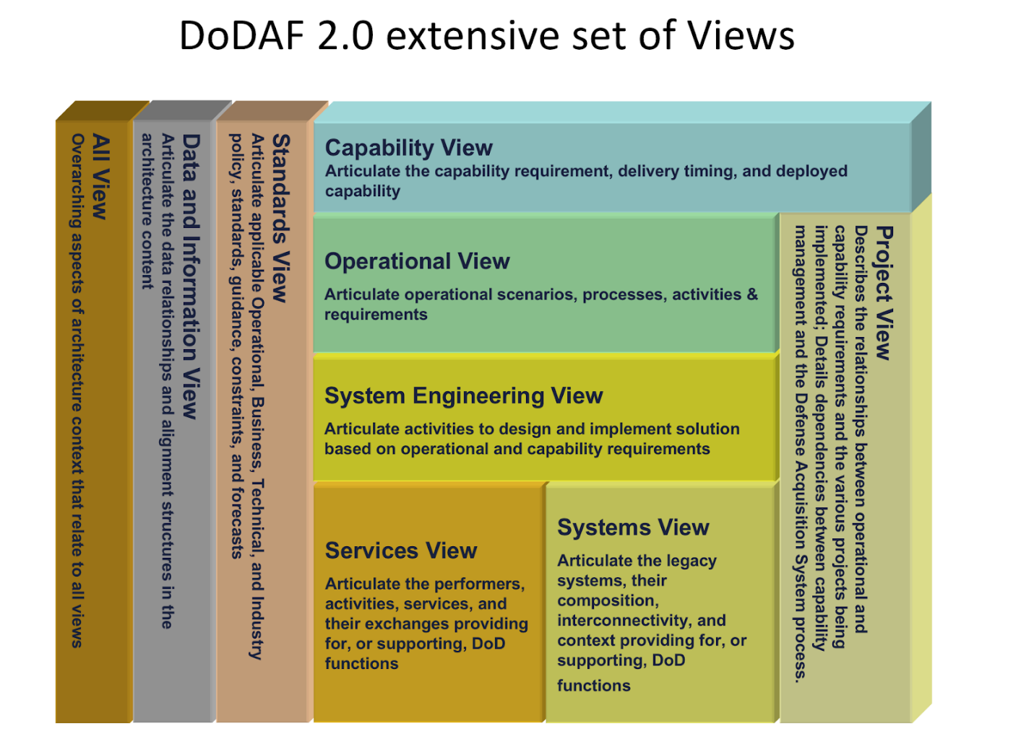
CSE 372: Requirements Elicitation Techniques (CS 364 SWE 1)
Discovery & Empathizing
Stakeholders: Interviews: Introspection
Stakeholders: Structured: Questionnaires
Stakeholders: Group Work: Brainstorming
Analysis & Designing
User: Ethnography: Scenarios, Profiles
User: Card Sort
User: Repertory Grid
Documentation and Prototyping
User: Prototyping
Domain: Card Sort: CRC
Domain: Laddering
Domain: Viewpoints: Goal-Based Approach
Domain: Viewpoints: Top Down: Task Analysis
Expert Judgement Tool #1: Requirements

Slide 14
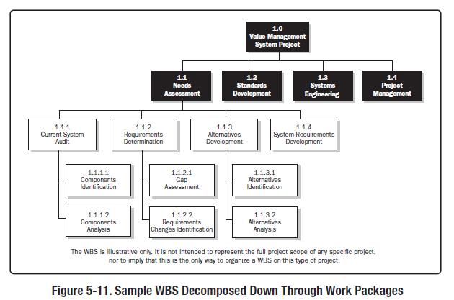
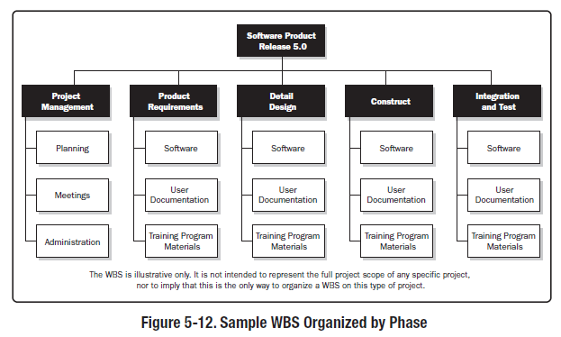
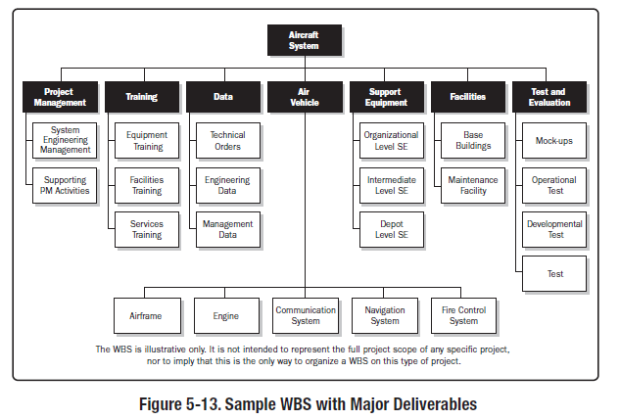
PMBoK

Slide 15

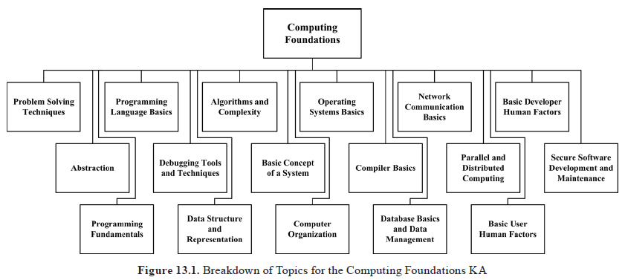
SWEBOK: Chapter 17
Functional SW Characteristics
Expert Judgement Tool #2: Requirements

Slide 16
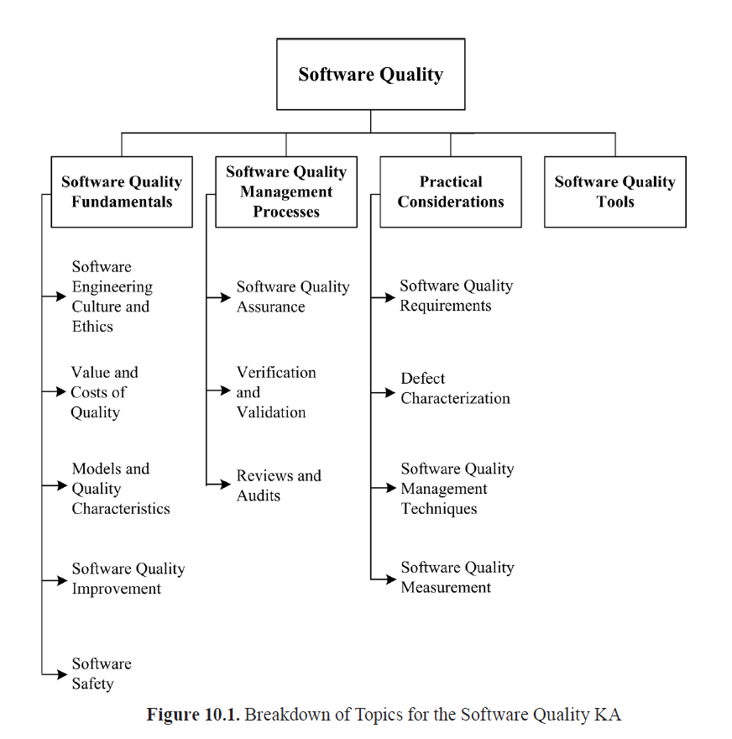
SWEBOK v3.0: Appx B Chap 10: Software Quality
BREAKDOWN OF TOPICS FOR SOFTWARE QUALITY
1. Software Quality Fundamentals
1.1. Software Engineering Culture and Ethics
1.2. Value and Costs of Quality
1.3. Models and Quality Characteristics
1.3.1. Software Process Quality
1.3.2. Software Product Quality
1.4. Software Quality Improvement
1.5. Software Safety
2. Software Quality Management Processes
2.1. Software Quality Assurance
2.2. Verification & Validation
2.3. Reviews and Audits
2.3.1. Management Reviews
2.3.2. Technical Reviews
2.3.3. Inspections
2.3.4. Walkthroughs
3. Practical Considerations
3.1. Software Quality Requirements
3.1.1. Influence Factors
3.1.2. Dependability
3.1.3. Integrity Levels of Software
3.2. Defect Characterization
3.3.1. Static Techniques
3.3.2. Dynamic Techniques
3.3.3. Testing
3.4. Software Quality Measurement
4. Software Quality Tools

Slide 17
SWEBOK v3.0: Appx B 1.3. Models and Quality Characteristics
Terminology for software quality characteristics differs from one taxonomy (or model of software quality) to another, each model perhaps having a different number of hierarchical levels and a different total number of characteristics.
Various authors have produced models of software quality characteristics or attributes that can be useful for discussing, planning, and rating the quality of software products.
ISO/IEC 25010: 2011 [4] defines product quality and quality in use as two related quality models. Appendix B in the SWEBOK Guide provides a list of applicable standards for each KA. Standards for this KA cover various ways of characterizing software quality.

Slide 18
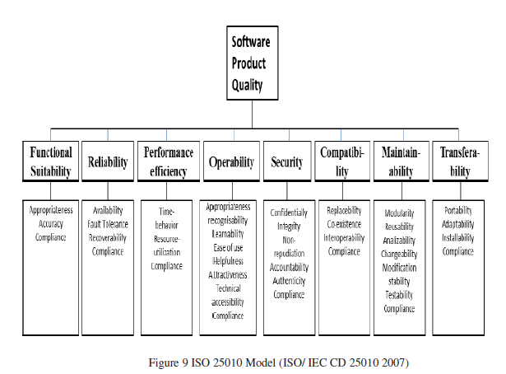
SWEBOK v3.0: Appx B
ISO/IEC 25010:2011 Systems and Software Engineering— Systems and Software Quality Requirements and Evaluation (SQuaRE)—System and Software Quality Models
ISO/IEC 25010:2011 defines the following:
1. A quality in-use model composed of five characteristics (some of which are further subdivided into subcharacteristics) that relate to the outcome of interaction when a product is used in a particular context of use. This system model is applicable to the complete human-computer system, including both computer systems in use and software products in use.
2. A product quality model composed of eight characteristics (which are further subdivided into subcharacteristics) that relate to static properties of software and dynamic properties of the computer system. The model is applicable to both computer systems and software products.

Slide 19
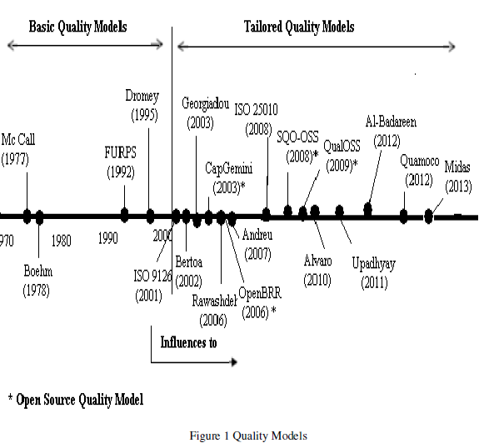
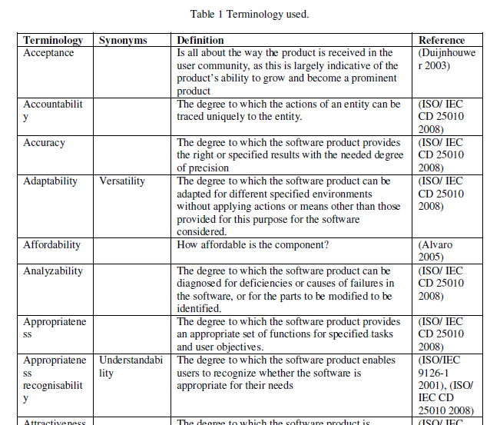
A review of software quality models for the evaluation of software products
1. Introduction
2. Methodology
2.1 Search strategies
2.2 Inclusion and exclusion criteria
3. Basic quality models
3.1 Mc Call Model
3.2 Boehm Model
3.3 Dromey Model
3.4 FURPS Model
3.5 ISO 9126 Model
3.6 ISO 25010Model
4. Tailored Quality Models
4.1 Bertoa Model
4.2 GEQUAMO
4.3 Alvaro Model
4.4 Rawashdeh Model
5. Open Source Models
5.1 CapGemini Open Source Maturity Model
5.2 OpenBRR Model
5.3 SQO-OSS Model.
5.4 QualOSS Model
6. Model Comparison
7. Conclusions
Expert Judgement Tool #3: Quality Models
Notes:
Additional Resources
http://www.professionalqa.com/comparison-quality-models

Slide 20
Class Activities – Consumer Reports
Pick a product!?
Root beer (soda)
Pizza
Bread
Build a Quality Model
Characteristics
Categories
Taste Test
Rate
Bring Food Wednesday
Bring Phone Wednesday and Friday

Slide 21
Teach Activity
W05 Plan: Quality Measurements (Links to an external site.).
Define Quality
Test Cases
W05 Lab: Quality Measurements (Links to an external site.).
Conduct the Quality Plan- with in group.
Report on Your Findings

Slide 22
CSE 270: W05 Plan: Quality Measurements
Part 1: Determining Non-Functional Requirements
Part 2: Create Test Cases
Determine a feature of a phone.
Determine a quality characteristic
How would you measure the characteristic? Nominal, Ordinal, Interval, or Ratio scale.
How accurate must it be?
What type of inputs does it need?
What type of conditions (environmental, internal state, non-human instrument, etc) might affect the measurement?
Write a requirement for the quality characteristic
Name: The name of the test.
Quality Requirement: The name of the quality requirement this test is meant to verify.
Steps: The steps one must perform to carry out the test. These steps must be precise, so anyone can conduct the test the way you envision. Remember to use the Action/Result or Action/Verify pattern.
Outcome: What is the expected outcome? What should the person conducting the test look for?

Slide 23

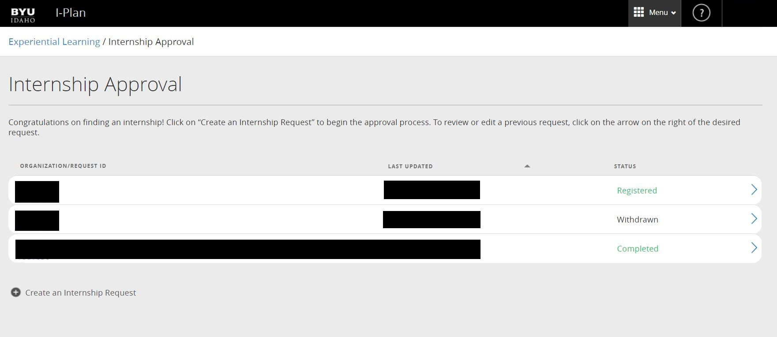
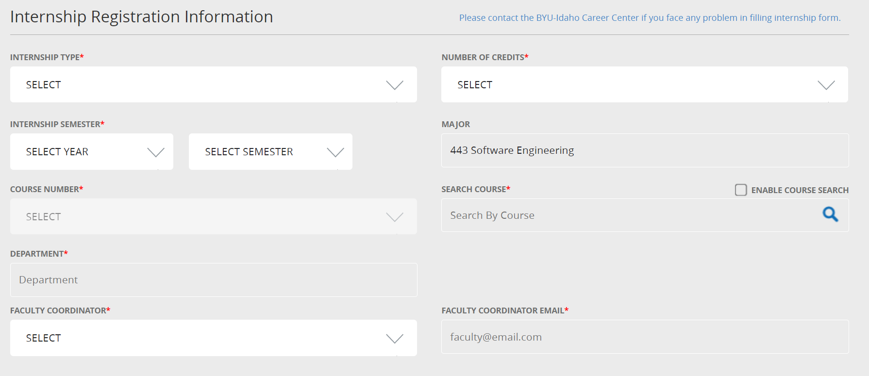
Remember Writing Tests Format Example
Purpose: How to register for the internship class
Requirements: Students shall request approval for a job in order to register for CSE 398
Story: As a student, I want my internship job to be approved , so that I can register for CSE 398 Internship
Pre-conditions:
Web Browser with connection to byui.edu.
Identical request has not been made.
Steps:
Action: Log into iPlan.byui.edu
Results: Browswer is open with web page
Action: Click on Internship Approval panel link
Results: Internship Approval page show up
Action: Click on “Create an Internship Request” link
Results: Internship Registration Information page appears
…
Action: Look over the form to see that you have fill out all of required fields, then press the Submit button.
Verify: Form is submitted and shows up in the Internship Approval page
…
Action: In two days, check back to see if the request has been approved.
Verify: When time for registration occurs, it is possible to register for CSE 398

Slide 24
Phone Sensor Information
Activate the hidden hardware diagnose program.
From Phone keypad type: *#0*#
Download a sensor app that will show the different sensor available on your phone
Android: Google Play: Sensor Lab or Phone Check and Test
iOS: Phone Diagnostics, Phone Doctor Plus,
Both: TestM Hardware (warning likes facebook info)

Slide 25
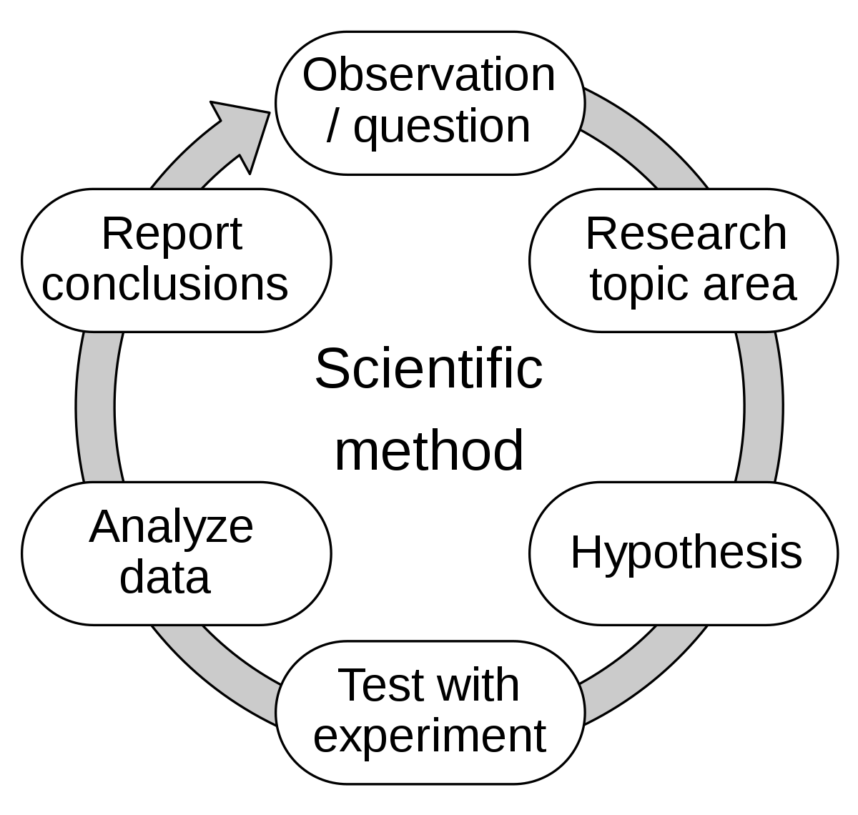
CSE 270: W05 Lab: Quality Measurements
Conduct the Quality Plan
Test other’s phones
Report on Your Findings
Quality Requirement: The quality requirement being tested.
Citation: A citation linking to any external source pertaining to your requirement. State "N/A" for not applicable is no sources were needed for this test case.
Steps: The steps one must perform to carry out the test. These steps must be precise, so anyone can conduct the test the way you envision.
Variations: If a tester varied from the intended steps, what did he/she do instead? Why?
Expected Outcome: The expected outcome according to the research.
Actual Outcome: What actually happened during the test.
Verdict: Did each test subject meet the requirements? Why or why not?

Slide 26


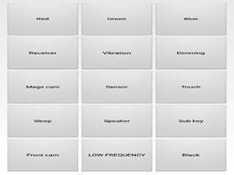
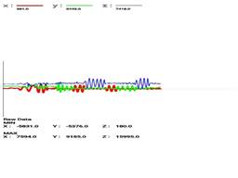
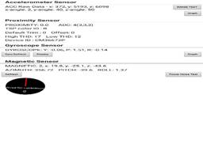
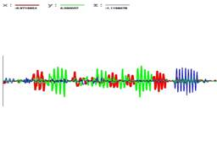
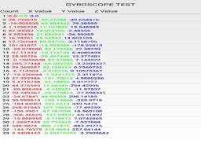
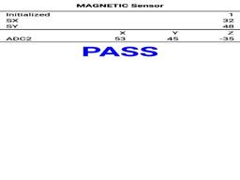

Slide 27
Assignment
Observe SENSOR
What is it measuring?
Determine the normal sensory?
Determine abnormal, change, or detection state? What caused it?
Create Three Scenarios
Come up with three different ways, activities, or scenarios that you would use the sensor.
Determine the measurement criteria, write them down.
Write down your prediction of what will happen during the activity.
What are some risks? What side effects could happen?
What would be considered a successful pass of your scenario? What would be an almost? And not quite?

Slide 28
Assignment
Test SCENARIOS
Using your observer sensor, test the device in your three scenarios.
Repeat your scenario until you get all successes.
Repeat your scenario until you get the almost successes
Repeat your scenario for not entirely.
Did you have to change the test, your expectation, or the technique?
SUMMARY
Write an overview of what you learned.
Include what you used to test the sensor you are testing (What software)
Include your scenarios and how you tried it
Include what you determined was successful and what was not.
Include data or proof that you completed the test: measurements, screen captured, etc
Peer Testing
Read over two of your classmates' scenario summaries. Run the tests as they described them.
Did you get the same results as your classmate?
If you didn't, what was the difference?
If you did, what could be improved?
Suggest another scenario to test. Provide predictions as to the results.

