Slide 2
Week 06 Software Tools
CSE 270 QA-Testing
Objectives
By the end of the week, each student will be able to:
Appreciate how testing automation tools enable testers to more effectively test a product.
Understand how testing automation tools work.
Automate testing using testing automation software.

Slide 3
Plan of the Week
This week, we will complete the following activities:
(M)Reading & Install: Read about the Selenium automation software and install it on your computer.
(W) Create Automation: Using Selenium, create automation to perform a dozen tests.
(F) Demonstration: Create a video demonstrating your automation.

Slide 4
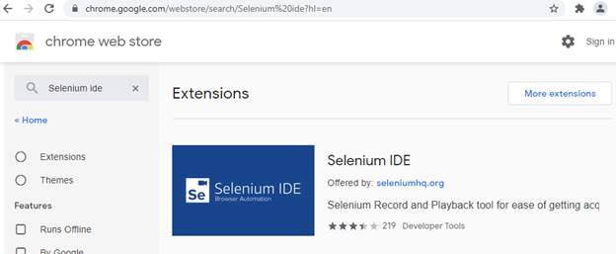
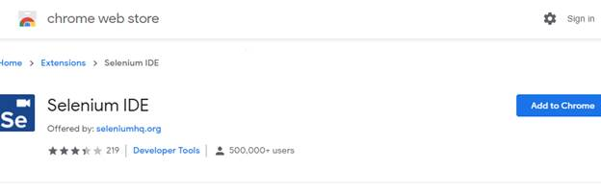
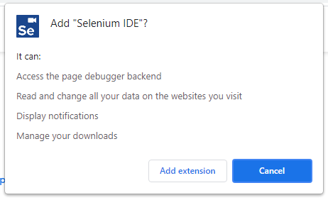
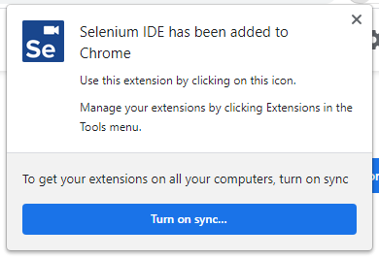
(Mon) Installing Selenium IDE
Add the Selenium IDE plug in.
The Selenium IDE work for Firefox and for Chrome. For the sake of the lab, I will be giving directions for downloading Chrome’s extention. Goto Chromes web store and select Selenium IDE.
Add the Selenium IDE extension, by selecting Add to Chrome.
Agree to the permissions, by clicking Add Extension:
Reading information box
You can use Katalon Recorder for Firefox. Edge and Safari has not been researched)

Slide 5
Reading – For more programming details
What to learn more about programming using Selenium?
Selenium : Overview
Read the following page: Selenium : Overview.
Selenium : A Deeper Look
Read the following page: Selenium : A Deeper Look.
Write your first Selenium script
Getting Started with IDE
Read the following: Installing and lauching Selenlium IDE:
Selenium IDE API Commands
Learn about the different commands that can be used with the API
Selenium IDE Code Export
Read the following: Exporting IDE to different languages
Selenium : Getting Started
Carefully read the following page Selenium : Getting Started. Follow the instructions precisely.
Install Selenium
On your computer, install Selenium by following the above "Getting Started" instructions.
Selenium : WebDriver
Read the following page: Selenium : WebDriver.
Selenium : Understanding the Components
This is perhaps the most technical page of this week's reading but also one of the most important. You may need to read this more than once: Selenium : Understanding the Components.
Selenium : Locating Elements
Another super important and somewhat technical page. You may need to read this more than once: Selenium : Locating Elements.
Selenium : Guidelines and recommendations
Read the following page: Selenium : Guidelines and recommendations.
Selenium : On test automation
This is a very important page which really cuts to the heart of the matter. Please read every word carefully: Selenium : On test automation.
Selenium : Types of testing
Hopefully, this is a review: Selenium : Types of testing.
Selenium : Page object models
Anther very technical page. You might need to step through this one very carefully: Selenium : Page object models.

Slide 6
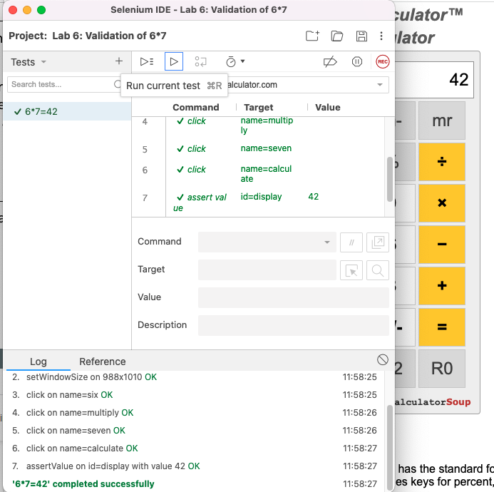
(W) Create automated tests
Automation.side
Creating a Test
This automation was created using the following steps:
Click on Brower’s plug in Selenium.
From the "Welcome to Selenium IDE" window, select Record a new test in a new project.
From the "Name your new project", enter Lab 6.
From the "Set your project’s base URL", enter: https://www.theonlinecalculator.com/.
Press the value "6" by pressing the key, the number six shows up in the results text box. Indicate multiplication by pressing the key, no change. Press the value "7" by pressing the key, the number seven shows up in the results text box. Indicate that computation is complete by pressing the key, the number 42 shows up in the results box. Create a verification (assert) step, by clicking on the last row (empty). From the Command drop-down, select assert value.
From the Target’s "Select Target" button, the results text frame was selected, before you press it it should indicate by changing light-blue.
From the Value’s text box, 42 was entered.
Stop the recording by pressing the red circle with a square in the top right corner. From the “Name your new test”, enter What is 6*7? 42. Verify that the test works by pressing the play button in the second menu on the right, just above the url. Save your test suite.

Slide 7
CSE 270: W06 Lab: Automation
Generate Automation
Using Selenium, automate your twelve test cases. This involves creating twelve individual test script
Screen capture each successful run and submit in a word doc or pdf.

Slide 8
(F)CSE 270: W06 Demonstration: Automation
Script
Recording
Once you are confident you have your script figured out, then record it using some type of screen-capture software. Your recording must include the faces of all members of the team. One of the easiest ways to do this is to record a meeting using Zoom.
Your recording must be posted online somewhere. It could be on YouTube, Loom, or the Zoom servers. It is up to you. Just make sure that the instructor has permission to view your video.
The entire video must be no more than one minute in length. Please provide a voice-over explaining what is happening in the video.
Before you create your video, make a plan for what will it contain. You may want to consider the following questions:
What will you say?
What will be on the screen?
How long do you expect it to take?
It would be a good idea to run through your script a few times before recording the video. The video needs to demonstrate all twelve test cases.

