Slide 1
CSE 270 Software QA-Testing Week 07: Writing Test Cases
W. Clements

Slide 2
Reading
Planning Your Test Effort
Please open Ron Patton's Software Testing, Second Edition:
Software Testing, Second Edition by Ron Patton, Published by Sams, 2005
Read Chapter 17: Planning Your Test Effort
Writing and Tracking Test Cases
Please open Ron Patton's Software Testing, Second Edition:
Software Testing, Second Edition by Ron Patton, Published by Sams, 2005
Read Chapter 18: Writing and Tracking Test Cases

Slide 3
Agenda
CSE 270: W07 Lab: Test Cases
CSE 270: W07 Demonstration: Test Cases

Slide 4
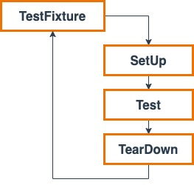
CSE 270: W07 Lab: Test Cases
Select a Web Application
select a web application
List Requirements
List four requirements that would be applicable for the web application you choose.
Generate Test Cases
Generate 12 manual test cases
Title/ID:
Purpose:
Requirements:
Pre-conditions:
Steps:
Action/Results
Action/Verify
Tear-down
Submission
Your team will submit a single document for your test cases. The document needs to be in the PDF format. It must consist of the following components:
Link: Provide a link to the web application to be tested.
Requirements: A list of all the requirements that are to be tested.
Test Cases: At least twelve complete and high-quality test cases.
Can’t be dynamic unless you are specific

Slide 5
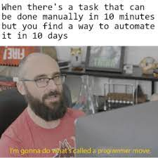
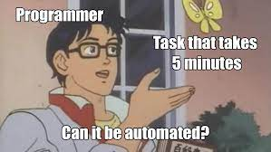
CSE 270: W07 Demonstration: Test Cases
Using Selenium, automate your twelve test cases. This involves creating twelve individual test scripts.
Before you create your video, make a plan for what will it contain. You may want to consider the following questions:
What will you say? How can you use a narration to make your demonstration more clear?
What will be on the screen?
How long do you expect it to take?
Recording
As with last week, create a script for how you will demonstrate your test cases.
Record a demonstration of your automation using some type of screen-capture software.
Your recording must include the faces of all members of the team.
One of the easiest ways to do this is to record a meeting using Zoom.

Slide 6
Example of Table Format
ID - Title | Req 10.1.3- Save Module 7 Test Case Discussion Web Page
Requirement | Browser shall save Test Case Discussion Description
Test Type | Demonstration
Pre-Conditions | Web Brower is open
Steps (Actions) |  | Results/Verify | Pass/ Fail | Comments
From the file menu, click File: Save Page As... |  | Save As dialog window appears
From the Save As dialog, Change the directory to Documents |  | Save As dialog now list the contents of Documents
From Save As dialog window, click in the File name: text box to change the name to test.html |  | Save As dialog window, File name's text field hold test.html
From Save As dialog window, click the Save button |  | Save As dialog window closed
Form the browser file menu, click File: Open File |  | Open File dialog window opens
From the Open file dialog window, click on Documents |  | Open file dialog window now lists the content of Documents
From the Open file dialog window, Click on the test.html file from the file listing |  | test.html file is highlighted and appears in the File name text box
From the Open file dialog window, click the Open button |  | Verify that the page that saved the file is identical to the newly opened file.

Slide 7
Example of Text Format
ID/Title: Req 10.1.3- Save Module 7 Test Case Discussion Web Page
Requirements: Browser shall save Test Case Discussion Description
Test Type: Demonstration
Pre-conditions: Web Brower
Steps ([ (A)ction/(R)esult)/(V)erify ]):
Action: From the file menu, click File: Save Page As...
Result: Save As dialog window appears
Action: From the Save As dialog, Change the directory to Documents
Results: Save As dialog now list the contents of Documents
Action: From Save As dialog window, click in the File name: text box to change the name to test.html
Results: Save As dialog window, File name's text field hold test.html
Action: From Save As dialog window, click the Save button
Results: Save As dialog window closed.
Action: Form the browser file menu, click File: Open File
Results: Open File dialog window opens
Action: From the Open file dialog window, click on Documents
Results: Open file dialog window now lists the content of Documents
Action: From the Open file dialog window, Click on the test.html file from the file listing
Results: test.html file is highlighted and appears in the File name text box
Action: From the Open file dialog window, click the Open button
Verify that the page that saved the file is identical to the newly opened file.

Slide 8

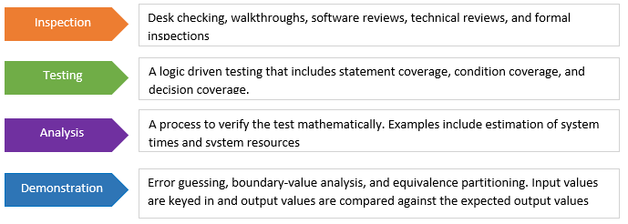
Test cases
Automated vs Manual
Examples:
Inspection, Analysis, Simulation, or Demonstration
Examples:
Notes:
https://static.complianceonline.com/images/articles/4_types_of_verification.PNG
https://base2s.com/4541-2/

Slide 9
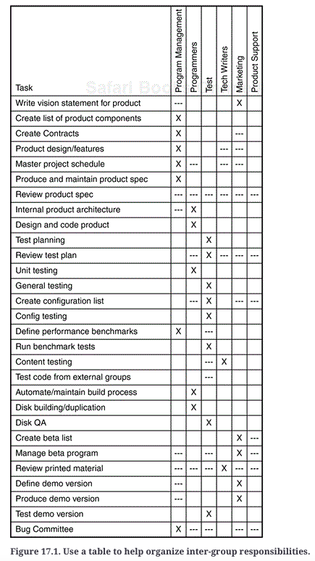
SW Testing (2nd Edition) Chap 17
Chapter 17. Planning Your Test Effort
The Goal of Test Planning
IEEE Standard 829–1998 for Software Test Documentation
Test Planning Topics
High-Level Expectations
People, Places, and Things
Definitions
Inter-Group Responsibilities
What Will and Won't Be Tested
Test Phases
Test Strategy
Resource Requirements
Tester Assignments
Test Schedule
Test Cases
Bug Reporting
Metrics and Statistics
Risks and Issues

Slide 10
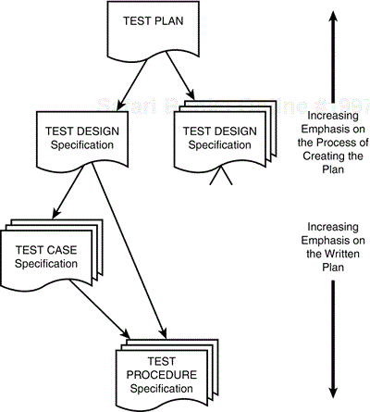
SW Testing (2nd Edition) Chap 18
Goal: Organization, Repeatability, Tracking, Proof
Design: Identifiers, Features/Requirements, Approach, ID,
Verification – Pass/Fail
Cases: Id, Item, Specification – I/O, Environment Needs, requirements, Dependencies
Procedure: ID, Purpose, Requirement,
Steps: Log, Setup, Start, Procedure, Measure, Shutdown, restart, Stop, Wrap-up, Contingencies
Detail vs Reality
Tracking: Spreadsheet, Database, Application

Slide 11
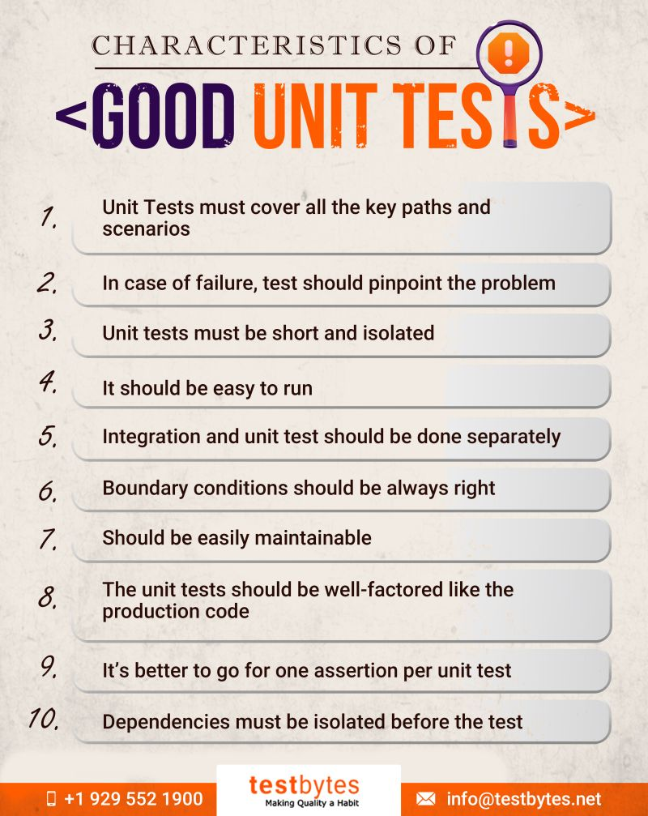

Slide 12
What questions do software engineers answer?
The five w’s and how
Who? Stakeholders Who is going to use the software?
Types: Elicitation, User, (user type), Customer, Investors, Suppliers, Personas,
What? Requirements What does the software do?
Format: [subject] shall [action][constraint]
Why? Story Why should the software work?
Format: As a <stakeholder>, I want <behavior> so that <business value>
Where? Architecture Where is the software going to run?
Tools: System, HW and SW architectures, Design Patterns
How? Design How does the software work?
Tools: UML, Workflow, Data Structures, Interfaces, Top-Down, Bottom-Up, Quality
When? Management When is the software dev, used, etc?
Tools: Schedule [Estimation (i.e. Planning Poker)], Resource Availability, Budget, CI/CD, Lifecycle, Maintenance, DevOps

Slide 13
What is the difference between a requirement and a story?
The five w’s and how
Who? Stakeholders Who is going to use the software?
Types: User, (user type), Customer, Investors, Suppliers, Personas,
What? Requirements What does the software do?
Format: [subject] shall [action][constraint]
Why? Story Why should the software work?
Format: As a <stakeholder>, I want <behavior | requirement> so that <business value>

Slide 14
When to use a Story vs a Requirement?
Who? Stakeholder: Elicitation, User, (user type), Customer, Investors, Suppliers, Personas
What? Requirement: [subject] shall [action][constraint]
Why? Story: Validation?
Where? Architecture : System, HW and SW architectures, Design Patterns: MVC & Structure
As a <stakeholder>,
I want <behavior | requirement>
so that <business value>
Story Points: <Complexity>
How? Design : UML, Workflow, Data Structures, Interfaces, Top-Down, Bottom-Up, Quality, Design Patterns: Create & Structure
Verification
Definition of Done
Test Driven Development
Availability of Updates
When? Management : Schedule [Estimation (i.e. Planning Poker)], Resource Availability, Budget, CI/CD, Lifecycle, Maintenance, DevOps
Requirements
Limited update
Cars, planes, space, HW
Stories
Consistent updates
Mobil, Web, PC

Slide 15
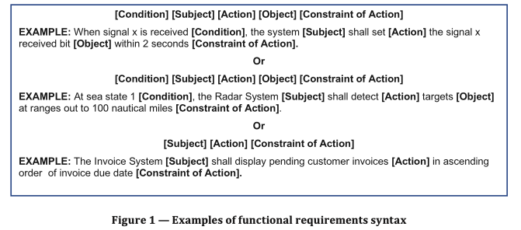
Activity: How to write requirements?
Requirements Topics to write verification tests:
Brush your teeth
Flossing your teeth
Making a peanut butter and jelly sandwich:
Driving kids to school:
Driving self to school:
Reading a book:
Winning at Tic-tac-toe:
Losing at Tic-tac-toe:
Setting up Christmas lights:
A requirement shall have the word ”shall” in it. (not must, will, should, could, would, or not)
It is specific, measurable, necessary, appropriate, unambiguous, complete, singular, feasible, verifiable, correct, conforming

Slide 16
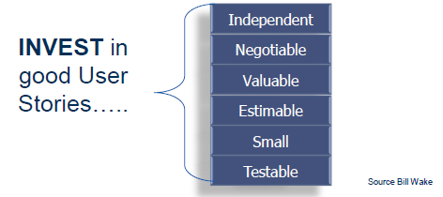
Activity: How to write a story?
Requirements Topics to write verification tests:
Brush your teeth
Flossing your teeth
Making a peanut butter and jelly sandwich:
Driving kids to school:
Driving self to school:
Reading a book:
Winning at Tic-tac-toe:
Losing at Tic-tac-toe:
Setting up Christmas lights:
STEP #1 Write User Stories
STEP #2 Add Acceptance Criteria
STEP #3 Identify constraints, risks, etc
As a <user>,
I want <behavior>
so that <business value>

Slide 17
Honey Do List
As a <user>, I want <behavior> so that <business value>
Exercise 1: Home Projects
Putting away a load of laundry
Building a shed
Vacuuming the floors
Packing lunch
Packing for an overnight campout
Mowing the lawn
Taking out the trash on trash day
Going on vacation/trip
Weeding the yard
Painting a Fence
Planting Flowers
Planting a Tree
As a member of the family, I want to put away a load of laundry so that clean clothes are available we have access to either the dryer, laundry basket, bed or coach where they are temporally stored.
As an armature fixer-upper, I want to build a shed to store the outdoor yard equipment (lawnmower, snow blower, etc) so that it doesn’t take up walking/traffic room and parking in the garage for the winter.
Exercise 1: Home Projects
Paying Bills
Change the car oil
Calling Mom
Calling Dad
Shopping for School Supplies
Organizing Family Vacation
Clean out Garage
Clean out closet
Build a deck
Renovate Kitchen
Replace Roof
Cook Dinner
Cook Breakfast
Cook Lunch
Take Dog to Vet
Go to Dentist
As the family budgeter/financial account, I want to pay the bills so that we maintain our financial goals and home utilities.
As a son/daughter, I want to call my mom or dad so that I stay connected with the family and maintain relationships.
As a family chief, I want to cook dinner, so that my family maintains a health lifestyle and each day we reconnect.

Slide 18
Activity: Write two unit test cases
Requirements Topics to write verification tests:
Brush your teeth: A user shall brush their teeth.
Flossing your teeth: A user shall brush their teeth
Making a peanut butter and jelly sandwich: A user shall produce a PBJ sandwich
Driving kids to school: A user shall deliver a child to school
Driving self to school: A user shall arrive at a school
Reading a book: A user shall read and finish a book
Winning at Tic-tac-toe: A user shall win a game of tic-tac-toe
Losing at Tic-tac-toe: A user shall lose a game of tic-tac-toe
Setting up Christmas lights: A user shall set up Christmas lights on one section of the house
Mathematics: A user shall add two 3-digit numbers together
Mathematics: A user shall subtract two 3-digit number together
Mathematics: A user shall multiply two 2-digit numbers together
Mathematics: A user shall divide a 2-digit number from a 3-digit number.
Chess: A user shall perform a Rook (castle) move
Elevator: A user shall go from the 1st floor to the 3rd floor
Asteroids Game: A user shall win a game
Scheduler: A user shall schedule a reoccurring event in Outlook
Mars Rover: A user shall move the Mars Rover in a square
Binge-watching app: A user shall binge-watch three episodes of a show
Radio Station: A user shall program the car radio button
Restaurant Reservation: A user shall make a reservation for dinner
Rent a Scooter: A user shall rent a vehicle
Flights Reservation: A user shall create a plan reservation
Personality Tests: A user shall determine a personality type by running a personality test
Hotel Reservations: A user shall make a hotel reservation
Class organizer: A user shall organize five classes in a semester
Title/ID:
Purpose:
Requirements:
Pre-conditions:
Steps:
Action/Results
Action/Verify
Tear-down
15 minutes: Write cases
We will walk through a couple of them.

