Slide 1
CSE 270: Architecture and Usability
W. Clements

Slide 2
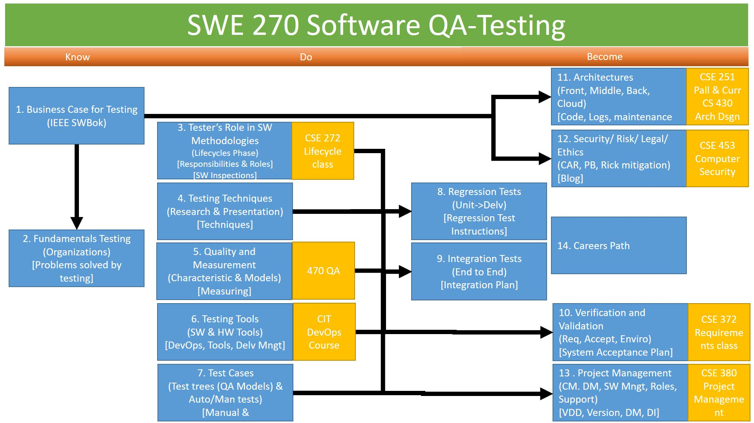
You are here

Slide 3
Continuous Improvement
Quality Assurances
(Built the Product Right)
Process ->
Q-Contrl/HMI
Value/Cost
Audit/Review/Std
Integrity/Sec
Testing
<- Product
Software Development
QA vs
Test vs
DevOp vs
Cont. Improvement
Support Roles (CM, DM, Code Mngr, etc)
Program/Project Manager
Development
QA-Tester
Acceptance Tester
System Tester
Integration Tester
Regression Tester
Unit Tester
(Sometime Developer)
Concept of Operations
Acceptance Test
Validation
Requirements
System Test
Verification
Architecture
Integration Test
Design
Regression Test
Implementation
Implementation
Unit Test
Verification: Have we built the software, right? (i.e., does it implement the requirements).
Validation: Have we built the right software? (i.e., do the deliverables satisfy the customer)
(Built the Right Product)
Dev Ops
Environment
Software Tools
Hardware
Network
Infrastructure
Test Zone (sandboxes)
Operation

Slide 4
Agenda
Reading
Usability Plan
Select a Feature
Identify the Instructions
Test the Plan
Logging
Architecture

Slide 5
Reading
Usability Testing
Please open Ron Patton's Software Testing, Second Edition:
Software Testing, Second Edition by Ron Patton, Published by Sams, 2005
Chapter 11: Usability Testing

Slide 6
Usability Plan
PBJ Sandwich Test
Select a Feature
Select a task, feature, activity, or process which has a moderate degree of complexity. You are looking for an action that has about a dozen steps and more than one screen.
Identify the Instructions
determine the set of instructions that the user will need to in order to accomplish the task
The goal of this usability plan is to find defects in the feature of choice.
Test the Plan
Using a friend, family member, or roommate, test your usability plan. Give your test subject the instructions as you have previously written them down. Observe them.
https://byui-cse.github.io/cse270-course/Teach/CSE270M10TeachArchitecture.html

Slide 7
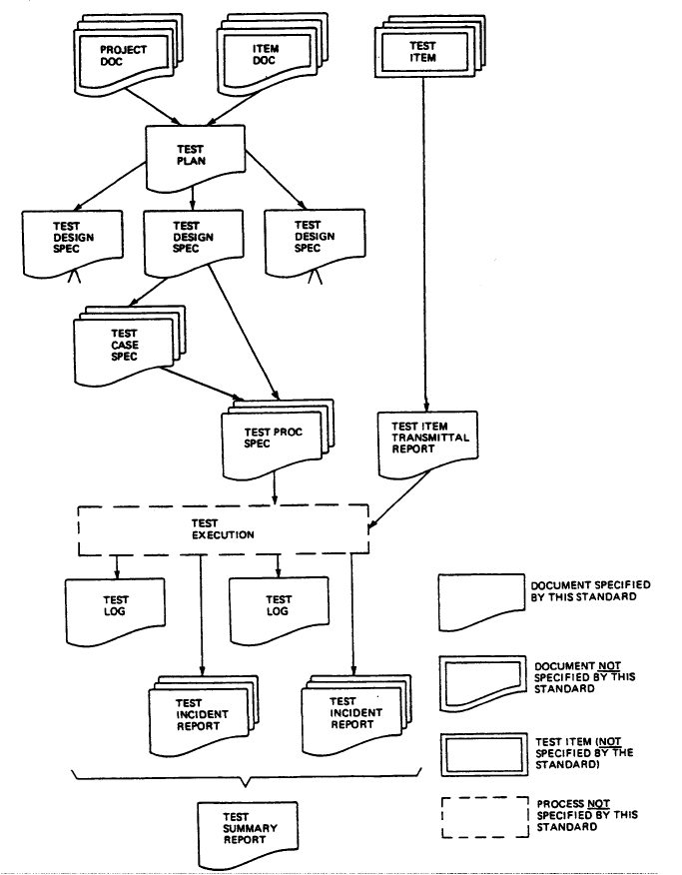
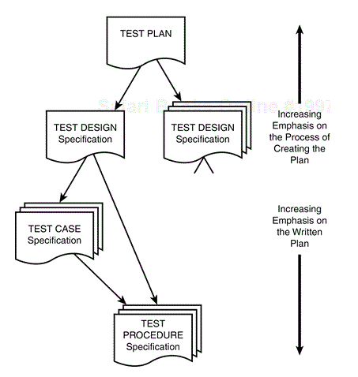
Writing a Test Plan
Throughout the semester you have been working on different aspect of the Test plan, this assignment you will be putting it all together.
Notes:
Software Testing, Second Edition by Ron Patton Published by Sams, 2005

Slide 8
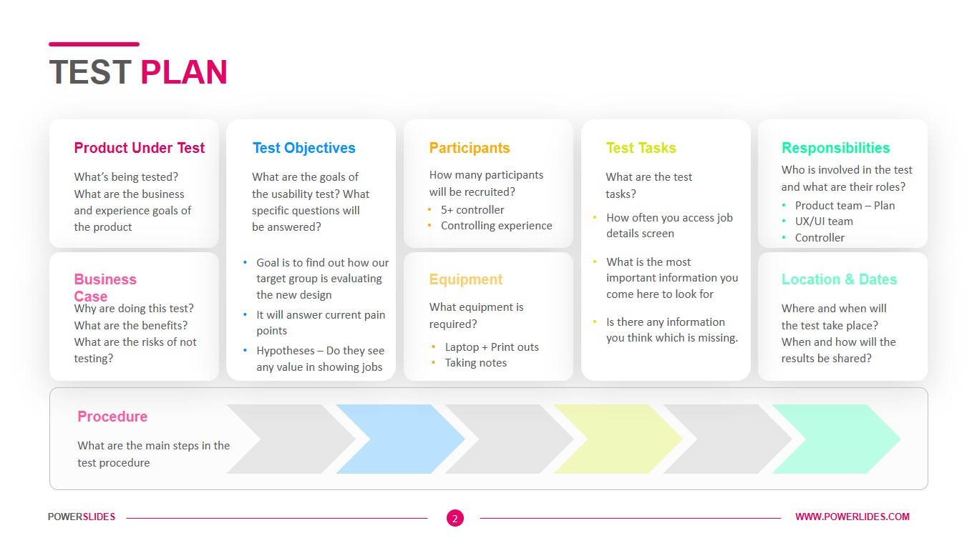
Fundamentals of Software Testing by Bernard Homès , and Bernard Homes, Publisher John Wiley & Sons, Incorporated Date 2012-01-17
Examples of a Test Plan

Slide 9
Usability Study
Conduct the Study
Each member of the team will interview three people. Detailed data from these interviews will be collected and compiled into a single report.
Will the average user be able to accomplish the task that the feature was designed to facilitate?
Most teams will have one page per interview with an additional page to summarize their findings.
Survey can be: Questionnaire, Observation, Interview, Remote, email
You may do it about the Plan, Plan’s feature,or another feature of your application.
https://byui-cse.github.io/cse270-course/Prove/CSE270M10ProveArchitecture.html

Slide 10
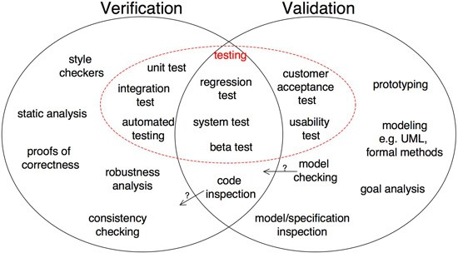
Static vs Dynamic Testing

Slide 11
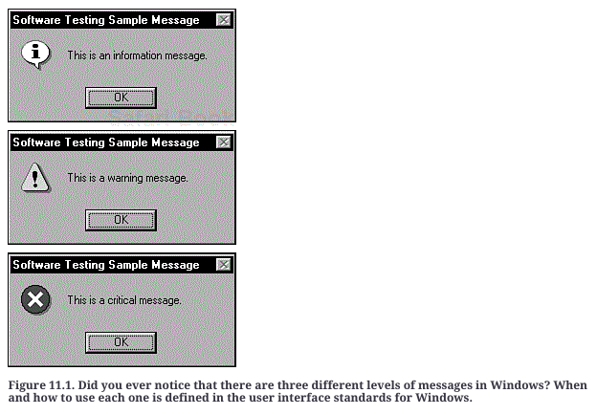
Software Testing, Second Edition Chapter 11. Usability Testing
User Interface Testing
What Makes a Good UI? Intuitive, Consistent, Flexible, Comfortable, Correct, Useful
Follows Standards and Guidelines
International - Language
Testing for the Disabled: Accessibility Testing
Visual impairments. Hearing impairments. Motion impairments. Cognitive and language
Legal Requirements
Accessibility Features in Software
www.microsoft.com/enable
www.apple.com/accessibility
www-3.ibm.com/able
www.linux.org/docs/ldp/howto/Accessibility-HOWTO

Slide 12
Testing Layers
Design Level
Function
Class
Patterns
Library
Interface
Sub-component
Entity
Multi-Entity
Sub-System
N-Tier
System
Architecture
Framework
Platform
Design Level
Data Level – primary, mono (arrays), struct, data structures, class, patterns
Architecture Level – i.e. MVC
Workflow Level – tasks and business logic
Using log files when useability is not available.

Slide 13

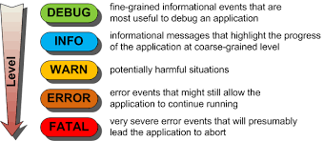
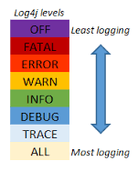
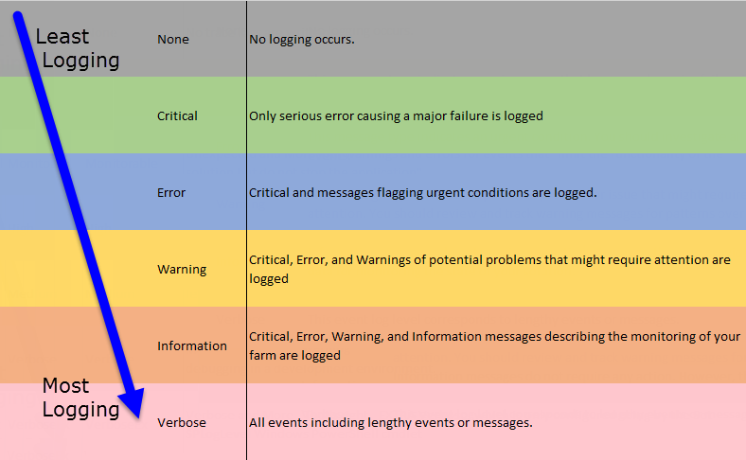
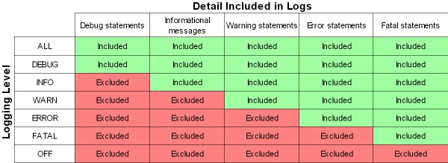
Levels of Logging

Slide 14
Log File Format
What to include:
Time stamp- date, time (precision)
Level – Fatal, error, warn, info, debug, trace, etc
Id type – unique signature, i.e. 404
Location – host, component, library, function,
Message
Activity, State, Communication, etc
Length – single or multiple line (start/stop)
Risk to log file:
Backup, version control, access, one or multiple, roll-over
What not to include in the log file:
PPI, Security Info (Pwds, data, logic/process flow)
#Version: 1.0
#Date: 12-Jan-1996 00:00:00
#Fields: time cs-method cs-uri
00:34:23 GET /foo/bar.html
12:21:16 GET /foo/bar.html
12:45:52 GET /foo/bar.html
12:57:34 GET /foo/bar.html
127.0.0.1 user-identifier frank [10/Oct/2000:13:55:36 -0700] "GET /apache_pb.gif HTTP/1.0" 200 2326
Notes:
https://en.wikipedia.org/wiki/Category:Log_file_formats

Slide 15

Types of Architectures
Examples
Design Patterns - Architecture
Client-Server
2,3,n-tier
Cloud
Component
Data
Event-driven
Layered
Peer-2-peer
Rule-based
Service-oriented (SOA)
REST
Web
Page
Plugin – different types (browser, page, backend)
Mobile Application
Architecture: Layered
Pipes and Filters
Model-View-Controller
Presentation-Abstraction-Control
Microkernel
Many more…
???

Slide 16
Model-View-Control
Most common

Slide 17
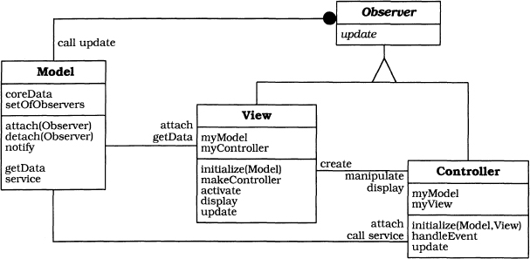
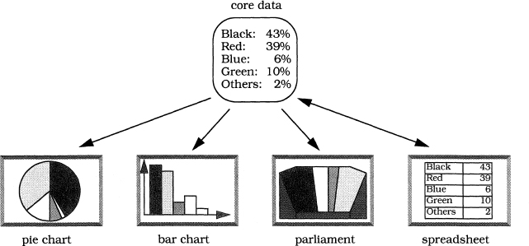
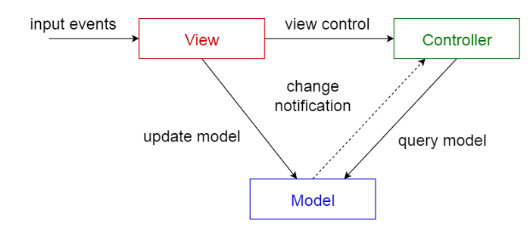
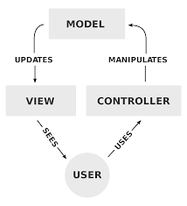
Model-View-Controller
???

Slide 18
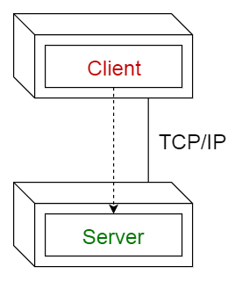
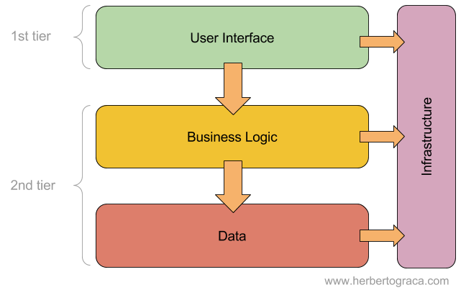
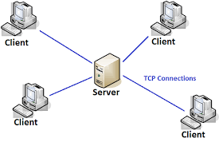
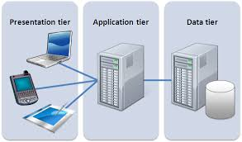
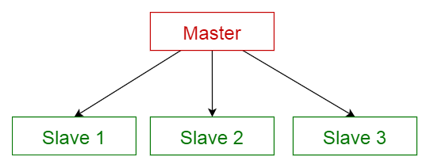
Types of Architectures
Client -Server
Tier
???
Notes:
https://towardsdatascience.com/10-common-software-architectural-patterns-in-a-nutshell-a0b47a1e9013

Slide 19
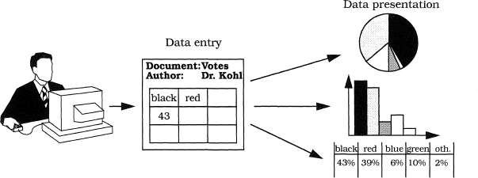
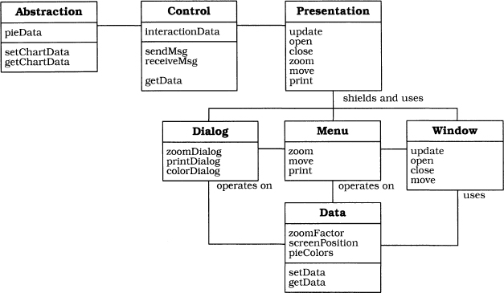
Presentation-Abstraction-Control (Alt)
???

Slide 20
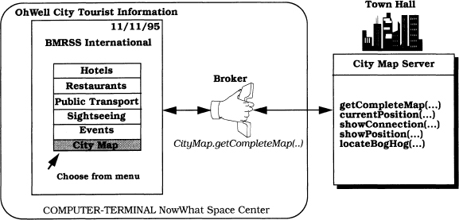
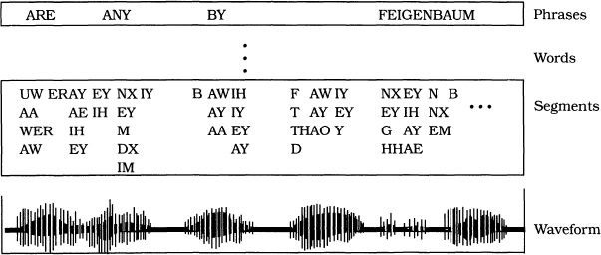
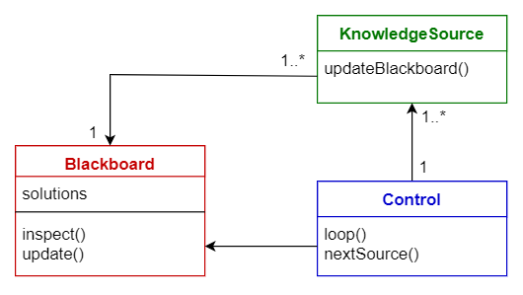
Blackboard
Broker
???
Notes:
https://towardsdatascience.com/10-common-software-architectural-patterns-in-a-nutshell-a0b47a1e9013

Slide 21
Architecture - Interfaces

Slide 22
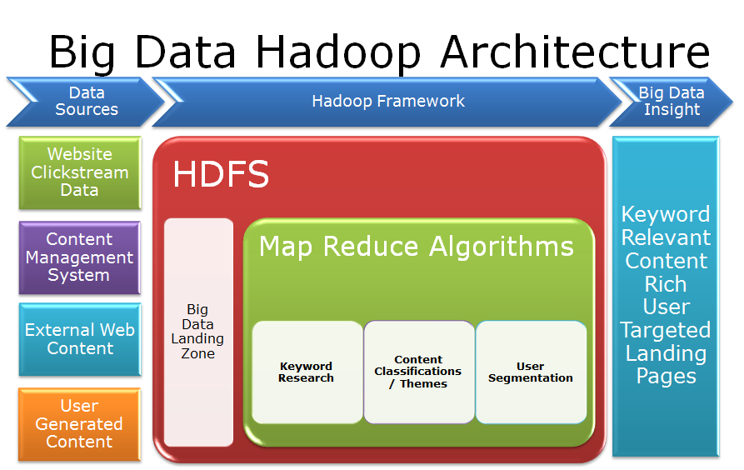
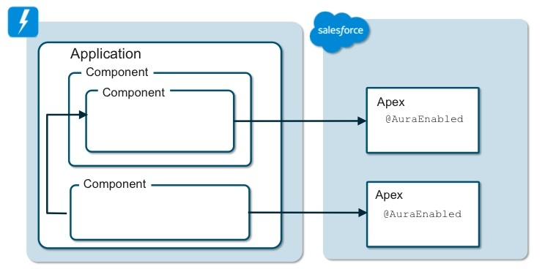
Types of Architectures (Interfaces)
???
Component
Data

Slide 23
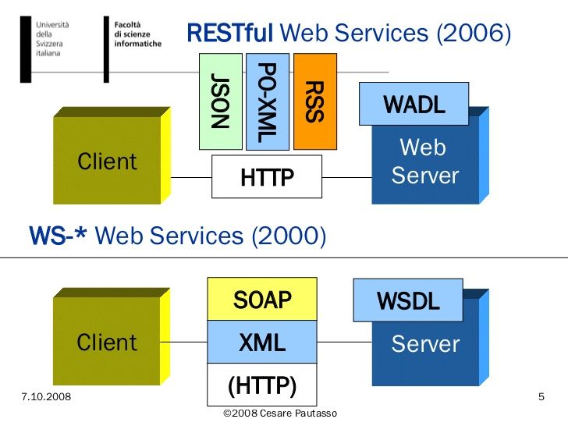
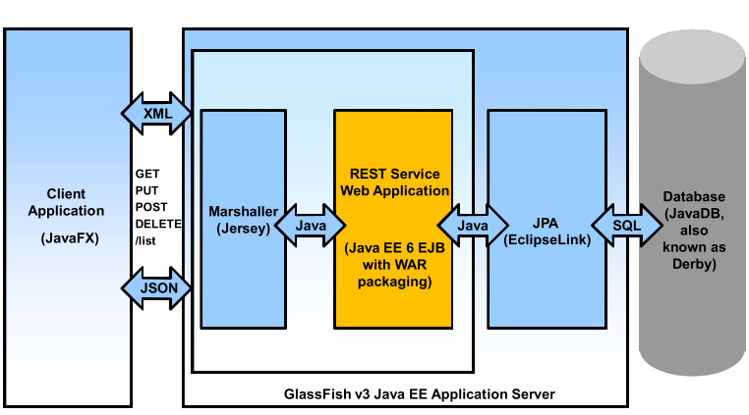
Types of Architectures
???
Marshaling/Un-Marshaling
REST

Slide 24
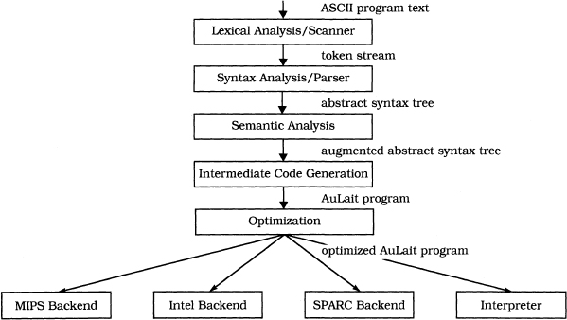
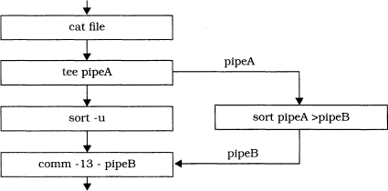
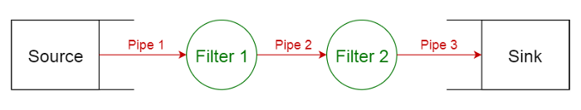
Pipes and Filters
???
Notes:
https://towardsdatascience.com/10-common-software-architectural-patterns-in-a-nutshell-a0b47a1e9013

Slide 25
Event driven architecture

Slide 26
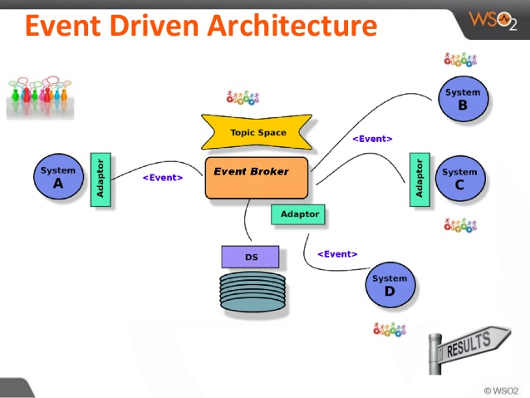
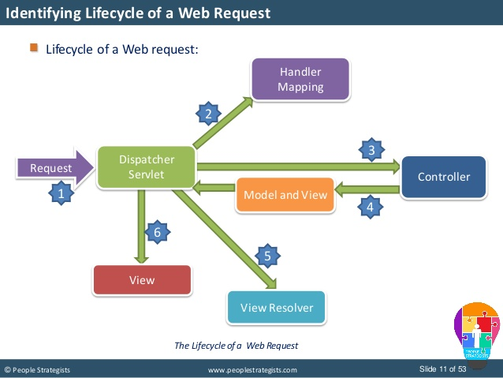
Types of Architectures (Event)
???
Event-driven
WEB

Slide 27
Layered Architecture

Slide 28
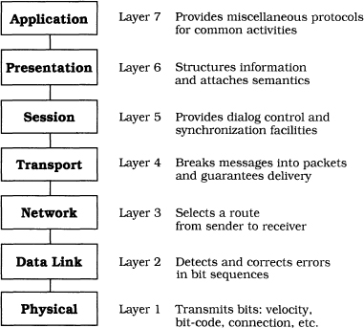
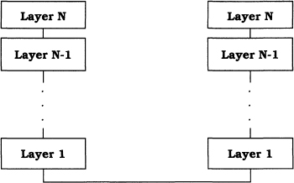
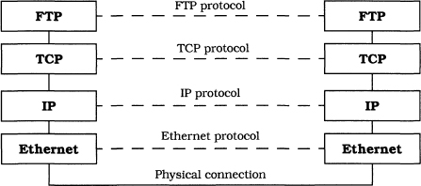
Architecture: Layered
???

Slide 29
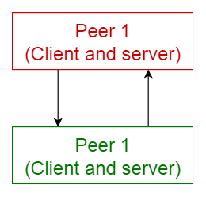
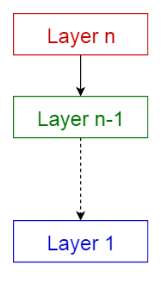
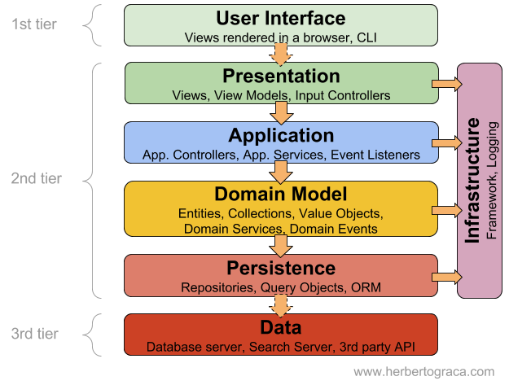
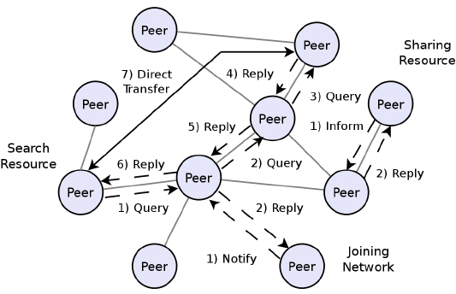
Types of Architectures (Networking)
LAYERED
Peer-To-Peer
???

Slide 30
Others

Slide 31
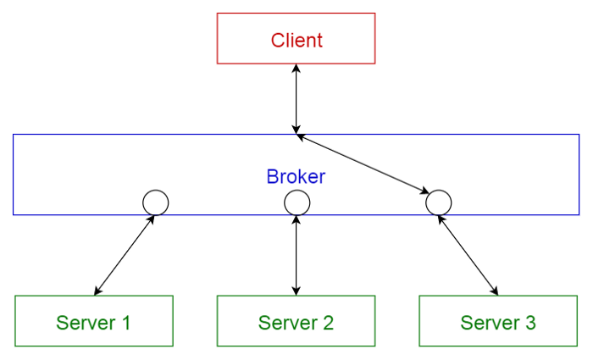
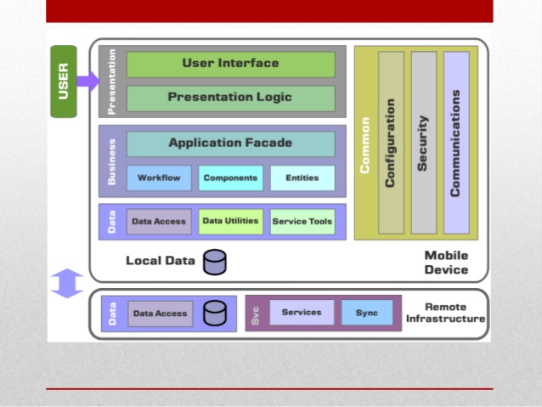
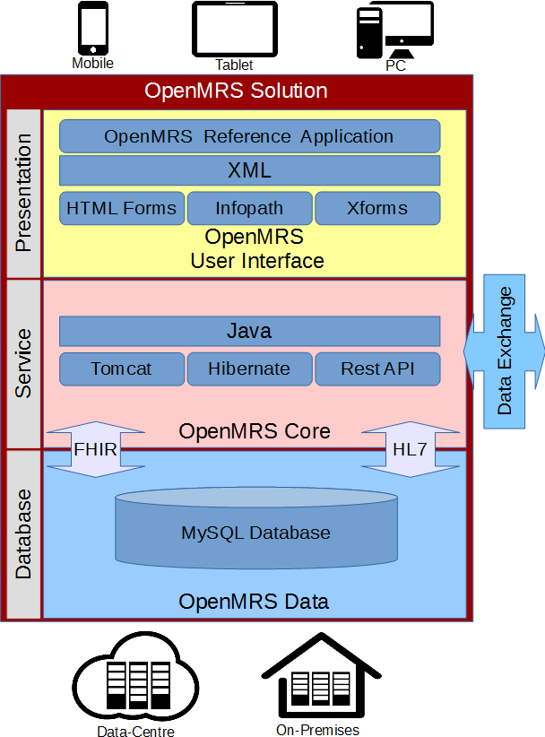
Types of Architectures
CORBA, JMS
Mobile
Service
???

Slide 32
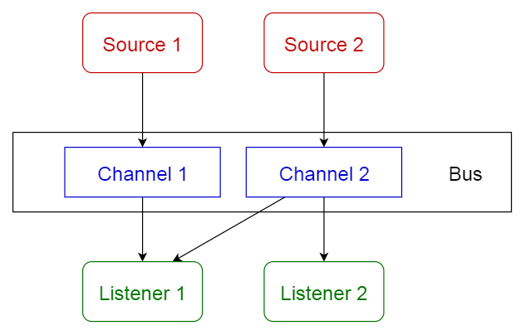
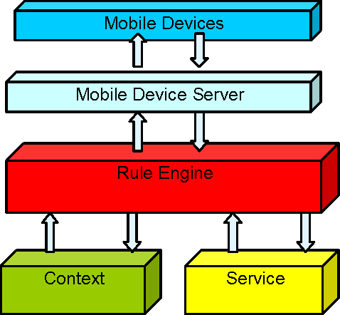
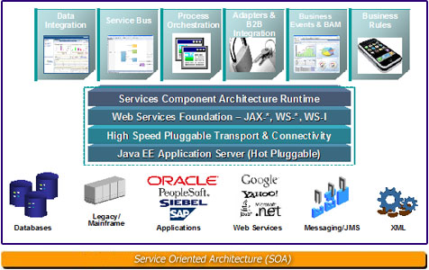
Types of Architectures (Enterprise)
???
Rule-based / Work FLOW
Service Oriented Architecture
(Bus-Archecture)
Pub/Sub; Queues/Topics
Microservices

Slide 33
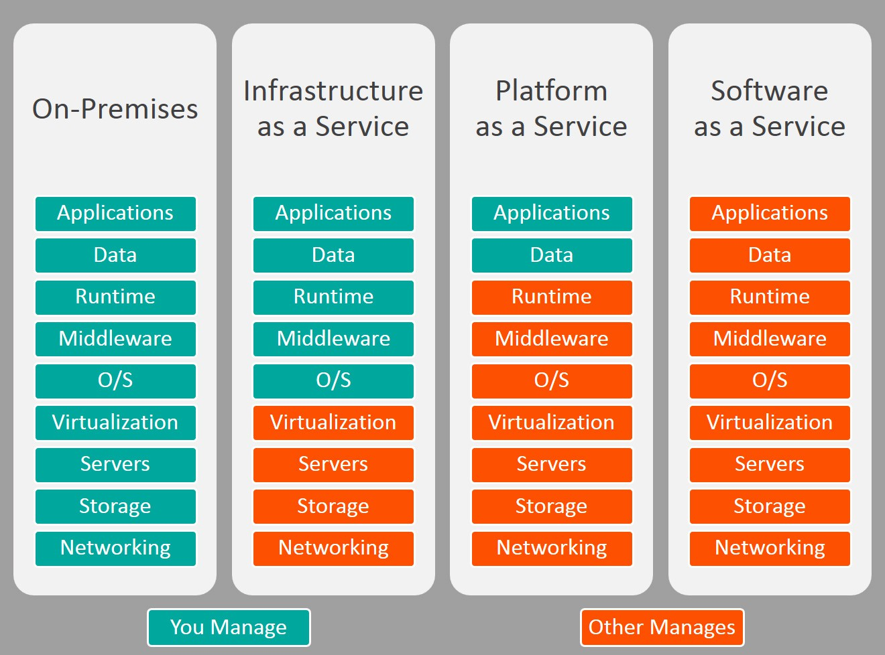
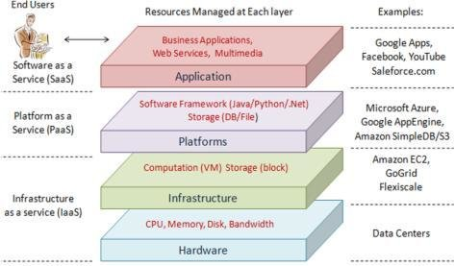
Cloud
???
SaaS, PaaS, IaaS
Load balancing
Hardware expansion
On demand, scalable
Notes:
https://www.bmc.com/blogs/saas-vs-paas-vs-iaas-whats-the-difference-and-how-to-choose/

Slide 34
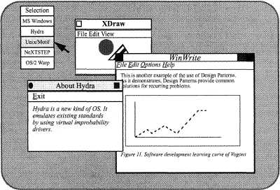
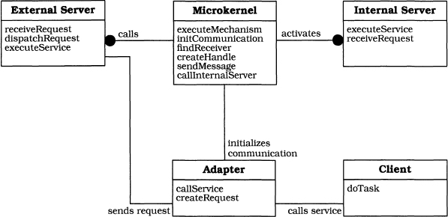
Microkernel
???

Slide 35


Slide 36
Architecture Application
e-commerce
Automotive Engineering – 2 T data per car
Train
Planes
Luggage's Delivery
Supply vehicles.

