Slide 1
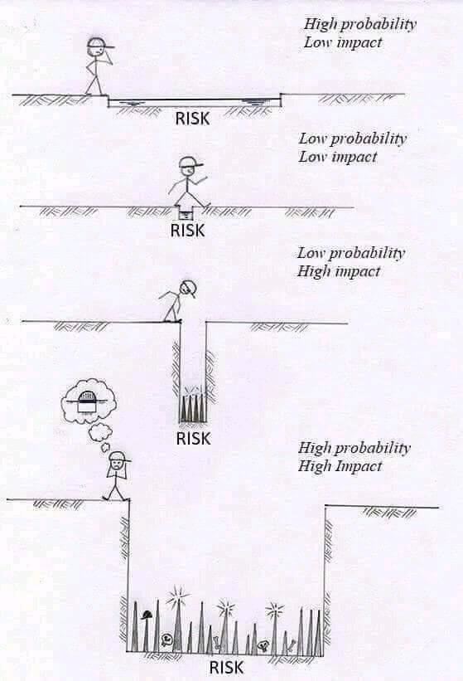
CSE 270
Testing Issues
W. Clements

Slide 2
Why do we do testing?

Slide 3
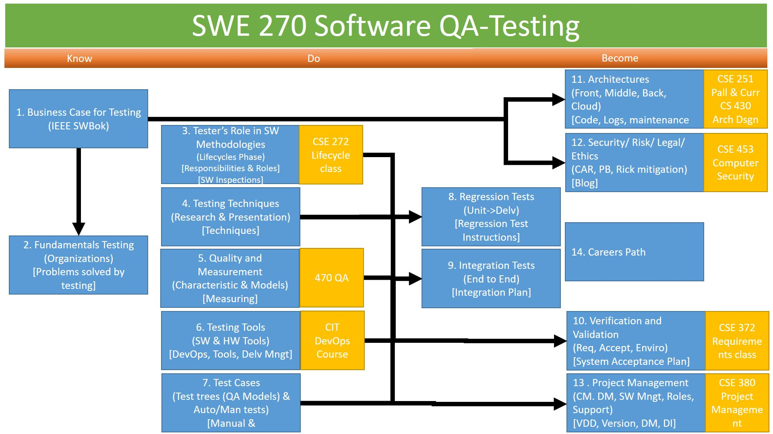
Overview
Preview week review
Reading
Assignments
W12 Report: Risk Identification
W12 Report: Risk Mitigation

Slide 4
W12 Report: Risk Identification
Scenario
The H.E.L.P. Inc. mobile application is a tool to facilitate medical workers record and share patient health care data. After much work, the development team believes they have sorted out all the technical issues. It is your team's job to identify the non-technical risks to the project.
Risk Identification
Risks to a project can come from a variety of sources:
Medical: Insurance, services, and payments of a health care giver
Governmental: Local, city, state, and federal government policies and laws
Political: Interpersonal issues, pride, dealing with hierarchy and authority of power
Academic: Schools, education and learning, and standard of living
Corporate: Trade secrets, rivalries, etc.
Military: Protection of civilians, advancing national interests, military secrets
Religious: Matters of faith and morality
Others: Is there another source not listed here?
These risks can manifest themselves in a variety of ways or types:
Security: Providing confidentiality, integrity, and availability assurances.
Ethical: Aligned with moral standards.
Financial: Could the project fail in the marketplace?
Legal: Could a law be broken or could the authors be sued?
Other: What other types of risk are there?

Slide 5
Class Assignment
Risk Report
With your partner(s), come up with a complete and comprehensible list of risks to our H.E.L.P. Inc. mobile application. Each risk should contain the following information:
Name: Give each risk a name.
Source: Medical, governmental, political, academic, corporate, military, or religious.
Type: Security, ethical, financial, or legal.
Severity: Give a two or three sentence description of how severe the risk is.
Description: Give a two or three sentence description of the risk.
Citation: Any source that informed you of this risk.
When making severity determinations, it is helpful to think of frequency and impact. If it occurs often and is severe, it is considered high risk. If it does occur often or is not highly severe, then it is medium risk. If it doesn't occur often and is not severe, then it is low risk.
Submission
Your team will submit a single document for your risks. The document needs to be in the PDF format. The number of risks will vary by team. For example, one team may have one broadly-defined risk whereas another may have six risks that describe the same issue. Nevertheless, a good rule-of-thumb is to have a few dozen risks.

Slide 6
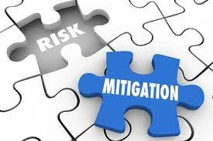
W12 Report: Risk Mitigation
Types of Risk Mitigation
There are several ways to mitigate a risk: prevention, transference, acceptance, or avoidance.
Prevention
Prevention mitigation is the process of putting up a defense to prevent it from happening. It could be as simple as fixing a bug. It can be as complex as adding technology to make the risk less likely to manifest itself. For example, to mitigate the risk of your car being stolen, you could lock at the doors or store it in the locked garage.
Transference
Transference is the process of having another party assume the risk. A typical example is an insurance policy. If your car is insured and it is stolen, the insurance company will replace the car. This is sometimes called "risk sharing."
Acceptance
Acceptance is recognizing a risk and deciding to not do anything about it. For example, you accept that driving on the highway may cause death or injury.
Avoidance
Avoidance is the process of changing the activity, process, or policy that introduces the risk. This can be as simple as cutting a feature that is known to be risky. It can be as complex as changing a technology from one that has a risk to one that does not. For example, you can avoid driving at night if you have night vision problems or avoid driving during bad weather if your tires are not new.
Risk Mitigation Plan
Your assignment is to create a plan for how to mitigate every risk from our risk identification assignment previously submitted. Copy your previous submission (making any necessary adjustments from your instructor's feedback) and add a new entry in each section: Mitigation. Each mitigation item should list the type (prevention, transference, acceptance, or avoidance) and details of how the mitigation will occur.
Note that each risk previously described should have a two to five sentence mitigation plan.

Slide 7
Development Telephone Game Video

Slide 8
Powers That Be… Friend or Foe
You & Your Job
Nature
Government
Politics
Academia
Corporations
Military
Religion
Medical

Slide 9
Powers That Be… Friend or Foe
You & Your Job
Nature
Government
Politics
Academia
Corporations
Military
Religion
Medical
People/
Culture
?

Slide 10
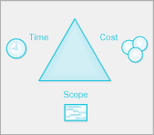
Ethics
SWBOK: SW Quality:
A healthy software engineering culture includes many characteristics, including the understanding that tradeoffs among cost, schedule, and quality are a basic tenant of the engineering of any product.
A strong software engineering ethic assumes that engineers accurately report information, conditions, and outcomes related to quality.
Ethics also play a significant role in software quality, the culture, and the attitudes of software engineers.
The IEEE Computer Society and the ACM have developed a code of ethics and professional practice (see Codes of Ethics and Professional Conduct in the Software Engineering Professional Practice KA).
Ethics
Values
Practice
Principles
Research
Ethics
Culture
Attitude
QA
Quality

Slide 11

ACM Code of Ethics and Professional Conduct
1. GENERAL ETHICAL PRINCIPLES.
1.1 Contribute to society and to human well-being, acknowledging that all people are stakeholders in computing.
1.2 Avoid harm.
1.3 Be honest and trustworthy.
1.4 Be fair and take action not to discriminate.
1.5 Respect the work required to produce new ideas, inventions, creative works, and computing artifacts.
1.6 Respect privacy.
1.7 Honor confidentiality.
2. PROFESSIONAL RESPONSIBILITIES.
2.1 Strive to achieve high quality in both the processes and products of professional work.
2.2 Maintain high standards of professional competence, conduct, and ethical practice.
2.3 Know and respect existing rules pertaining to professional work.
2.4 Accept and provide appropriate professional review.
2.5 Give comprehensive and thorough evaluations of computer systems and their impacts, including analysis of possible risks.
2.6 Perform work only in areas of competence.
2.7 Foster public awareness and understanding of computing, related technologies, and their consequences.
2.8 Access computing and communication resources only when authorized or when compelled by the public good.
2.9 Design and implement systems that are robustly and usably secure.

Slide 12
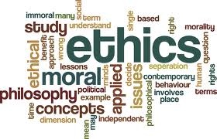
ACM Code of Ethics and Professional Conduct
3. PROFESSIONAL LEADERSHIP PRINCIPLES.
3.1 Ensure that the public good is the central concern during all professional computing work.
3.2 Articulate, encourage acceptance of, and evaluate fulfillment of social responsibilities by members of the organization or group.
3.3 Manage personnel and resources to enhance the quality of working life.
3.4 Articulate, apply, and support policies and processes that reflect the principles of the Code.
3.5 Create opportunities for members of the organization or group to grow as professionals.
3.6 Use care when modifying or retiring systems.
3.7 Recognize and take special care of systems that become integrated into the infrastructure of society.
4. COMPLIANCE WITH THE CODE.
4.1 Uphold, promote, and respect the principles of the Code.
4.2 Treat violations of the Code as inconsistent with membership in the ACM.

Slide 13

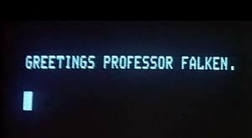
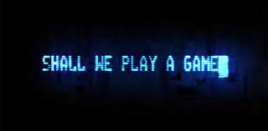
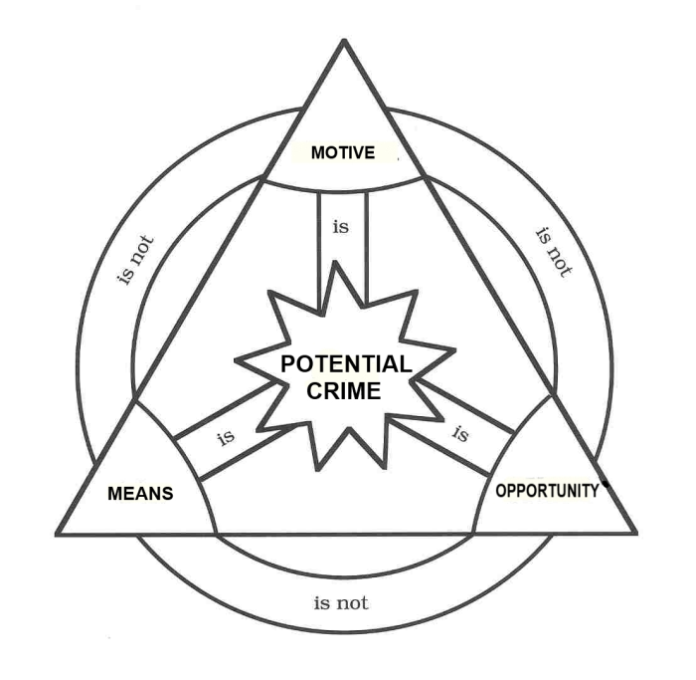

Chapter 13. Testing for Software Security
WarGames—the Movie
Understanding the Motivation
A secure product
A security vulnerability
Hacker
Motivations: Challenge/Prestige, Curiosity, Use/Leverage, Vandalize, any others?
Threat Modeling
Is Software Security a Feature? Is Security Vulnerability a Bug?
Understanding the Buffer Overrun
Using Safe String Functions
Computer Forensics
Mom – motive, opportunity, means

Slide 14
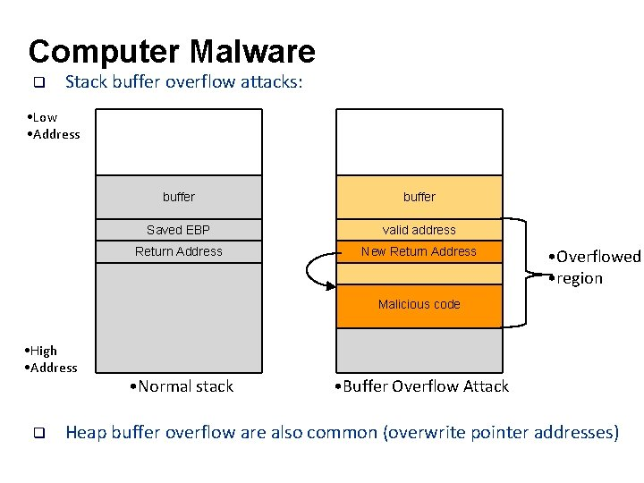
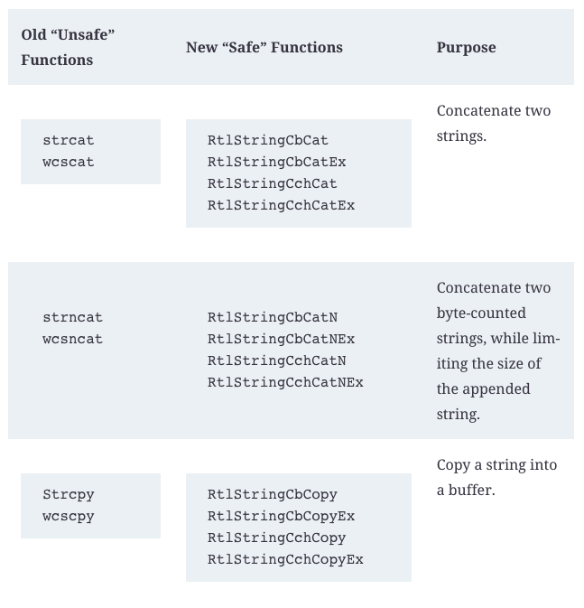
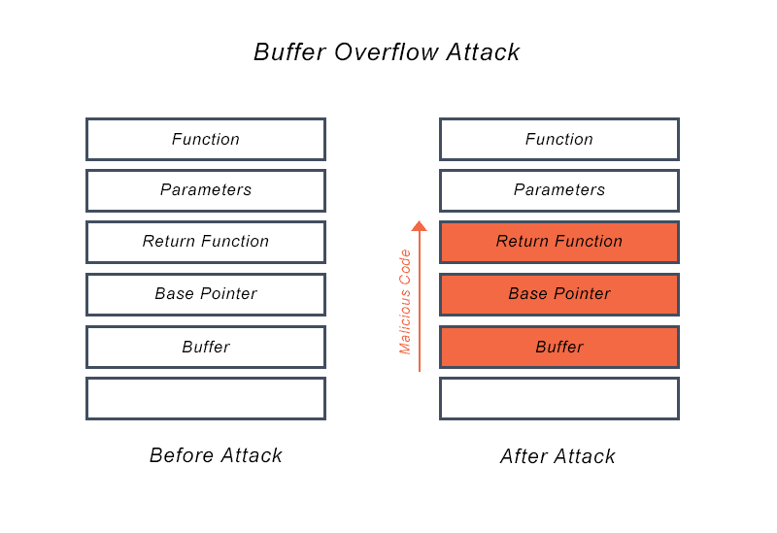
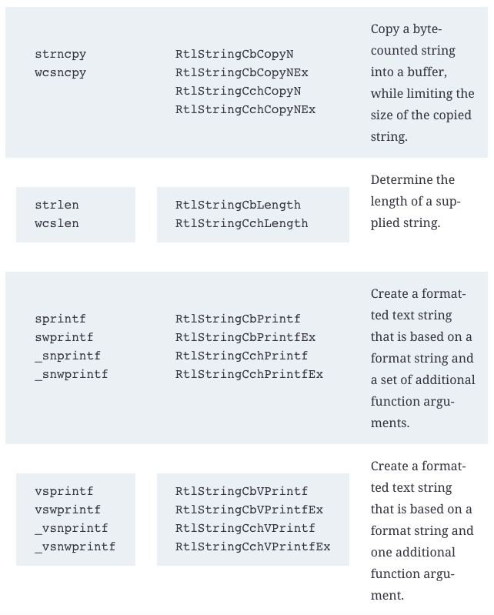
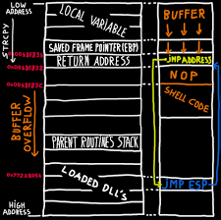
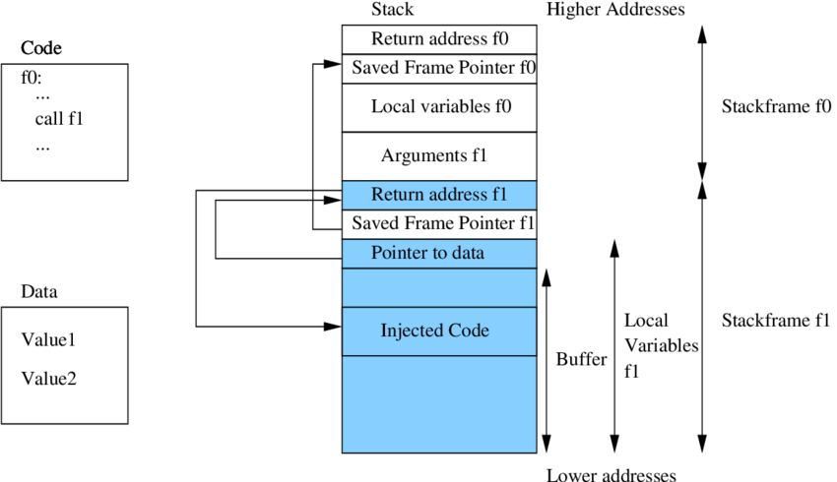
Buffer overflow 101
Not Safe Strings - #1 cause of overflow

Slide 15
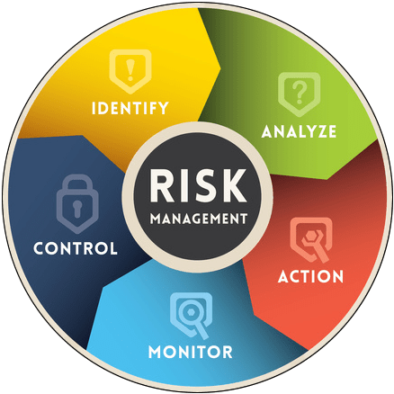
Chapter 13. Testing for Software Security
Assemble the threat modeling team.
Identify the Assets.
Create an Architecture Overview
Decompose the Application
Identify the Threats.
Document the Threats.
Rank the threats.
Damage Potential, Reproducibility (Ease), Exploitability(difficult), Affected Users (Asset Value), Discoverability(Likely)

Slide 16
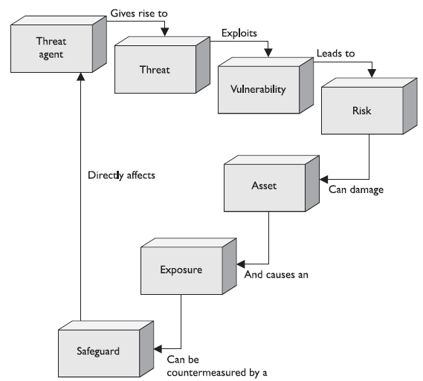
A Few Commonly Used Risk Management Terms
Risk - Project risk is an uncertain event or condition that, if it occurs, has a positive or negative effect on one or more project objectives such as scope, schedule, cost, and quality.
Positive Risk = opportunity
Negative Risk = threat
Issue = matter in dispute
Known Risk = identified and analyzed
Unknown Risk = KwK, KwNK, NKwK, NKwNK
Risk Tolerance = sensitive: high, low; limits
Risk Threshold = Acceptable limits
Residual Risk = expected after response plan
Secondary Risk = direct outcome of a plan
Risk Trigger = cause
Risk Owner = team to address issues
Risk Action Owner= team manager

Slide 17
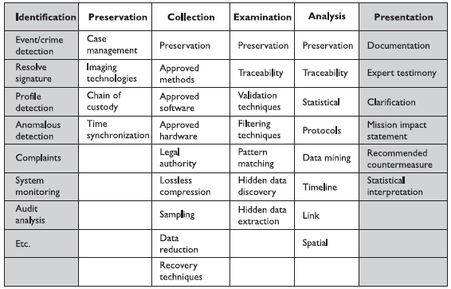
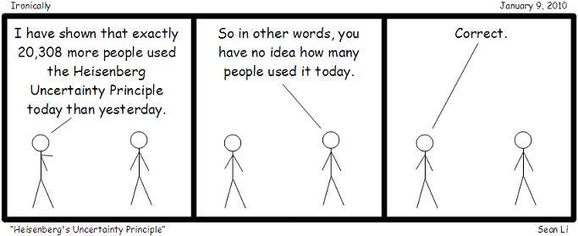
Computer Forensics
Identification,
Preservation,
Collection,
Examination,
Analysis,
Presentation,
Decision
History
Buffer/Cache
Latten Information
When dealing with digital evidence, all of the general forensic and procedural principles must be applied
Upon seizing of digital evidence, actions taken should not change that evidence
When it is necessary for a person to access original digital evidence, that person should be trained for the purpose
All activities relating to the seizure, access, storage, or transfer of digital evidence must be fully documented, preserved, and available for review
An individual is responsible for all actions taken with respect to digital evidence while the digital evidence is in their possession
Any agency that is responsible for seizing, accessing, storing, transferring digital evidence is responsible for compliance with those principles

Slide 18
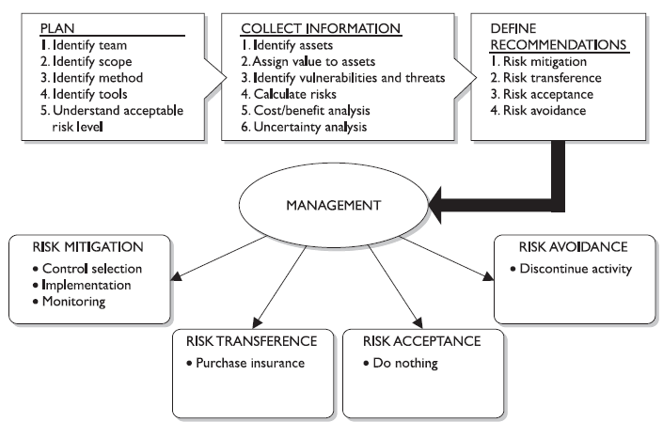
A Short Guide to Project Risk Management Plan
Different Mitigation
Prevention: Countermeasures
Transference: Insurance
Acceptance: Do Nothing
Avoidance/ Reject: Stop Activity
Steps in a risk management plan are as follows:
Plan Risk Management
Identify Risks
Analyze Risks
Planning the Responses
Monitor and Control the Risks
If the opposite of Risks is Opportunities, what are the opposite of risk mitigations?
Prevention
------------

Slide 19
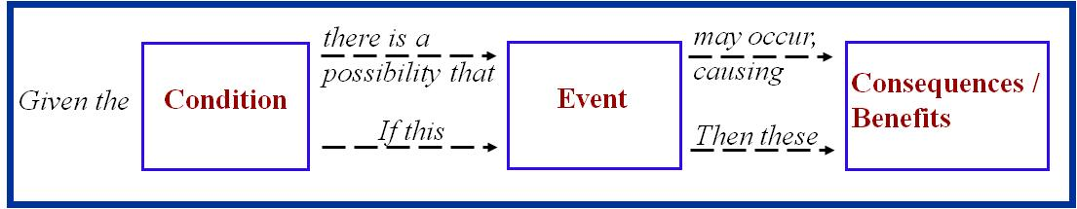
Risk Phrasing
Something is specifically actionable if the following are true:
An activity that has an end result (i.e. data) that can be clearly shown to have contributed to or directly lessened the probability of occurrence and/or severity (impact) of the risk
An activity that can be scheduled and tracked to completion in the IMS
An activity whose progress can be measured (especially important for lengthy tasks)
An activity that has clearly defined timeframe - start and finish dates
Good risk statements lead to specific and effective risk mitigations!
Because we have asked and answered “ is this something specifically actionable”

Slide 20
But we don’t have any risks!
Note: See the Taxonomy-Based Risk Identification, June 1993, SEI (CMU/SEI-93-TR-6)

Slide 21
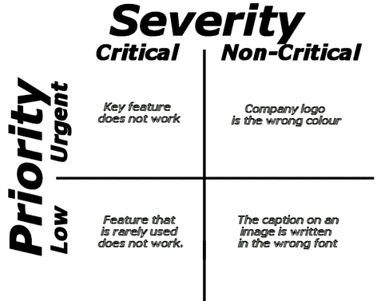
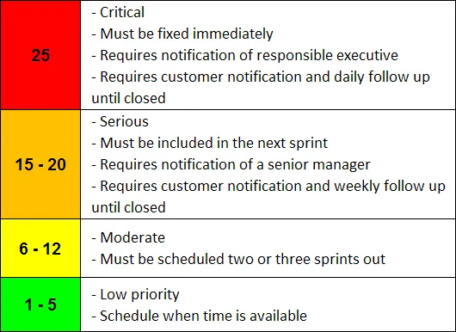
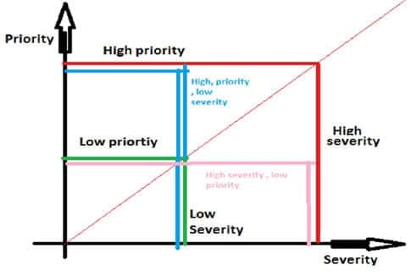
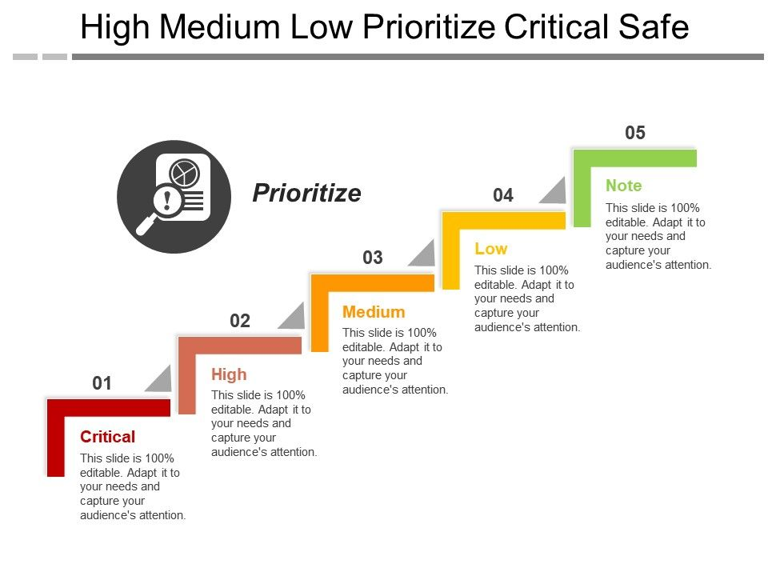

Slide 22
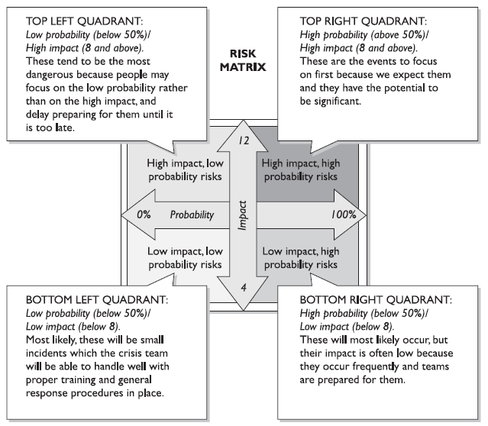
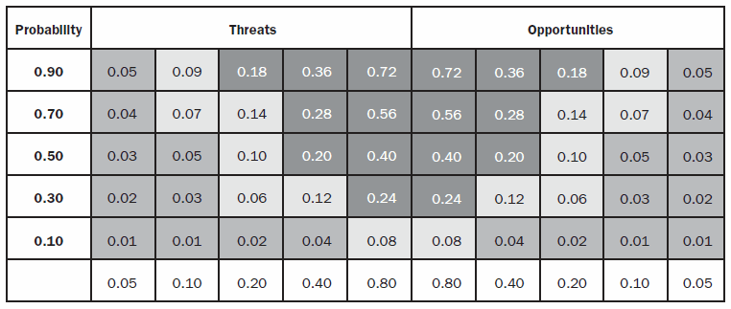
Risk Quadrants
Probability of Occurrence
Consequences of Occurrence

Slide 23
What is Risk Management?
Systematic proactive approach towards all possible risks, and taking measures to manage them
What may go wrong? And
If something wrong happens, how to prevent it?
Risk Management is ignored because of two primary reasons:
Organizations consider it as an additional cost to them, and
The Project Manager and his team find it a time-consuming task.
Benefits of Risk Management
Preventable loss of resources, time, money, quality and success
Problems with Risk Management
Learning the hard way
Monitor and Control Risks
Summary
RISKS
Acquisition
Requirements
Design
Product Development
Process Development
Verification and Validation
Operations
Process
Examples: Snake in the power panel
Cross Training
GPS – heart attacks
Program
Failure
Adapted from : James Reason, Managing the Risks of Organizational Accidents, 1997, p. 12

Slide 24
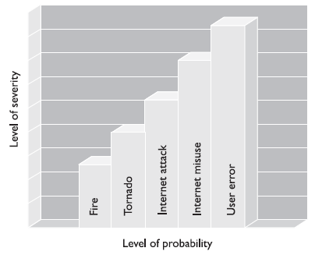
Risk Assessment
Process
Identify Vulnerabilities
Identify Threats
Likelihood Determination
Determination of Impact
Determine of Risk
Reporting Findings
Countermeasure Selection
Information Valuation
Plans
Business Continuity Plan
Disaster Recovery Plan
Continuity Of Operations Plan (COOP)
Threat
Vulnerabilities
Asset
Risk
Attack
Attack: A ‘threat’ exploiting a ‘vulnerability’ to effect an ‘asset’

Slide 25
W12 Report: Risk Identification
Scenario
The H.E.L.P. Inc. mobile application is a tool to facilitate medical workers record and share patient health care data. After much work, the development team believes they have sorted out all the technical issues. It is your team's job to identify the non-technical risks to the project.
Risk Identification
Risks to a project can come from a variety of sources:
Medical: Insurance, services, and payments of a health care giver
Governmental: Local, city, state, and federal government policies and laws
Political: Interpersonal issues, pride, dealing with hierarchy and authority of power
Academic: Schools, education and learning, and standard of living
Corporate: Trade secrets, rivalries, etc.
Military: Protection of civilians, advancing national interests, military secrets
Religious: Matters of faith and morality
Others: Is there another source not listed here?
These risks can manifest themselves in a variety of ways or types:
Security: Providing confidentiality, integrity, and availability assurances.
Ethical: Aligned with moral standards.
Financial: Could the project fail in the marketplace?
Legal: Could a law be broken or could the authors be sued?
Other: What other types of risk are there?

Slide 26
Class Assignment
Risk Report
With your partner(s), come up with a complete and comprehensible list of risks to our H.E.L.P. Inc. mobile application. Each risk should contain the following information:
Name: Give each risk a name.
Source: Medical, governmental, political, academic, corporate, military, or religious.
Type: Security, ethical, financial, or legal.
Severity: Give a two or three sentence description of how severe the risk is.
Description: Give a two or three sentence description of the risk.
Citation: Any source that informed you of this risk.
When making severity determinations, it is helpful to think of frequency and impact. If it occurs often and is severe, it is considered high risk. If it does occur often or is not highly severe, then it is medium risk. If it doesn't occur often and is not severe, then it is low risk.
Submission
Your team will submit a single document for your risks. The document needs to be in the PDF format. The number of risks will vary by team. For example, one team may have one broadly-defined risk whereas another may have six risks that describe the same issue.
Nevertheless, a good rule-of-thumb is to have a few dozen risks.

Slide 27
W12 Report: Risk Mitigation
Types of Risk Mitigation
There are several ways to mitigate a risk: prevention, transference, acceptance, or avoidance.
Prevention
Prevention mitigation is the process of putting up a defense to prevent it from happening. It could be as simple as fixing a bug. It can be as complex as adding technology to make the risk less likely to manifest itself. For example, to mitigate the risk of your car being stolen, you could lock at the doors or store it in the locked garage.
Transference
Transference is the process of having another party assume the risk. A typical example is an insurance policy. If your car is insured and it is stolen, the insurance company will replace the car. This is sometimes called "risk sharing."
Acceptance
Acceptance is recognizing a risk and deciding to not do anything about it. For example, you accept that driving on the highway may cause death or injury.
Avoidance
Avoidance is the process of changing the activity, process, or policy that introduces the risk. This can be as simple as cutting a feature that is known to be risky. It can be as complex as changing a technology from one that has a risk to one that does not. For example, you can avoid driving at night if you have night vision problems or avoid driving during bad weather if your tires are not new.
Risk Mitigation Plan
Your assignment is to create a plan for how to mitigate every risk from our risk identification assignment previously submitted. Copy your previous submission (making any necessary adjustments from your instructor's feedback) and add a new entry in each section: Mitigation. Each mitigation item should list the type (prevention, transference, acceptance, or avoidance) and details of how the mitigation will occur.
Note that each risk previously described should have a two to five sentence mitigation plan.

