Slide 1
CSE 270 Software Testing
Week 14: QA-Testing Careers
W. Clements

Slide 2
Agenda
Assignments
Career Advice

Slide 3
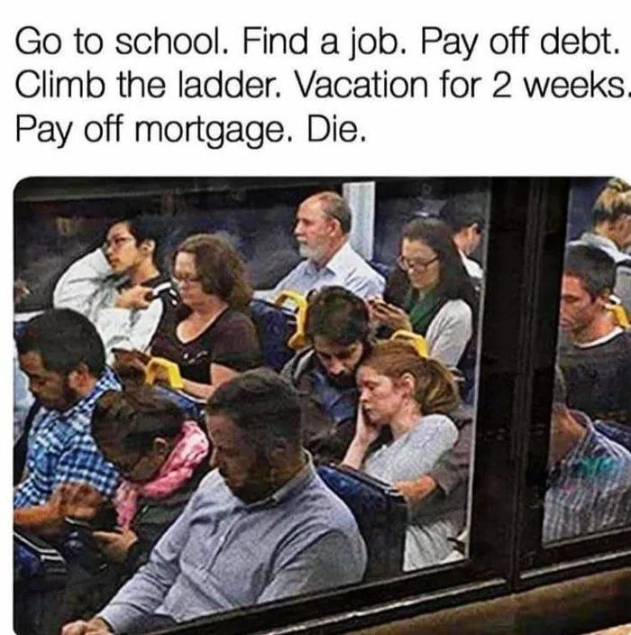

Slide 4
Continuous Improvement
Quality Assurances
(Built the Product Right)
Process ->
Q-Contrl/HMI
Value/Cost
Audit/Review/Std
Integrity/Sec
Testing
<- Product
Software Development
QA vs
Test vs
DevOp vs
Cont. Improvement
Support Roles (CM, DM, Code Mngr, etc)
Program/Project Manager
Development
QA-Tester
Acceptance Tester
System Tester
Integration Tester
Regression Tester
Unit Tester
(Sometime Developer)
Concept of Operations
Acceptance Test
Validation
Requirements
System Test
Verification
Architecture
Integration Test
Design
Regression Test
Implementation
Implementation
Unit Test
(Built the Right Product)
Dev Ops
Environment
Software Tools
Hardware
Network
Infrastructure
Test Zone (sandboxes)
Operation

Slide 5
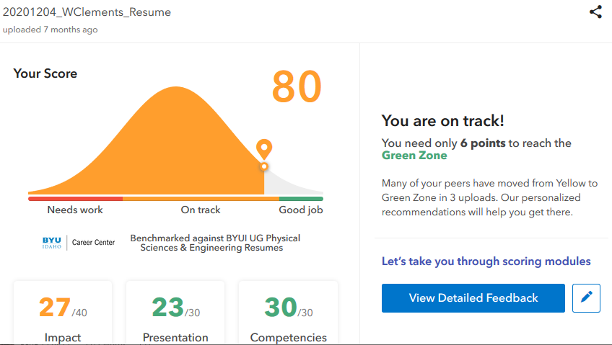
Your Resume
Resume Building
Avoid
Contact information: name, phone#, email
Education –
class’s topics, projects, start and expected grade date
Experience – jobs, jobs, jobs
Doesn’t matter what the job is right now, frame the responsibilities with soft skills
Dates matter, it is a bibliography and timeline
Statistics and Numbers
Personal Projects
#1 influencer, what did you do outside of class.
Societies, Sr Project, Competitions, Non-profit
Portfolium, GitHub, etc -> tiny url.
Skills & Knowledge list
Get past the AI filters and HR Intern
Must be specifically support (dup) in other sections.
GPA: Unless specially asked for
History gaps
Long paragraphs
No more than 2 pages, most important on the 1st page
Use MS Word magic: Font size, margins, white space
Do this
On the back side of 1-page, include photos, talking points, etc of projects.
Use a different color paper, that is easily copiable. (Not red, etc)
Be prepare to have a STAR story for every point on your resume
Use V-Mock to review your resume

Slide 6
Strategies
Year 1
Year 2
Year 3
Year 4
S1-on
S2-on
off
S1-on
S2-on
off
S1-on
S2-on
off
S1-on
S2-on
Start looking for a internship job
CSE 398 full-time
Ideal time to get an internship
Extending your Internship, some company require that for their internship they need you to take it for credit.
CSE 498R full-time
S1-on
S2-on
If you are International student, you must work part time during your on-semester.
CSE 398 full-time
CSE 498R part-time
S1-on
S2-on
This would be a better
CSE 398 full-time
CSE 498R full-time
Work Experience
Non-tech campus job
Lab Assistant
non-tech job
Teacher Assistant
Off campus tech job
On-campus tech job
CSE 398 full-time
Off-Campus tech job
Projects
Assist Society Projects
Lead Society Projects
Expeditions
ALP-Basic
ALPS Adv
Sr. Proj.
Personal Projects
Attend Competitions
Attend Professional Conferences

Slide 7
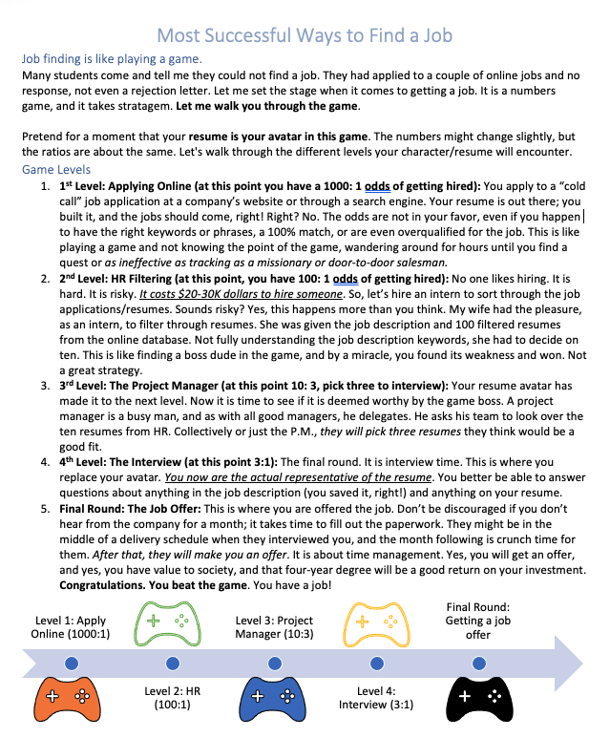
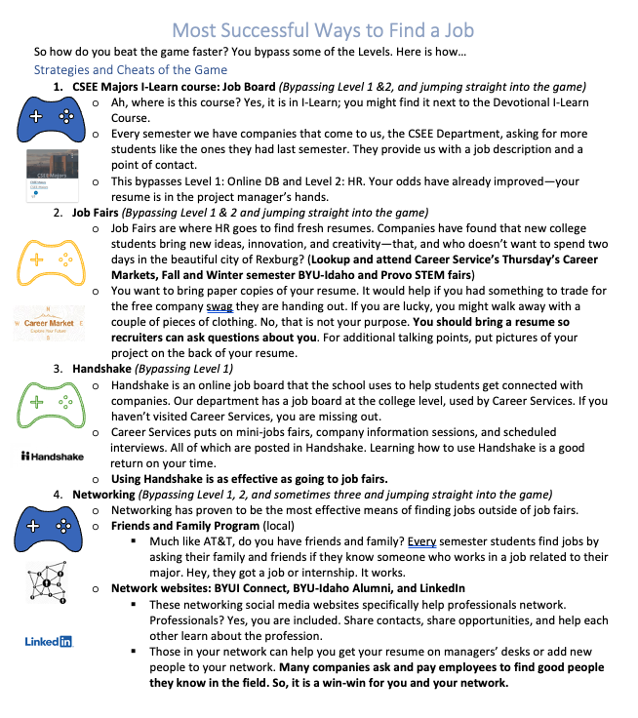
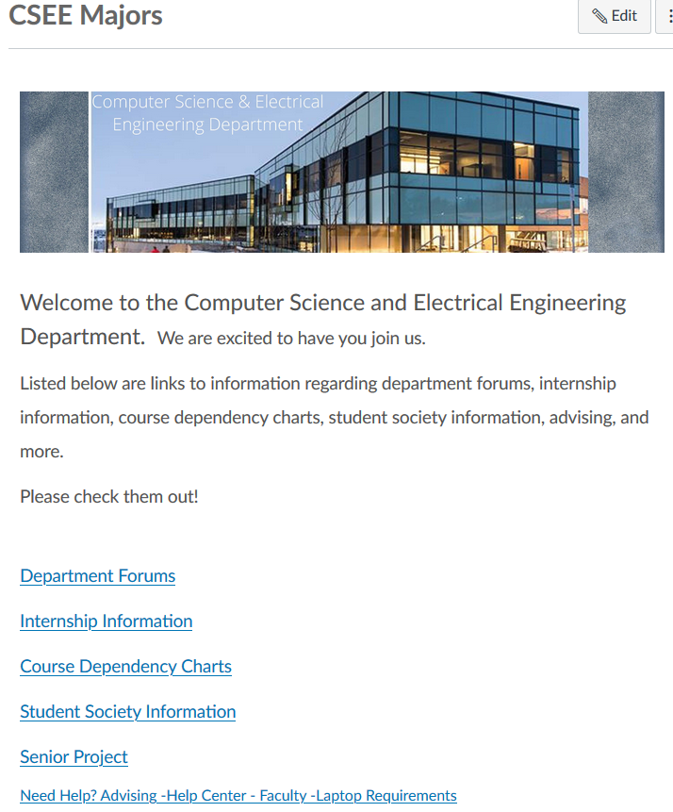

Slide 8
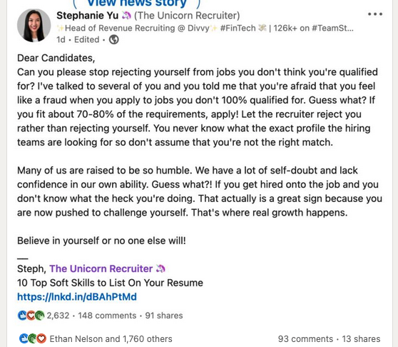

Slide 9
QA Job Search Engines
Format of a Job Description
About the company
Legal
Responsibilities – what you will be doing
Qualifications – what you need to have – 80%-90% match, otherwise you are over qualified
Where to go for finding a job:
CSEE Majors iLearn Course
byui.joinhandshake.com
www.linkedin.com
www.indeed.com
www.dice.com
www.salary.com
Byuiconnection.edu

