Slide 1
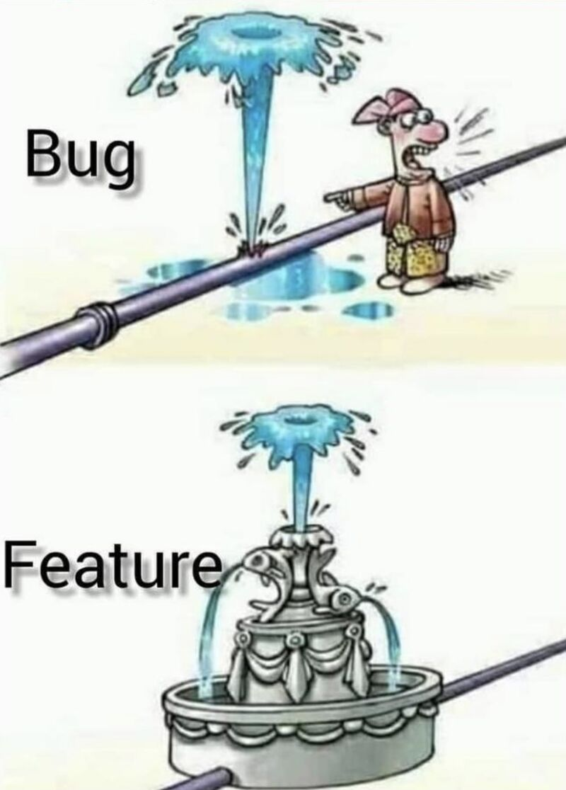
Welcome to CSE 270 Quality Assurance Testing
Bro. Clements

Slide 2
What is Software Quality Assurance Testing?
What is the differences between IT and CS and Programming?

Slide 3
What is Software Quality Assurance Testing?
What is the differences between IT and CS and Programming?
Software Testing is the process of ensuring the product is doing the right thing.
Quality Assurance is the process ensuring that it is the right product.
Testing is different than Quality Assurance. Testing focuses on Verification and Validation of the product, while Quality assurance focuses on the process. Testing asks the question, "Is the product right?" while QA asks, "Is it the right product."
Most companies refer to SW Testing as QA, so we named the course QA-Testing. We have separate course, CSE 474: Quality Assurance.

Slide 4
Course Outcomes
By the end of the semester, each student will be able to:
Classify (4) Professional, Business, Career field, and Security Issues.
Appraise (5) different testing tools and justify which to use in a given scenario.
Assess (5) the different Testing Techniques and discriminate the different use of each.
Prepare (6) and Implement (3) Test Plans at different Levels using different Processes and Tools.

Slide 5

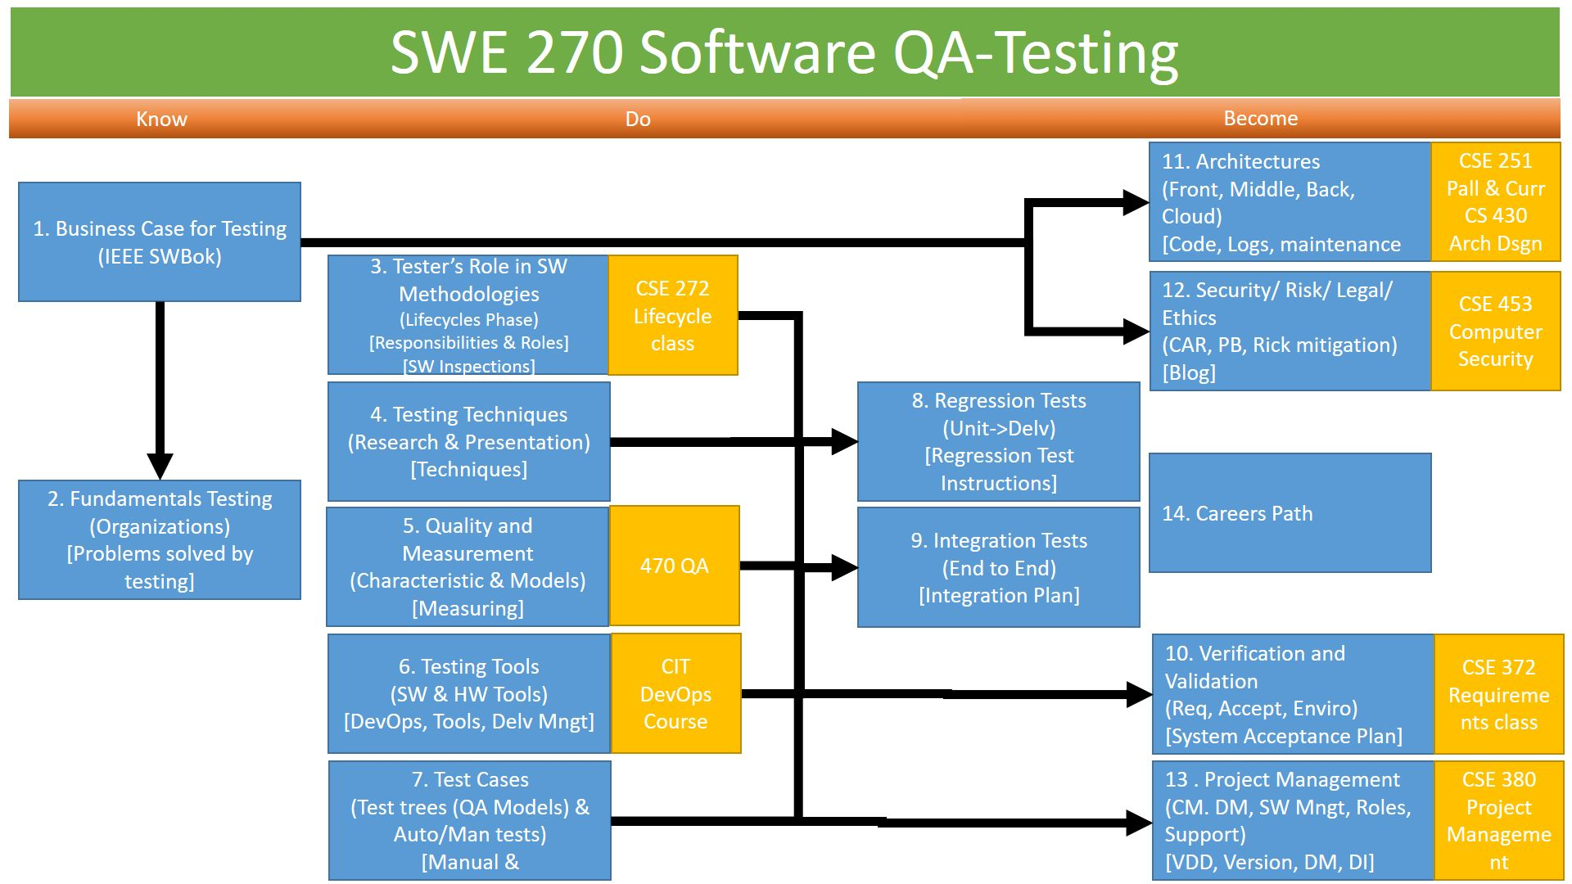
Course Overview
In this course we will explore Software Testing standards, techniques, tools, and cases
Standards
We will research Testing standards expected of a tester through associations, organizations, magazines, and web site resources.
Techniques
Summarize testing techniques (Exploratory, Domain, Flow, and Box) and how they are used to deliver a software product.
Tools
We will determine the critical roles that Testing has in DevOps. We are also analyzing different tools available to the tester to make the job easier, more efficient, and less prone to error.
Cases
We will demonstrate how to create through processes how to create different tests, types of tests approval (Inspection, Demo, Sim, Test[Manual or Automated]), techniques to handle different programming principles.

Slide 6
Course Overview
Software Methodologies
We will be exploring the responsibilities a tester must perform for each phase of a software lifecycle and how these phases integrate into different software methodologies (example: Waterfall, Spiral, Agile).
Business needs
We will be discussing business needs and return on investment opportunities for businesses to do due diligence to provide testing resources, schedule, and funds for Testing.
Quality & Measurement
We will be analyzing methods to provide accurate data and coverage of the software to prove confidence that the product being delivered will be successful and fulfill the customer needs and expectations.

Slide 7
Course Overview
System Architectures
We will differentiate different testing needs for different architectures.
Ethical and Security issues
We will breakdown issues revolving around ethics, legal, and Security
Project Management
We will determine how to tie Testing into project management and other roles synergistically.
Career paths
We will explore different career paths and qualifications for each.

Slide 8
Weekly expectations:
CSE 270 is a three-credit course. In a normal on-campus course, you would spend 3 hours in class and spend 2 hours per class doing assignments. That is about 9 hours per week for this class (3 hours for class and six for assignments). Depending on the week, the hours may vary.
Each week in the Prepare the hours our organized as such:
1st Hour: Prepare Material & Quiz
2nd & 3rd Hour: Teach:
4th & 5th Hour: Teach:
6th & 7th Hour: Teach Lab
8th Hour: Prove Assignment
9th Hour: Ponder Reflection Quiz

Slide 9
Weekly expectations:
CSE 270 is a three-credit course. In a normal on-campus course, you would spend 3 hours in class and spend 2 hours per class doing assignments. That is about 9 hours per week for this class (3 hours for class and six for assignments). Depending on the week, the hours may vary.
Assignments:
1st Hour: Prepare: Prepare Reading & Quiz
2nd & 3rd Hour: Teach: Introduction: Who are you?
4th & 5th Hour: Teach: What is Software Testing?
6th & 7th Hour:
8th Hour: Prove: Business Case Report
9th Hour:
Day | Sun | Mon | Tue | Wed | Thu | Fri | Sat
In Class |  | Class Lecture |  | Class Lecture |  | Class Lecture
Out of Class | Rest and Worship | Preparation Material | Preparation Material |  |  | Report on Teach Assignments | Due: Prove Ponder

Slide 10

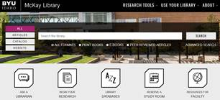
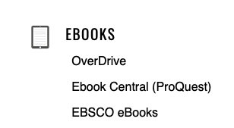




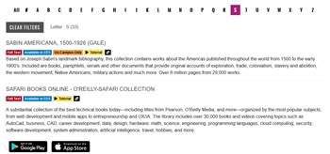
Text Books:
There is no textbook to purchase. All reading is available online through the BYU-Idaho Library, and direct links are available in the Prepare reading.

Slide 11
LOGISTICS
Group Work
You will work with a partner or small group to complete W03–W13 prove assignments. Everyone will be required to submit your own copy of the work with everyone’s name on it.
Late Work
Assignments must be completed as scheduled. Late work is generally not accepted. However, assignments may be rescheduled for a limited number of emergency situations if you discuss your situation with your instructor before (not on and especially not after) the scheduled due date. Be prepared to justify any requests for extensions. Simply submit a note as your assignment when you will turn in the assignment before the due date.
You are allowed to resubmit assignments for better grades. As stated before, late work is not accepted but resubmissions are, so turn something in.
Extra Credit
There is no extra credit for this course. Department policy is that extra credit distracts from the core objectives of the course. See Late Work.

Slide 12
Grades
Prepare: 10% : Quiz
Complete Reading
Read over assignments
Do the prepare work
Teach – Team Assignments (40%)
Class Discussions, Presentations, etc
Prove- 50%
Weekly assignments
The assignment’s requirements are set at 89%. To get 100%, you need to Make It Your Own. I provided some suggestions, but you can add as you see fit. You must identify what you did to Make It Your Own in the assignment comments; otherwise, I will default it at 89%.

Slide 13
University Policies
https://content.byui.edu/file/d24f576f-d34b-47be-a466-d00bd4792fb6/29/universitypolicies.html
Student Honor – Grooming Professionals, Masks – Safety.
Academic Honesty – Cheating, Turn in your work, cite your research (3-4 sources)
Student Conduct – This is a safe place, the only person you can make fun of is me or yourself – positively.
Sexual Harassment – safety first
Students with Disabilities – Accommodations (Extra Time, Due Dates, etc)
Complaints and Grievances – Please let me know, I will be happy to work with you.
Copyright Notice – You may keep a copy, but are not allow to post it on the internet.

Slide 14
Up COMING ASSIGNMENT
Prepare
Reading: SW Engr BoK: Chapter 4: SW Testing
Answer the questions
Teach
Introduction Discussion Board
Find two articles about on Testing (Class Discussion)
Lab
No Lab This week
Prove
Business Case Report

Slide 15
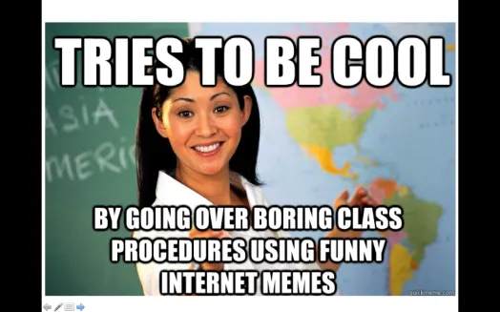
A little about YOUR Instructor…
20+ Years experience
Masters: Univ of CO @ Denver; Bachlors; BYU-Provo; Associates: Ricks College
Worked for Northrop Grumman (TRW) for 13 years, Raytheon for 5 years
Been teaching for 8 years: Online, Hybrid, and Campus for Community Colleges of Colorado, BYU-Online, and BYU-Idaho
I love computing, I have since I saw my first for-loop fill the screen with my name.
I have moved over 20x, CA, UT, ID, MO, OK, TX, CO
Hobbies: Board Games, Family outings

Slide 16
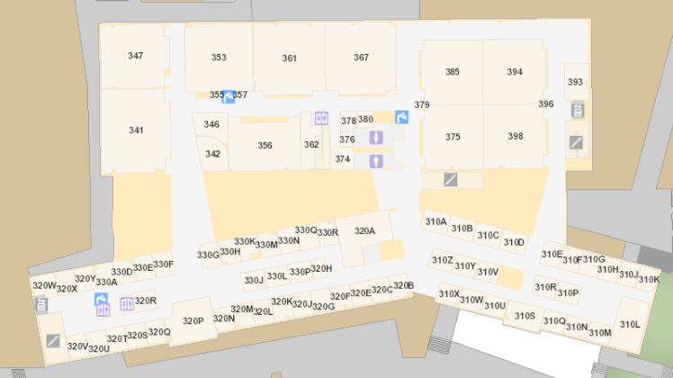
Bro Clements
William Clements
Email: ClementsW@byui.edu
Google Phone: (208) 557-4333
Office Phone: 208-496-7617
Office Rm: 320 T (Mark Twain with a T – Samuel Clemens)
Office hours: See Schedule
https://web.byui.edu/Directory/Employee/clementsw

Slide 17
Communication
MS Teams – CSE 270 - optional
Zoom
Topic: CSE 270 QA-Testing
https://byui.zoom.us/j/93106404255?pwd=Uk8yM3FZUVYyandEYkRTTlRwTC9YUT09
Meeting ID: 931 0640 4255
Passcode: 24861379

Slide 18
Day 2

Slide 19
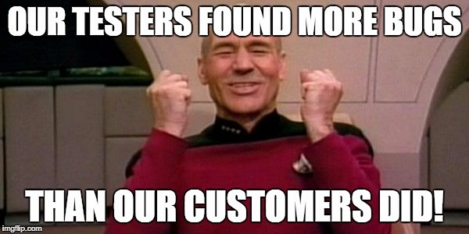
Welcome to CSE 270 Quality Assurance Testing
Bro. Clements
Week 01 Day 2

Slide 20
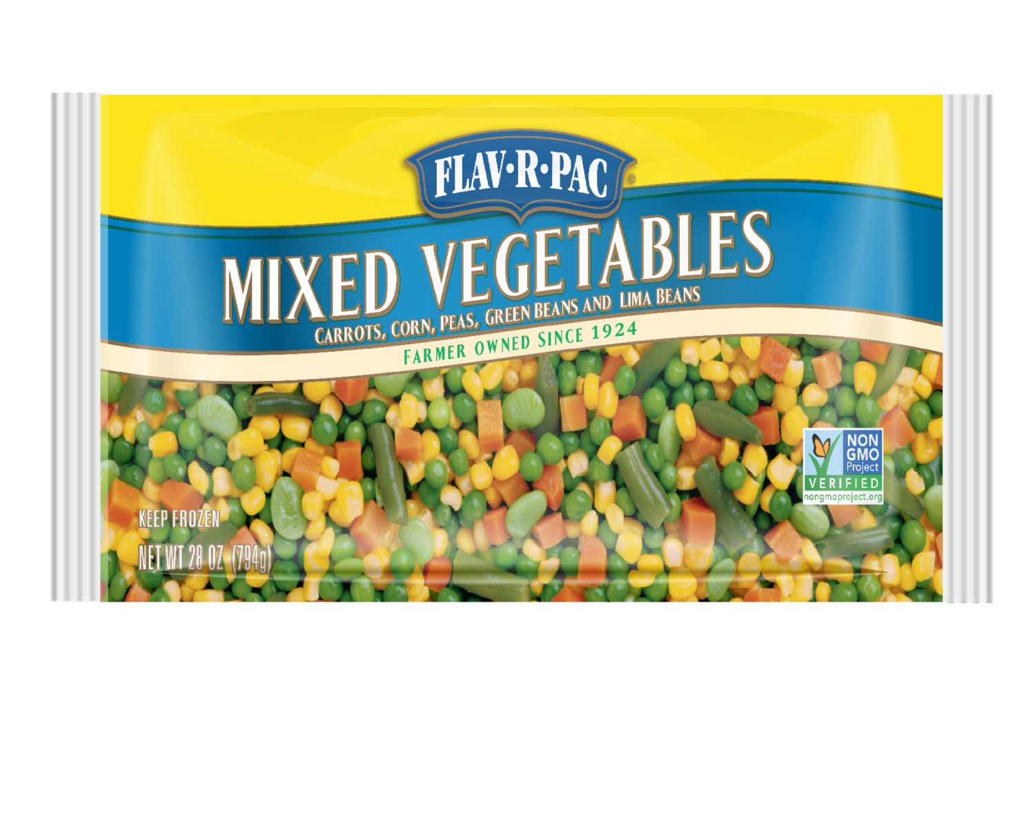
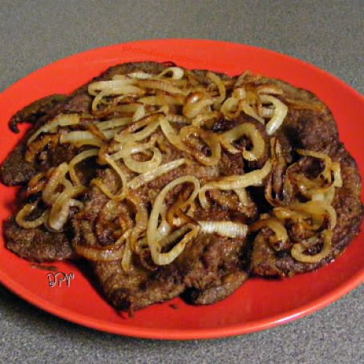
Let’s Debate -Safely
Food: Indian, Tex-mex, Italian, and everything but lima beans and liver and onions.
What food do you like? Why?
What food do you refuse to eat? Why?

Slide 21
How do you know what food you like or dislike?
How do you know that Montana is real?
Do vitamins really work?
How do you know that the Book of Mormon is true?
How do you know if you are going to get a specific grade in the class?
How do you know what grade you are going to get for a specific assignment?
What makes a good computer program?

Slide 22
Discussion TOPICS
Types of errors? (Faults vs Failures) (1.1)
Issues? Effectiveness, Discovery, Oracle Problem, Limitations, Infeasibility, Testability (1.2)
What is the difference between CM, QA, DM, PM, SE roles? (1.3)
Levels (2.0) [Overview, more detail in Week 8, 9 and 10]
Measurements (4.0) [Overview more detail in Week 5]
Tools (5.0) [Overview more detail in Week 6]

Slide 23
SWEBoK Chapter 4

Slide 24
Continuous Improvement
Quality Assurances
(Built the Product Right)
Process ->
Q-Contrl/HMI
Value/Cost
Audit/Review/Std
Integrity/Sec
Testing
<- Product
Software Development
QA vs
Test vs
DevOp vs
Cont. Improvement
Support Roles (CM, DM, Code Mngr, etc)
Program/Project Manager
Development
QA-Tester
Acceptance Tester
System Tester
Integration Tester
Regression Tester
Unit Tester
(Sometime Developer)
Concept of Operations
Acceptance Test
Validation
Requirements
System Test
Verification
Architecture
Integration Test
Design
Regression Test
Implementation
Implementation
Unit Test
(Built the Right Product)
Dev Ops
Environment
Software Tools
Hardware
Network
Infrastructure
Test Zone (sandboxes)
Operation

Slide 25
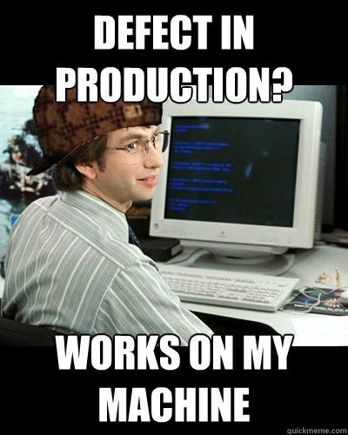
Types of errors? (Faults vs Failures) (1.1)
Cause
Defect = Fault or Failure
Fault – must be removed
Failure - observed
Error – report/logged
Testing reveals faults manifested as failures and reported as errors.

Slide 26
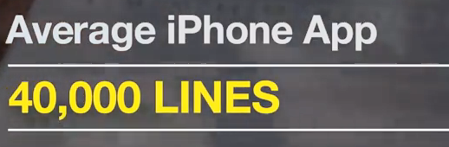

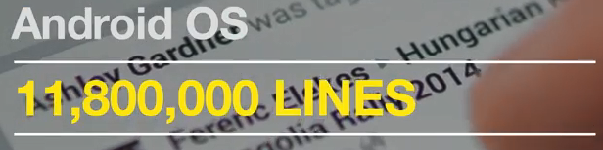
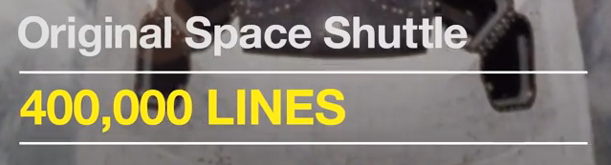

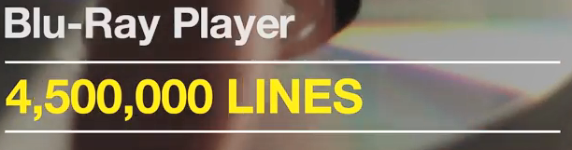
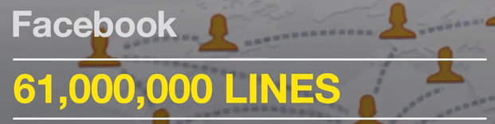
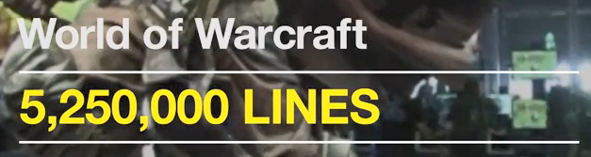
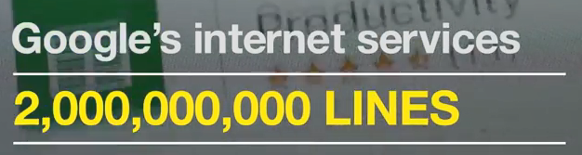


Slide 27
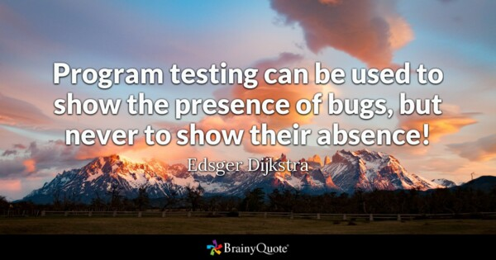
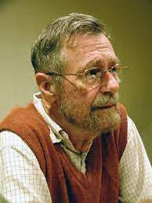
Issues? Effectiveness, Discovery, Oracle Problem, Limitations, Infeasibility, Testability (1.2)
Effectiveness: Test Selection Criterion
You can’t test everything. For large project it is impossible.
Example: Venn diagram:
What parts can be tested separate vs together vs are dependent on each other?
Do all parts needs to be tested
Defect Discovery: Success is discovering the cause of failure.
Meets Specification: No failures under realistic test cases
Oracle: Knowing when a test is correct: unambiguous requirements specifications, behavioral models, and code annotations.
Limitations: Dijkstra aphorism that “program testing can be used to show the presence of bugs, but never to show their absence”
Infeasibility: Path-based testing, no input will trigger it. (Heart condition)
Testability:
to the ease with which a given test coverage criterion can be satisfied;
the likelihood, possibly measured statistically, that a set of test cases will expose a failure if the software is faulty

Slide 28
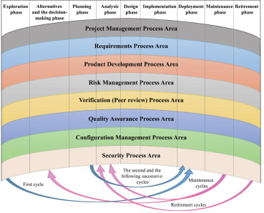
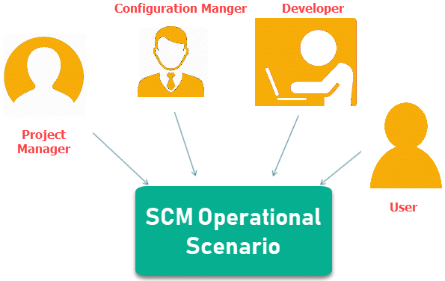
What is the difference between CM, QA, DM, PM, SE roles? (1.3)
CM – Configuration Management
QA – Quality Management
DM – Data Management
PM – Project Management
SE – System Engineer

Slide 29


Slide 30
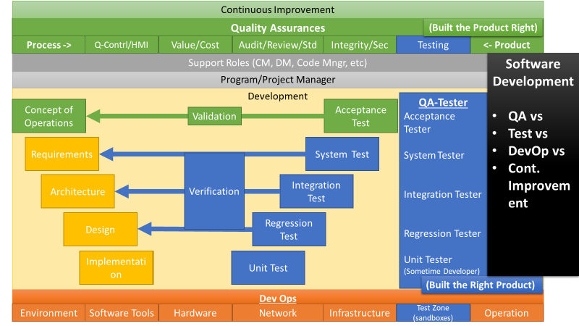
Levels (2.0) [Overview, more detail in Week 8, 9 and 10]
2.1. The Target of the Test
2.1.1. Unit Testing
2.1.2. Integration Testing
2.1.3. System Testing
2.2. Objectives of Testing
2.2.1. Acceptance / Qualification Testing
2.2.2. Installation Testing
2.2.3. Alpha and Beta Testing
2.2.4. Reliability Achievement and Evaluation
2.2.5. Regression Testing
2.2.6. Performance Testing
2.2.7. Security Testing
2.2.8. Stress Testing
2.2.9. Back-to-Back Testing
2.2.10. Recovery Testing
2.2.11. Interface Testing
2.2.12. Configuration Testing
2.2.13. Usability and Human Computer Interaction Testing

Slide 31
2. Test Levels
3. Test Techniques
4. Test-Related Measures
6. Software Testing Tools
5. Test Process

Slide 32
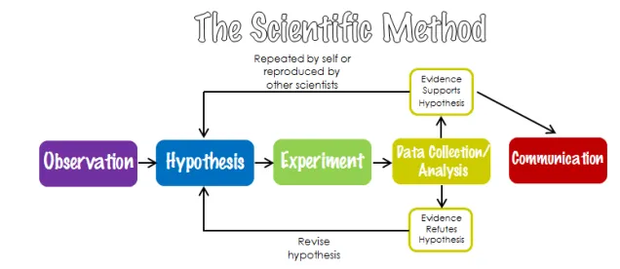
Scientific Method
Software Testing is very similar to the Scientific Method.
Hypothesis is the Requirement
Experiment is the Test
You don’t have to create a new hypothesis. It pass or didn’t pass based on the verification of requirements.

Slide 33
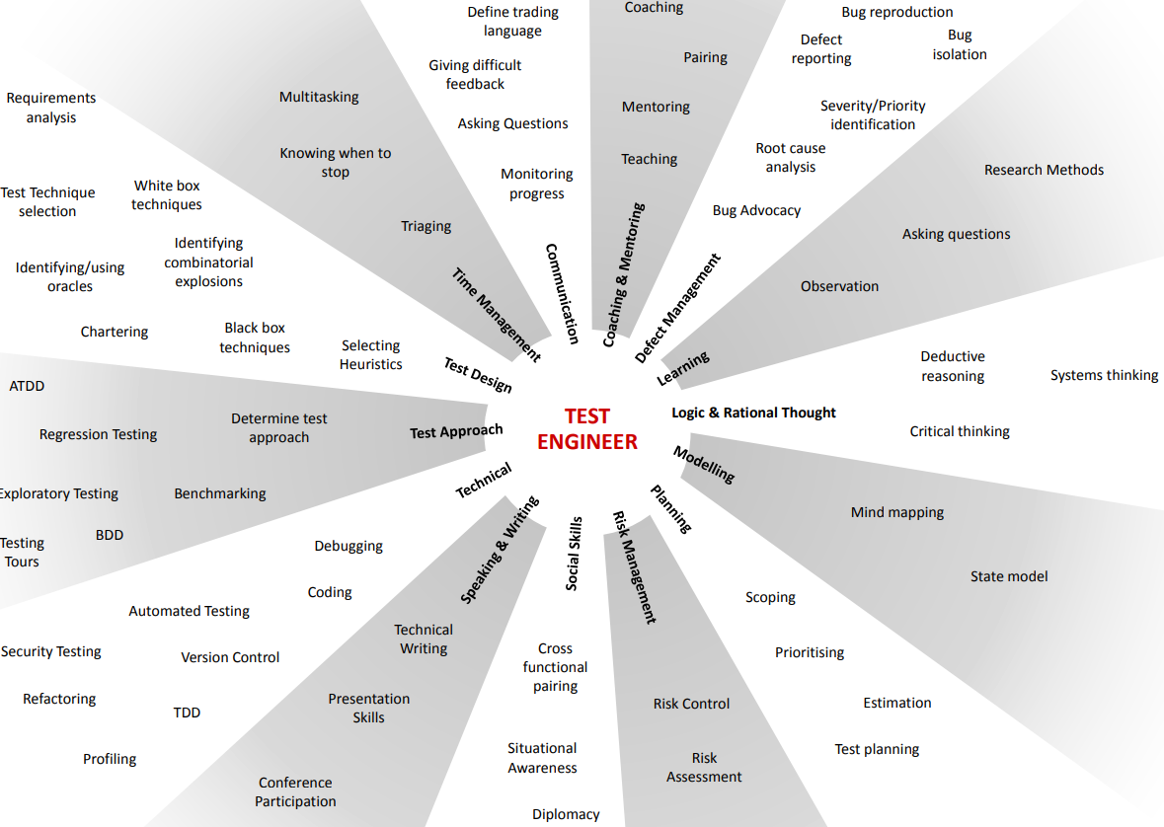
Activity

Slide 34
For Friday
Please be prepared to share your articles you found about testing.

Slide 35
Day 3

Slide 36
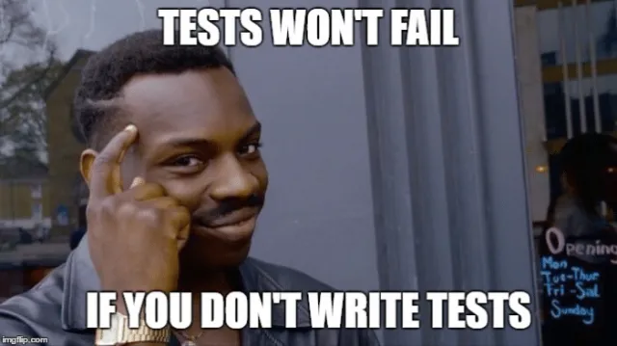
Welcome to CSE 270 Quality Assurance Testing
Start ZOOM
Bro. Clements
Week 01 Day 3

Slide 37
What ARTICLES did you FIND?
Article Title:
Article Author:
Article Reference/Citation:
Where did you find it?
Article Summary:
Summary
Follow-up Questions
Answer the following:
What is the issue?
What are the risks associated with it?
What mitigation or preventions were used or suggested?
What could you learn from this?

Slide 38
What ARTICLES did you FIND?
2020 State of Testing Report
www.infoq.com/articles/2020-state-testing-report/,
What is Manual Testing?
https://www.toolsqa.com/software-testing/manual-testing/
Why Is Software Testing and QA Important for Any Business?
https://dzone.com/articles/why-is-software-testing-and-qa-important-for-any-b
https://www.westagilelabs.com/blog/why-is-software-testing-and-qa-important-for-any-business/
In 2017 a report released by Tricentis reveals that global enterprises have testified a loss of 1.7 trillion in assets and affects 3.7 million people across the globe. In 2018 across the US, poor software quality incurs a scaring loss of $2.84 trillion collectively.
“Software Testing,” IBM, 2021,
https://www.ibm.com/topics/software-testing
Consider Nissan having to recall over 1 million cars due to a software defect in the airbag sensor detectors. Or a software bug that caused the failure of a $1.2 billion military satellite launch.(2) The numbers speak for themselves. Software failures in the US cost the economy $1.1 trillion in assets in 2016. What’s more, they impacted 4.4 billion customers.(3)
Stories from a Software Tester
http://testerstories.com/2020/09/test-shapes/#more-3895

Slide 39
What ARTICLES did you FIND?
Problem-Solving in Software Testing: A Conversation
https://www.stickyminds.com/article/problem-solving-software-testing-conversation
5 Major Problems With Large QA Testing Teams And How To Handle Them
https://www.softwaretestinghelp.com/problems-with-large-qa-testing-teams-and-remedies/
The Industry needs a foolproof way to test mass-Produced Autonomous Vehicles
https://www.powerelectronics.com/markets/automotive/article/21864141/the-industry-needs-a-foolproof-way-to-test-massproduced-autonomous-vehicles
My experience as a Quality Engineering Manager – 5 takaways
https://medium.com/swlh/my-experience-as-a-quality-engineering-manager-key-takeaways-af225b8768fe
Real Life Examples of Software Development Failures
https://www.tricentis.com/blog/real-life-examples-of-software-development-failures/
What is Technical Debt and Why QA Testers Should be Concerned About It?”
https://www.softwaretestinghelp.com/technical-debt-and-qa/
How much do bugs cost to fix during each phase of the SDLC?
https://www.synopsys.com/blogs/software-security/cost-to-fix-bugs-during-each-sdlc-phase/

