Slide 1
Phoenix eye
By Brandon hoyt and Wesley varughese
Florida Polytechnic University Spring 2016
Dr. Sherif Rashad -Project Advisor

Slide 2

Presenting: Phoenix Eye
Need a logo/graphic here.
Phoenix Eye

Slide 3
Objectives
Use citizen science to understand bird life
Create a social media application for eBird

Slide 4
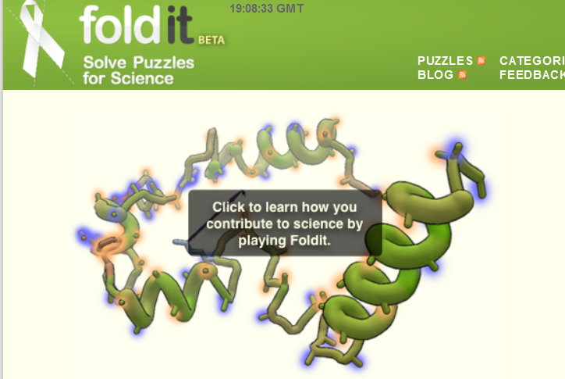
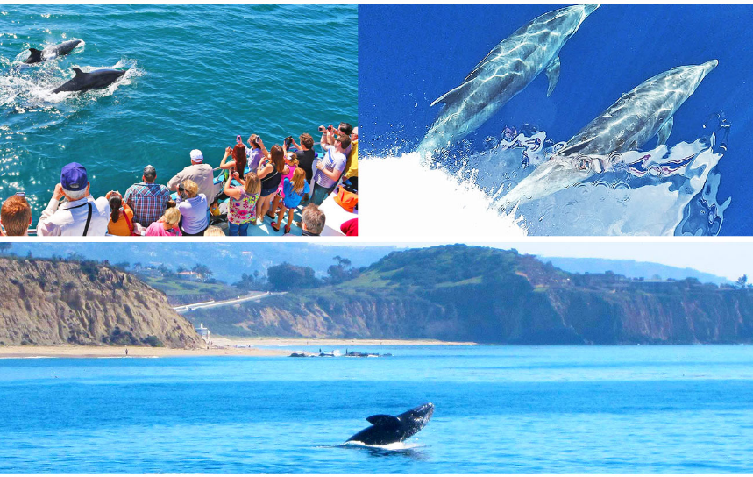
what is citizen science?
“The public involvement in inquiry and discovery of new scientific knowledge”
Examples-
-Foldit Void Crushers
-Great Whale Count
-eBird
Notes:
Scistarter defines it

Slide 5
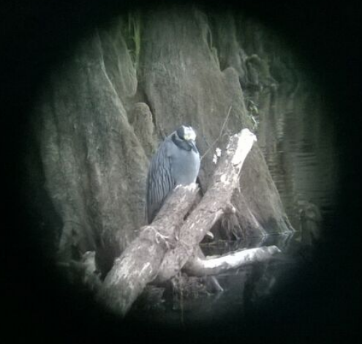
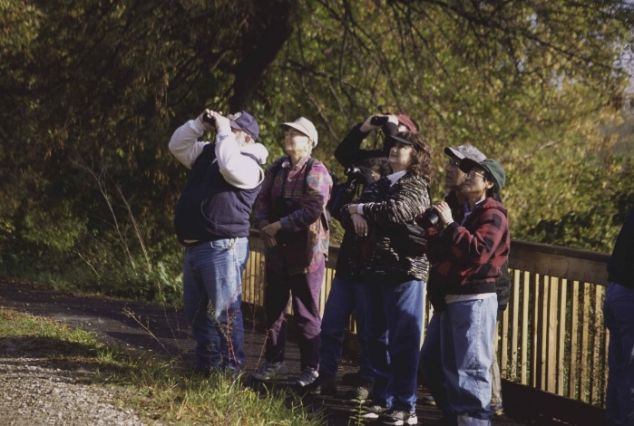
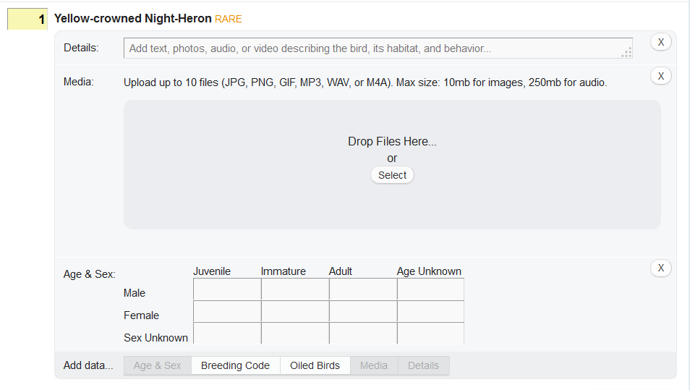
WhaT IS E-BIRD?
Citizen Science Project
-Records species
-Records numbers
-Records behavior
Notes:
Needs to be more social

Slide 6
Purpose of Phoenix EYE
Social Networking App
Coordinate
Share your observations
Template of future CSP

Slide 7
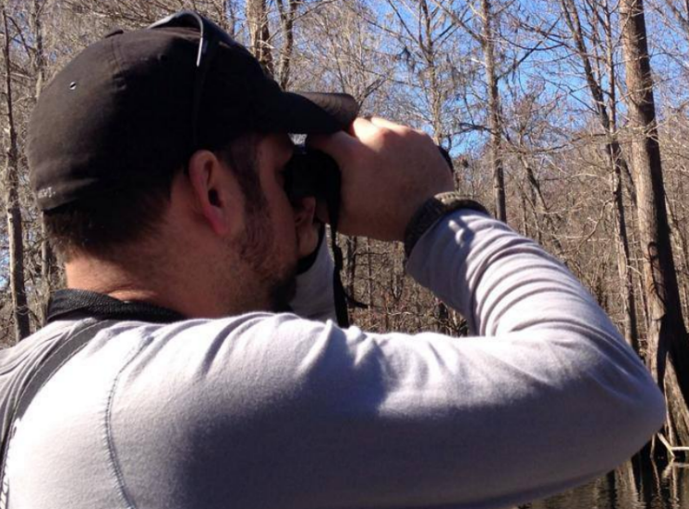
Who needs phoenix eye?
Birders!
Cornell Laboratory of Ornithology
Biologists all over the world!
Project designers

Slide 8
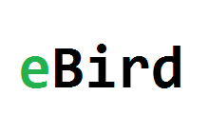


How it works
Submit bird observations to the eBird Project
Share submissions with other app users
Share submission to Twitter and Facebook to allow broader access

Slide 9

Timeline for release
Choose a technology: Android or mobile web based
Declare initial features
Establish test group
Develop initial features
Receive feedback for further development
Notes:
Iphone will follow

Slide 10
Citations
SciStarter. (n.d.). Retrieved February 05, 2016, from http://scistarter.com/page/Citizen Science.html
News and Features. (n.d.). Retrieved February 13, 2016, from http://www.ebird.org/
Great Whale Count. (n.d.). Retrieved February 13, 2016, from http://www.pacificwhale.org/research/great-whale-count
Solve Puzzles for Science | Foldit. (n.d.). Retrieved February 13, 2016, from http://fold.it/portal/
https://upload.wikimedia.org/wikipedia/commons/2/2d/Birdwatchers_taking_a_closer_look_through_their_binoculars.jpg

