Slide 1
Agenda!
Memory Verse
Heather, Report!
Chapter overview
Confirm who's and what's for next week's dinner

Slide 2
Memory Verse!
1 Peter 3:15
15. But in your ______ set apart _____ as ____. Always __ ________ to give an answer to ________ who asks you to ____ the ______ for the hope you have. But do this with gentleness and respect,

Slide 3
“Aren't All Religions Much the Same?”
Buddism
Hinduism
Islam
Animism
*There is something special about Christianity.

Slide 4
The Matrix
 | Hinduism | Islam | Buddhism | Christianity
Followers: | Different, but not, violence ok. | Zealously convert with violence | Sometimes superstitious, lassiez faire | Violence forbidden, superstition forbidden.
Doctrine of God: | All is God, impersonal | Personal | “Religion without God” | God is personal and imminent.
Goal: | Rejoin “the One” | Sensual delights await you in paradise! | Extinction | “Know God and enjoy Him forever in the company of His redeemed people.”
How is God revealed? | In yourself | Only God's will is known, not the personhood of God | What is God? | God's will and personhood are known through his Word and through Christ.
How am I 'saved'? | Karma | God's will | Karma | Faith, grace, Jesus

Slide 5
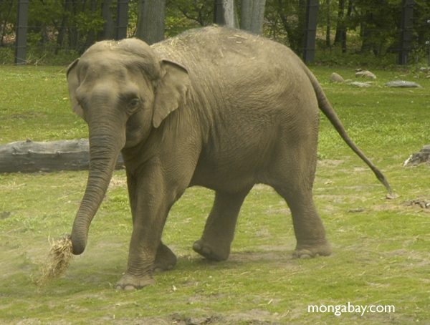
The Fallacy of the Elephant
Who made you the king?
How do you know what is essential and non-essential?

Slide 6
Assignments for next week:
Work on memory verse
Read chapter
Nikki → create a list of three more differences between Islam and Christianity. Answer the question, can they exist side by side in peace?

