Slide 1
Agenda!
Memory Verse
Jonah, Report!
Chapter overview
Assignments for next week
Discuss expectations for young singles ministry

Slide 2
Memory Verse!
1 Peter 3:15
15. But in your hearts set apart Christ as Lord. Always be prepared to give an answer to everyone who asks you to give the reason for the hope you have. But do this with gentleness and respect,

Slide 3
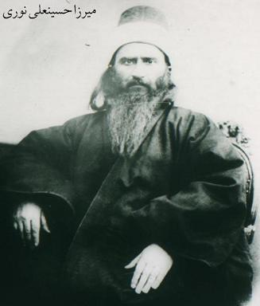
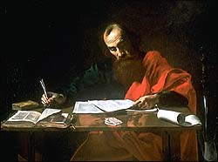
Chapter 1: “It Doesn't Matter What you Believe as Long as you are Sincere”
The Apostle Paul as depicted in 1620.
Baha'u'llah's picture, founder of the Bahai faith.

Slide 4
Key Point of the Chapter
It is “manifestly nonsense” to believe that sincerity is more important than what you believe.

Slide 5
So why do People Believe it?
“people may simply not want to get drawn into a religious argument”
“because they have never really stopped to think”
“we are practical people”
“Religion is about the fundamental issues of life and death, and there is something in us that does not want to look at them.”
????

Slide 6
Why Should People Believe that What they Believe is Important?
1. The various prophets/religions/religious teachers are fundamentally different.
2. Right belief is the spring of right action.
3. Sincerity is important and essential, but insufficient by itself.

Slide 7
Assignments for next week:
Work on memory verse
Read chapter two
Heather: interview someone you know who doesn't come to church about their belief in God. Discover if they believe: 1. it doesn't matter what you believe as long as you are sincere, 2. that all religions are much the same.

