Slide 1
COZMO
Zhong Heng, Jun ming, Ridwan, Jeryl, Yu yang

Slide 2
Task 2: Jeryl
While moving, if Cozmo sees a cube, the cube will light up and he will stop and sing a song
Challenges
How to stop Cozmo while singing
How to make a cube light up instead of all the cubes
Singing portion is tricky
Limited coding
Especially the notes
Solutions
Use a lot of if then functions
Stop and wait functions

Slide 3
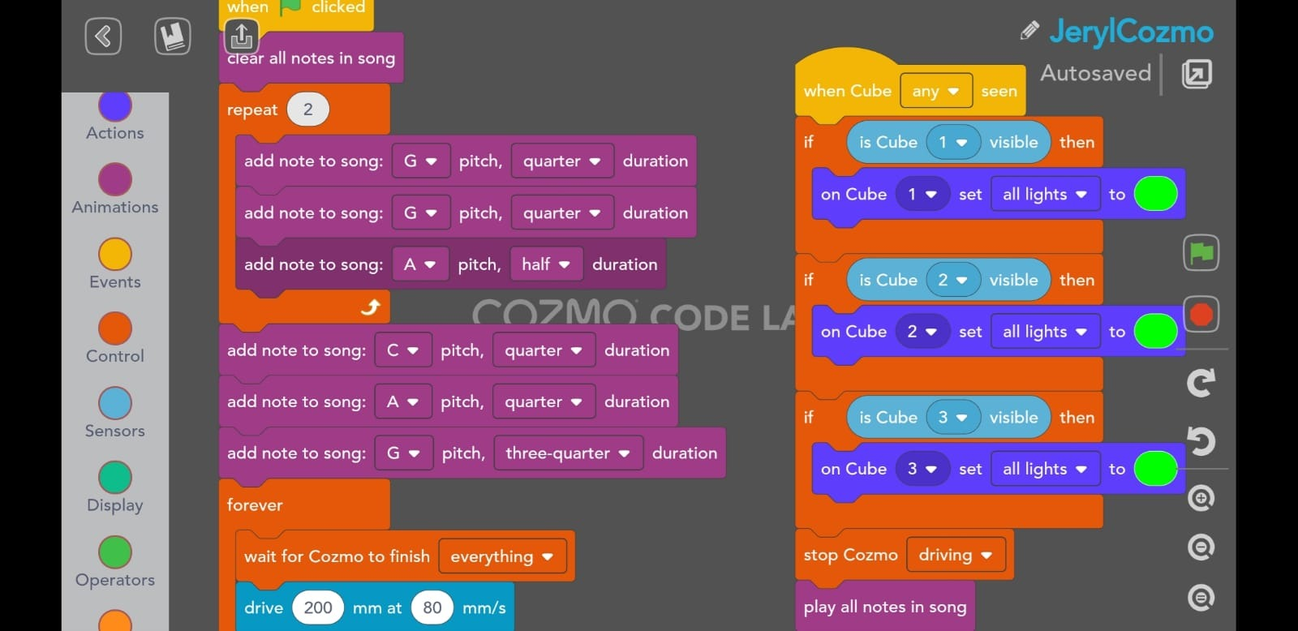

Slide 4
Task 3: Zhong Heng
When cozmo sees a cube, he will avoid the cube
Challenges
Initially wanted to do if else, but could not connect blocks
Had to find a way to do it without if else
Limited coding
Solutions
Used 2 separate codes, 1 with going forward and 1 for spotting and avoiding the cube

Slide 5
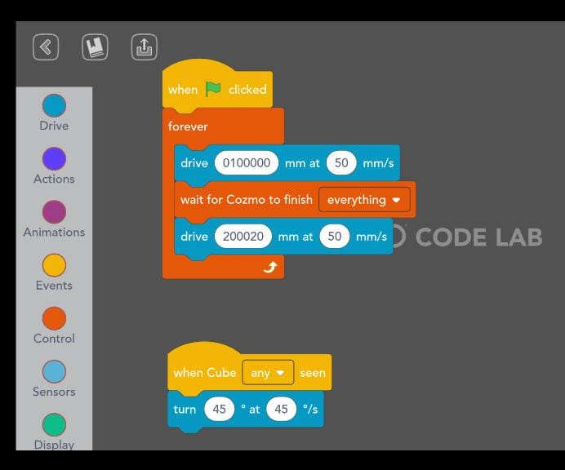

Slide 6
Task 4 : Yu Yang
Instruct Cozmo to build a pyramid
Challenges
Cozmo would only pick up a cube if it is within sight of Cozmo
Dynamically assigning cubes to form different parts of the pyramid was difficult to program
Docking with cubes was inconsistent
Solutions
Programmed a searching algorithm so that Cozmo would be able to find his cubes without knowing their prior locations
Took advantage of lights on Cozmo and cubes to indicate what he was doing makes it easier to debug code
I assigned the 3 cubes to be placed in fixed positions of the pyramid
Implemented error correction codes to check that Cozmo places the cubes correctly

Slide 7
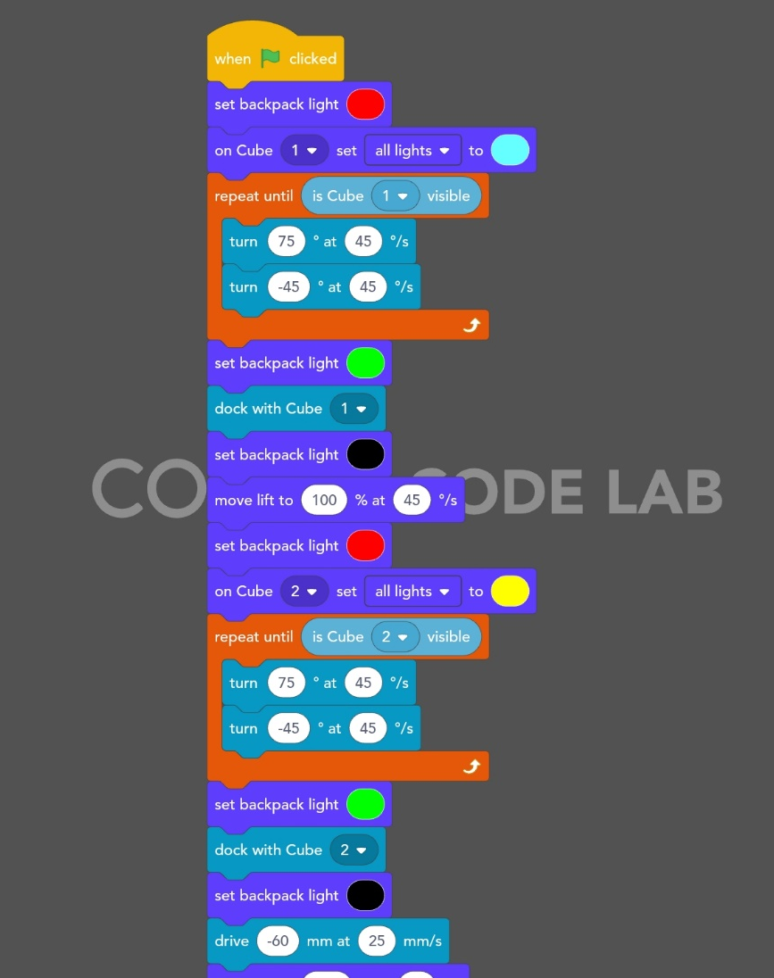
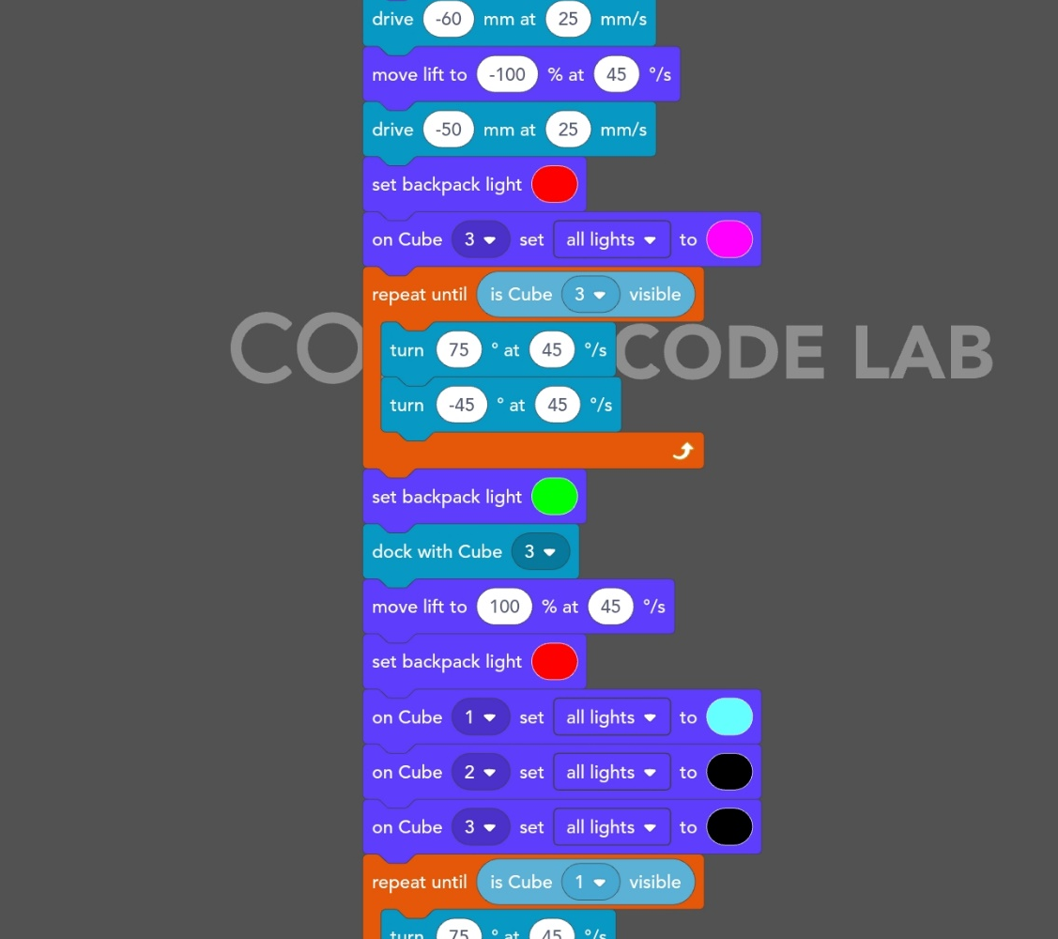
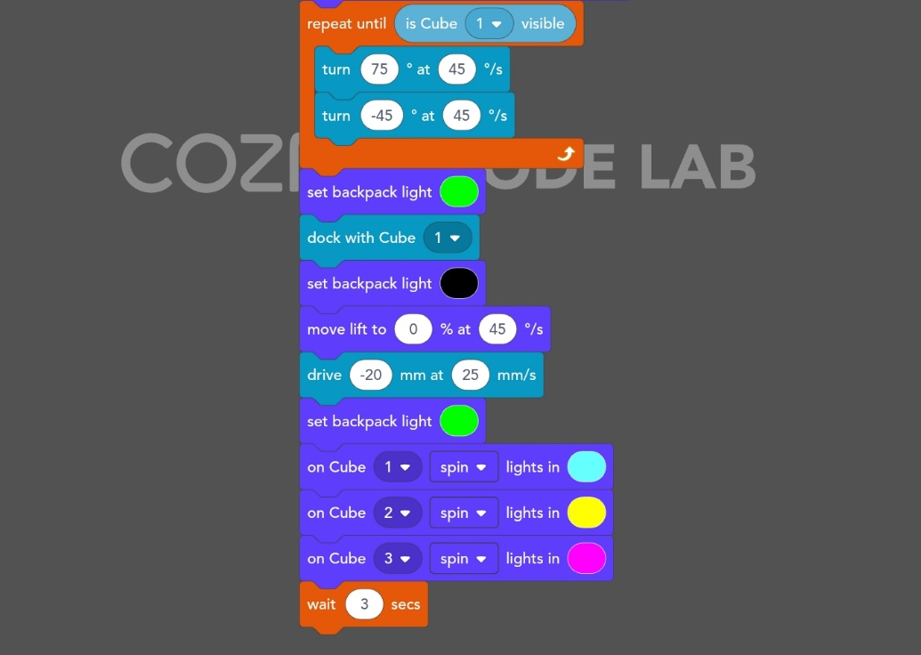

Slide 8
Task 5: Jun Ming
Cozmo will pick up the touched cube
Challenges
Could not connect the blocks
Limited codes
The codes ran simultaneously through too fast
Solutions
Left the blocks separate
Put a code to let the previous command complete before running the next code

Slide 9
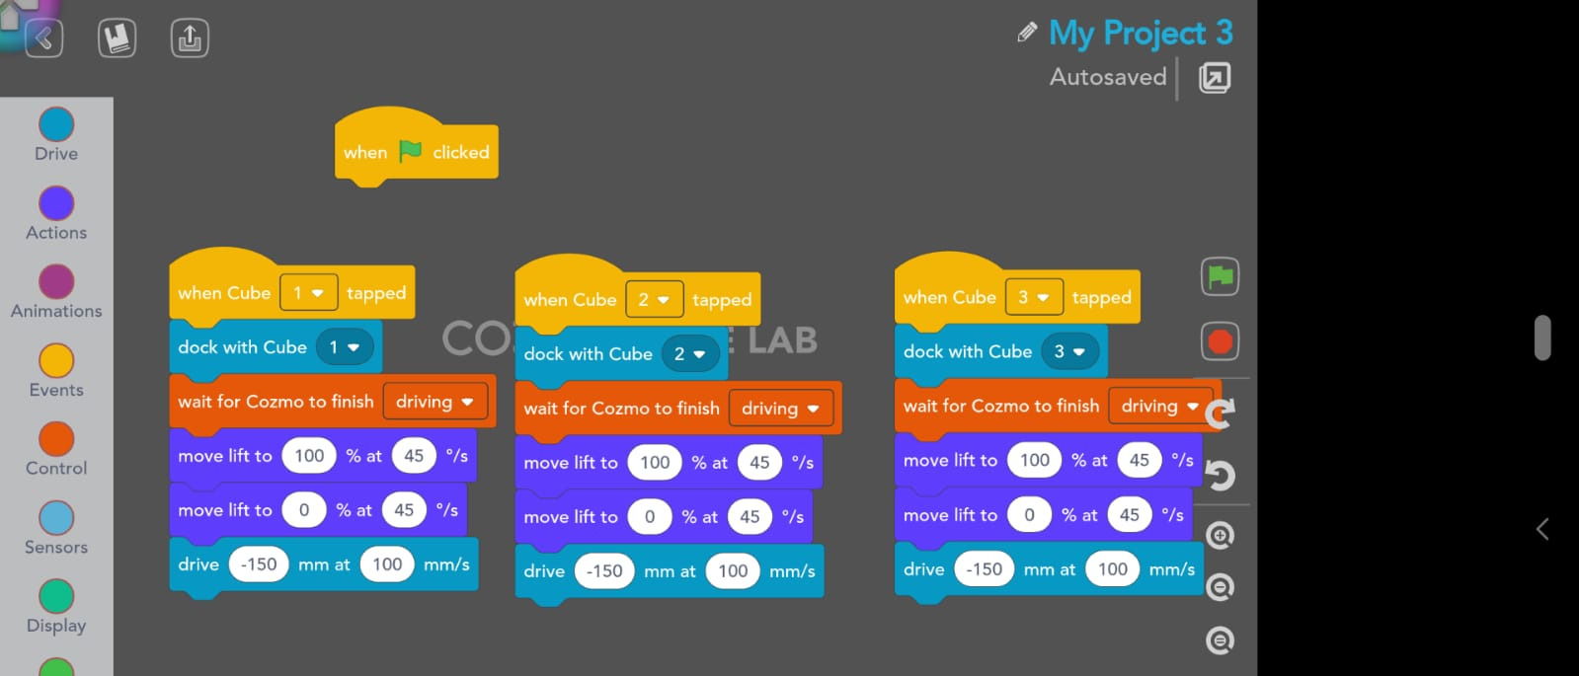

Slide 10
Task 6: Ridwan
Cozmo will pick a predefined cube and stack it on top of another cube which is tapped
Challenges
Cozmo will keep lifting the cube forever until stopped
Solution
Implement a variable so that it stops lifting when it is docked

Slide 11
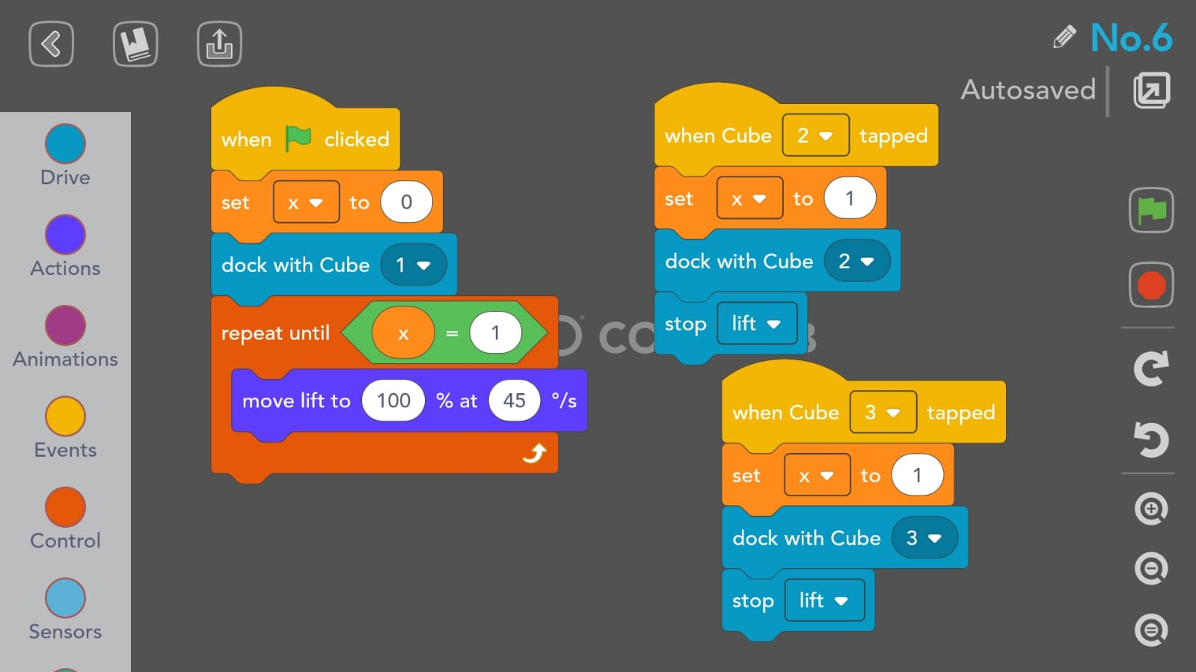

Slide 12
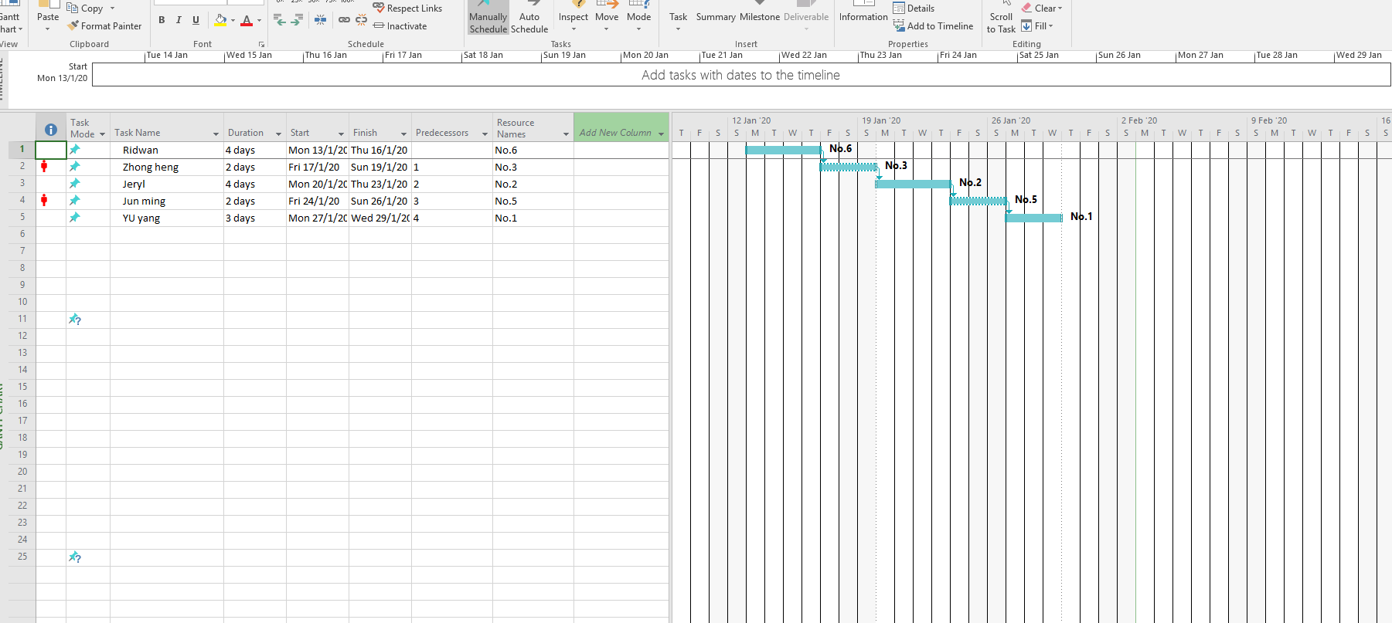
Gantt Chart

