Slide 1
Лекция 4. Наивный классификатор Бэйеса и оценка точности
  Содержание
Бэйесов подход к проблеме предсказания
Наивный Бэйесов классификатор 6
Категоризация статей: Наивный алгоритм Бэйеса 9
Оценка вероятностей с помощью модели мешка слов для текстов 17
Оценка точности классификатора 22

Slide 2
Бэйесов подход к АД
  T. Bayes (1702-1761) perspective at data analysis:
  “There is a probabilistic distribution over patterns. Observed entities change that from a prior distribution to a posterior distribution.”

Slide 3
Naïve Bayes classifier, 1
  A database of 12×10 newspaper article-to-keyword items. Article labels: F for feminism, E for entertainment, and H for household. Problem: Classify the last item x, of an unknown category.
Article | Keyword
 | drink equal fuel play popular price relief talent tax woman
F1 F2 F3 F4 E1 E2 E3 E4 H1 H2 H3 H4 x | 1 2 0 1 2 0 0 0 0 2 0 0 0 1 0 1 0 2 0 2 0 2 0 0 0 0 0 1 0 2 2 1 0 0 0 2 0 2 0 1 2 0 1 2 2 0 0 1 0 0 0 1 0 3 2 1 2 0 0 0 1 0 2 0 1 1 0 3 1 1 0 1 0 1 1 0 1 1 0 0 0 0 2 0 1 2 0 0 2 0 1 0 2 2 0 2 2 0 0 0 0 0 1 1 2 1 1 0 2 0 0 0 1 0 0 2 2 0 2 0 1 1 2 1 1 0 0 1 0 0

Slide 4
Naïve Bayes classifier, 2
  A database of 12×10 newspaper article-to-keyword items. Article labels: F for feminism, E for entertainment, and H for household. Problem: Classify the last item x, of an unknown category.
  Bayesian thinking:
  Consider the prior situation according to the 12-item database: three classes, F,E, and H, probabilities of which are p(F)=1/3, p(E)=1/3, p(H)=1/3. Out of the 12 items, each class accounts for 4 of the, leading to 4/12 proportion.
  Assume we can derive probabilities of x in each of the classes, p(x|F), p(x|E), p(x|F) from the database. Then the posterior probabilities of the classes will be proportional to the products (Bayes theorem):
  P(F|x)=p(x|F)p(F), P(E|x)=p(x|E)p(E), P(H|x)=p(x|H)p(H).
  Бэйесово правило:
  Отнести x к категории с максимальной постериорной вероятностью.

Slide 5
Naïve Bayes classifier, 3
  A database of 12×10 newspaper article-to-keyword items. Article labels: F for feminism, E for entertainment, and H for household. Problem: Classify the last item x, of an unknown category.
  Bayesian solution:
  Отнести x категории с максимальной постериорной вероятностью
  P(F,x)=p(x|F)p(F), P(E,x)=p(x|E)p(E), P(H,x)=p(x|H)p(H).
  Загвоздка: Откуда брать вероятности х, p(x|F), p(x|E), p(x|H)?

Slide 6
Naïve Bayes classifier, 4
  Caveat: How can we derive probabilities of x in each of the classes, p(x|F), p(x|E), p(x|H) from the database?
  Универсальный совет:
  будьте наивными!
  Природа благоприятствует наивным. Аналогичные : Лезвие Оккама, Максимальная экономия, Minimum length, Maximum likelihood.
  Of course, each of these is utterly wrong, yet usually conclusions derived from them are quite reasonable.

Slide 7
Naïve Bayes classifier, 5
  Загвоздка: Откуда брать вероятности х, p(x|F), p(x|E), p(x|H)?
  Наивный Бэйес: предположим, что внутри классов F, E, H признаки независимы! Признаки
  1. drink 4. play 7. relief 10. woman
  2. equal 5. popular 8. talent
  3. fuel 6. price 9. tax
  Then, given probabilities f₁, f₂,…,f₁₀ of the keywords within each class, a product of them according to the query should do!

Slide 8
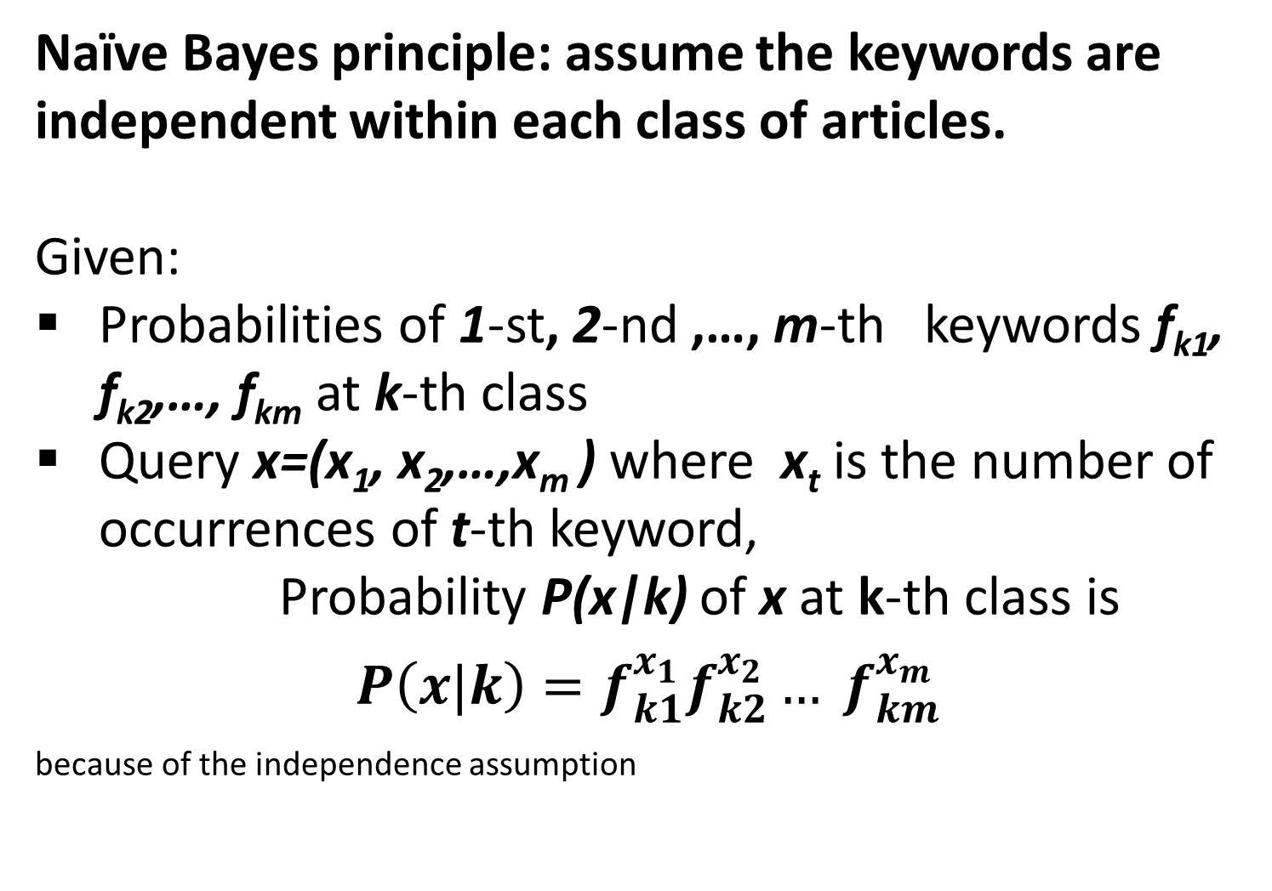
Naïve Bayes classifier, 6
  Naïve Bayes principle: assume the keywords are independent within each class of articles.
  Given:
  Probabilities of 1-st, 2-nd ,…, m-th keywords f_{k1}, f_{k2},…, f_{km} at k-th class
  Query x=(x₁, x₂,…,x_{m} ) where x_{t} is the number of occurrences of t-th keyword,
  Probability P(x|k) of x at k-th class is
$P\left(x|k\right)=f_{k1}^{x_{1}}f_{k2}^{x_{2}}… f_{km}^{x_{m}}$ because of the independence assumption

Slide 9
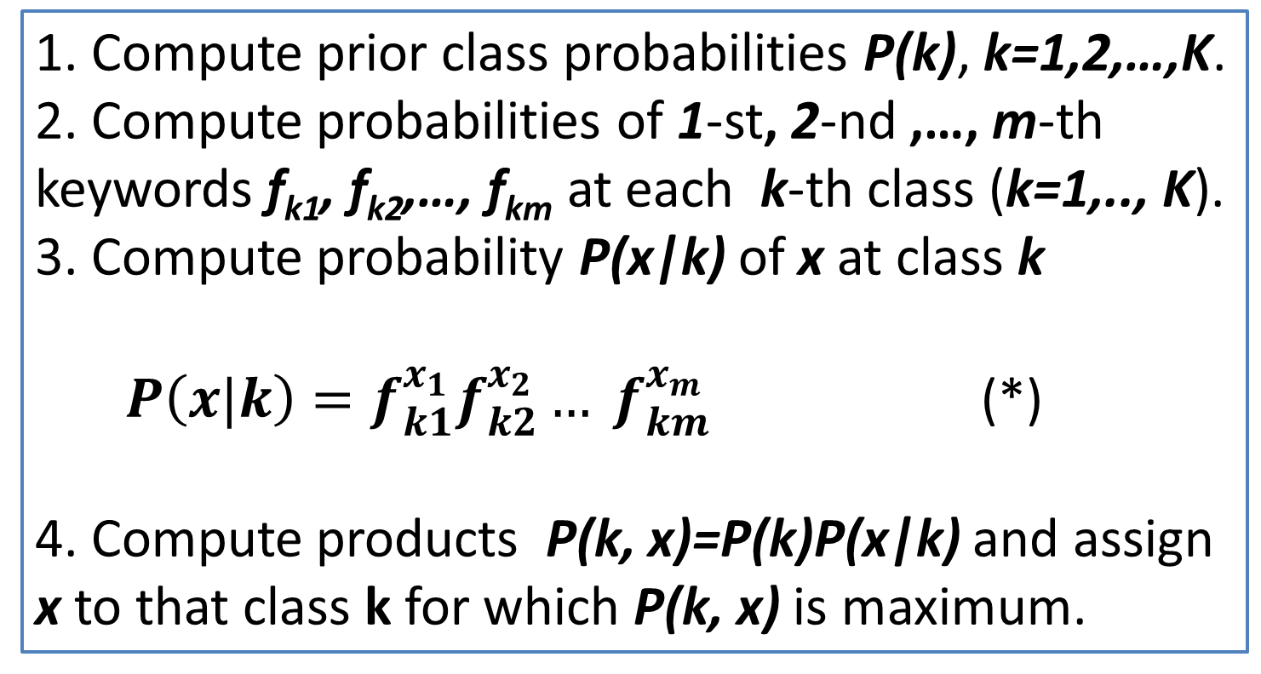
Naïve Bayes classifier, 7
  Naïve Bayes algorithm.
  Given a database of classified articles with m keywords and query x=(x₁, x₂,…,x_{m} ) where x_{t} is the number of occurrences of t-th keyword
  1. Compute prior class probabilities P(k), k=1,2,…,K.
  2. Compute probabilities of 1-st, 2-nd ,…, m-th keywords f_{k1}, f_{k2},…, f_{km} at each k-th class (k=1,.., K).
  3. Compute probability P(x|k) of x at class k
$P\left(x|k\right)=f_{k1}^{x_{1}}f_{k2}^{x_{2}}… f_{km}^{x_{m}}$ (*)
4. Compute products P(k, x)=P(k)P(x|k) and assign x to that class k for which P(k, x) is maximum.

Slide 10
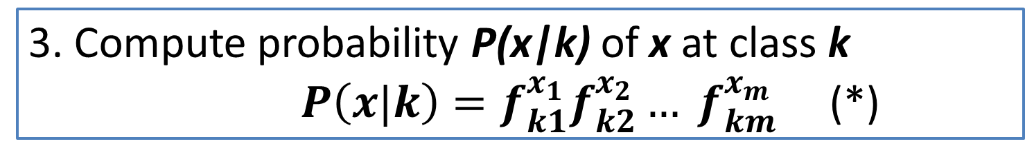
Naïve Bayes classifier, 8
  Naïve Bayes algorithm: a PITFALL
  Given a database of classified articles with m keywords and query x=(x₁, x₂,…,x_{m} ) where x_{t} is the number of occurrences of t-th keyword
  3. Compute probability P(x|k) of x at class k
$P\left(x|k\right)=f_{k1}^{x_{1}}f_{k2}^{x_{2}}… f_{km}^{x_{m}}$ (*)
Pitfall: The probabilities f_{kt} are small in applications, of the order of a thousandth or millionth.
The product (*) is very small then. Say, a product of a dozen of reals of the order of 0.001 each, will come out as a real of the order of 1/10³⁶ (35 нулей до первого не-нуля). This is a digital zero for all practical purposes.
Way out: Use logarithms instead.

Slide 11
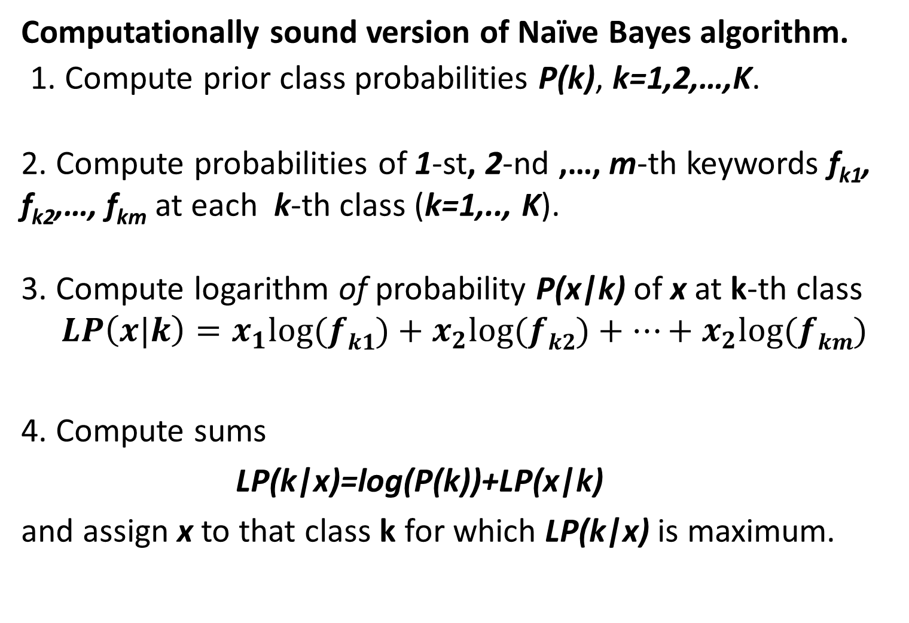
Naïve Bayes classifier, 9
  Computationally sound version of Naïve Bayes algorithm.
  1. Compute prior class probabilities P(k), k=1,2,…,K.
  2. Compute probabilities of 1-st, 2-nd ,…, m-th keywords f_{k1}, f_{k2},…, f_{km} at each k-th class (k=1,.., K).
  3. Compute logarithm of probability P(x|k) of x at k-th class
$$LP\left(x|k\right)=x_{1}log⁡(fk1)+x_{2}log⁡(fk2)+…+x_{2}log⁡(fkm)$$
4. Compute sums
LP(k|x)=log(P(k))+LP(x|k)
and assign x to that class k for which LP(k|x) is maximum.

Slide 12
Probabilities of keywords,1
  A crucial part of Naïve Bayes algorithm:
  2. Computing probabilities of keywords within classes.
Article | Keyword
 | drink equal fuel play popular price relief talent tax woman
F1 F2 F3 F4 E1 E2 E3 E4 H1 H2 H3 H4 | 1 2 0 1 2 0 0 0 0 2 0 0 0 1 0 1 0 2 0 2 0 2 0 0 0 0 0 1 0 2 2 1 0 0 0 2 0 2 0 1 2 0 1 2 2 0 0 1 0 0 0 1 0 3 2 1 2 0 0 0 1 0 2 0 1 1 0 3 1 1 0 1 0 1 1 0 1 1 0 0 0 0 2 0 1 2 0 0 2 0 1 0 2 2 0 2 2 0 0 0 0 0 1 1 2 1 1 0 2 0 0 0 1 0 0 2 2 0 2 0

Slide 13
Probabilities of keywords, 2
  A crucial part of Naïve Bayes algorithm:
  2. Computing probabilities of keywords within classes.
  Take a look, say, at class F and see what is going on.
  First issue: Zero probability for keywords “fuel”, “relief”, and “tax” because of no occurrences. Not good because it would never assign an article x from the class to it if the article contains any of these keywords.
Article | Keyword
 | drink equal fuel play popular price relief talent tax woman
F1 F2 F3 F4 | 1 2 0 1 2 0 0 0 0 2 0 0 0 1 0 1 0 2 0 2 0 2 0 0 0 0 0 1 0 2 2 1 0 0 0 2 0 2 0 1

Slide 14
Probabilities of keywords, 3
  A crucial part of Naïve Bayes algorithm:
  2. Computing probabilities of keywords within classes.
  Take a look, say, at class F and see what is going on.
  Second issue: What probability should one assign to “woman”? A unity? And what is about “popular” or “equal”? How one should take into account the multiple occurrences?
Article | Keyword
 | drink equal fuel play popular price relief talent tax woman
F1 F2 F3 F4 | 1 2 0 1 2 0 0 0 0 2 0 0 0 1 0 1 0 2 0 2 0 2 0 0 0 0 0 1 0 2 2 1 0 0 0 2 0 2 0 1

Slide 15
IV: Probabilities of keywords, 4
  2. Computing probabilities of keywords within classes.
  “Bag of words” model solves first issue
  “Bag of words”: representation of text as a set of its keywords and their frequencies.
  All the occurrences of all keywords in the category F 3+5+0+2+2+3+0+5+ 0+7=27. The probability of keyword “equal” is the proportion of its occurrences, 5/27=0.185.
  Drawback: too many zeros, like P(tax)
Article | drink equal fuel play popular price relief talent tax woman
F1 F2 F3 F4 | 1 2 0 1 2 0 0 0 0 2 0 0 0 1 0 1 0 2 0 2 0 2 0 0 0 0 0 1 0 2 2 1 0 0 0 2 0 2 0 1

Slide 16
Probabilities of keywords, 5
  2. Computing probabilities of keywords within classes.
  “Laplace smoothing” solves the second issue
  Laplace: add to the “Bag” all the keywords from the upper line.
  Then, all the occurrences of all keywords in the category F: 27+10=37. The proportion of equal’s occurrences, now is (5+1)/37=0.162.
  Advantage: no more zeros, like P(tax)=(0+1)/37=0.027.
Article | drink equal fuel play popular price relief talent tax woman
F1 F2 F3 F4 | 1 2 0 1 2 0 0 0 0 2 0 0 0 1 0 1 0 2 0 2 0 2 0 0 0 0 0 1 0 2 2 1 0 0 0 2 0 2 0 1

Slide 17
Probabilities of keywords, 6
  A crucial part of Naïve Bayes algorithm:
  2. Computing probabilities of keywords within classes with Bag of Words model + Laplace Smoothing.
  For example, compute f_{drink,E}=(3+1)/(32+10)=4/42=0.0952.
  Here 3 is the total number of occurrences of keyword “drink” in class E, and 32, the total number of occurrences of all the ten keywords in E, so that 42 is the size of bag of words for class E.
Class | Probabilities of keywords within classes
 | drink equal fuel play popular price relief talent tax woman
F E H | 0.108 0.162 0.027 0.081 0.081 0.108 0.027 0.162 0.027 0.216 0.095 0.071 0.095 0.167 0.167 0.071 0.095 0.143 0.048 0.048 0.049 0.024 0.171 0.098 0.098 0.195 0.146 0.024 0.171 0.024

Slide 18
Probabilities of keywords, 7
  A crucial part of Naïve Bayes algorithm:
  Take logarithms (natural here) of the probabilities above expressed in hundredth (to make all the logarithms positive):
Class | Within class probabilities of keywords
 | drink equal fuel play popular price relief talent tax woman
F E H | 0.108 0.162 0.027 0.081 0.081 0.108 0.027 0.162 0.027 0.216 0.095 0.071 0.095 0.167 0.167 0.071 0.095 0.143 0.048 0.048 0.049 0.024 0.171 0.098 0.098 0.195 0.146 0.024 0.171 0.024
Class | Logarithms of within class probabilities of keywords multiplied by 100
 | drink equal fuel play popular price relief talent tax woman
F E H | 2.380 2.786 0.994 2.093 2.093 2.380 0.994 2.786 0.994 3.074 2.254 1.966 2.254 2.813 2.813 1.966 2.254 2.659 1.561 1.561 1.585 0.892 2.838 2.278 2.278 2.971 2.683 0.892 2.838 0.892

Slide 19
Naïve Bayes - Final decision,1
  Take logarithms of 100/3 (class probabilities being equal here): C=log(100/3)=3.5066.
  Take vector of query x (bottom line in Table above) and compute inner product of it and each of the lines in Table:
3. Add respective results of 1 and 2.
4. Assign x to class of maximum of the found values.
Class | Logarithms of within class probabilities of keywords multiplied by 100
 | drink equal fuel play popular price relief talent tax woman
F E H | 2.380 2.786 0.994 2.093 2.093 2.380 0.994 2.786 0.994 3.074 2.254 1.966 2.254 2.813 2.813 1.966 2.254 2.659 1.561 1.561 1.585 0.892 2.838 2.278 2.278 2.971 2.683 0.892 2.838 0.892
x | 1 1 2 1 1 0 0 1 0 0

Slide 20
Naïve Bayes - Final decision,2
  Take vector of query x (bottom line in Table above) and compute inner product of it and each of the lines in Table:
AF=1*2.380+1*2.786+2*0.994+1*2.093+1*2.093+0*2.380+0*0.994+1*2.786+
0*0.994+0*3.074=14.127
AE=1*2.254+1*1.966+2*2.254+1*2.813+1*2.813+0*1.966+0*2.254+1*2.659+
0*1.561+ 0*1.561 = 17.014
AH=1*1.585+1*0.892+2*2.838+1*2.278+1*2.278+0*2.971+0*2.683+1*0.892+
0*2.838+0*0.892 = 13.600
Class | Logarithms of within class probabilities of keywords multiplied by 100
 | drink equal fuel play popular price relief talent tax woman
F E H | 2.380 2.786 0.994 2.093 2.093 2.380 0.994 2.786 0.994 3.074 2.254 1.966 2.254 2.813 2.813 1.966 2.254 2.659 1.561 1.561 1.585 0.892 2.838 2.278 2.278 2.971 2.683 0.892 2.838 0.892
x | 1 1 2 1 1 0 0 1 0 0

Slide 21
Naïve Bayes - Final decision,3
3. Add respective results of 1 and 2:
AF+C=17.633; AE+C=20.520; AH+C=17.105
4. Assign x to class of maximum value, E,
in this case. (Indeed, x is for an article from E)
Class | Logarithms of within class probabilities of keywords multiplied by 100
 | drink equal fuel play popular price relief talent tax woman
F E H | 2.380 2.786 0.994 2.093 2.093 2.380 0.994 2.786 0.994 3.074 2.254 1.966 2.254 2.813 2.813 1.966 2.254 2.659 1.561 1.561 1.585 0.892 2.838 2.278 2.278 2.971 2.683 0.892 2.838 0.892
x | 1 1 2 1 1 0 0 1 0 0

Slide 22
Assessment of Accuracy of Classifiers

Slide 23
Metrics of Accuracy, 1
A classifier in Table, a lung cancer screening device.
Errors: 1+7=8 out of 200. The accuracy is high, 192/200=96%, error 4%. These are too general and can be misleading at non-balanced samples.
 |  | True lung cancer | Total
 |  | Yes No
Device’s diagnosis | Yes | 94 7 | 101 99
 | No | 1 98
Total |  | 95 105 | 200

Slide 24
Metrics of Accuracy, 2
Lung screening device errors and accuracy.
Two kinds of error: 7 False Positives and 1 False Negative, which may be of different cost. A FP will be identified in additional tests, whereas a FN may cause trouble because of a late diagnosis.
 |  | True lung cancer | Total
 |  | Yes No
Device’s Diagnosis | Yes | 94 7 | 101 99
 | No | 1 98
Total |  | 95 105 | 200

Slide 25
Metrics of Accuracy, 3
Lung screening device errors and accuracy.
Difference in correctly identified cases, True Positives and True Negatives, when a less balanced sample is screened.
 |  | True lung cancer | Total
 |  | Yes No
Device’s Diagnosis | Yes | 94 7 | 101 99
 | No | 1 98
Total |  | 95 105 | 200

Slide 26
Metrics of Accuracy, 4
Lung screening device errors and accuracy at a crowd at large.
2) Imbalance: difference in correctly identified cases, True Positives and True Negatives. The accuracy is 197/200=98.5% hiding a poor performance: 1/3 of cancer sufferers is misdiagnosed, and ½ of “Yes” diagnoses are wrong.
 |  | True lung cancer | Total
 |  | Yes No
Device’s Diagnosis | Yes | 2 2 | 4 196
 | No | 1 195
Total |  | 3 197 | 200

Slide 27
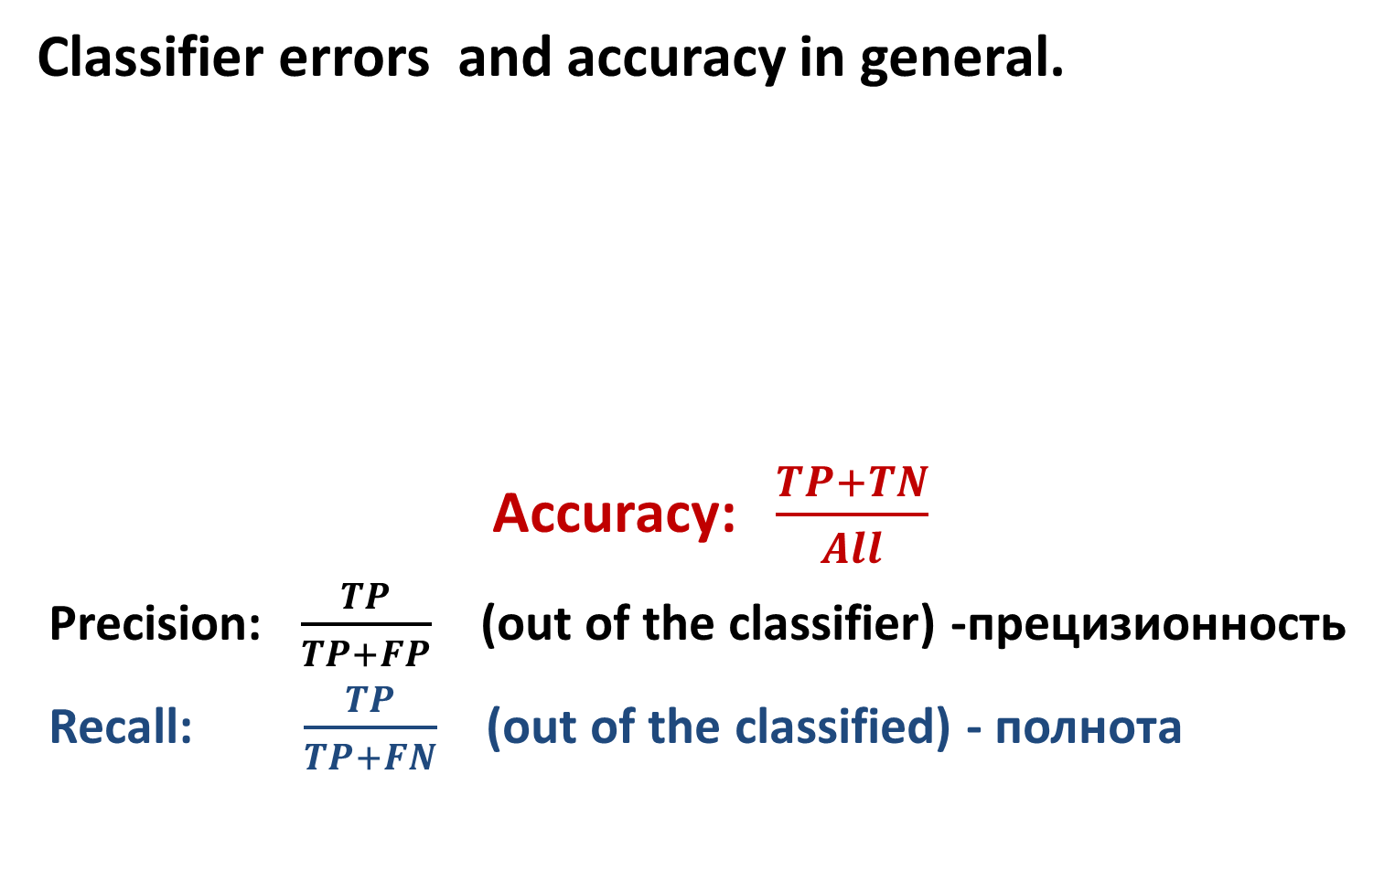
Metrics of Accuracy, 5
Classifier errors and accuracy in general.
Accuracy: $\frac{TP+TN}{All}$
Precision: $\frac{TP}{TP+FP}$ (out of the classifier) -прецизионность
Recall: $\frac{TP}{TP+FN}$ (out of the classified) - полнота
 |  | True lung cancer | Total
 |  | Yes No
Device’s Diagnosis | Yes | TP FP | TP+FP FP+TN
 | No | FN TN
Total |  | TP+FN FN+TN | All

Slide 28
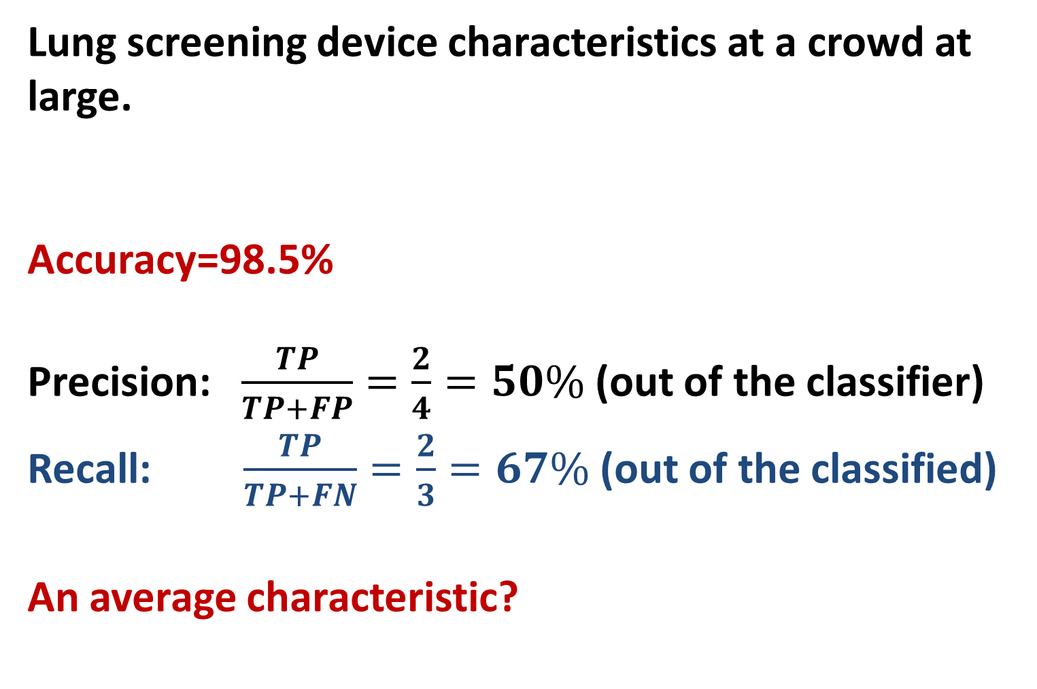
Metrics of Accuracy, 6
Lung screening device characteristics at a crowd at large.
Accuracy=98.5%
Precision: $\frac{TP}{TP+FP}=\frac{2}{4}=50\%$ (out of the classifier)
Recall: $\frac{TP}{TP+FN}=\frac{2}{3}=67\%$ (out of the classified)
An average characteristic?
 |  | True lung cancer | Total
 |  | Yes No
Device’s Diagnosis | Yes | 2 2 | 4 196
 | No | 1 195
Total |  | 3 197 | 200

Slide 29
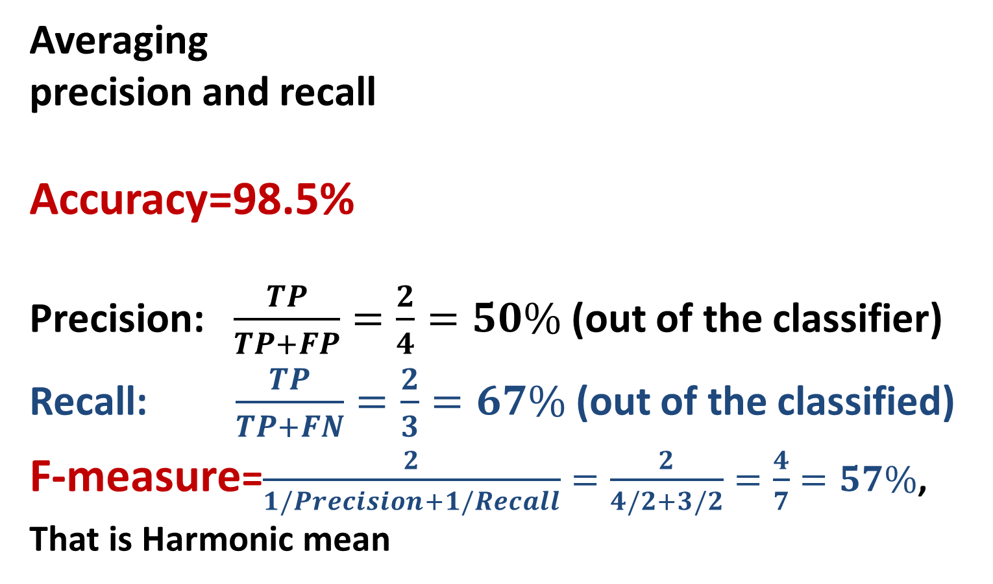
Metrics of Accuracy, 7
Averaging
precision and recall
Accuracy=98.5%
Precision: $\frac{TP}{TP+FP}=\frac{2}{4}=50\%$ (out of the classifier)
Recall: $\frac{TP}{TP+FN}=\frac{2}{3}=67\%$ (out of the classified)
F-measure=$\frac{2}{1/Precision+1/Recall}=\frac{2}{4/2+3/2}=\frac{4}{7}=57\%$,
That is Harmonic mean
 |  | True lung cancer | Total
 |  | Yes No
Device’s Diagnosis | Yes | 2 2 | 4 196
 | No | 1 195
Total |  | 3 197 | 200

Slide 30
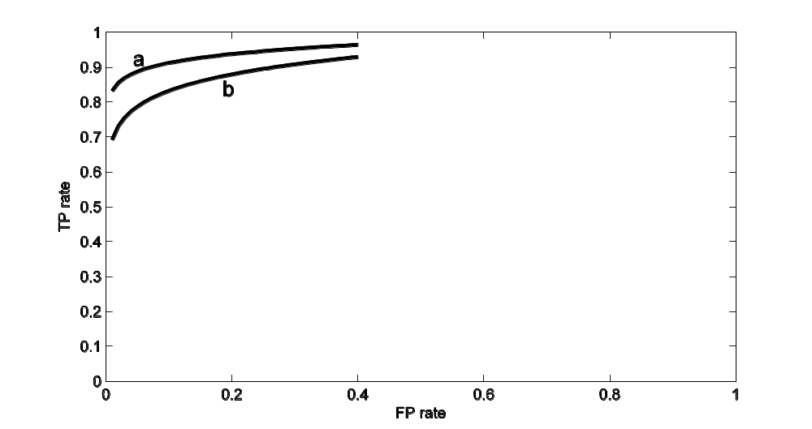
Receiving Operating Characteristic ROC
TP rate = TP/(TP+FN) FP rate = FP/(FP+TN)
ROC: FP x-axis, TP y-axis
Two classifiers, a is superior over b

Slide 31
Изученные понятия
Подход Бэйеса к анализу данных
Классификатор по наивному методу Бэйеса
Локальная независимость
Модель мешка слов
Лапласово сглаживание
Метрики точности: прецизионность и полнота

