Slide 1
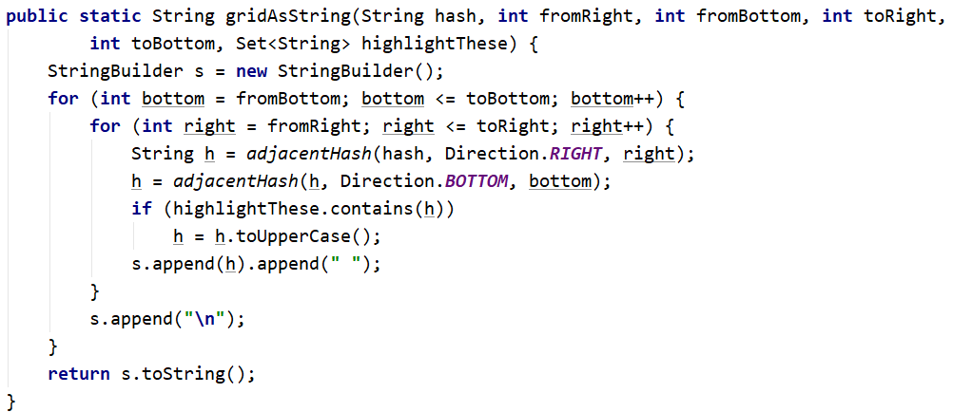
Class GeoHash
n1
n11
n1
n2
n3
n4
n9
n5
n5
n6
n7
n8
n10
n12

Slide 2
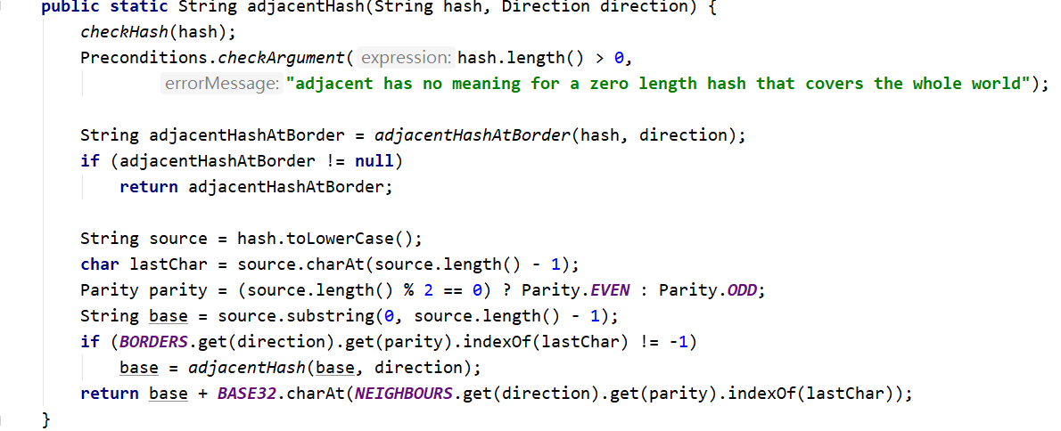
Class GeoHash
n1
n1
n2 (exception)
n3
n3
n4
n5
n5
n5
n6
n7
n8
n8
n9
n10

Slide 3
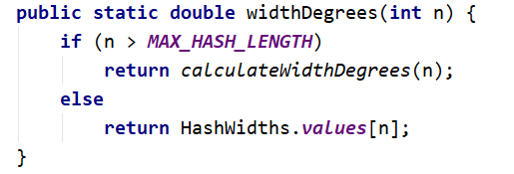
Class GeoHash
n1
n2
n3

Slide 4
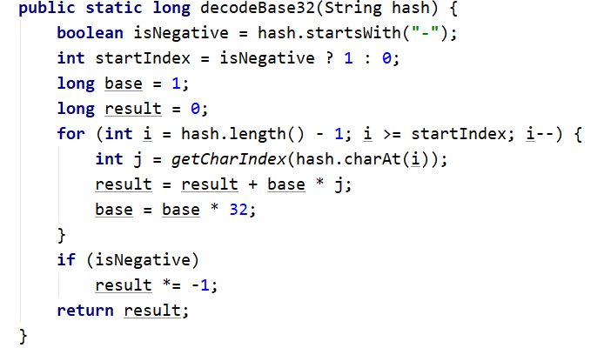
Class Base32
n1
n1
n4
n2
n3
n4
n8
n4
n5
n6
n7(IllegalArgumentException)
n8
n8
n9
n10
n11

Slide 5
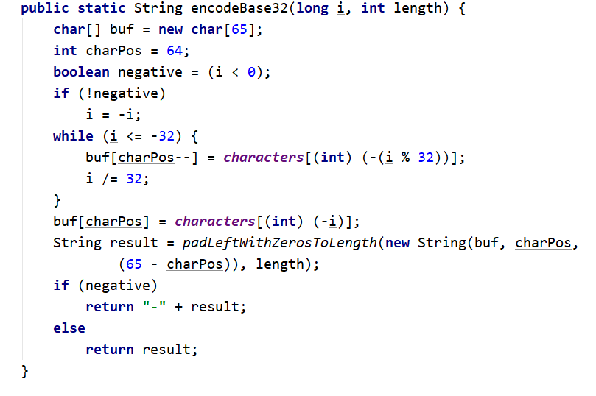
Class Base32
n1
n1
n1
n2
n3
n4
n5
n5
n6
n6
n6
n7
n8

Slide 6
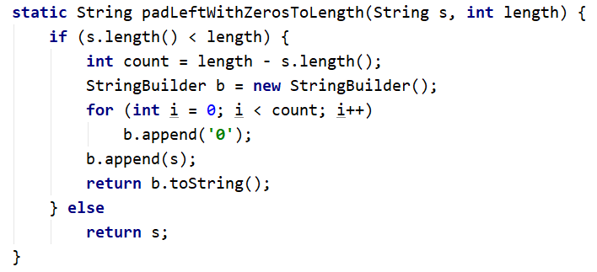
Class Base32
n1
n3
n3
n3
n4
n5
n5
n6
n6
n2

Slide 7
n1
n2
n3
n4
n5
n6
n7
n8
n9
n10
n11
n12

Slide 8
n1
n2
n3
n4
n5
n6
n7
n8
n9
n10
n11
n12

Slide 9
n1
n2
n3
n4
n5
n6
n7
n8
n9
n10
n11
n12

