Slide 1
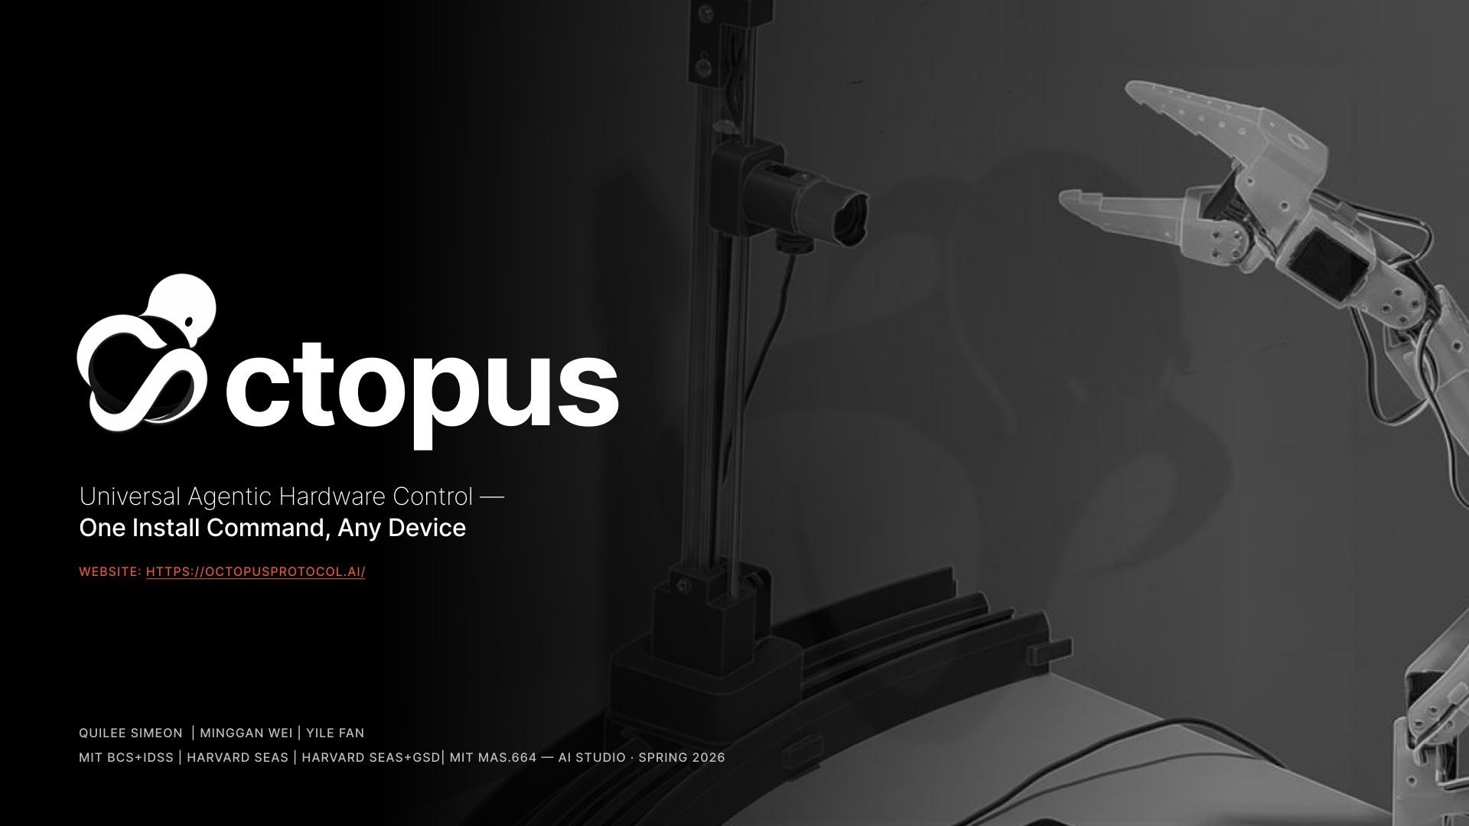

Slide 2
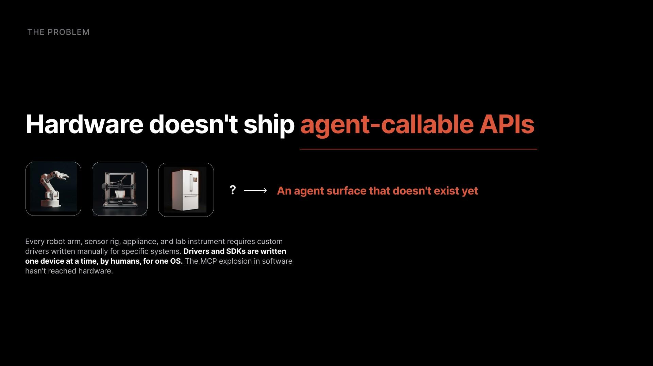

Slide 3
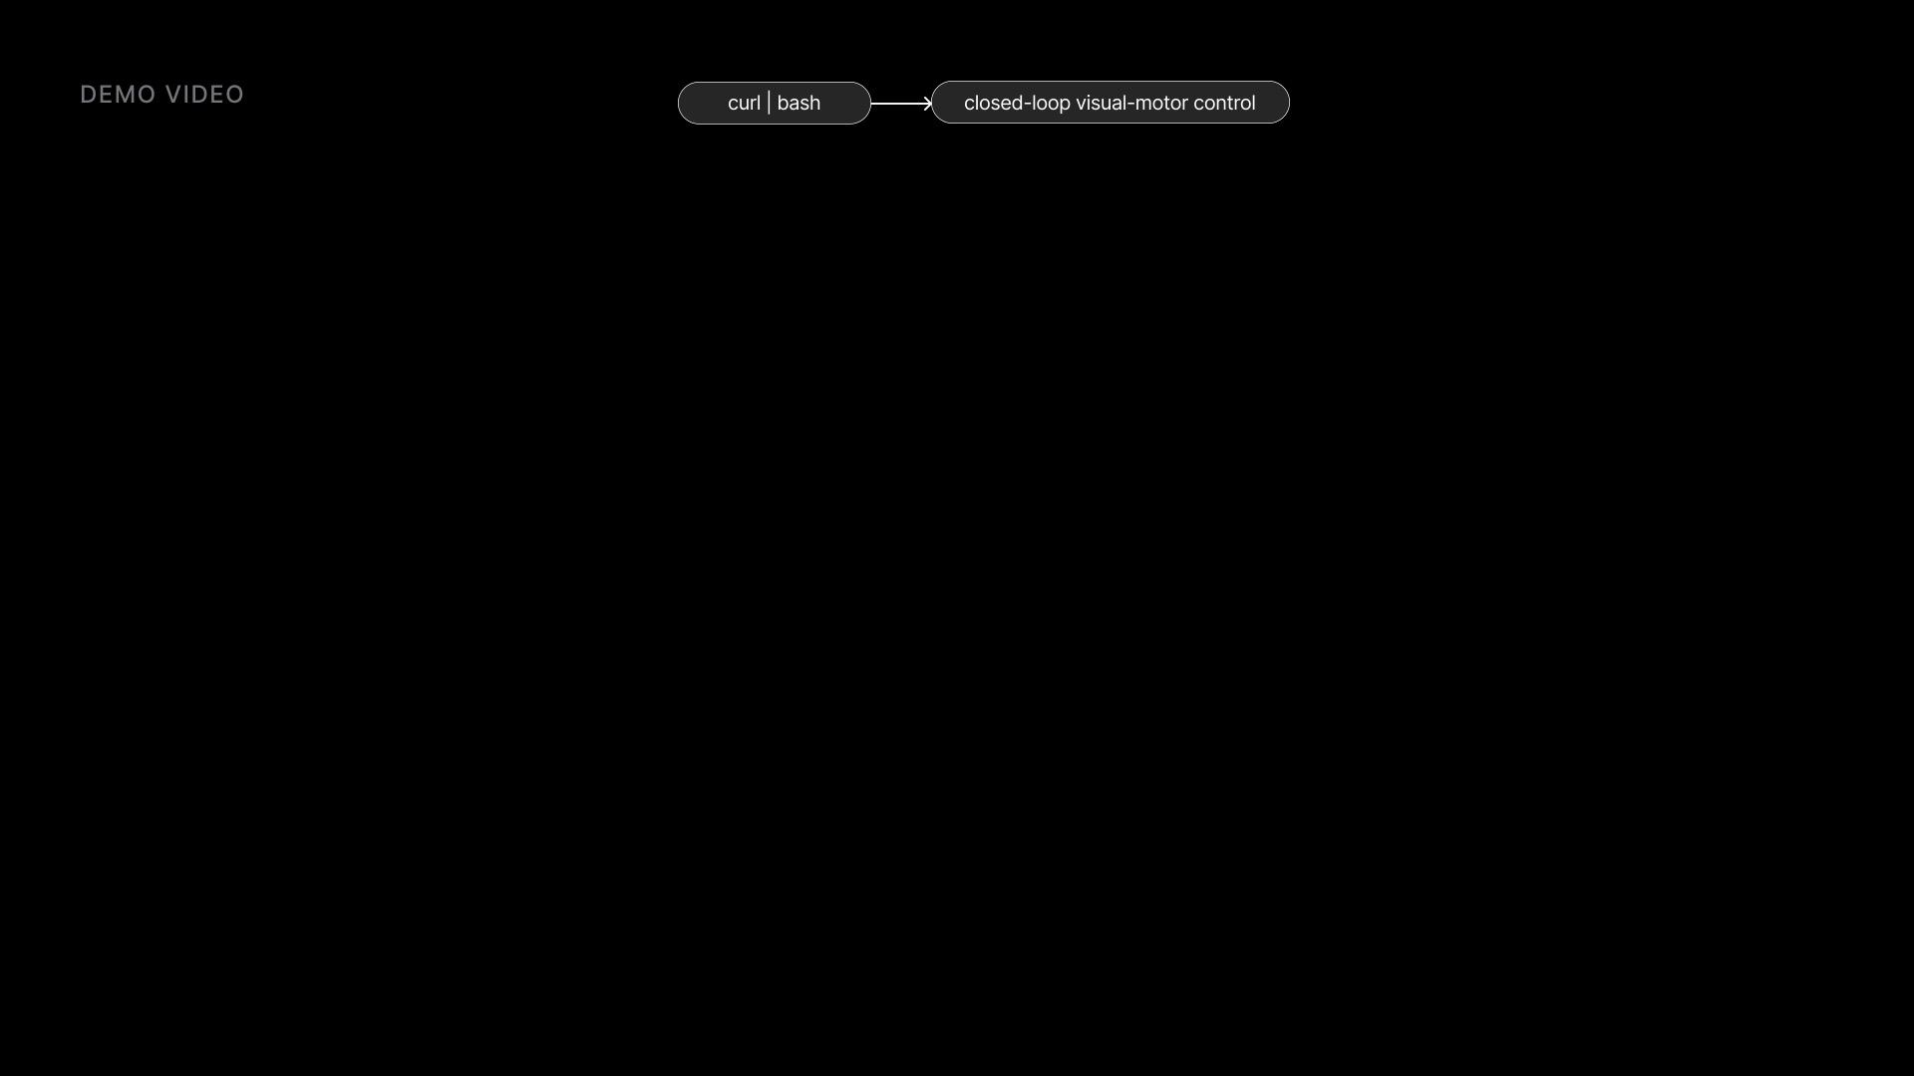
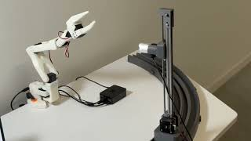
Pi install → Cloudflare tunnel → Claude Desktop calls our Pi → arm physically moves → camera sees the result. Narrated by Daniel (ElevenLabs).

Slide 4
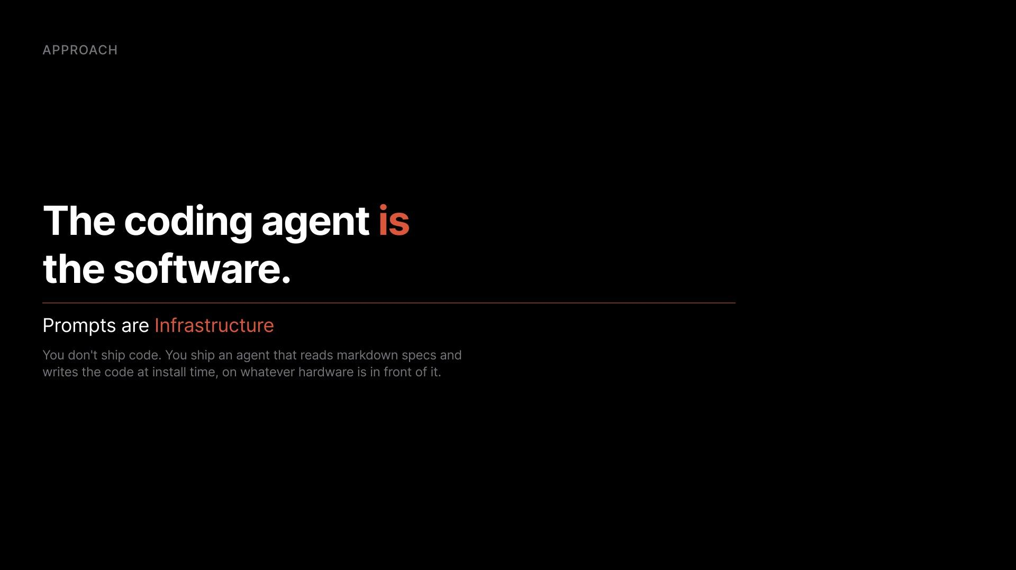
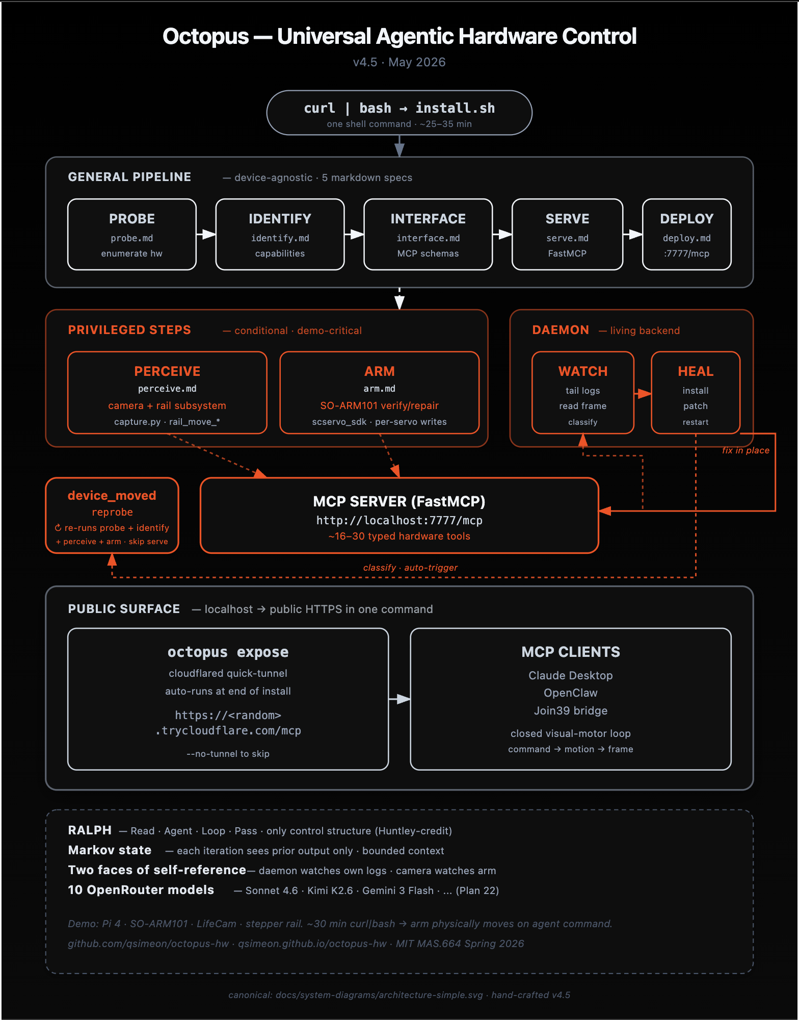
One install command. ~20 minutes. Every connected peripheral becomes a typed, agent-callable MCP tool.

Slide 5
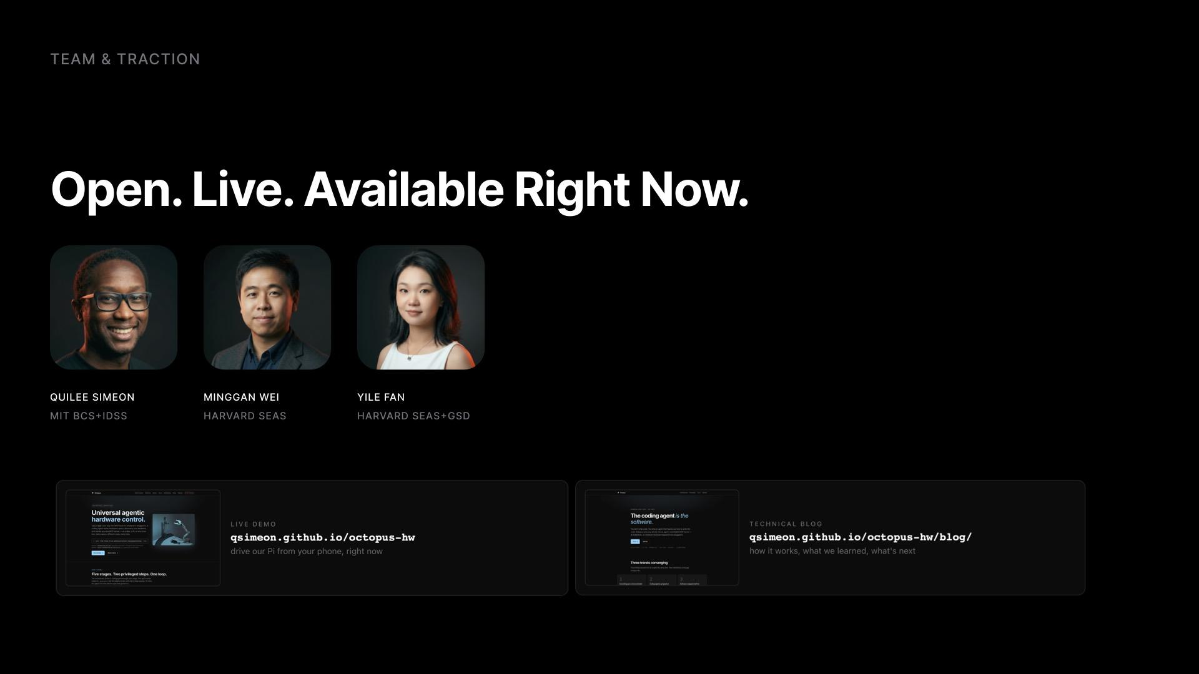


Slide 6
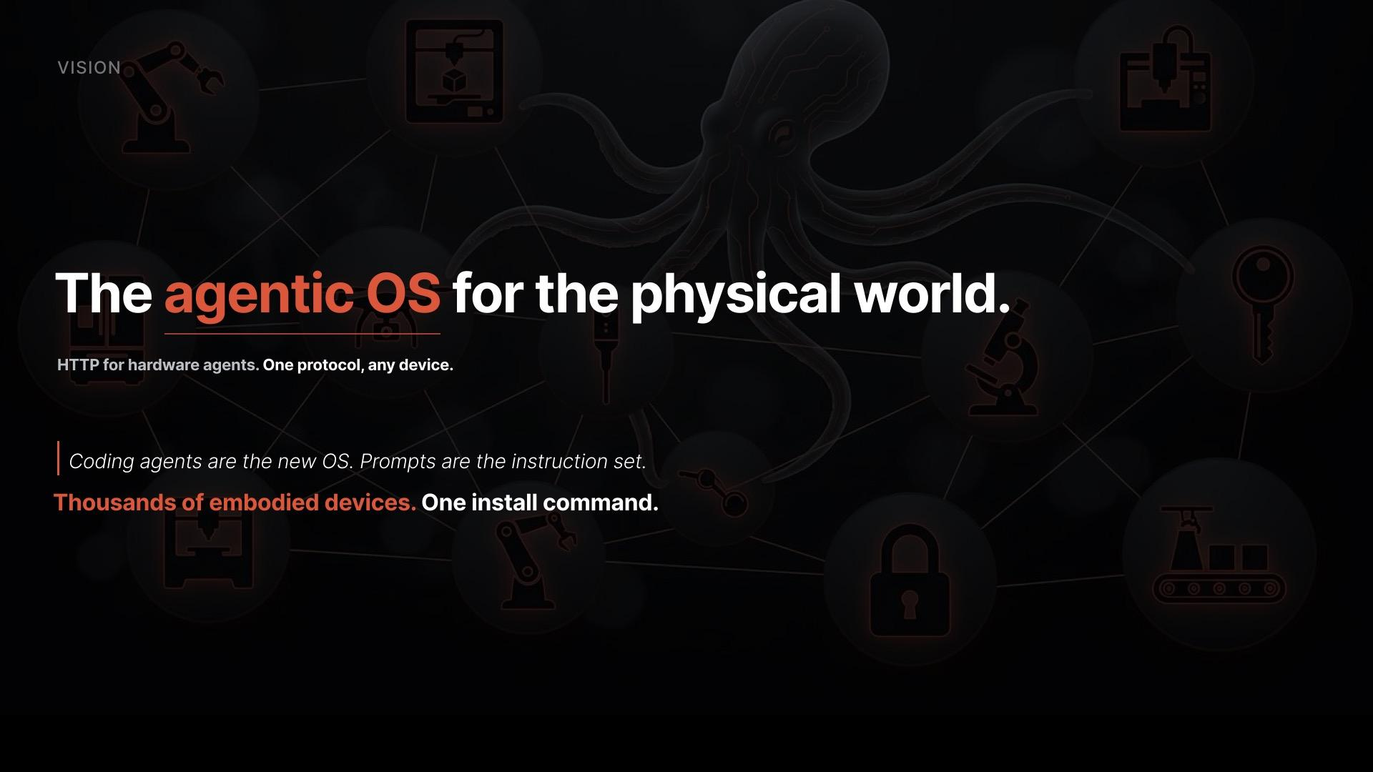

Slide 7
