Slide 1


Implement FTP with Gol
刘乔升 / 佘家瑞
https://github.com/qsliu2017/FxxkTheProject

Slide 2
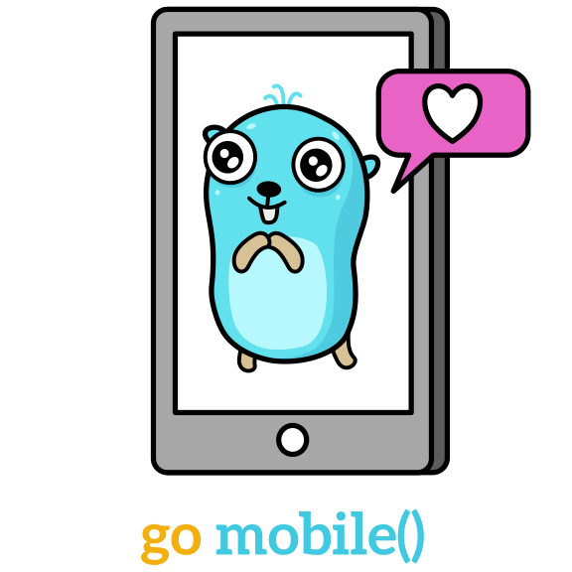
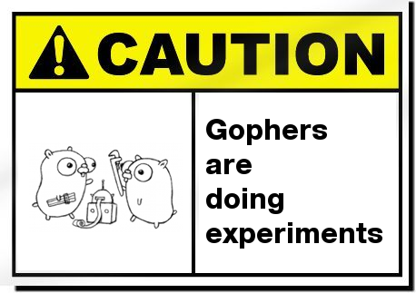
Gomobile: from Golang to AAR

Slide 3


3 Reasons to Use Golang
Build-in Goroutine Support
Well-designed IO and Network Packages
Gophers are CUTE!

Slide 4




Build-in Goroutine Support
// To run a function parallel
go handleClient()
// Use channel for communicating
msgChannel := make(chan string)
msg := <- msgChannel
msgChannel <- msg

Slide 5
Example: Command PORT
200 Command okay.
Client PI
PORT (1,2,3,4,5,6)
Server PI
I’ve
Accepted
A
Connection
I’m listening
I’ve
Created
Connection
Client DTP
TCP Connect
Server DTP

Slide 6
Example: Command PORT
Data
Goroutine
net.Listen()
go data_conn()
Control
Goroutine
chan <- addr
PORT (...)
chan <- conn
addr := <-chan
conn := <-chan

Slide 7



IO and Network Packages
// Make a TCP connect
conn, _ := net.Dial("tcp", addr)
// Send a local file to connect
io.Copy(f, conn)
// Save conn data to local file
io.Copy(conn, f)

Slide 8
Stream Model
File
net.Conn
io.Copy(dst, src)
File
net.Conn

Slide 9
Example: Compressed Mode
File
net.Conn
zip.NewWriter(io.Writer)
zip.Writer
io.Copy(dst, src)
File
zip.Writer

Slide 10
Example: Block Mode
File
net.Conn
r := io.TeeReader(dst, src)
File
net.Conn

Slide 11
Example: Block Mode
File
hash.Hasher()
net.Conn
io.CopyN(dst, src, n)
h := hasher.Hash()
net.Conn.Write(h)
hasher.Reset()

Slide 12


Pitfalls (and Solutions)
Project Managers Differences
Communication between Golang and Android

Slide 13
Dependencies Injection
// Golang
// FTP server should print some log
type Logger interface{
Log(string)
}
func NewFtpServer(Logger, ...)
// Java
public class MyLogger implements server.Logger{
@override
public void log(String){...}
}
server.newFtpServer(
new MyLogger(), ...)

Slide 14
Adapter Pattern
// Golang
// I want to read/write Android files
type File interface{
Read(...)
Write(...)
}
// Java
public class MyFile implements server.File{
public MyFile(File f){...}
@override
public read(...){
return f.read(...);
}
@override
public write(...){
return f.write(...);
}
}

Slide 15
Thanks! Let’s GO!!

