Slide 1

API Testing

Slide 2
Agenda
Introduction to Type of Software
Introduction to Web Application
Web Server
App Server
Web Browser
Data Base
3. Web URL
4. Http Structure
5. XML
6. JSON
7. Web Service
8. Post Man
9 New Man

Slide 3
Webservice tool
Rest API testing tools
PostMan(Chrome/Windows)
RestClient(Firefox)
httpMaster
RestAuusred
Karate
Katalon
TestOptimze
Soap API testing tools
SoapUI
SOAP Sonar
Wizdl
SOAtest
TestMaker

Slide 4
PostMan
It is a API testing tool and platform to test rest Webservices, using postman we can send json request and verify response pattern.
Started in 2012 and till now well know API testing tool , which can be used for fulfilling all requirement of a developer
and a tester during API development life cycle.
It is a GUI API testing tool where we can create our own request and it provide lot of features(snippit) to verify the response header and body.
It is open source plugin for chrome browser and also available for windows desktop
Two ways to install Postman tool
1. Go to chrome browser install “postman” as plugin
2. Go to website https://www.postman.com/downloads/ download .msi file

Slide 5
Postman can be used for
Automated testing : Run automated test suite using collection runner
Debug : The Postman console was designed to help debug Postman collections and API network calls
Publish : We can automatically generate documentation for postman API
Monitor : Create automated test to monitor API periodically check for its performance and response
Document : Create web-viewable documentation
Mock : Mock server allow you to simulate your API data

Slide 6
Prerequisites for Rest-API Testing
Knowledge of client server architecture of the application
Knowledge of HTTP request and HTTP response;
Knowledge of JSON or XML language
API documentation / API Functional spec from Development team
Get the list of rest API (URI)
Knowledge of CRUD
Write test case for every API that include CRUD operation
Required tool for API TESTING
Postman → GUI based API testing tool
RestAssured → Headless Java libraries for REST API testing
Collect API authentication if required (like Basic Auth , Bearer Auth , Oauth-1.0, Oauth-2.0)
Basic knowledge on database

Slide 7
CRUD operation
For Every API crud operation to be tested to check the customer expectation
Create → POST and PUT
Read → GET
Update →PATCH
Delete → DELETE
GET - Get all the resource from the server
POST - Create resource inside the server
PUT - Create or resource or complete update already existing resource inside the server
PATCH - Partially update the existing resource inside the server
DELETE - Delete the existing resource inside the server

Slide 8
Sample Application for Rest API
Steps to download Node-JS
Go to https://nodejs.org/en/download/
Download the “Windows installer.msi”
Install the node-js
To check the installation , go to CMD prompt.
type “node --version”
Execute below command for to install “json-server” stub
npm install –g json-server
Execute below command for to run “json-server”
npx json-server --watch db.json or npx json-server --watch db.json
Sample URI
http://localhost:3000/posts
http://localhost:3000/comments
http://localhost:3000/profile

Slide 9
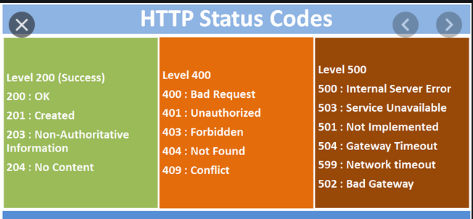
Status Code

Slide 10
Git API
GitHub is a could based distributed centralized repository tool , which used to maintain the resource in one place
Developers usage: Maintain entire source code of the application
Test Engineer usage: Maintain CRS of the application based on requirement version
Automation Engineer usage: Maintain automations framework source code
Build Engineer usage : Maintain application build based on versions
Git API document : https://developer.github.com/v3/repos/
List of Git API
Rest API | Rest API Options
URI | https://api.github.com/user/repos (Get , Post ) https://api.github.com/users/:username/repos (Get) https://api.github.com/repos/:owner/:repo (Post , Get ,Delete)

Slide 11
API test case
Envorniments | Testing Env
Web Base URI | http://api.github.com/user
PostNumber
Autherization | qspidersseleniumoar123/password
 |  | Request Properties |  |  |  |  |  | Response Properties
TestName | TestID | Http method | End point | Content Type | Body | Path paremter | Query paremter | status Code | Response Time | Actual Data
creteRepo | Git_API_01 | Post | /user/repos | application/json | { "name": "FirstRepo", "description": "This is your first repository", "homepage": "https://github.com", "private": false, "has_issues": true, "has_projects": true, "has_wiki": true } | N/A | N/A | 201:Created | 300 ms | 1. Project should be created with status of "Created" 2. verify the status of the Project in database 3. verify the owner name
addDuplicateProject | RMG_API_02 | Post | /user/repos | application/json | { "name": "FirstRepo", "description": "This is your first repository", "homepage": "https://github.com", "private": false, "has_issues": true, "has_projects": true, "has_wiki": true } | N/A | N/A | 422:Created | 300 ms | 1. Project should not be created & status should be "Unprocessable Entity" 2. verify the status of the Project in database 3. verify the failed message

Slide 12
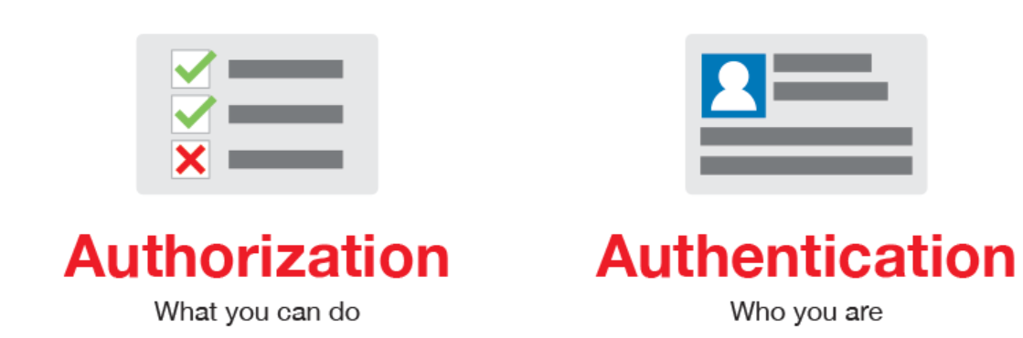
Request Authentication/ Authorization
Almost every REST API must have authorization to check weather you are authorized client or no? before allowing access to the resource
Authorization is present in header of the request.
There are 4 types of authorisation:
Bearer token : Required “TokenID” to access an API
Basic auth: Required “Username & Password “ for to access an API
3. OAuth 1.0 : Two level authentication
OAuth 2.0 : One level authentication
Oauth
Oauth is an Open Standard for Authorization protocol, widely used in web application , which allows API services to accesses user data without sharing is password.

Slide 13
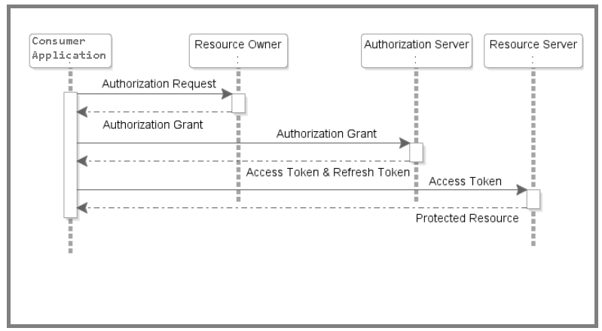
Oauth-2.0
Whenever your application requests private user data, it must send an OAuth 2.0 token along with the request. Your application first sends a client ID and, client secret to obtain a token. You can generate OAuth 2.0 credentials for web applications, service accounts, or installed applications.
Client application includes “client secret” with every request.
Client Id
Client secret

Slide 14
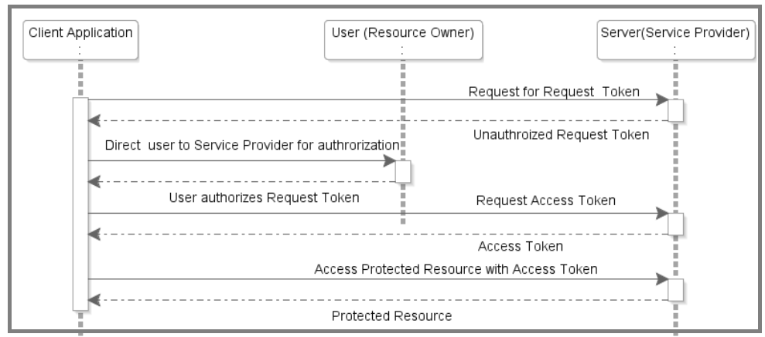
Oauth-1.0
Client app signs all OAuth requests to Twitter with its unique “consumer secret.”.
Consumer key and secret (client credentials): These two strings are used to identify and authenticate the client application
Request token (temporary credentials): This is a temporary credential provided by the server when the resource owner authorizes the client application to use the resource
Access token (token credentials): The server returns an access token to the client when the client submits the temporary credentials obtained from the server during the resource grant approval by the user.
Consumer ID / Consumer secret
Access token / Access secret

Slide 15
Postman Variable
Global variables allow you to access data between collections, requests, test scripts, and environments. Global variables are available throughout a workspace.
EG : pm.global
Collection variables are available throughout the requests in a collection and are independent of environments, so do not change based on the selected environment.
EG : Created/Modify only via postman GUI
Environment variables allow you to tailor your processing to different environments, for example local development vs testing or production. Only one environment can be active at a time.
EG : pm.environment
Local variables are temporary, and only accessible in your request scripts. Local variable values are scoped to a single request or collection run, and are no longer available when the run is complete.
EG : pm.varibales

Slide 16
Snippets
Two Types of Snippets
Pre-Request scripts : Executed before request (used for setting the precondition)
Tests snippets : Execute after request (used for validation/ assertion)
Test Snippet is a default feature available in postman for response validation. Code is automatically generated in JavaScript.
List of Test Snippets Available Postman :
Status code : Used to verify the response status code
Response time is less than: used to verify the time taken between request and response
Response body contain string: used to verify if the specific data is present throughout the body
Response body JSON value check: used to verify specific data inside the response body, in order to fetch specific data we should write json/ xpath.
Response header Content-type check
Response code name has String

Slide 17
Request Data Parameters
There are 2 types of parameter
1. Path parameter
2. Query parameter
Path parameter: it is used to set the recourse path or end point in the URI. Using path parameter we can execute same API with different parameter.
https://api.github.com/search/repositories?q=DeepakHR&sort=updated
https://api.github.com/search/users?q=qspidersseleniumoar
After Path Parameter
EG : https://api.github.com/search/:pathPram?q=DeepakHR&sort=updated
>Query parameter: It always in the form of key value pair followed by ‘?’. It is always present at the end of the URL.
After Query Parameter
EG : https://api.github.com/search/users
QueryParam1 = DeepakHR
sort = updated

Slide 18
Collection
Collections are a group of requests grouped into one folder
The Collection Runner allows you to run sets of requests in a specified sequence. The Collection Runner will log your request test results, and your scripts cancan pass data between requests as well as altering the request workflow.
You can run collections against specific environments, and can pass data files into a run
Collection runs allow you to automate your API testing
You can integrate collection runs to your CI/CD pipeline using Postman's CLI Newman

Slide 19
Newman
Newman is a powerful command-line collection runner for Postman. It allows you to run and test a Postman collection directly from the
Steps to run Collection in CLI
Create a Collection in postman
Add multiple request inside the collection
Export collection & save collection in .json format
Make sure Node-Js installed in your local machine
Go to CLI
Install Newman using below command
cli >npm install –g newman
Run below command to execute collection which is exported via postman
cli> newman run pathoftheFile.json

