Slide 1
Introduction to Compilers
編譯器介紹
  Wei Chung Hsu
  徐慰中
Department of Computer Science and Information Engineering

Slide 2



Course Information
Instructor: Wei Chung Hsu (徐慰中)
Compiler Background:
  Compiler development for Cray XMP/YMP, Cray-2, Cray-3 supercomputers.
  Tech lead for the optimizing compilers of Hewlett Packard HP-7200, HP-8000 processors
  Compiler architect for Intel/HP Itanium (IA-64) Merced and McKinley
  Binary Translation/Optimizations for Itanium, Sun SPARC, x86, MIPS and ARM processors
  Finalization for HSAIL (HSA Intermediate Language)
Department of Computer Science and Engineering

Slide 3

  Text Book:
  C.N. Fischer, R.K. Cytron, and R.J. LeBlanc, Jr.,
  "Crafting a Compiler", 2010
  Reference book:
  A.V. Aho, M. Lam, R. Sethi, and J.D. Ullman “Compilers: Principles, Techniques and Tools”
  the Dragon book, 2nd edition, 2007
  (1st edition was in 1986)
  Instructor Office Hours:
    Thursday 10-12, room 313
  email address: hsuwc@csie.ntu.edu.tw
  TAs
    傅勝余 (interaction.fu@gmail.com)
Department of Computer Science and Engineering

Slide 4
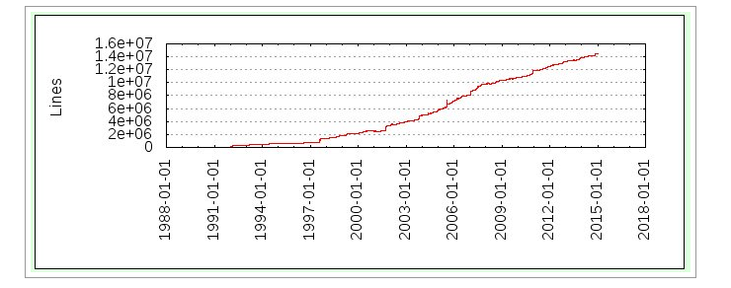
GCC Soars Past 14.5 Million Lines Of Code
System Software Dragons
Linux kernel is over 19 Million Lines Of Code
Department of Computer Science and Engineering

Slide 5
Grading:
    Compiler Implementation Project : 50%
    for language C--
    Midterm Exam: 20% (in-class)
    Final Exam: 25% (in-class)
    Quizzes and Class Participation (10%)
Compiler Implementation Project
    Team of two
    In C or C++
    Details: visit the class website often
(Ceiba)
Department of Computer Science and Engineering

Slide 6
課綱
Week 1 | 9/17 | 1) Course Organization, 2) Chapter 1: Introduction
Week 2 | 9/24 | 1) Chapter 1: Introduction, 2) Chapter 2: A Simple Compiler
Week 3 | 10/1 | Chapter 2: A Simple Compiler
Week 4 | 10/8 | Chapter 3: Scanner
Week 5 | 10/15 | Chapter 3 and Quiz1 (Chapter 1-3)
Week 6 | 10/22 | Chapter 4: Formal Grammar and Parsing
Week 7 | 10/29 | Chapter 5: Top-Down Parsing, Chapter 6: Bottom-up Parsing
Week 8 | 11/5 | Chapter 7: Syntax Directed Translation , Quiz2 (Chapter 4-7)
Week 9 | 11/12 | Midterm Exam
Week 10 | 11/19 | Chapter 12: Runtime Support
Week 11 | 11/26 | Chapter 8: Declaration Processing and Symbol Table
Week 12 | 12/3 | Chapter 9: Semantic Analysis
Week 13 | 12/10 | Code Generation for ARM/RISC-V
Week 14 | 12/17 | Code Generation for Data Accesses and Simple Register Allocation
Week 15 | 12/24 | Code Generation for Control Structures
Week 16 | 12/31 | Basic Code Optimizations: CSE, Register Allocation
Week 17 | 1/7 | Basic Code Optimizations: Code Scheduling, Parallelization
Department of Computer Science and Engineering

Slide 7

Ch 1: Introduction
What is a compiler? (original meaning)
  A compiler reads a program written in the source language and translate it into an equivalent program in machine language.
Source
Program
(in high level lang.)
Compiler
Machine code (or object code)
Automatic translation +
Optimization
Error messages
Department of Computer Science and Engineering

Slide 8
  Fallacy: Code in assembly language to obtain the highest performance
  Modern compilers are very sophisticated, and can generate code competitive to hand crafted code.
  Compilers are very patient in conduct register allocation and code scheduling. Such optimization by hand are error prone.
  To achieve highest performance, an assembly coder must have a deep understanding of the underlying processor architecture. The compiler code generator usually has the best knowledge of the processor architecture.
  Productivity, maintainability, portability, ease of debugging, code reusability all favor High Level Languages
Department of Computer Science and Engineering

Slide 9
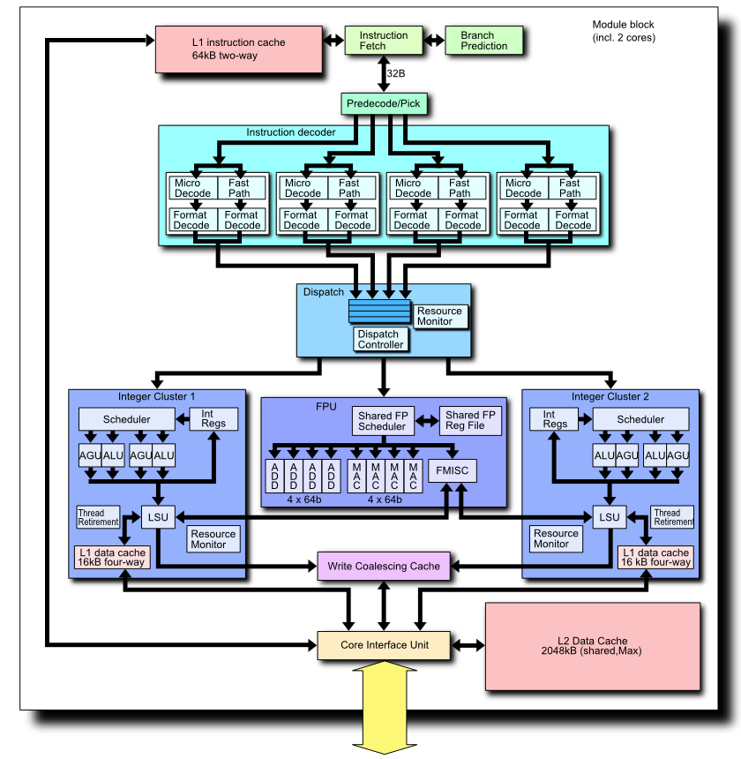
Micro-architectures are getting increasingly more complex, writing assembly code to obtain high performance is no longer a manageable task.
Micro-architectures are company IP, for example, Intel would not give out all details of x86 micro-architectures.
For dynamic, OOO processors, it is hard for a programmer to know how to write a high performance code. Should leave this to experts.
Department of Computer Science and Engineering

Slide 10
What is a compiler? (broader meaning)
  A compiler reads a program written in a source language and translate it into an equivalent program in target language.
Compiler
Source
program
Target
Program
Error messages
Department of Computer Science and Engineering

Slide 11
What Do Compilers Do?
Source language:
  High-level programming languages,
  Text-formatting languages,
  Query languages,
  Logic-level specification languages
  Application binaries in one ISA
Target language:
  Machine languages,
  Other high-level PL,
  Typesetting commands,
  VLSI layout
  other ISAs
  Compiler Technology can be broadly applied
Department of Computer Science and Engineering

Slide 12

  Target machine code
  Pure machine code (i.e. ISA)
    Assembly language format
    Relocatable binary format
  Augmented machine code (augment with system calls, I/O, memory allocation, math functions, …) (i.e. ABI)
  Virtual machine code (e.g. P-code or byte code)
    Good for transportable compilers
    Generated code need to be interpreted
  No matter what target code or target machine code format are generated, compilers do the same job: Translation.
VISA
Department of Computer Science and Engineering

Slide 13
Analysis and Synthesis
Two parts to compilation
  Analysis: This part breaks up the source program into pieces for syntax and semantic analysis, e.g. parsing.
  The analysis portion is widely used in many tools.
  Synthesis: This part constructs the desired target program, e.g. code generation.
  The synthesis portion can be very complex, such as the optimizer.
Department of Computer Science and Engineering

Slide 14
Interpreter and Compiler
Interpreter: executes programs without explicitly performing target code generation.
Interpretation often involves large overhead
Interpretation avoids the synthesis part.
Interpreter
Output
Source
program
Data
Department of Computer Science and Engineering

Slide 15
Why Interpretation
  A higher degree of machine independence: high portability.
  Dynamic execution: modification or addition to user programs are allowed (e.g. for interactive debugging).
  Dynamic data type: type of objects may change at runtime (e.g. Javascript)
  Easier to write an interpreter – no synthesis part.
  Better diagnostics: more source text information available
Department of Computer Science and Engineering

Slide 16
Hybrid Translation
Source program
JIT
Translator
Virtual
Machine
Intermediate
Code (bytecode)
Output
Input
Compilation
(javac)
Interpretation
(JVM)
Compilation
(JIT)
Example: A Java Virtual Machine with a JIT
Department of Computer Science and Engineering

Slide 17
  Fallacy: Compilation is always static
  Runtime compilation is increasingly more common, consider Java JIT, MS .net, Graphics rendering, GPGPU code generation, …
  Runtime compilation allows for more portable applications. (compile then distribute vs. distribute then compile)
  Runtime compilation enables more machine dependent code optimizations.
  Runtime compilation enables adaptive systems (e.g. dispatching OpenCL kernels to a more suitable device)
Department of Computer Science and Engineering

Slide 18
The Structure of a Compiler
Analysis
Lexical analysis (Linear Analysis) : stream of characters are grouped into tokens
Syntax analysis (Hierarchical Analysis): tokens are grouped hierarchically with collective meaning
Semantic Analysis: ensure the components of a program fit together (type, scope, ..)
Synthesis
Code generation and optimization
Department of Computer Science and Engineering

Slide 19
Source
Program
Scanner
Tokens
Parser
Syntactic
Semantic
Routines
(Character
Stream)
Structure
Intermediate
Representation
Symbol and
Attribute
Tables
Optimizer
(Used by all
Phases of
The Compiler)
Code
Generator
The structure of a Syntax-Directed Compiler
Target Machine
Code
Department of Computer Science and Engineering
Department of Computer Science and Engineering

Slide 20
Lexical Analysis Example
Pay := Base + Rate* 160
Lexical analysis:
characters are grouped into seven tokens:
Pay, Base, Rate are identifiers
:= is assignment symbol
+ and * are operators
160 is a number
Error example:
pay := base + rat@e*160
pay := base + rat^^e*160
→ this error (^^) will be propagated to syntax analysis and reported as a syntax error
Department of Computer Science and Engineering

Slide 21
Syntax Analysis Example
Pay := Base + Rate* 160
The seven tokens are grouped into a parse tree
Assignment stmt
identifier
expression
:=
pay
expression
expression
+
identifier
*
base
Rate
160
Department of Computer Science and Engineering

Slide 22
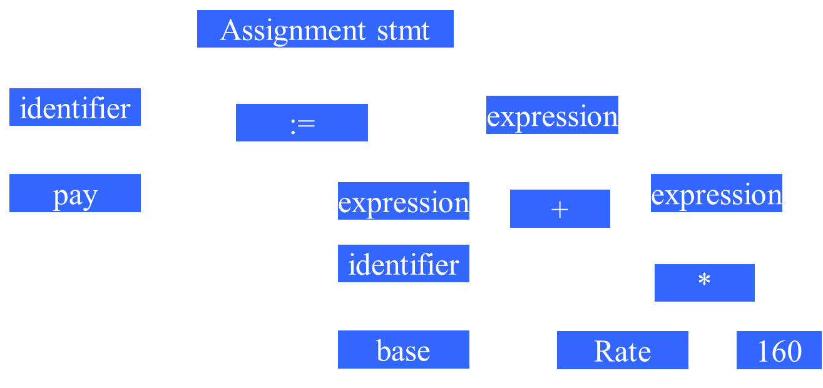
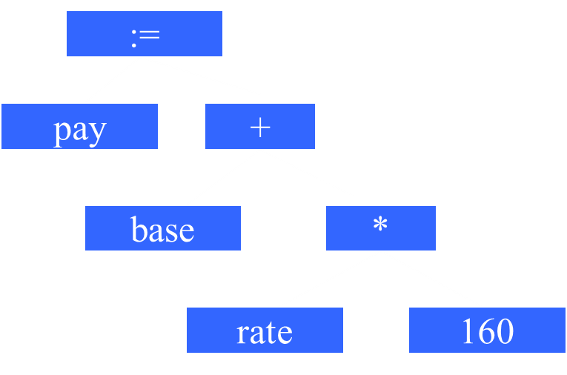
Transform a Parse Tree to a Syntax Tree
Syntax Tree
(also called
Abstract Syntax Tree
AST)
Parse Tree
Department of Computer Science and Engineering

Slide 23
Semantic Analysis Example
Pay := Base + Rate* 160
Checks for semantic errors and gathers type information for code generation.
:=
:=
pay
+
pay
+
base
*
base
*
rate
Int-to-real
rate
160
160
Department of Computer Science and Engineering

Slide 24
The Phases of a Compiler
Source Program
Analysis
Lexical
Syntax
Semantic
IR code gen
Optimizer
Synthesis
Target code gen
Target Program
Department of Computer Science and Engineering

Slide 25
The Phases of a Compiler
Source Program
Lexical
Symbol
Table
manager
Syntax
Error
handler
and
recovery
Semantic
IR code gen
Optimizer
資料庫
Target code gen
監察院?
Target Program
Department of Computer Science and Engineering

Slide 26
The Phases of a Compiler
Source Program
Lexical
Symbol
Table
manager
Syntax
Error
handler
and
recovery
Semantic
IR code gen
Optimizer
Target code gen
Is increasingly more important
Target code Optimizer
Department of Computer Science and Engineering

Slide 27
Source Program
Pay := base + rate * 60
Id1 := Id2 + Id3 * 60
lexical
:=
+
syntax
id1
*
id2
:=
id3
60
semantic
+
id1
*
id2
id3
inttoreal
IR code gen
temp1 = inttoreal(60) temp2 = id3* temp1 temp3 = id2+ temp2 id1 = temp3
60
temp1 = id3* 60.0
id1 = id2+temp1
optimizer
target code gen
movf id3, fr2; movf id2, fr1
mulf #60.0, fr2
addf fr2,fr1
movf fr1, id1
Target Program
Department of Computer Science and Engineering

Slide 28

Grouping of Compiler Phases
Front end
  Consist of those phases that depend on the source language but largely independent of the target machine.
Back end
  Consist of those phases that are usually target machine dependent such as optimization and code generation.
Department of Computer Science and Engineering

Slide 29
Pop quiz
Indicate which of the following components are part of front-end, which are part of back-end.
  Target code optimizer
  Parser
  Scanner
  IR code generator
  Type checker
Back-end
front-end
front-end
front/middle end
front-end

Slide 30
Common Back-end Compiling System
Fortran
C/C++
Pascal
Cobol
Common IR (e.g. Ucode)
Optimizer
Target Machine Code Gen
Department of Computer Science and Engineering

Slide 31
Retargetable Compiler
C compiler Front-End
IR Code Generation
Machine Independent Optimization
Code gen for
MIPS
Code gen for
IA32
Code gen for
SPARC
Code gen for
PowerPC
Department of Computer Science and Engineering

Slide 32
Pop quiz
The HP PA-RISC compiler/optimizer is
a) a common back-end compiling system
b) a retargetable compiler
The ICC compiler (Intel’s C Compiler) is
a) a common back-end compiling system
b) a retargetable compiler
The GCC (GNU C Compiler) is
a) a common back-end compiling system
b) a retargetable compiler
a
a (C and C++)
b (x86 and IA64)
b

Slide 33
Quick Overview
What are the two main functions of translation?
  Analysis and Synthesis
What are major work involved in analysis?
  Lexical, Syntax and Semantics analysis
What are the typical phases in a compilation?
  lexical,syntax,semantics,IR-CG,optimization,TargetCG
What phases belong to FE (Front-End)
  Analysis + IR
What phases belong to BE (Back-End)
  Target Code Gen + Machine dependent optimization
How is a JIT different from an ordinary compiler
  JIT compiles ByteCode (VISA) into native code at runtime
Department of Computer Science and Information Engineering

Slide 34
Without IR
C front-end
X86 backend
Fortran
front-end
ARM backend
Basic
front-end
PPC backend
Pascal
front-end
SPARC backend

Slide 35
With IR
C front-end
X86 backend
Fortran
front-end
ARM backend
IR
Basic
front-end
PPC backend
Pascal
front-end
SPARC backend

Slide 36
LLVM Compiler Infrastructure
Clang
(C/C++/Objective-C)
X86 backend
dragonegg
(GCC tool chain)
(Fortran/Ada/OpenMP/…)
ARM backend
LLVM IR
Others
(Java, C#, Haskell, Ruby, Python, Rust,…)
PPC backend
SPARC backend
LLBT
( Arm, x86, …)

Slide 37
LLVM Compiler Infrastructure
Clang
(C/C++/Objective-C)
X86 backend
dragonegg
(GCC tool chain)
(Fortran/Ada/OpenMP/…)
ARM backend
LLVM
IR
Ind
Opt
Others
(Java, C#, Haskell, Ruby, Python, Rust,…)
PPC backend
SPARC backend
LLBT
( Arm, x86, …)

Slide 38
Syntax and Semantics
A complete definition of a PL includes specification of its syntax (structure) and semantics (meaning)
Syntax
Syntax is usually defined by CFG (context free grammar)
e.g. A := B+C; is legal, A:=B+; is not.
CFG example:
<exp> → <exp> + identifier
B+C, A+D, A+B+C, … are valid expressions
Semantics
Many important language features such as type
compatibility and scoping rules are context-sensitive.
e.g. A:=B+C; is legal when all variables are declared, are not boolean or structure type, and are type compatible
Will Will will Will’s will?
Department of Computer Science and Engineering

Slide 39
Static Semantics
Static semantics provide a set of rules which syntactically legal programs are actually valid, such as type rules.
e.g.
all identifiers are declared
operator and operands are type compatible
procedures are called with the proper parameters
Attribute grammars are a popular method of formally specifying static semantics.
e.g.
Exp1→Exp2+Term (Exp2.type == numeric && Term.type==numeric).
Department of Computer Science and Engineering

Slide 40
Runtime Semantics
Runtime (or execution time) semantics specifies what a program computes. For example, a program state is defined, and program execution is described as in terms of changes to that state.
Natural semantics
  Give assertions known to be true before a construct, we may infer assertions that will hold after the evaluation of the construct.
Axiomatic semantics
  A set of formally specified relations or predicates that relate program variables.
  Statements are defined by how they modify these relations
Denotational semantics
Above methods try to enable runtime checks to be generated automatically from language semantic specification
Department of Computer Science and Engineering

Slide 41
Imprecise Semantics Challenges
Example:
In Pascal, a logical expression
(I <> 0) and (K div I > 10)
is not well-defined – because it is not defined whether the and operator should be treated as ordinary binary operator (both expressions {I<>0} and {K div I} should be evaluated first) or like a short-circuit operator (i.e. expression {K div I} should not be evaluated if I==0).
Why short-circuit is not always a preferred
implementation here ?
Department of Computer Science and Engineering
Department of Computer Science and Engineering

Slide 42
Another Example:
In Java, all functions must return via a return expr statement.
The following function is illegal:
public static int subr(int b) {
if (b!=0) return b+100; }
How about the following?
public static int subr(int b) {
if (b!=0) return b+100;
else if (10*b == 0) return 1; }
Department of Computer Science and Engineering
Department of Computer Science and Engineering

Slide 43
Why Study Compilers?
Influences on programming language design (see section 1.6)
Influences on computer design (see section 1.7)
Compiling techniques are useful for software development
  Parsing techniques are often used
  Learn practical data structures and algorithms
  Basis for many tools such as text formatters, structure editors, silicon compilers, design verification tools,…
So you may write more efficient code
  Writing a compiler requires an understanding of almost many important CS subfields
Department of Computer Science and Engineering
Department of Computer Science and Engineering

Slide 44
Why Study Compilers?
Influences on programming language design (see section 1.6)
Influences on computer design (see section 1.7)
Compiling techniques are useful for software development
  Parsing techniques are often used
  Learn practical data structures and algorithms
  Basis for many tools such as text formatters, structure editors, silicon compilers, design verification tools,…
So you may write more efficient code
  Writing a compiler requires an understanding of almost many important CS subfields
Requirements for a successful language
Easy to compile
Has a quality compiler on a wide variety of machines
Better code will be generated
Fewer compiler bugs
Compiler is smaller, faster, reliable
Good diagnostic messages and development tools
Department of Computer Science and Engineering
Department of Computer Science and Engineering

Slide 45
Why Study Compilers?
Influences on programming language design (see section 1.6)
Influences on computer design (see section 1.7)
Compiling techniques are useful for software development
  Parsing techniques are often used
  Learn practical data structures and algorithms
  Basis for many tools such as text formatters, structure editors, silicon compilers, design verification tools,…
So you may write more efficient code
  Writing a compiler requires an understanding of almost many important CS subfields
Many machines failed because they are hard to compile/optimize for:
Intel 860
IBM cell
Cray-2
Department of Computer Science and Engineering
Department of Computer Science and Engineering

Slide 46
Why Study Compilers?
Influences on programming language design (see section 1.6)
Influences on computer design (see section 1.7)
Compiling techniques are useful for software development
  Parsing techniques are often used
  Learn practical data structures and algorithms
  Basis for many tools such as text formatters, structure editors, silicon compilers, design verification tools,…
So you may write more efficient code
  Writing a compiler requires an understanding of many important CS subfields
programming, data structures and algorithms, automata and formal language, system programming, computer organization.
Department of Computer Science and Engineering
Department of Computer Science and Engineering

Slide 47

A Short History of Compiler Construction
1945—1960 Code Generation
How to generate code for a given machine
The goal was to match the efficiency of assembly coding.
1960—1975 Parsing
Many new languages came out. Automatic parsing became more important.
1975—present Code Optimization
ILP: RISC and Post-RISC machines.
Vectorization: SIMD(SSE, GPGPU) Parallelization: Multiprocessors (SMP, MPP)
Heterogeneous Computing: Cuda, OpenCL, HSA
Department of Computer Science and Engineering

Slide 48
Compiler Constructions Tools
First Fortran compiler took 18 person-years. Now with compiler construction tools, you may build a simple compiler in one semester.
Translator writing tools:
  Scanner generator
  Parser generator
  Symbol table manager
  Attribute grammar evaluator
  Automatic code generator
  Data flow analyzer generator
Compiler - Compiler
Department of Computer Science and Engineering

Slide 49
Quiz
In 2001, Intel introduced the new 64-bit architecture IA-64 or IPF (called Itanium Processor Family), and a few generations of processors, including Merced(01), McKinley (02), Madison (03), Montecito (06), and Tukwila (2010). IA-64 is not binary compatible to x86 (i.e. IA-32)machines.
Q: How to create the first C compiler on the Itanium machine?
Requirements:
1) the compiler must generates Itanium code
2) the compiler must run on Itanium machines
Department of Computer Science and Engineering

Slide 50
Quiz
Q: How to create the first C compiler on the Itanium machine?
a) Write a C compiler in C, compiled it on Itanium machines using GCC.
b) Write a C compiler in Itanium machine code
c) Develop a Cross-compiler on x86 PC and use it to compile itself into C/Itanium.
d) Leave it to MicroSoft
Department of Computer Science and Engineering

Slide 51
Cross-Compilation
A C Compiler
Written in C
Generates
Itanium code
GCC compiler
on PC
Step 1
A C Compiler
Gen Itanium code
Runs on x86
C Compiler
Gen Itanium code
Runs on Itanium
Step 2
Department of Computer Science and Engineering

Slide 52
Cross-Compilation and Bootstrapping
Quiz: How to create the first C compiler on the new Itanium if no cross-compilers to use?
Department of Computer Science and Engineering

Slide 53
Answer: Bootstrapping.
A subset of C is selected (e.g. C--) and a simple compiler is written in assembly code, called this compiler C0.
Rewrite this subset compiler using the subset (C--), compile it with C0, get a new compiler called C1.
Write a more complete set of C in C--, compiled with C1, get a new compiler C2
Repeat the process until a complete C compiler is done
Department of Computer Science and Engineering

Slide 54
Summary
What is a compiler
Why is compiling technique important
Three phases of analysis
Phases of a compiler
Grouping of phases
Compiler construction tools
Department of Computer Science and Engineering

