Slide 1

Book Metadata and Recommendation API
Coursework Presentation
NAME
Changwei Li
STUDENT ID
201690978
MODULE
Web Services and Web Data
Notes:
Hello everyone, and thank you for attending my presentation. Today, I will be discussing my coursework project, a Book Metadata and Recommendation API.
This project involved building a comprehensive backend system to manage book information and provide personalized recommendations.
I'll walk you through the project scope, the development process, key technical decisions, and the final deliverables.

Slide 2

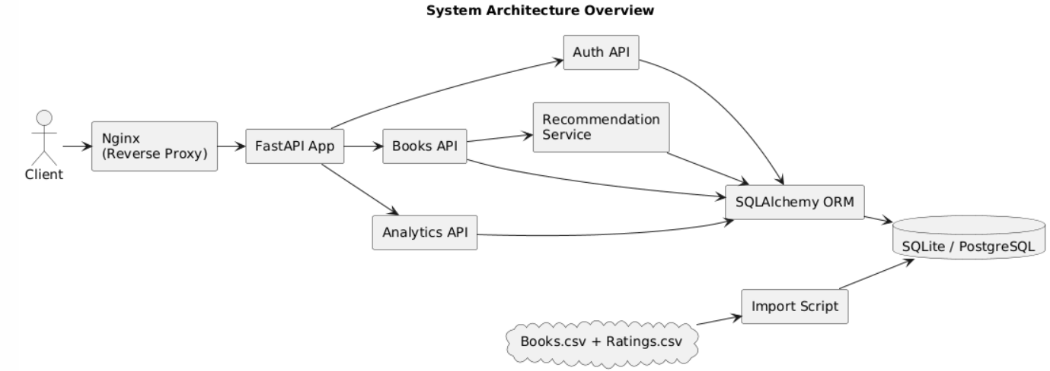
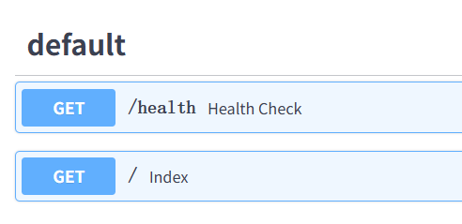
Project Scope & Delivered System
What Was Built
• RESTful book metadata management API with JWT authentication
• Complete CRUD operations, recommendation engine & analytics endpoints
• Reproducible dataset import pipeline based on public Kaggle data
Key Deliverables
• Secure, testable backend system is ready designed
• Realistic data behavior simulation via integrated public dataset ingestion
Notes:
First, let's define the project scope. I built a RESTful API for managing book metadata, secured with JWT authentication. The system includes full CRUD operations, a recommendation engine, and analytics endpoints. A key feature is the reproducible dataset import pipeline that uses public Kaggle data. The main deliverables are a secure, testable backend system and realistic data behavior achieved through the integration of this dataset.

Slide 3
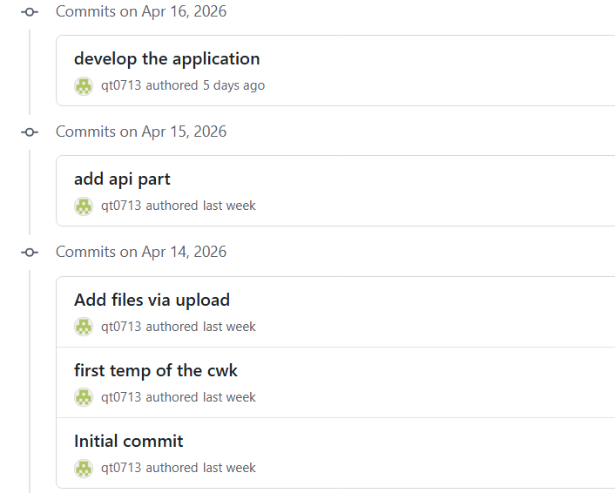
Version Control & Development Process
part of the commits history
Commit Strategy
•Incremental & Feature-based:Standardized format (e.g., `feat: auth`, `fix: import`).
•Traceable History:Task-focused commit messages for full auditability.
Codebase Evolution
Core API → Authentication → Analytics → Data Optimization → Docs
• Demonstrates iterative engineering and progressive workflow.
• Strict separation of bug fixes from feature work (no "final dump").
Notes:
For the development process, I adopted a rigorous version control strategy using Git. Commits were incremental and feature-based, with clear, task-oriented messages to ensure full traceability. The codebase evolved through a clear progression: starting with the core API, then adding authentication, analytics, optimizing the data importer, and finally, comprehensive documentation. This demonstrates iterative engineering and careful management, rather than a single final upload.

Slide 4
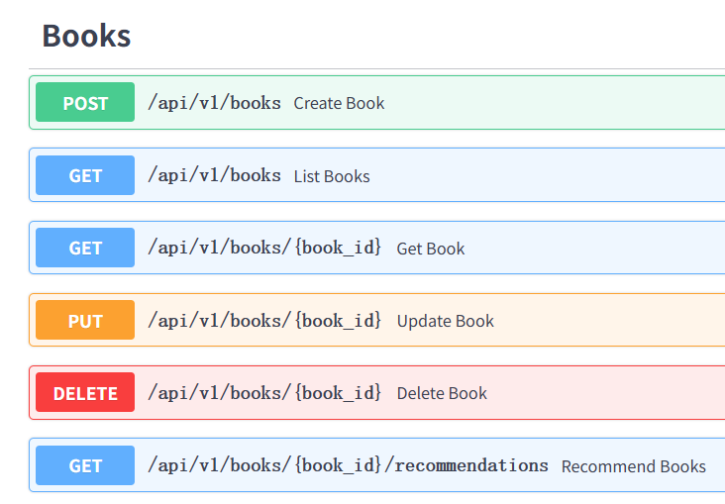


API Documentation
Documentation Coverage
• Full endpoint specs for Auth, Books & Analytics modules
• Complete schemas, HTTP codes & auth examples included
Accessibility
• Stored locally:docs/API_DOCUMENTATION.pdf
• Supports offline review & live demo testing workflows
Notes:
Comprehensive API documentation was a key deliverable. It covers all endpoints for the Auth, Books, and Analytics modules, including detailed request and response schemas, HTTP status codes, and authentication examples. The documentation is accessible as a PDF within the repository, supporting both offline assessment and live demonstration testing.

Slide 5
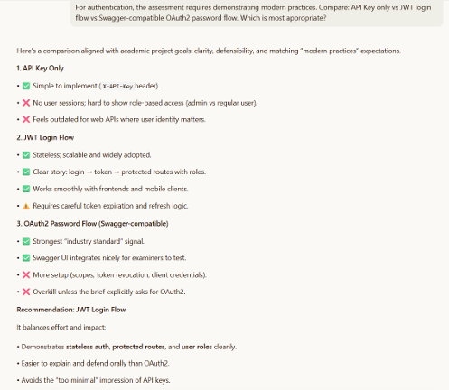








Technical Report Highlights
Technology Stack Justification
A screenshot of GenAI
FastAPI Static typing & high perf
SQLAlchemy Robust ORM mapping
Dual DB Support SQLite / PostgreSQL
System Architecture JWT + Resource Routing
Analysis & Evidence
Dataset Methodology 0–10 Rating Scale Logic
Pytest Summary Coverage & Unit Tests
Deployment Validated CVM + Nginx Stack
GenAI Declaration Logs Attached in Appendix
Notes:
The technical report details the rationale behind key decisions. The technology stack, including FastAPI for performance and typing, SQLAlchemy for ORM, and dual database support, was chosen for its robustness and flexibility. The architecture follows resource-oriented routing and a JWT security model. The report also includes analysis of the dataset import methodology, testing with Pytest, deployment validation, and a declaration of GenAI usage with supporting logs.

Slide 6
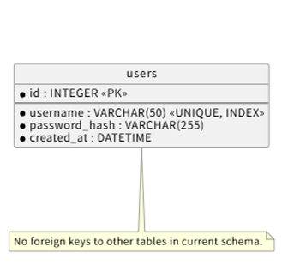


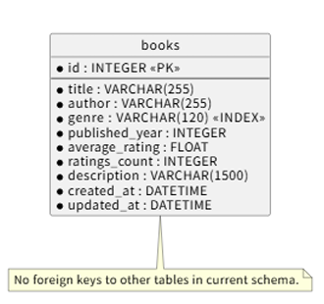

System Architecture & Data Model
System Execution Flow
Recommendation Logic
Client → FastAPI Routes → Service Layer → SQLAlchemy ORM → Database → JSON Response
1
Prioritize books matching the **genre** of the user's seed book.
2
Sort results by **average rating**, then by total number of ratings.
Core Data Schema
• User: Account credentials & profile data • Book: Title, author, genre, & ratings info
3
Fallback to **global top-rated** books if insufficient matches are found.
Notes:
Let's look at the system architecture. The execution flow is straightforward: a client request hits the FastAPI routes, which interact with the service layer, then the SQLAlchemy ORM, and finally the database, returning a JSON response. The core data schema consists of User and Book entities. The recommendation logic prioritizes books by genre, ranks them by rating, and falls back to global top-rated books if needed. The ERD diagram, which I'll show you shortly, visualizes these relationships.

Slide 7
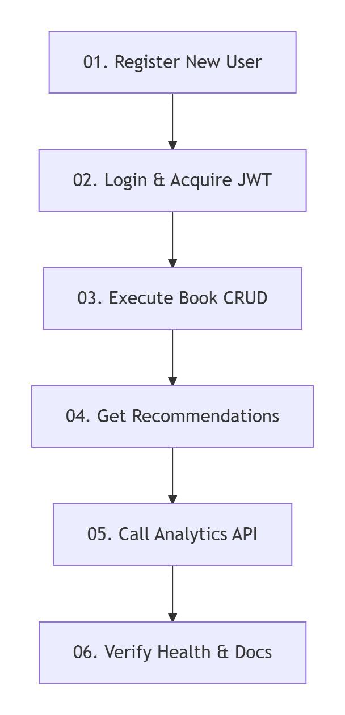
Testing & Demo Validation
Automated Testing Suite
• Built with Pytest + FastAPI TestClient for robust API testing
• 100% coverage: Auth, CRUD ops, Recommendations & Analytics
Execution Sequence
01.Register New User
02.Login & Acquire JWT
03.Execute Book CRUD
04.Get Recommendations
05.Call Analytics API
06.Verify Health & Docs
Notes:
To ensure reliability, the system was thoroughly tested using Pytest and the FastAPI TestClient, covering all critical flows including authentication, CRUD operations, recommendations, and analytics.
For the live demonstration, I will follow a step-by-step sequence: registering a user, logging in to get a token, performing CRUD operations, requesting recommendations, calling analytics, and finally verifying system health and documentation access.

Slide 8




Deliverables List
Code Repository
API Documentation
https://github.com/qt0713/Web-cwk
https://github.com/qt0713/Web-cwk/blob/main/docs/API_DOCUMENTATION.pdf
GenAI Usage Evidence
Technical Report
https://github.com/qt0713/Web-cwk/blob/main/TECHNICAL_REPORT.pdf
https://github.com/qt0713/Web-cwk/blob/main/docs/GENAI_EXCERPTS.md
https://github.com/qt0713/Web-cwk/blob/main/docs/GENAI_EXPORTED_LOG_SNIPPETS.md
Notes:
Finally, here is a checklist of all deliverables for this project. The code repository, API documentation, technical report, and GenAI usage evidence are all complete and available. Thank you for your time. I am now happy to answer any questions you may have.

