Slide 1
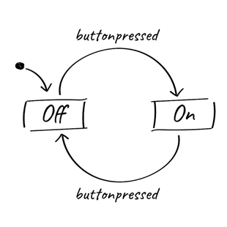
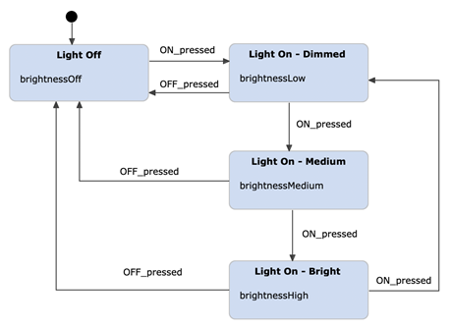
State machine
A state machine is a behavior model. It consists of a finite number of states and is therefore also called finite-state machine (FSM). Based on the current state and a given input the machine performs state transitions and produces outputs.

Slide 2
Understanding the State Machine Design Pattern
At its core, a state machine represents an object or system that can exist in one of several predefined states. Transitions between these states are determined by a set of predefined conditions or events. This design pattern is based on the following key elements.
State: A state represents a specific condition or mode that an object can be in. Each state defines a set of behaviors and actions that the object can perform while in that state.
Transition: A transition represents the change from one state to another. Transition occur in response to specific events or conditions.
Event: An event is a trigger that initiates a transition from one state to another. Events can be external input, internal condition, or specific actions performed by the object.
Action: An action is piece of code or behavior that is executed when a specific transition occurs. Actions can be associated with entering or exiting a state, or they can associated with the transition itself.
Guard Condition: A guard condition is a Boolean expression that must evaluate to true for a transition to take place. It helps in determining whether a transition is allowed or not.

Slide 3
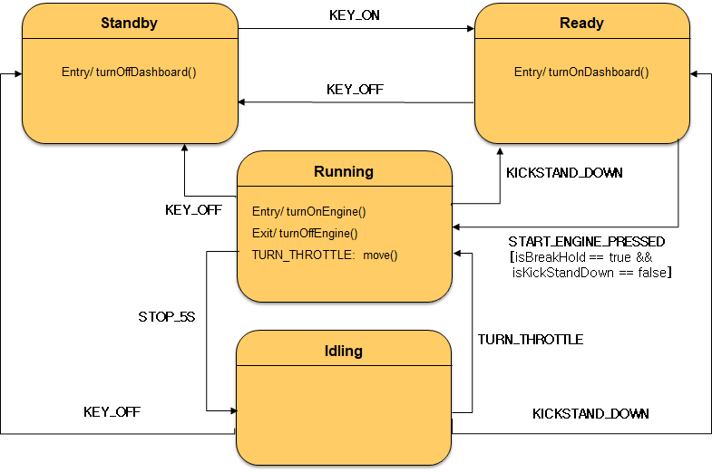
Example: Motorbike system
- If you turn the key ON → Turn on the dashboard display.
- If you turn the key OFF → Turn off the dashboard display,
if the engine is running, stop it.
- (3) If you press the start button when the key is ON and the brake is held and the kickstand is pushed up → Start the engine
- If you turn the throttle when the engine starts → Move the motorbike
- If the car stops for 5 seconds while the engine starts, the engine will stop, then turn the throttle and the engine will start again.
- If the motorcycle kickstand is pushed down:
- The engine will stop, the throttle and starter will not work.
- The engine will only start if Action 3 is performed

Slide 4
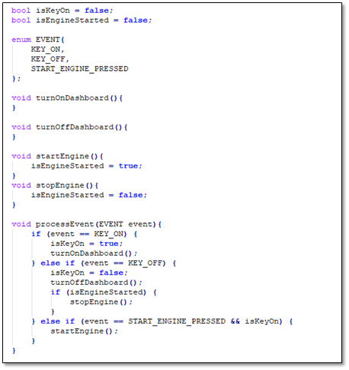
Example: Motorbike - If you turn the key ON → Turn on the dashboard display. - If you turn the key OFF → Turn off the dashboard display, if the engine is running, stop it. - If you press the start button when the key is ON → Start the engine.

Slide 5
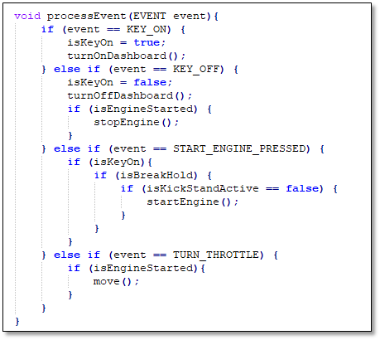
Example: Motorbike - If you turn the key ON → Turn on the dashboard display. - If you turn the key OFF → Turn off the dashboard display, if the engine is running, stop it. - If you press the start button when the key is ON and the brake is held and the kickstand is pushed up → Start the engine - If you turn the throttle when the engine starts → Move the motorbike

Slide 6
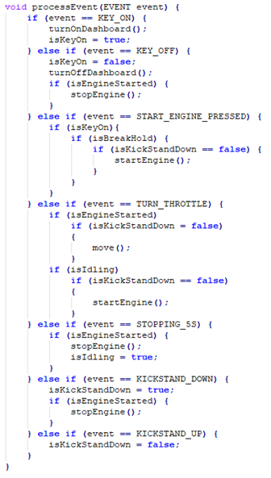
Example: Motorbike
- If you turn the key ON → Turn on the dashboard display.
- If you turn the key OFF → Turn off the dashboard display,
if the engine is running, stop it.
- (3) If you press the start button when the key is ON and
the brake is held and the kickstand is pushed up → Start the engine
- If you turn the throttle when the engine starts → Move the motorbike
- If the car stops for 5 seconds while the engine starts, the engine will stop,
then turn the throttle and the engine will start again.
- If the motorcycle kickstand is pushed down:
- The engine will stop, the throttle and starter will not work.
- The engine will only start if Action 3 is performed

Slide 7
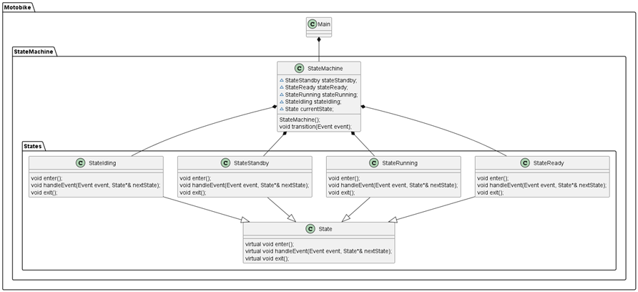

Slide 8
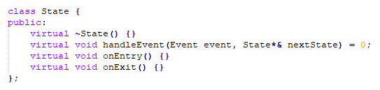

Slide 9
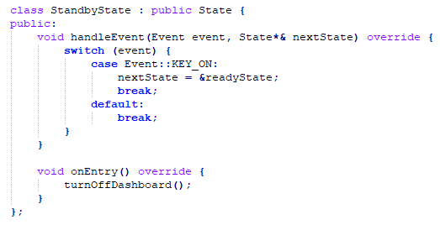
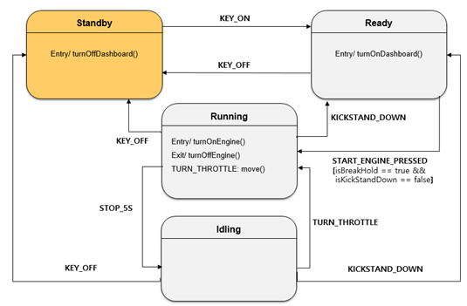

Slide 10
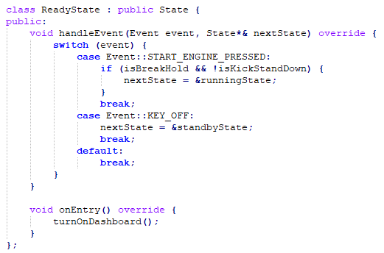
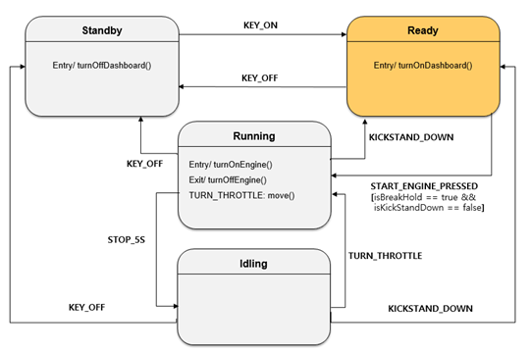

Slide 11
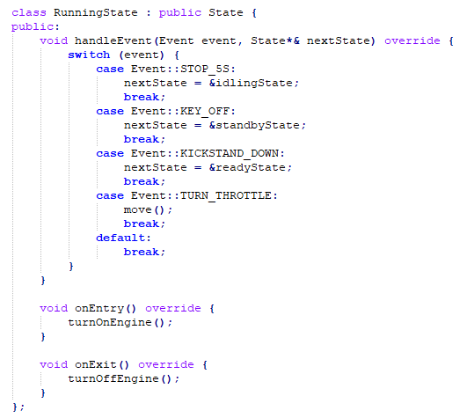
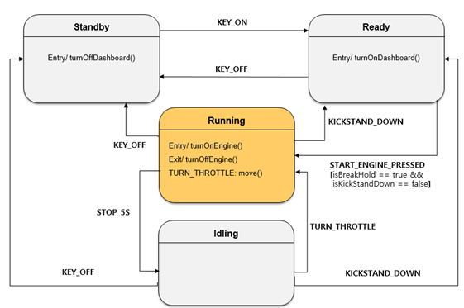

Slide 12
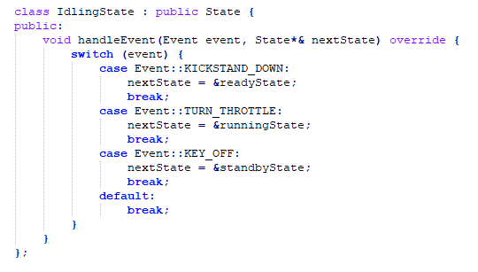
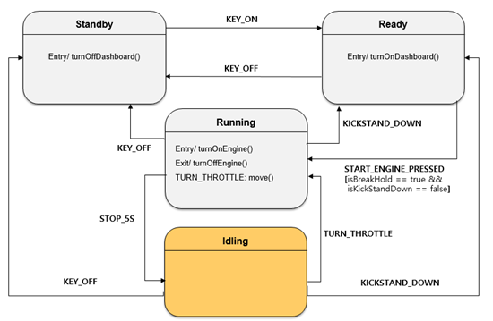

Slide 13
