Slide 1

Project
Bodyguard
Software Architecture
Quentin Clark, Dixon Rand, Robert D’Antonio, Sebastian Gangemi

Slide 2

Four Levels of Architecture
Level 1
Level 2
Level 3
Level 4
Front End
Input and output with the user
Graphs
Back End
Various files of program
How they interact
Back End
Classes and objects
How they interact
Back End
Functions and code
How it all works

Slide 3

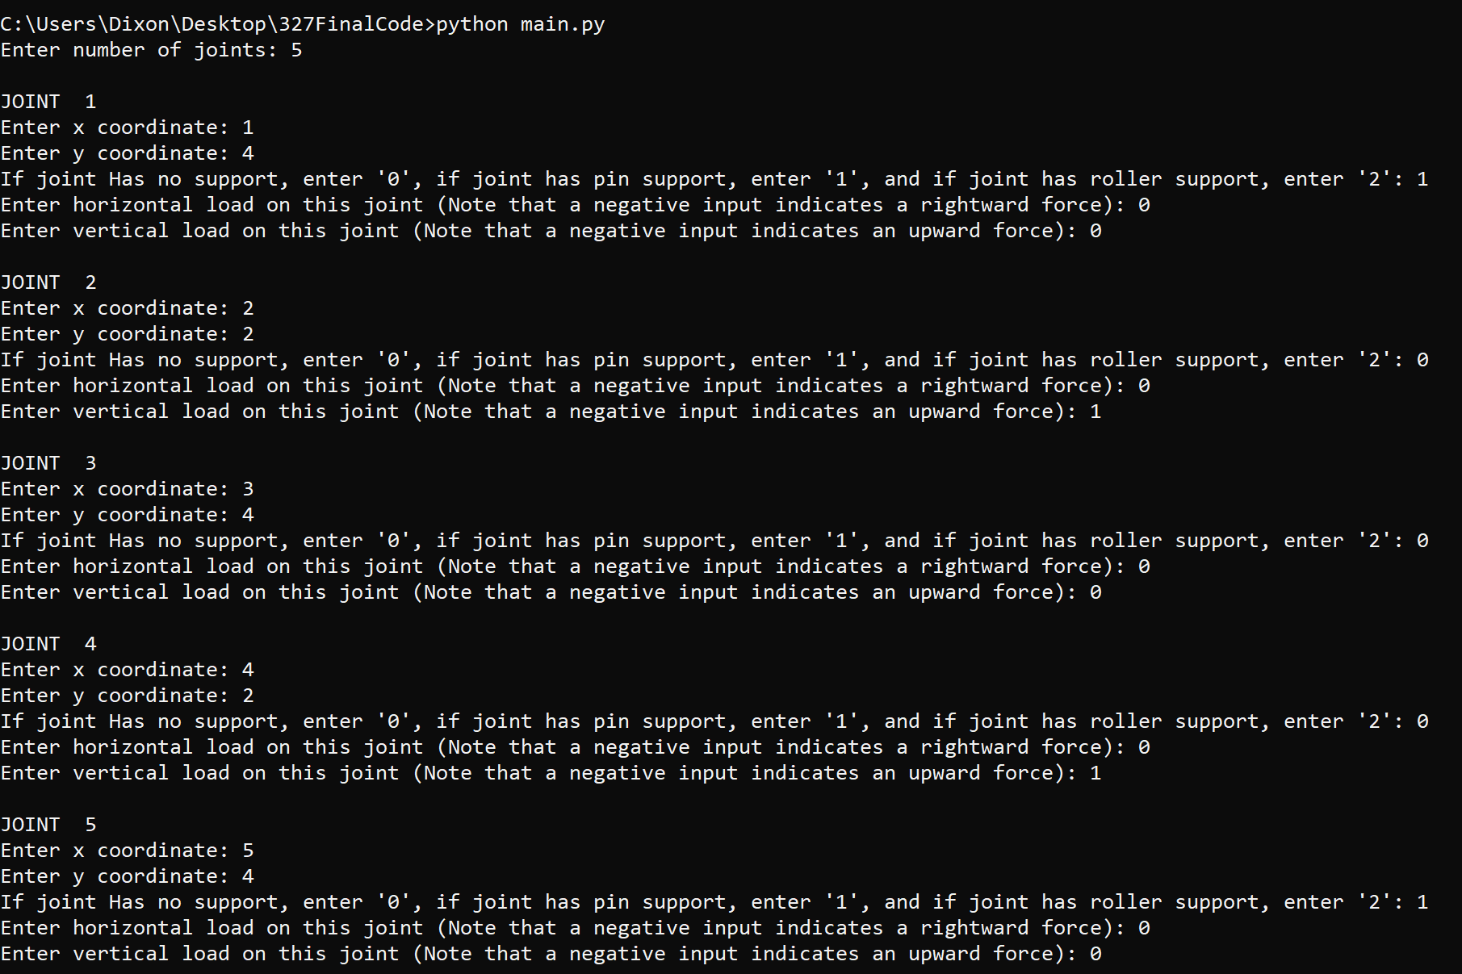
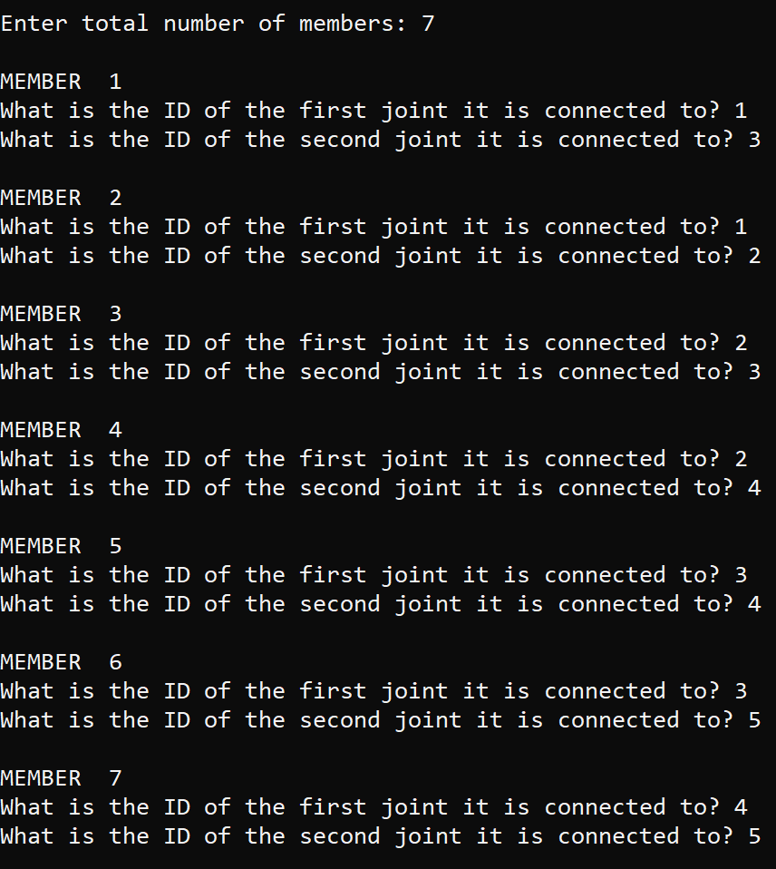
Level 1 - Front End - User Inputs and Program Output
User initiating program and specifying information on joints
Specifying information on Members

Slide 4
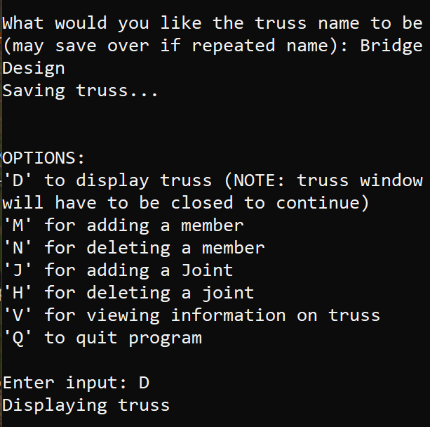
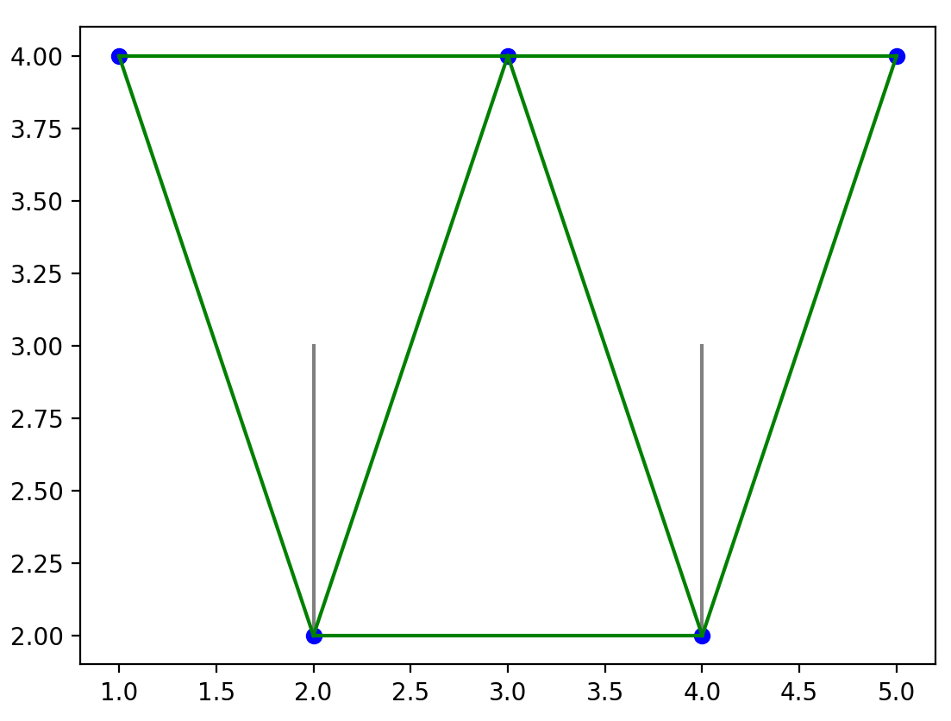
Level 1 - Front End - User Inputs and Program Output
Specifying name and choosing to display truss
Resulting display of truss
Upward lines at (2,2) and (4,2) show forces by truss

Slide 5
Level 2 - Back End - Various Files of Program
The file run by the user to use the program. Uses all other files to create the truss and analyze it
main.py
Uses below four files to convert a truss into a matrix and then analyzes it for cost, loads, stresses, etc.
truss_analysis_program.py
Uses below three files to put together a Truss object with all of the information on joints, members, etc.
truss.py
joint.py
Uses the coordinate file to put together a Joint object with information such as loads and support
member.py
Uses the coordinate file to put together a Joint object with information such as length and id
coordinate.py
Puts together the Coordinate class that allows locations to be stored, and distances calculated

Slide 6
Level 3 - Back End - Classes and Objects
Coordinate class is the base class for a defining coordinates.
Joint and Member classes both us Coordinate class to create Joint and Member objects with distinct coordinates.
Truss class puts together the Joint and Member objects to create a Truss object and uses the Coordinate class to check if it is valid.
Truss class
Joint class
Member class
Coordinate class

Slide 7
Level 4 - Back End - Functions and Code
main.py functions
display() - Creates a plot with joints, members, and loads. Also calculates load angle and magnitudes.
main() - Is the function that is run to complete the program. Has all of the input fields for the user to create a truss to their specifications.
truss_analysis_program.py functions
generate_validation_data() -
convert_truss_to_matrix() - takes a Truss object and converts it into a matrix that can be better used for calculations. Also includes checks to make sure the truss is valid.
convert_matrix_to_truss() - takes a matrix and creates a Truss object from it.
read_data_file() and read_data_dict() - sets the variables C, Sx, Sy, X, Y, L, X, Y.
Analyze_System() - Does the calculations needed to analyze the various values for the outputs
get_cost() - determines the total cost of the truss based on member lengths and joints
run() - Is called by main. Calls the other functions in this file to get member forces, cost, loads, etc.

Slide 8
Level 4 - Back End - Functions and Code
truss.py functions
__init__() - Used to initialize the Truss object’s state
add_member() - Adds a member to the Truss
add_joint() - Adds a joint to the Truss
delete_member() - Deletes a member from the Truss
delete_joint() - Deletes a joint from the Truss
get_number_members() - Returns number of members in the Truss
get_number_joints() - Returns number of joints in the Truss
is_valid() - Determines if the Truss is valid
reassign_joint_ids() - assigns id’s to the joints
reassign_member_ids() - assigns id’s to the members

Slide 9
Level 4 - Back End - Functions and Code
joint.py functions
__init__() - Used to initialize a Joint object’s state
get_joint_location() - Returns the coordinates of the joint
member.py functions
__init__() - Used to initialize a Member object’s state
get_length() - Returns the length of a Member
get_member_location() - Returns the coordinates of the Member
coordinate.py functions
__init__() - Used to initialize a Coordinate object’s state
get_coordinate() - Returns the coordinates of a Coordinate object
get_distance() - Used to return the distance between two coordinates

