Slide 1
CHAPTER 11 Trees
11.1 Introduction to Trees
11.2 Applications of Trees
11.3 Tree Traversal
11.4 Spanning Trees
11.5 Minimum Spanning Trees

Slide 2
Homework: (Due on June 12)
Sec.11.2 1, 20, 23
Homework: June 12
Sec. 11.3 8, 16
Homework: (June 12)
Sec. 11.4 4, 14, 16(14), 29
Homework: (Due June 12)
Sec. 11.5 3,7,12

Slide 3
11.2 Applications of Trees
Problems:
How should items in a list be stored so that an item can be easily located?
Binary search trees
What series of decisions should be made to find an object with a certain property in a collection of objects of a certain type?
Decision trees
How should a set of characters be efficiently coded by bit strings?
Prefix codes （前缀码）

Slide 4
1. Binary Search Trees
11.2 Applications of Trees
The problem of search
The concept of binary search tree
How to construct a binary search tree
Binary search tree algorithm
The computational complexity

Slide 5
The Concept of Binary Search Trees
11.2 Applications of Trees
A binary search tree can be used to store items in its vertices. It enables efficient searches.
Binary search tree
  An ordered rooted binary tree
  Each vertex contains a distinct key value
  The key values in the tree can be compared using “greater than” and “less than”, and
  The key value of each vertex in the tree is less than every key value in its right subtree, and greater than every key value in its left subtree.

Slide 6
Construct the binary search tree
11.2 Applications of Trees
The shape of a binary search tree depends on its key values and their order of insertion.
For example, Insert the elements ‘J’ ‘E’ ‘F’ ‘T’ ‘A’ in that order.
-- The first value to be inserted is put into the root.
‘J’

Slide 7
-- Inserting ‘E’ into the BST
11.2 Applications of Trees
Thereafter, each value to be inserted begins by comparing itself to the value in the root, moving left it is less, or moving right if it is greater.
This continues at each level until it can be inserted as a new leaf.
‘J’
‘E’

Slide 8
-- Inserting ‘F’ into the BST
11.2 Applications of Trees
Begin by comparing ‘F’ to the value in the root, moving left it is less, or moving right if it is greater. This continues until it can be inserted as a leaf.
‘J’
‘E’
‘F’

Slide 9
-- Inserting ‘T’ into the BST
11.2 Applications of Trees
Begin by comparing ‘T’ to the value in the root, moving left it is less, or moving right if it is greater. This continues until it can be inserted as a leaf.
‘J’
‘E’
‘T’
‘F’

Slide 10
--Inserting ‘A’ into the BST
11.2 Applications of Trees
Begin by comparing ‘A’ to the value in the root, moving left if it is less, or moving right if it is greater. This continues until it can be inserted as a leaf.
‘J’
‘E’
‘T’
‘A’
‘F’

Slide 11
What binary search tree . . .
11.2 Applications of Trees
is obtained by inserting the elements ‘A’ ‘E’ ‘F’ ‘J’ ‘T’ in that order.
‘A’
‘E’
‘F’
‘J’
‘T’

Slide 12
Another binary search tree
11.2 Applications of Trees
‘J’
‘E’
‘T’
‘A’
‘H’
‘M’
‘K’
‘P’
Add nodes containing these values in this order:
‘D’ ‘B’ ‘L’ ‘Q’ ‘S’ ‘V’ ‘Z’

Slide 13
Is ‘F’ in the binary search tree?
11.2 Applications of Trees
‘J’
‘E’
‘T’
‘A’
‘H’
‘M’
‘V’
‘D’
‘K’
‘P’
‘Z’
‘B’
‘L’
‘Q’
‘S’

Slide 14
Binary Search Tree Algorithm
11.2 Applications of Trees
Algorithm 1 Locating and adding items to a binary search tree
Procedure insertion (T: binary search tree, x: item)
v:=root of T
While v≠null and label(v) ≠x
Begin
if x<label(v) then
if left child of v ≠null then v:=left child of v
else add new vertex as a left child of v and set v:=null
else
if right child of v ≠null then v:=right child of v
else add new vertex as a right child of v and set v:=null
end
if root of T =null then add a vertex r to the tree and label it with x
else if v is null or label(v) ≠x then label new vertex with x and let v be this new vertex
{ v = location of x}

Slide 15
The computational complexity
11.2 Applications of Trees
Suppose we have a binary search tree T for a list of n items.
We can form a full binary tree U from T by adding unlabeled vertices whenever necessary so that every vertex with a key has two children.

Slide 16
11.2 Applications of Trees
The most comparisons needed to add a new item is the length of the longest path in U from the root to a leaf.
If a binary search tree is balanced, locating or adding an item requires no more than ⎡ log (n+1) ⎤ comparisons.

Slide 17
2. Decision Trees
11.2 Applications of Trees
Rooted trees can be used to model problems in which a series of decisions leads to a solution.
A rooted tree in which each internal vertex corresponds to a decision, with a subtree at these vertices for each possible outcome of the decision, is called a decision tree.

Slide 18
An example: Counterfeit coin detection
11.2 Applications of Trees
1 2 3
4 5 6
Lighter (1,2,3) Balance (4,5,6) Lighter
1
2
7
8
4
5
Lighter (1) Balance (2) Lighter
Lighter (1) Balance (2) Lighter
Lighter (1) Balance (2) Lighter
1 3 2
7 impossible 8
4 6 5

Slide 19
3. Prefix Codes（前缀码）
11.2 Applications of Trees
The problem of using bit strings to encode the letters of the English alphabet.
How to improve coding efficiency?
Using bit strings of different lengths to encode letters can improve coding efficiency.
How to ensure the code having the definite meaning?
For example, e: 0 a: 1 t: 01
0101: eat, tea, eaea, tt?
When letters are encoded using varying numbers of bits, some method must be used to determine where the bits for each character start and end.

Slide 20
the Concept of Prefix Codes
11.2 Applications of Trees
To ensure that no bit string corresponds to more than one sequence of letters, the bit string for a letter must never occur as the first part of the bit string for another letter. Codes with this property are called prefix codes.
For example,
e: 0 a: 10 t: 110

Slide 21
How to Construct Prefix Codes
11.2 Applications of Trees
Using a binary tree.
-- the left edge at each internal vertex is labeled by 0.
-- the right edge at each internal vertex is labeled by 1.
-- the leaves are labeled by characters which are encoded with the bit string constructed using the labels of the edges in the unique path from the root to the leaves.
0
1
1
0
1
0
0
1
01
1
1
000
111
001
101

Slide 22
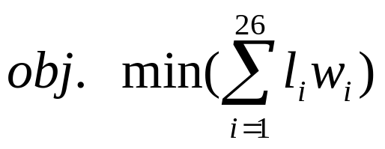
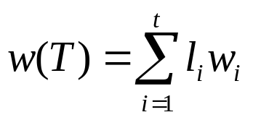

Huffman Coding
11.2 Applications of Trees
Problem: How to produce efficient codes based on the frequencies of occurrences of characters?
For example,
Character a b c d e ……
--------------------------------------------------------------
Frequences (w_{i}) 0.30 0.14 0.28 0.38 0.13 ……
where l_{i} is the length of prefix codes for characters i.
General problem: Tree T has t leaves, w₁, w₂,…, w_{t} are weights, l_{i}=l(w_{i}). Let the weight of tree T be

Slide 23
Huffman Coding
11.2 Applications of Trees
Algorithm 2 Huffman Coding.
Procedure Huffman (C: symbols a_{i} with frequencies w_{i}, i=1, …, n)
F:=forest of n rooted trees, each consisting of the single vertex a_{i} and assigned weight w_{i}
While F is not a tree
begin
Replace the rooted trees T and T’ of least weights from F with w(T) ≥w(T’) with a tree having a new root that has T as its left subtree and T’ as its right subtree. Label the new edge to T with 0 and the new edge to T’ with 1.
Assign w(T) + w(T’) as the weight of the new tree.
end
{The Huffman coding for the symbol a_{i} is the concatenation of the labels of the edges in the unique path from the root to the vertex a_{i} }

Slide 24
11.2 Applications of Trees
〖Example 1〗 Use Huffman coding to encode the following symbols with the frequencies listed: A:0.08, B:0.10, C:0.12, D:0.15, E:0.20, F:0.35. What is the average number of bits used to encode a character?
Solution:
0.08
0.10
0.12
0.15
0.20
0.35
A
B
C
D
E
F
0.18
0.12
0.15
0
1
0.20
0.35
C
D
E
F
B
A
0.18
0.27
1
0.20
0.35
0
0
1
E
F
B
A
D
C

Slide 25
11.2 Applications of Trees
〖Example 1〗 Use Huffman coding to encode the following symbols with the frequencies listed: A:0.08, B:0.10, C:0.12, D:0.15, E:0.20, F:0.35. What is the average number of bits used to encode a character?
Solution:
0.27
0.38
1
0.35
0
1
0
F
0
1
D
C
E
B
A
……
1.00
0
1
0
1
0
1
0
0
1
1
1
0
1
F
0
0
E
D
D
C
B
C
A

Slide 26
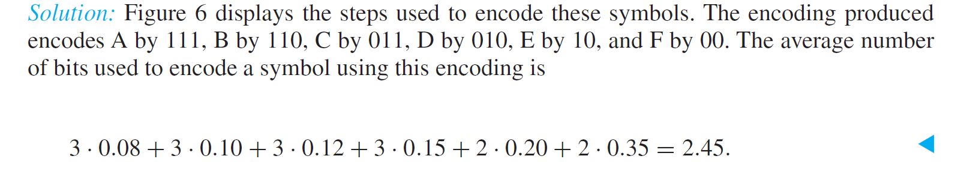
11.2 Applications of Trees
〖Example 1〗 Use Huffman coding to encode the following symbols with the frequencies listed: A:0.08, B:0.10, C:0.12, D:0.15, E:0.20, F:0.35. What is the average number of bits used to encode a character?
Solution:

Slide 27
Homework: (Due on June 12)
Sec.11.2 1, 20, 23

Slide 28
CHAPTER 11 Trees
11.1 Introduction to Trees
11.2 Applications of Trees
11.3 Tree Traversal
11.4 Spanning Trees
11.5 Minimum Spanning Trees

Slide 29
1. Traversal Algorithms
11.3 Tree Traversal
A traversal algorithm is a procedure for systematically visiting every vertex of an ordered rooted tree.
Tree traversals are defined recursively.
Three traversals are named:
      preorder（前序）,
      inorder（中序）,
      postorder（后序）.

Slide 30
PREORDER Traversal Algorithm
11.3 Tree Traversal
【Definition】 Let T be an ordered tree with root r. If T has only r, then r is the preorder traversal of T. Otherwise, suppose T₁, T₂ , …, T_{n} are the subtrees at r from left to right in T. The preorder traversal begins by visiting r. Then traverses T₁ in preorder, then traverses T₂ in preorder, and so on, until T_{n} is traversed in preorder.
Note:
Preorder traversal of an binary ordered tree
    Visit the root.
    Visit the left subtree, using preorder.
    Visit the right subtree, using preorder.

Slide 31
Preorder Traversal:
11.3 Tree Traversal
J E A H T M Y
Visit first.
ROOT
‘J’
‘E’
‘T’
‘A’
‘H’
‘M’
‘Y’
Visit left subtree second
Visit right subtree last

Slide 32
INORDER Traversal Algorithm
11.3 Tree Traversal
【Definition】 Let T be an ordered tree with root r. If T has only r, then r is the inorder traversal of T. Otherwise, suppose T₁, T₂,…, T_{n} are the left to right subtrees at r. The inorder traversal begins by traversing T₁ in inorder. Then visits r, then traverses T₂ in inorder, and so on, until T_{n} is traversed in inorder.
Note:
Inorder traversal of an binary ordered tree
  Visit the left subtree, using inorder.
  Visit the root.
  Visit the right subtree, using inorder.

Slide 33
Inorder Traversal:
11.3 Tree Traversal
A E H J M T Y
Visit second
ROOT
‘J’
‘E’
‘T’
‘A’
‘H’
‘M’
‘Y’
Visit left subtree first
Visit right subtree last

Slide 34
POSTORDER Traversal Algorithm
11.3 Tree Traversal
【Definition】 Let T be an ordered tree with root r. If T has only r, then r is the postorder traversal of T. Otherwise, suppose T₁, T₂,…, T_{n} are the left to right subtrees at r. The postorder traversal begins by traversing T₁ in postorder. Then traverses T₂ in postorder, until T_{n} is traversed in postorder, finally ends by visiting r.
Note:
Postorder traversal of an binary ordered tree
    Visit the left subtree, using postorder.
    Visit the right subtree, using postorder.
    Visit the root.

Slide 35
11.3 Tree Traversal
Postorder Traversal:
A H E M Y T J
Visit last
ROOT
‘J’
‘E’
‘T’
‘A’
‘H’
‘M’
‘Y’
Visit left subtree first
Visit right subtree second

Slide 36
11.3 Tree Traversal
〖Example 1〗 In which order does a preorder, inorder or postorder traversal visit the vertices in the ordered rooted tree shown in the following figure?
a
Note:
Inorder traversal of an binary ordered tree
  Visit the left subtree, using inorder.
  Visit the root.
  Visit the right subtree, using inorder.
b
c
d
f
e
g
h
i
Preorder traversal : a, b, d, c, e, g, f, h, i
Inorder traversal : d, b, a, e, g, c, h, f, i
Postorder traversal : d, b, g, e, h, i, f, c, a
Note:
Preorder traversal of an binary ordered tree
    Visit the root.
    Visit the left subtree, using preorder.
    Visit the right subtree, using preorder.

Slide 37
2. Infix, prefix, and postfix notation
11.3 Tree Traversal
Complicated expressions can be represented using ordered rooted trees, such as
      Compound propositions
      Combinations of sets
      Arithmetic expressions

Slide 38
A Binary Expression Tree is . . .
11.3 Tree Traversal
A special kind of binary tree in which:
1. Each leaf node contains a single operand,
2. Each nonleaf node contains a single operator, and
3. The left and right subtrees of an operator node represent subexpressions that must be evaluated before applying the operator at the root of the subtree.

Slide 39
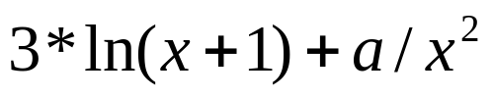
11.3 Tree Traversal
〖Example 2〗 What is the ordered tree that represents the expression ?
Solution:
+
*
/
3
ln
a
↑
+
x
2
x
1

Slide 40
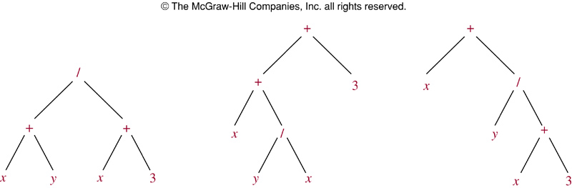

Slide 41
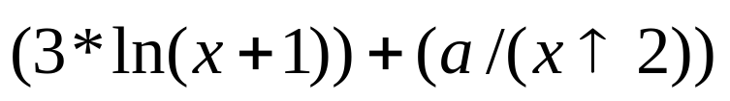
Infix Form
11.3 Tree Traversal
The fully parenthesized expression obtained by an inorder traversal of the binary tree is said to be in infix form.
For example,
+
*
/
3
ln
a
↑
+
x
2
x
1
Infix form:

Slide 42

Prefix Form
10.3 Tree Traversal
The expression obtained by an preorder traversal of the binary tree is said to be in prefix form (Polish notation ).
For example,
+
*
/
Note:
Preorder traversal of an binary ordered tree
    Visit the root.
    Visit the left subtree, using preorder.
    Visit the right subtree, using preorder.
3
ln
a
↑
+
x
2
x
1
Prefix form:

Slide 43

Postfix Form
11.3 Tree Traversal
The expression obtained by an postorder traversal of the binary tree is said to be in postfix form (reverse Polish notation ).
For example,
+
*
/
Note: Postorder traversal of an binary ordered tree
    Visit the left subtree, using postorder.
    Visit the right subtree, using postorder.
    Visit the root.
3
ln
a
↑
+
x
2
x
1
Postfix form:

Slide 44
Evaluate the binary expression tree
11.3 Tree Traversal
When a binary expression tree is used to represent an expression, the levels of the nodes in the tree indicate their relative precedence of evaluation.
Operations at higher levels of the tree are evaluated later than those below them. The operation at the root is always the last operation performed.

Slide 45
Evaluate this binary expression tree
11.3 Tree Traversal
‘*’
‘-’
‘/’
‘8’
‘5’
‘+’
‘3’
‘4’
‘2’
Prefix form: * - 8 5 / + 4 2 3
Note:
We can evaluate this expression from right to left.

Slide 46
Evaluate this binary expression tree
11.3 Tree Traversal
‘*’
‘-’
‘/’
‘8’
‘5’
‘+’
‘3’
‘4’
‘2’
Postfix form: 8 5 - 4 2 + 3 / *
Note:
We can evaluate this expression from left to right.

Slide 47
Homework: June 12
Sec. 11.3 8, 16

