Slide 1
MEGAPHONE TELEPHONE GIANLUIGI BUFFON
Presents
CLASSICAL VS
MULTI-AGENT
Transit Anomaly Detection
Clean
Engineer
Baseline
Detect
Explain
Core Idea
Both systems share the same detection core: historical baselines, IF/LOF/Z-score, consensus voting and risk prioritization. The difference is operational: the classical pipeline monitors fast at scale, while the multi-agent system explains selected perimeters.
Team 1
Kassymzhomart Kalkayev 813641
Davoud Danish 807901
Orfeo Sirianni 817511

Slide 2
Overview
02
Project objective and scope
What the system should inspect and why the comparison matters
Main goal
From raw flows to a focused anomaly perimeter
Implement the same anomaly-detection task twice and compare convenience, interpretability and operational fit.
Raw CSVs
Perimeter
Signals
Alert queue
TIPOLOGIA_VIAGGIATORE
ALLARMI
IATA code
Features
Baselines
Ranked
Anomalies
Target perimeter
A user-selected airport / IATA code, e.g. FCO, MXP or LIN.
Comparison logic
Output
The classical pipeline gives a stable benchmark. The multi-agent system tests whether modular agents improve explanation quality and perimeter-based investigation.
Classical: ranked anomaly queue.
MAS: ranked queue + natural-language transit anomaly report.
No ground-truth anomaly labels → evaluation focuses on overlap, stability, interpretability and operational usefulness.
Classical vs Multi-Agent

Slide 3
ARCHITECTURE
03
Shared analytical core
The same logic is kept comparable; only the coordination and explanation layer changes.
Classical pipeline
Clean
Engineer
Baseline
Detect
Report
standardize + checks
signals + grain
rolling + monthly
IF · LOF · Z
static queue
Shared analytical core
• Date × route_airport aggregation
• Historical rolling + monthly baselines
• Isolation Forest / LOF / Z-score
• Consensus anomaly logic
• Risk prioritization
Multi-agent workflow
Data Agent
Baseline Agent
Outlier Agent
Risk Agent
Report Agent
fetch perimeter
build normality
detect flags
score severity
explain results
Key design principle: keep detection logic comparable, then evaluate which architecture is more useful for monitoring and explanation.
Classical vs Multi-Agent

Slide 4
CLASSICAL IMPLEMENTATION
04
Route coverage
Cleaning and aggregation create one reliable route-day table for both pipelines
5,095
5,080
3,267 × 56
534 routes
passenger rows
case rows
final route-day table
analytical grain
Standardization
Logical checks
Operational preservation
Dates, airport codes, ISO country codes and categorical values are harmonized.
Rows must respect ENTRATI ≥ INVESTIGATI ≥ ALLARMATI; unresolved conflicts are removed.
Low-volume observations are flagged rather than discarded, avoiding biased filtering.
Raw data
Clean fields
Logical checks
Aggregate
Merge cases
Route-day table
The final table keeps route_city and route_country for interpretation, while date × route_airport is the precise detection grain.
Classical vs Multi-Agent

Slide 5
CLASSICAL IMPLEMENTATION
05
Feature groups: what becomes “normal”
The models see engineered operational signals, historical deviations and contextual evidence.
Operational signals
Segment signals
Case context
Temporal changes
entries · investigated · flagged
investigation rate · flag rate
flag given investigated
nationality · document type
airline · control result
counts + avg/max rates
case records · total flights
alarm reasons · event types
alarm density per entry
lag1 · diff1 · pct_change1
per route_airport
captures sudden shifts
Historical baselines
1 · Rolling averages
2 · Monthly baseline
3 · Route mean
7- and 30-observation windows for entries, flag rate and investigation rate.
Expected entries per route × month; residuals measure deviation from seasonality.
Stable reference for routes with too few observations for rolling windows.
Why observation-based windows?
Route observations are irregular; observation-based windows avoid empty calendar windows and produce more stable baselines.
Classical vs Multi-Agent

Slide 6
MULTI-AGENT IMPLEMENTATION
07
Multi-agent workflow
Specialized agents pass structured state through a LangGraph pipeline
Shared state
perimeter · passenger_json · alarm_json · baseline_dataframe_json · anomaly_results · risk_profile · final_report
Data Agent
Baseline Agent
Outlier Agent
Risk Agent
Report Agent
perimeter + data
normal behavior
IF · LOF · Z
severity levels
final narrative
Data Agent
Baseline Agent
Outlier Agent
Risk Agent
Report Agent
Extracts and validates the airport perimeter from user input.
Builds rolling baselines, monthly z-scores and route-day metrics.
Runs IF, LOF and Z-score with consensus selection.
Converts indicators into risk scores, levels and priorities.
Turns structured outputs into a transit anomaly report.
Classical vs Multi-Agent

Slide 7
MULTI-AGENT IMPLEMENTATION
08
Key methodological choices
The choices that make the comparison fair and technically defensible
1 · No train/test split
Models used
Prompt safeguards
There are no ground-truth labels, so the task is retrospective unsupervised scoring.
• Data Agent: llama3.2:3b
• Baseline Agent: deterministic Python
• Outlier Agent: phi4-mini-reasoning
• Risk Agent: qwen2.5:7b
• Report Agent: llama3.2:3b
The report must use only structured outputs, avoid external assumptions and avoid treating nationality or city as suspicious by itself.
2 · Detection/reporting split
Traffic and baseline features trigger anomalies; alarm and flag variables explain them.
3 · Deterministic baseline agent
Why this matters
Numerical baselines stay in Python to avoid LLM hallucinations in calculations.
The MAS is not just a different model. It changes the operating style: the user selects a perimeter, agents perform specialized tasks, and the final output becomes a dynamic explanation.
4 · Complementary roles
Classical monitors fast at scale; MAS explains selected perimeters.
Classical vs Multi-Agent

Slide 8
COMPARISON
10
FCO quantitative comparison
Both systems were evaluated on the same FCO perimeter and comparison-ready outputs.
Metric
Classical
Multi-Agent
Total observations
579
579
Final anomalies
33
40
Anomaly rate
5.70%
6.91%
Execution time
3.21 seconds
134.54 seconds
Output format
Structured CSV + ranked queue
Structured CSV + narrative report
Use classical when
Use agents when
the goal is fast, deterministic and reproducible full-network monitoring.
the goal is targeted perimeter analysis and clearer human-readable explanations.
Classical vs Multi-Agent

Slide 9
CLOSING
11
Agreement analysis and final takeaway
The two systems are complementary rather than interchangeable
High overlap
Classical strength
MAS strength
Jaccard index = 0.7805. Both systems detect largely similar anomalous patterns.
Fast, deterministic and easier to reproduce for network-wide monitoring.
Slower, but stronger for contextual explanation and operator communication.
Agreement metrics
Overlapping anomalies: 32
Overlap vs Classical: 96.97%
Overlap vs Multi-Agent: 80.00%
Classical-only: 1
Multi-Agent-only: 8
Next: present the Gradio interface and validate top alerts with domain feedback.
Final message: classical gives reliable monitoring; agents add contextual explanation; the strongest design is hybrid.
Classical vs Multi-Agent
End

Slide 10
MEGAPHONE TELEPHONE GIANLUIGI BUFFON
Presented
THANK YOU

Slide 11
CLASSICAL RESULTS
06
Classical pipeline: FCO comparison subset
Network-wide logic re-run on the same selected airport perimeter for a fair comparison
Leakage fix
Detection features describe traffic behavior and historical baselines. Reporting variables help explain the anomaly, but they do not create the anomaly label alone.
579
33
5.70%
Report output
observations
final anomalies
anomaly rate
Output: full scored FCO subset, ranked anomalies, risk levels and comparison-ready CSV.
3.21s
96.97%
1
Consensus anomaly = 14
runtime
overlap vs MAS
classical-only
contamination = 0.05 keeps detection rates comparable across methods
Classical vs Multi-Agent

Slide 12
MULTI-AGENT RESULTS
09
Multi-agent run example: FCO perimeter
Final MAS run on the same FCO comparison perimeter
FCO
579
40
6.91%
134.54s
target airport
route-day observations
final anomalies
anomaly rate
execution time
local LLM calls
Date
Route / signal
Risk
FCO risk evidence
Model consensus
21
2024-02-24
SAW_FCO · 12 entries · 8.33% flag rate
CRITICAL
Business rules
28
2024-02-28
JED_FCO · 64 entries · model + rules
CRITICAL
Both sources
9
Avg. risk score
4.41
2024-02-22
IKA_FCO · 48 entries · 2.08% flag rate
CRITICAL
MAS adds value through structured risk profiling and a readable transit anomaly report.
2024-01-26
TIA_FCO · 353 entries · 4.53% flag rate
HIGH
Report Agent output
Structured report with executive summary, anomaly details, risk profile, follow-up actions and limitations.
Classical vs Multi-Agent

Slide 13
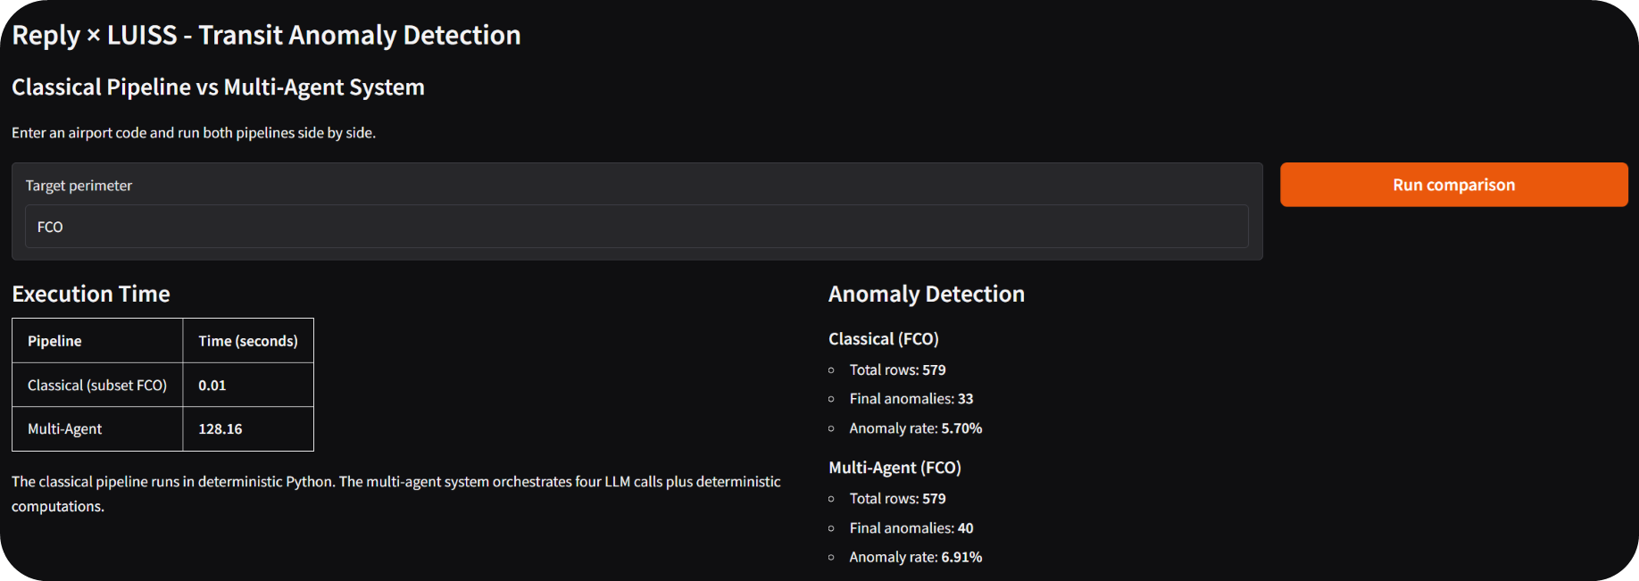
A Snippet of our interface

