Slide 1
Cross-Sectional Returns in the Chinese Stock Market: A Rank-Based Regression Analysis
December 9th, 2025
Leo Liu, Jiayi Yao, Yunelle Teng
1

Slide 2
Agenda
Introduction
Data Description
Feature Engineering
Model Specification
Variable Selection
Results and Interpretation
Prediction (Out-of-Sample)
Sensitivity Analysis
Model Limitations & Improvements
Conclusion

Slide 3

Introduction
Research Question
To explain the cross-sectional variation of monthly excess returns in the Chinese stock market.
Applied Context
Investment Strategy: Results guide Quantitative Factor Investing strategies.
Risk Control: Identifies risk exposures that need to be managed in a portfolio.
Motivation
The Theoretical Gap: Simple market beta (CAPM) is insufficient. Returns are often driven by specific firm characteristics, not just general market movements.
Contextual Relevance: The Chinese market is unique (high retail participation, volatility). We test if classic factors like Fama-French Five Factors hold true in this specific emerging market environment.

Slide 4
Data Description
Data Source
Database: CSMAR (China Stock Market & Accounting Research).
Sample Period: Jan 2010 – Dec 2022 (13 Years).
Scope: Chinese A-share listed companies.
Processing: Merged Monthly Trading Data with Quarterly Financial Statements.
Target Variable (y)
Variable: Monthly Excess Return
Formula: y=Stock Return​−Market Return.
Meaning: Represents the stock's idiosyncratic performance relative to the market index.
Data Cleaning
Missing Data: Excluded observations with missing Equity, Assets, or Return data.
Alignment: Lagged financial data to ensure information was publicly available at the time of trading (avoid look-ahead bias).

Slide 5
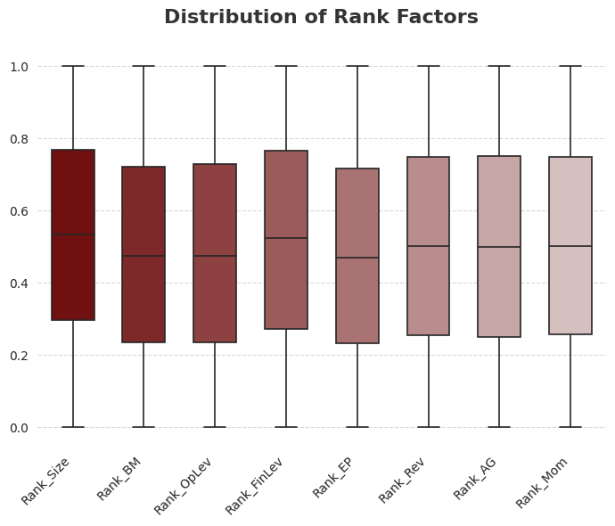
Feature Engineering
Data Transformation: Monthly Ranking
Method: Percentile Ranking by Date.
Code: groupby('date').rank(pct=True)
Result: All values are converted to a simple 0-to-1 scale.
Why we do this:
Unified Scale: It allows us to compare big numbers with small percentages fairly.
Relative Strength: It removes general market trends. We only compare how a stock performs against other stocks at the same time, rather than against historical prices.

Slide 6
Model Specification
yᵢ = β₀ + β₁ Rank_Sizeᵢ + β₂ Rank_BMᵢ + β₃ Rank_OpLevᵢ
+ β₄ Rank_FinLevᵢ + β₅ Rank_Momᵢ + β₆ Rank_Reviᵢ + β₇ Rank_AGᵢ + εᵢ
Explanatory Variables(Rank - transformed)
Rank_Size — firm size Rank_BM — book-to-market ratio Rank_OpLev — operating leverage Rank_FinLev — financial leverage Rank_Mom — momentum Rank_Rev — revenue growth Rank_AG — asset growth
Dependent Variable
y_i：Monthly excess return for firm i

Slide 7
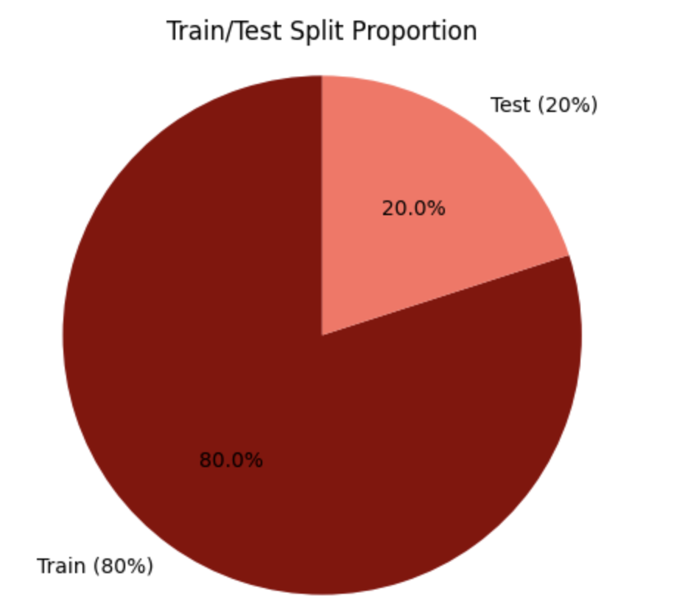
Model Specification
OLS
Linear regression
Interpretable relationship
Train–Test Split
80/20 split
Random split OK with ranking
HC1
Robust errors for heteroskedasticity
More reliable t-values
Goal
Stable estimates
Reliable inference
Figure 1

Slide 8
Variable Selection
Selection Objective
Ensure statistically valid and interpretable predictors
Improve model stability by reducing multicollinearity
Build a simpler model with strong predictive performance
Two-Step Variable Selection
1. Multicollinearity Check (VIF)
Identify predictors with high multicollinearity
2. Backward Elimination (BIC)
Remove variables that do not improve BIC
Final model keeps predictors that minimize BIC

Slide 9
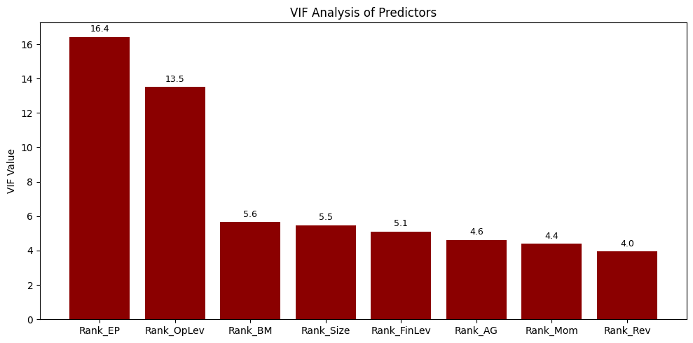
Variable Selection
Figure 2
VIF analysis identifies multicollinearity among ranked predictors
Rank_EP exhibits the highest VIF (= 16.4)
Variables with high VIF were flagged for potential removal
VIF insights inform the subsequent BIC-based backward elimination step

Slide 10
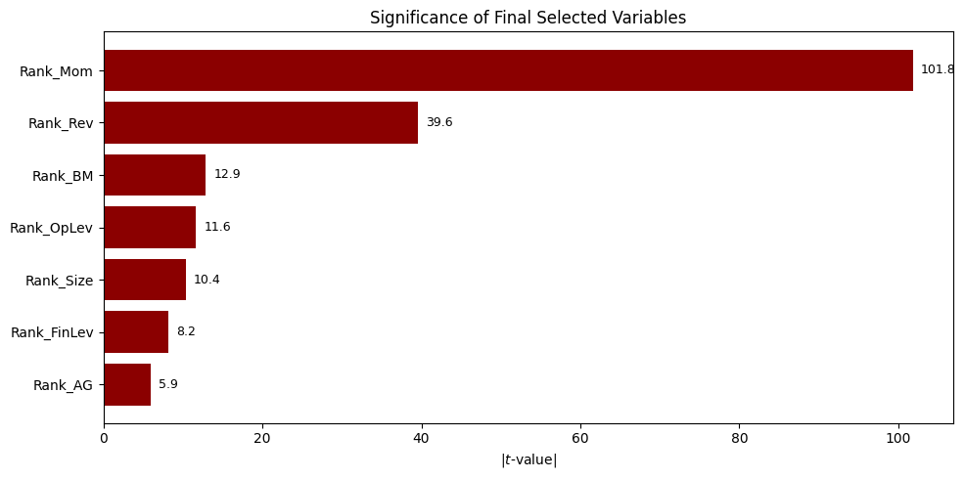
Variable Selection
Momentum and Revenue Growth are the strongest contributors
All retained variables show strong significance (see |t|-values)
BIC-based elimination retained 7 final predictors
Figure 3

Slide 11
Variable Selection
Justification
Final variables show strong statistical significance
Each factor adds unique predictive information
Momentum & Revenue Growth dominate; others align with asset-pricing theory
Removing any variable increases BIC → lower model quality

Slide 12
Results and Interpretation
Findings:
Significance: All selected factors are statistically significant at the 0.1% level (T-values > 3.29).
Momentum: Has the strongest positive effect on next-month excess returns.
Book-to-Market & Reversal: Show distinct negative effects, indicating a "Growth Premium" and mean reversion.
Size and Asset Growth → modest positive return premiums.
Variable | Coefficient | T-value
Rank_Mom | 0.1126*** | 101.80
Rank_Rev | -0.0384*** | -39.62
Rank_OpLev | -0.0131*** | -11.65
Rank_BM | -0.0116*** | -12.88
Rank_Size | 0.0098*** | 10.39
Rank_FinLev | -0.0091*** | -8.15
Rank_AG | -0.0061*** | -5.91
Model Fit:
Adjusted R^2 = 0.05. This low value is consistent with monthly individual stock returns, which are dominated by random noise.
Table 1
Notes:
Let’s look the regression results in Table 1.
First, regarding Significance: every variable in this table has three stars and a high T-value. This confirms that all seven factors are statistically significant drivers of returns at the 1% level.
Momentum is the clear leader. It has the largest coefficient of 0.1126 and a massive T-value of 101.8. This implies that ranking stocks by past performance is the most effective way to separate winners from losers.
Next, we observe negative coefficients for Reversal and Book-to-Market. The negative sign on Book-to-Market is a critical finding. It indicates that in this sample, Growth stocks systematically outperformed Value stocks.
Finally, regarding Model Fit: our Adjusted R-squared is 0.052. While this appears low, it is standard for monthly individual stock returns, confirming that noise still dominates short-term price movements.

Slide 13
Prediction (Out-of-Sample)
We evaluate model performance using a temporal split (early period train → later period test). Rank transformation reduces impact of market regime shifts, improving generalizability.
Metric | Value
Train RMSE | 0.1418
Test RMSE | 0.1421
Table 2
Train and test performance are nearly identical, showing no overfitting.
The simple ranked-factor model generalizes well across time.
Monthly return prediction is noisy, so stability matters more than absolute RMSE.
Notes:
To prove that our model works in a real-world investment setting, we tested its predictive power using a temporal split.
As described on the screen, we trained the model on early historical data and tested it on later observations. This mimics a realistic scenario where you must predict the future using only past information.
Looking at Table 2, we used Root Mean Squared Error, or RMSE, as our primary metric. The In-Sample Training RMSE is 0.1418. The Out-of-Sample Test RMSE is 0.1421.
The fact that these two numbers are nearly identical is the most critical finding. It demonstrates that our model generalizes well across time and is not overfitting to the historical data.

Slide 14
Sensitivity Analysis
Table 3
Variable | Y_at_Min(0) | Y_at_Max(1) | Total_Impact
Rank_Mom | -0.0484 | 0.0641 | 0.1125
Rank_Rev | 0.0271 | -0.0113 | -0.0384
Rank_OpLev | 0.0144 | 0.0013 | -0.0131
Rank_BM | 0.0137 | 0.0021 | -0.0116
Rank_Size | 0.0029 | 0.0128 | 0.0098
Rank_FinLev | 0.0124 | 0.0033 | -0.0091
Rank_AG | 0.0109 | 0.0048 | -0.0061
Since the model is linear, the coefficient represents the constant slope. This table quantifies the total economic spread between the lowest (0) and highest (1) ranked stocks for each factor.
Notes:
To understand the real-world economic impact of our model, we calculated the Total Impact Range for each factor in Table 3.
Let’s take Momentum as our key example to show how this works.
If a stock has the lowest possible momentum rank of 0, our model predicts a negative excess return of -4.8%.
If that same stock had the highest momentum rank of 1, the predicted return jumps to positive 6.4%.
The difference between these two extremes is the Total Impact. For Momentum, this spread is 11.25%.
This magnitude dwarfs all other factors. It confirms that in our linear model, Momentum is the single most powerful lever for generating returns.

Slide 15
Model Limitations & Improvements
Limits
Assumption Violation (Linearity): The linear form misses nonlinear patterns, potentially biasing inference on "Superstar" stocks.
Outliers & Scale: Ranking transformation mitigates outliers but compresses magnitude differences, affecting the precision of coefficient estimates.
Prediction: Low R^2 reflects high idiosyncratic noise, limiting absolute predictive power despite stable relative rankings.
Future Improvements
Include industry fixed effects to control for sector-specific risks.
Test nonlinear or interaction terms to better capture complex relationships.
Split sample into sub-periods (e.g., pre/post 2015), to account for changing market regimes.
Notes:
Finally, we must critically assess the limitations of our model and how to fix them.
First, looking at the 'Limits' section: We face an Assumption Violation regarding linearity. Our model assumes a straight line, which likely misses the nonlinear patterns of top-performing stocks. Regarding Outliers, our ranking transformation helps standardize the data, but it compresses magnitude differences, which affects precision. And for Prediction, our low R-squared reflects high noise, limiting our absolute predictive power.
Moving to 'Future Improvements': To address these issues, we propose three specific steps:
We would include Industry Fixed Effects to control for sector-specific risks.
We would test nonlinear terms to better capture complex relationships.
Most importantly, we would split the sample into sub-periods, like pre- and post-2015, to account for changing market regimes.

Slide 16
Conclusions
Momentum and Revenue Growth are the strongest predictors.
The final 7-factor model remains stable and interpretable despite low R².
Supports factor-based investing and risk-managed portfolio design.
Rank-transformed predictors improve robustness across firms.
Add industry controls or nonlinear effects.
Explore regime splits or portfolio-level factor construction.
Key Takeaways
Practical Relevance
Possible Extensions

Slide 17
Appendix

Slide 18
BIC Drop-One Comparison Table
 | dropped_var | BIC_reduced | delta_BIC | adj_R2_reduced | delta_adj_R2
4 | Rank_EP | -373991.611534 | -4.394823 | 0.051671 | -0.000020
7 | Rank_AG | -373968.378480 | 18.838232 | 0.051607 | -0.000083
2 | Rank_OpLev | -373963.236313 | 23.980399 | 0.051593 | -0.000097
1 | Rank_BM | -373944.645710 | 42.571002 | 0.051543 | -0.000148
3 | Rank_FinLev | -373937.745303 | 49.471408 | 0.051524 | -0.000167
0 | Rank_Size | -373809.505101 | 177.711610 | 0.051174 | -0.000516
6 | Rank_Rev | -372017.444984 | 1969.771727 | 0.046275 | -0.005415
5 | Rank_Mom | -359437.589183 | 14549.627529 | 0.011167 | -0.040524

