Slide 1




The Meme Team
“Vieram revolucionar o paradigma dos ginásios” – Mariana Fidalgo
Brilliantly created by:
Ivan Andrushka
Francisco Santos
Miguel Monteiro
Pedro Fernandes

Slide 2


Struggling for motivation
Cardio is boring!
But everyone wants to be fitter.
“Cardio can be boring AF. I can't even count the number of times I've hopped on the treadmill(…)gazing at the ticking clock the entire time.” – Elite Daily, May 2018

Slide 3
There’s light at the end of the tunnel…
Interactive racing game to pump up the Cardio.
Measure the strength output of your muscles.
Reignite your passion for exercise.

Slide 4
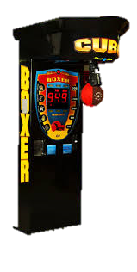
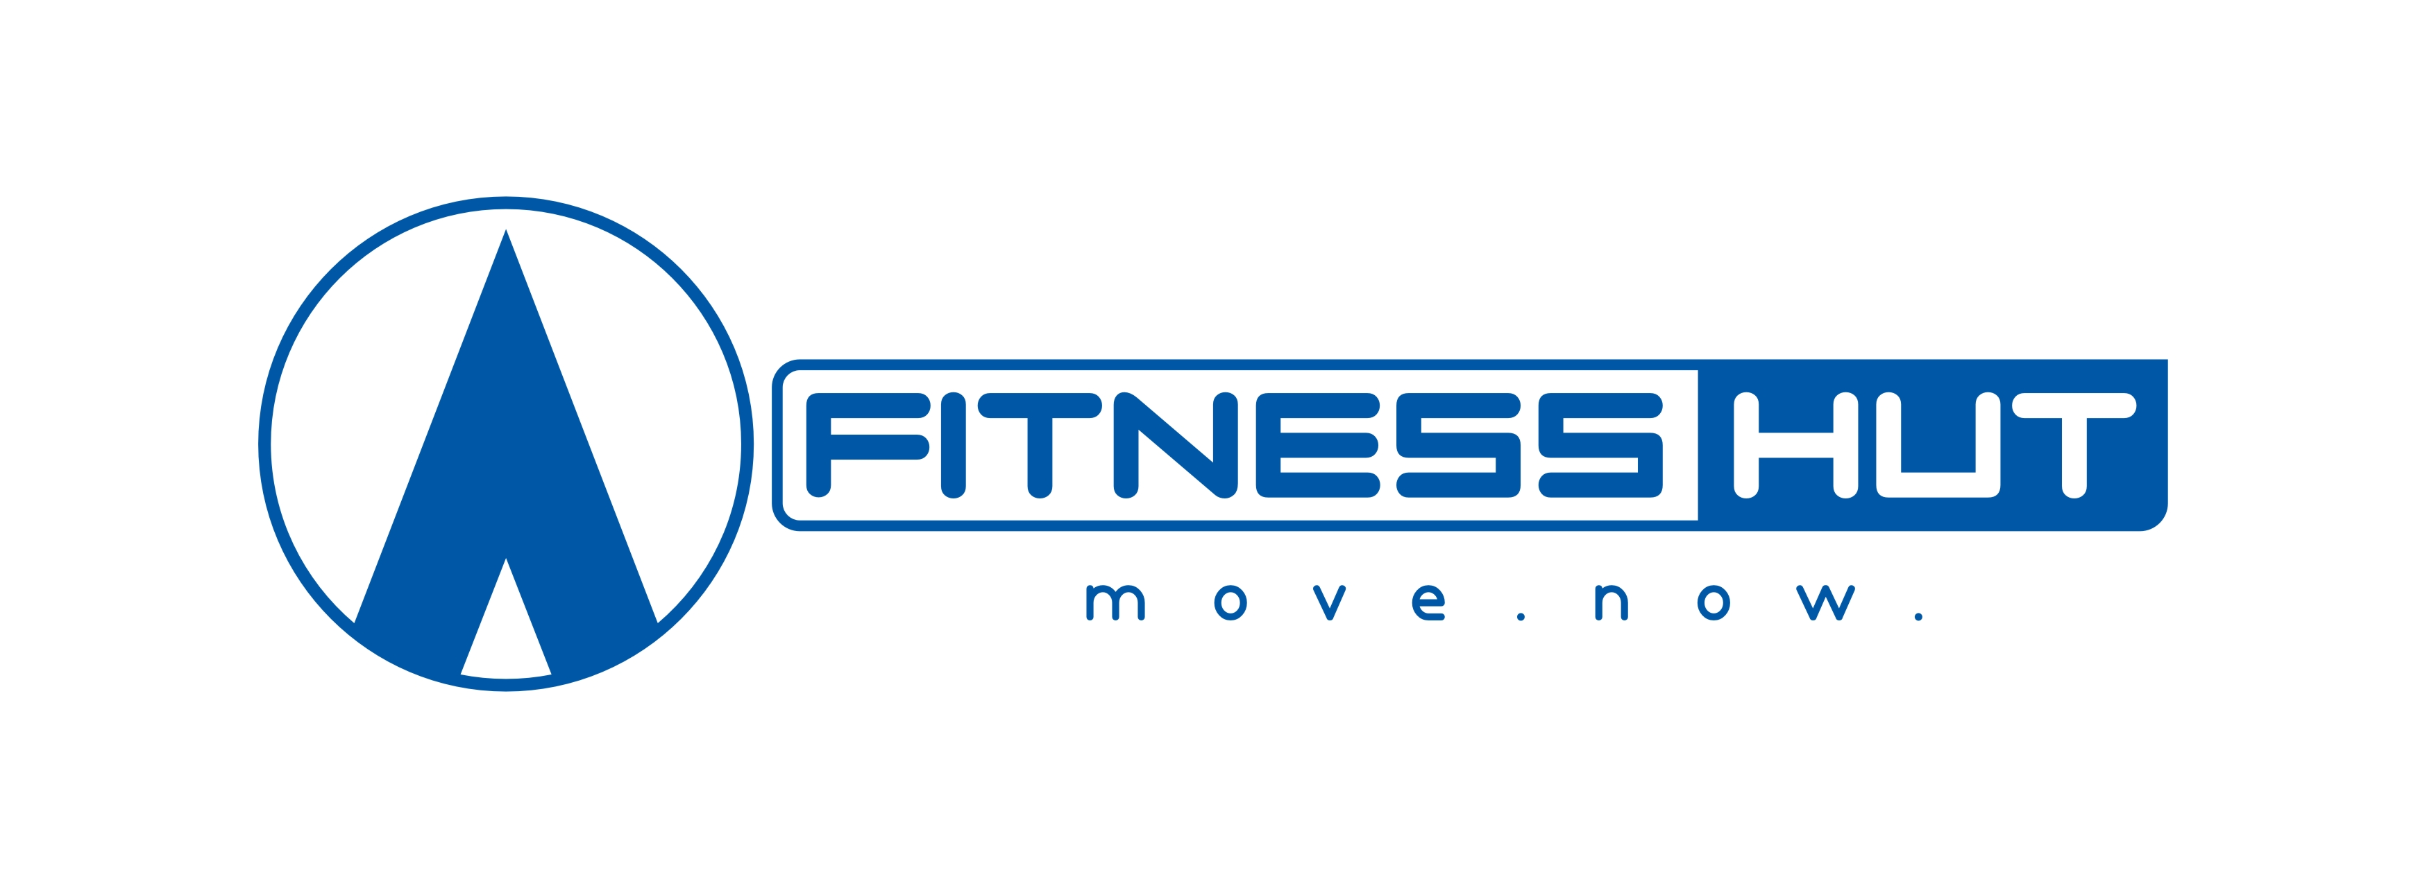
Who cares?
Low cost gyms
Fitness freaks
Arcade games

Slide 5
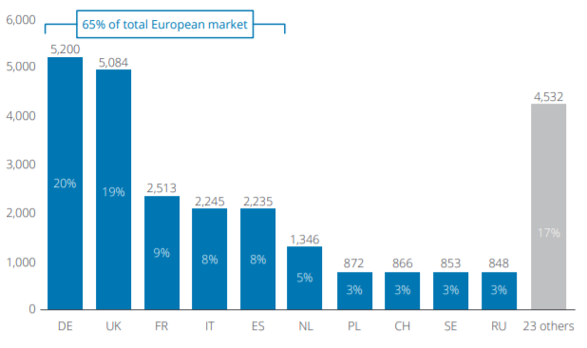
Some numbers…
By 2018, in Europe:
60.0 million gym members (4% growth)
59,055 clubs
~30€ profit per unit -> Big Money
Source: https://www2.deloitte.com/content/dam/Deloitte/de/Documents/consumer-business/European%20Health%20and%20Fitness%20Report_2018_extract.pdf
Figure 2 – Gyms per country in Europe,2018

Slide 6
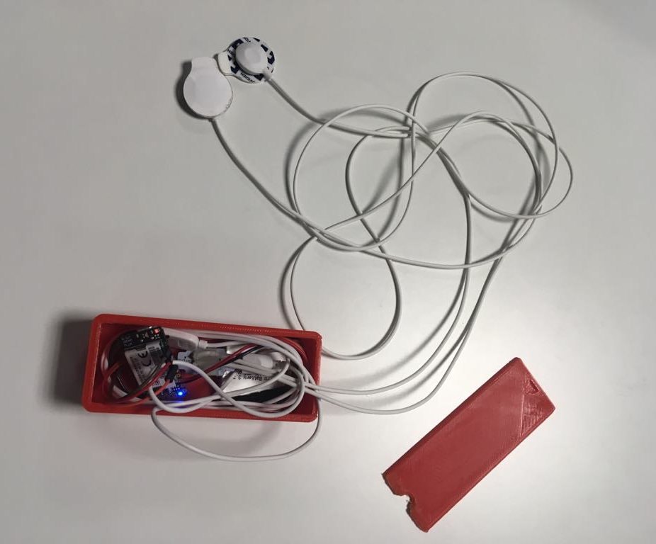
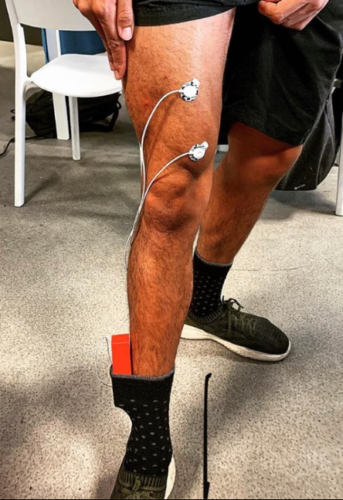
The Good Stuff
Required materials:
BITalino
EMG
Electrodes
3D printed box
Electrode wires
Figure 1 - Prototype
Figure 2 – Lab Rat

Slide 7
How it all connects
EMG
Computer - APP
BITalino
Skin Electrodes
User

Slide 8
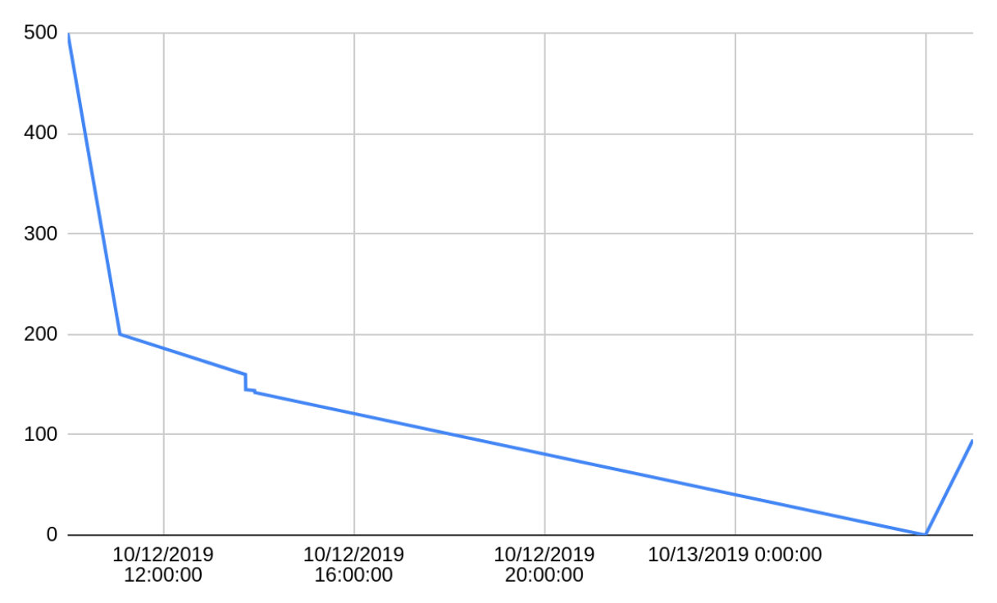
Smart investments

Slide 9
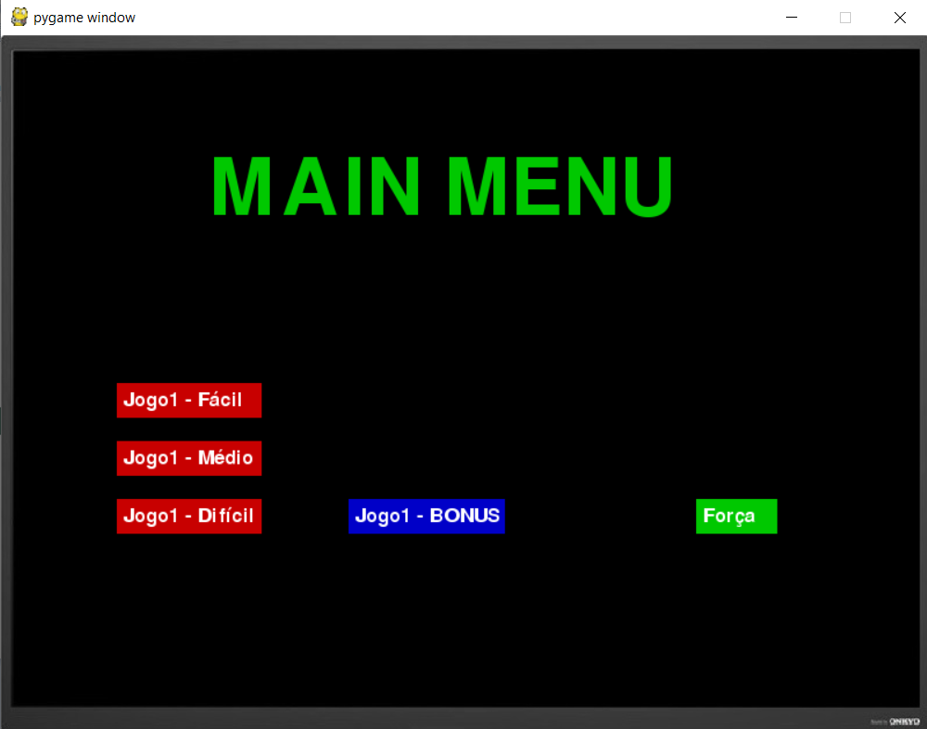
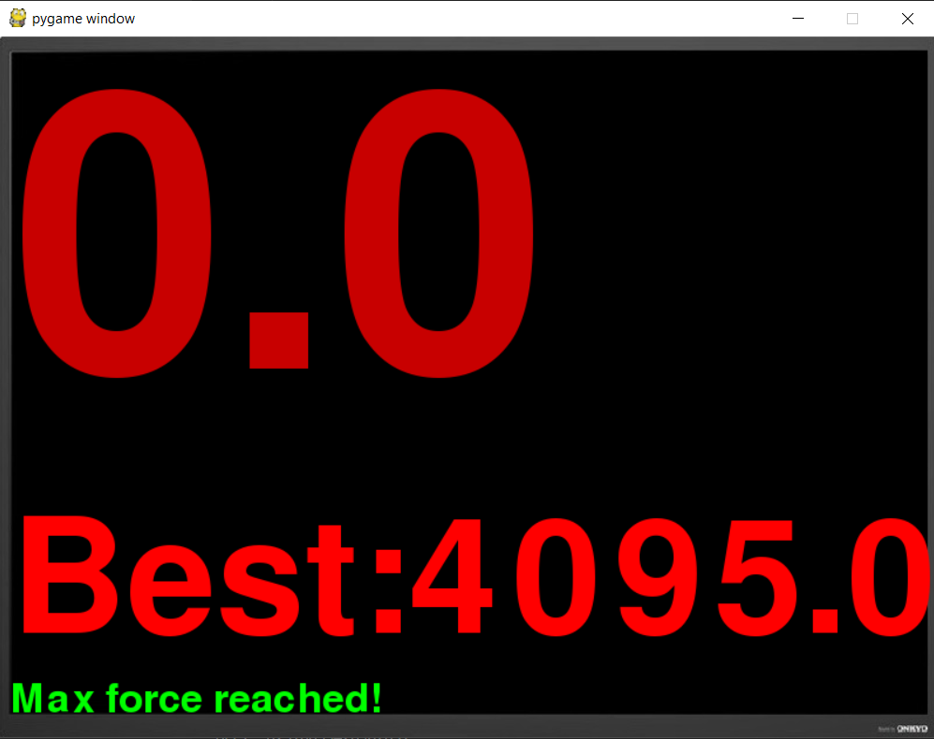
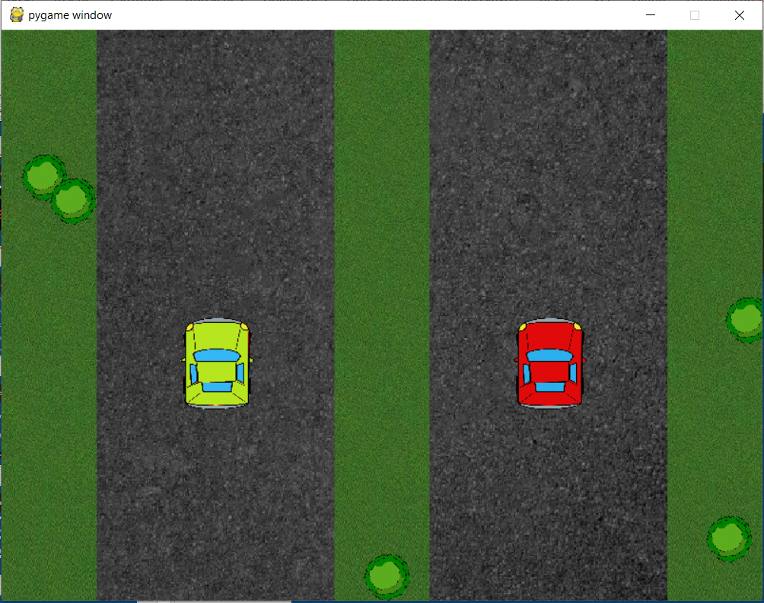
How it looks

Slide 10

Well, that was ruff
Learning how to use Bitalino
Getting real time data
Data processing
Python performance
Bitalino “steals” wi-fi

Slide 11

Keeping the love strong
Continuous debbuging
New features, new game modes, more fun
“Love is a two-way street constantly under construction” - Carrol Bryant

Slide 12
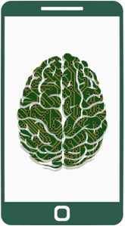
Future endeavors
Create a mobile app
Computer generated AI for your opponents
More powerful hardware and software for research and medicinal purposes

Slide 13
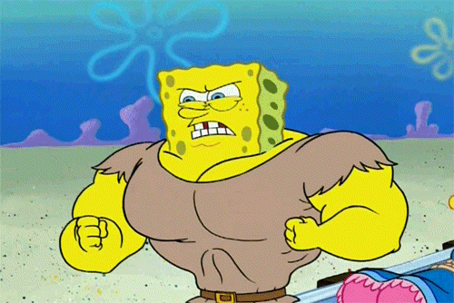
And never Forget…
FOCUS
GYM GAINS
FUN
“Desde a primeira neecathon que não via um projeto assim tão ambicioso” – Neecathon founder

