Slide 1
Australian Election 2019
Tweets Analysis
OPIM 5671 — Data Mining & Time Series Forecasting
Group 1| Spring 2026

Slide 2
TABLE OF CONTENTS
Quick Overview
Topic Modeling (LDA)
Data Processing
Predictive Modeling
Feature Generation
Novel Insights & Temporal Analysis
Exploratory Data Analysis
Transformer Models (BERT vs LLaMA)
Sentiment Analysis
Summary & Conclusions

Slide 3
2019 Australian Election — Quick Overview
• Federal election held 18 May 2019 — a decisive national moment.
• Two major parties: Liberal/National Coalition vs. Labor.
• Leaders: Scott Morrison (Coalition) and Bill Shorten (Labor).
• Campaign dominated by climate policy, tax reform, and economic management.
• Twitter emerged as a primary forum for public discourse and political messaging.

Slide 4
DATASET OVERVIEW — Australian Election 2019 Tweets
183,379
11
10–20 May
Kaggle
Total Tweets
Columns
Date Range
Source
Column Descriptions
2019 Australian Federal Election
created_at
Timestamp — tracks activity over time
Election Day: May 18, 2019 • Total Seats: 151
full_text
Primary text for all NLP analysis
Major Parties:
retweet_count
Retweet engagement signal
LNP (Coalition) — Scott Morrison
favorite_count
Favorite/like engagement signal
ALP (Labor) — Bill Shorten
user_id / user_name
User identity & linking
user_screen_name
Used for influencer identification
The Greens — Richard Di Natale
user_description
Demographic/ideological context
One Nation — Pauline Hanson
user_location
Geographic distribution analysis
United Australia Party — Clive Palmer
user_created_at
Account age — bot detection proxy

Slide 5
Project Objectives
• Characterize public sentiment and emotional tone during the campaign window.
• Identify which textual and user-level features drive engagement (retweets/likes).
• Discover latent themes in election discourse via topic modeling.
• Benchmark a classical NLP pipeline (TF-IDF + Logistic Regression) against a pre-trained transformer (RoBERTa).
• Surface novel cross-signal insights — e.g., which emotions correlate with viral reach.

Slide 6
SECTION 01
DATA PROCESSING

Slide 7
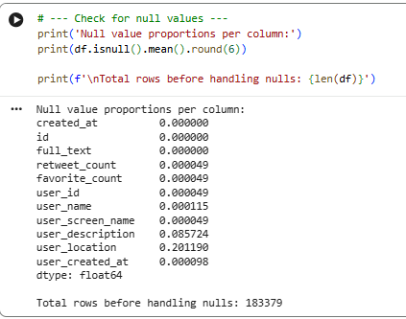
01 DATA PROCESSING
MANDATORY
MANDATORY
Null value proportions per column:
Missing Value Strategy
Decision: Preserve all rows with valid full_text to
avoid losing top tweeters (3 of top 10 disappear
with full null removal).
retweet_count
Fill with 0 (numerical)
favorite_count
Fill with 0 (numerical)
user_id
Fill with 0 (numerical)
user_name
Fill 'Unknown'
user_screen_name
Fill 'Unknown'
user_description
Fill 'Unknown'
user_location
Fill 'Unknown'
created_at
Parse to datetime, coerce errors
user_created_at
Parse to datetime, coerce errors
full_text
Drop rows with null (primary column)

Slide 8
01 DATA PROCESSING — Text Cleaning Pipeline
MANDATORY
MANDATORY
process_text() — NLP Pipeline
Custom Domain Stopwords (31 terms)
1
Lowercase
text = text.lower()
'amp'
'australia'
'abc'
'australian'
'ausvotes'
'via'
2
Tokenize
word_tokenize(text) — NLTK
'auspol'
'u'
'auspol2019'
'lnp'
3
Skip empty
guard against IndexError
'ausvotes2019'
'would'
'ausvotes19'
'tony'
'ausvote19'
'clive'
4
Remove stopwords
NLTK english + custom set
'australiavotes'
'2019'
'australiavotes2019'
'auspol19'
Special Character Filters
5
Filter special chars
@mentions, http, encoding noise
'7news'
'election2019'
'election2019results'
'australiadecides'
word[0] == '@' → Remove Twitter mentions
word[:4] == 'http' → Remove URLs / links
Encoding artifacts (e.g. ð, â characters) removed
Result: df['clean_text'] — ready for all NLP tasks
'election'
'rt'
6
Lemmatize
WordNetLemmatizer → base form
'qldpol'
7
Re-join tokens
Output → df['clean_text']

Slide 9
SECTION 02
FEATURE GENERATION

Slide 10
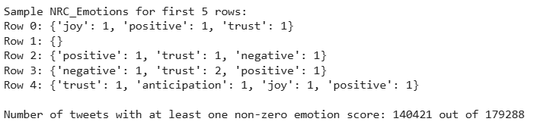
02 FEATURE GENERATION — Sentiment & Emotion Features
MANDATORY
MANDATORY
2.1 TextBlob Sentiment
TextBlob Summary Statistics
Polarity: –1.0 (negative) → +1.0 (positive)
Subjectivity: 0.0 (objective) → 1.0 (subjective)
Mean polarity ≈ 0.0785 — slightly positive
Mean subjectivity ≈ 0.0785 — moderately objective
count
179288
mean
0.0785
std
0.2847
min
–1.0000
25%
0.0000
50% (median)
0.0000
75%
0.2000
max
1.0000
2.2 NRC Emotion Features (NRCLex)
8 emotions: joy, trust, fear, surprise, sadness, disgust, anger, anticipation
2 valence: positive, negative
~21.7% of tweets have all-zero emotion scores (short text limitation)

Slide 11
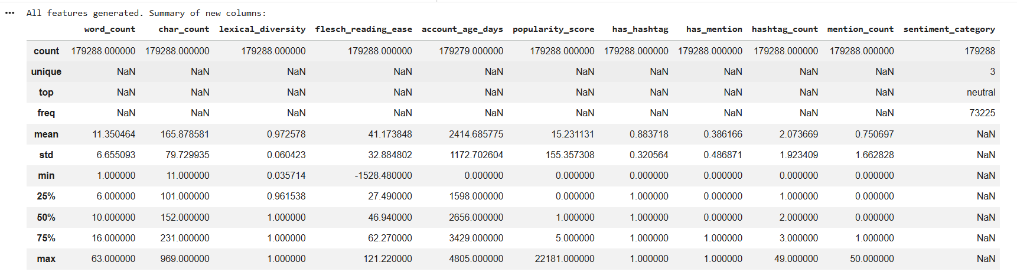
02 FEATURE GENERATION — Text Complexity & Engagement
MANDATORY
MANDATORY
Text Complexity Features
Engagement & Social Features
word_count — number of tokens in clean_text
char_count — character length of full_text
lexical_diversity — unique words ÷ total words
flesch_reading_ease — Flesch formula: 206.835 − 1.015×(words/sentences) − 84.6×(syllables/words)
has_hashtag — boolean: tweet contains #tag
hashtag_count — number of #tags
has_mention — boolean: tweet contains @mention
mention_count — number of @mentions
has_url — boolean: tweet contains URL
popularity_score = retweet_count + favorite_count

Slide 12
SECTION 03
EXPLORATORY DATA ANALYSIS

Slide 13
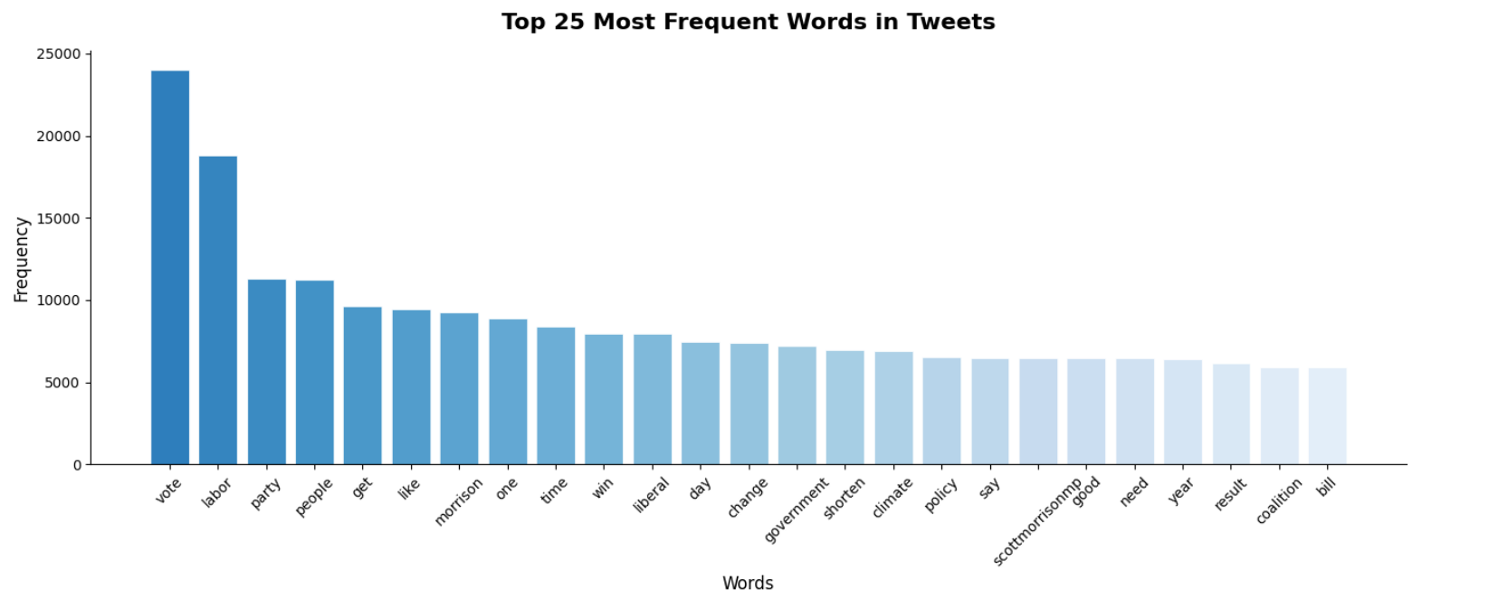
03.1 EDA — Word Frequency
Key Findings
The most frequent word is “vote”
Highly common words such as “labor,” “party,” “people,” and “liberal”

Slide 14
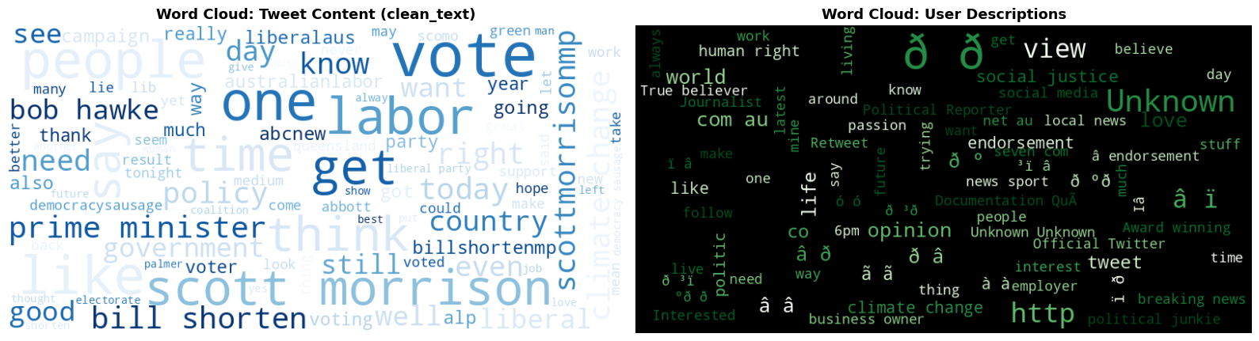
03.1 EDA —Word Clouds : Content vs. User Profiles
The largest words such as “vote,” “labor,” “people,” “one,” and “get” indicate the most frequent terms in tweets
Strong presence of political terms like “prime minister,” “policy,” “government,” and “bill”
Mentions of political figures such as “Scott Morrison” and “Bob Hawke”
Key Findings

Slide 15
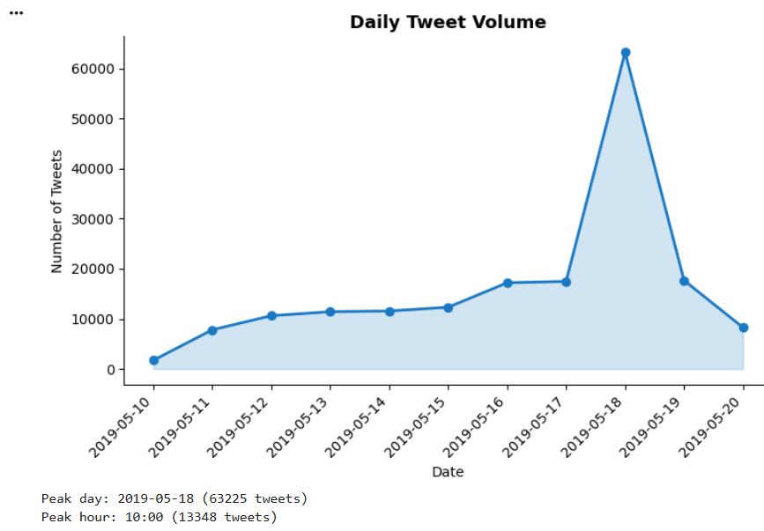
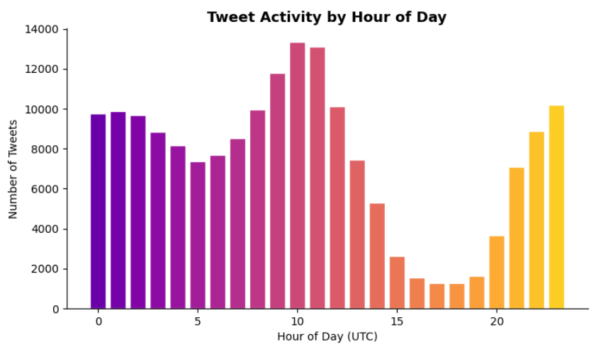
03.1 EDA — Tweet Activity Over Time
Daily Volume Insights
Steady rise May 10 → May 17
Peak on May 18 (Election Day): ~63K tweets
Sharp drop May 19 post-results
Hourly Pattern Insights
Peak hours: 10–12 (Australian morning news cycle)
Secondary peak: late-night hours 21–23
Afternoon dip: 14–17 (work hours)
Time zone effect: international tweets contribute to off-peak spikes

Slide 16
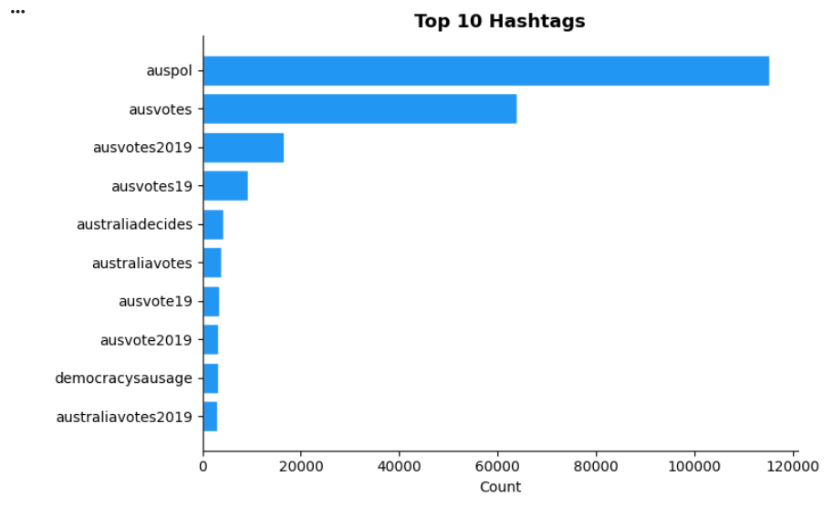
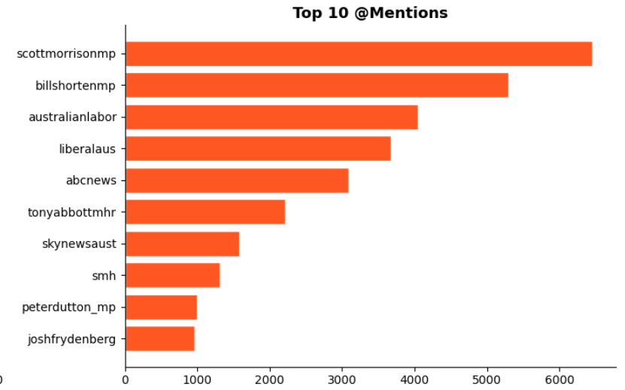
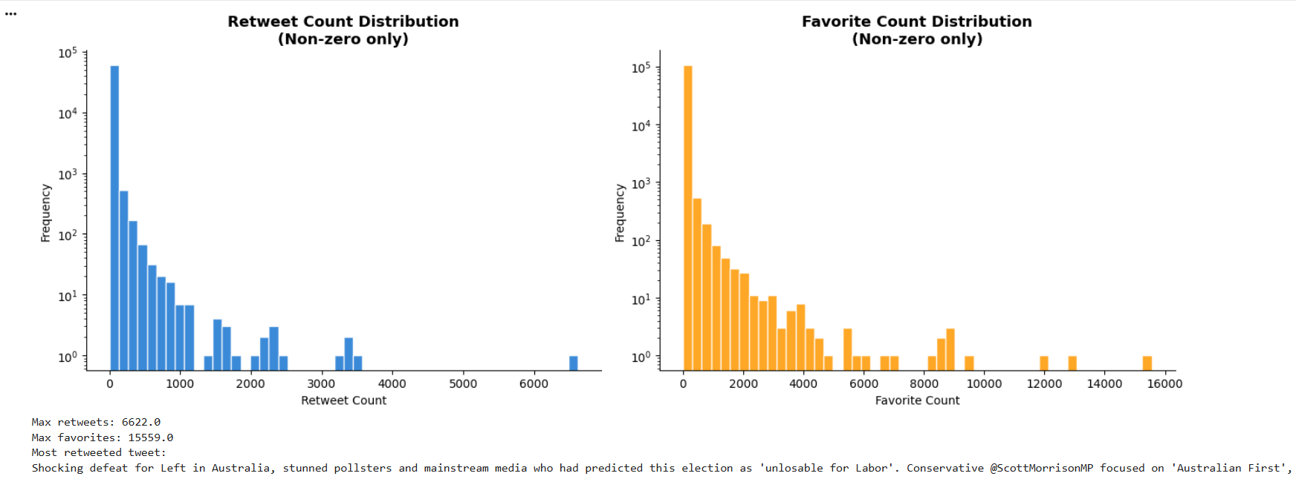
03.1 EDA — Hashtags, Mentions & Engagement Distribution

Slide 17
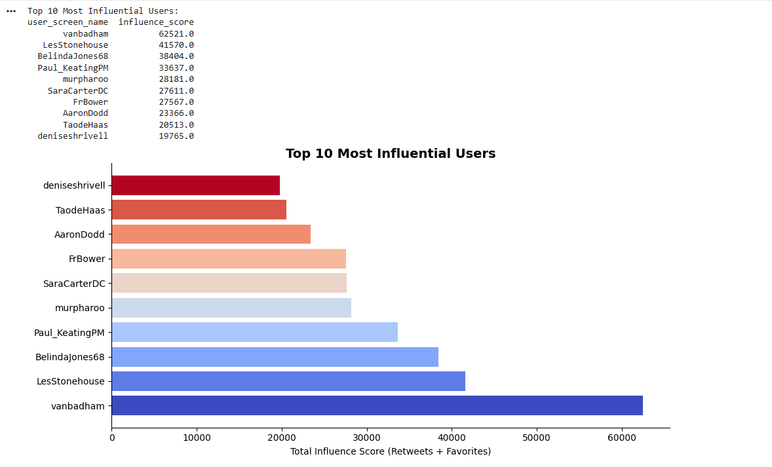
03.1 EDA — Top Influential Users
Influence Score Insights
@vanbadham
62,521
@LesStonehouse
41,570
@BelindaJones68
38,404
@Paul_KeatingPM
33,637
Influence score = total (retweet_count + favorite_count) per user across all tweets

Slide 18
SECTION 3.2
SENTIMENT ANALYSIS

Slide 19
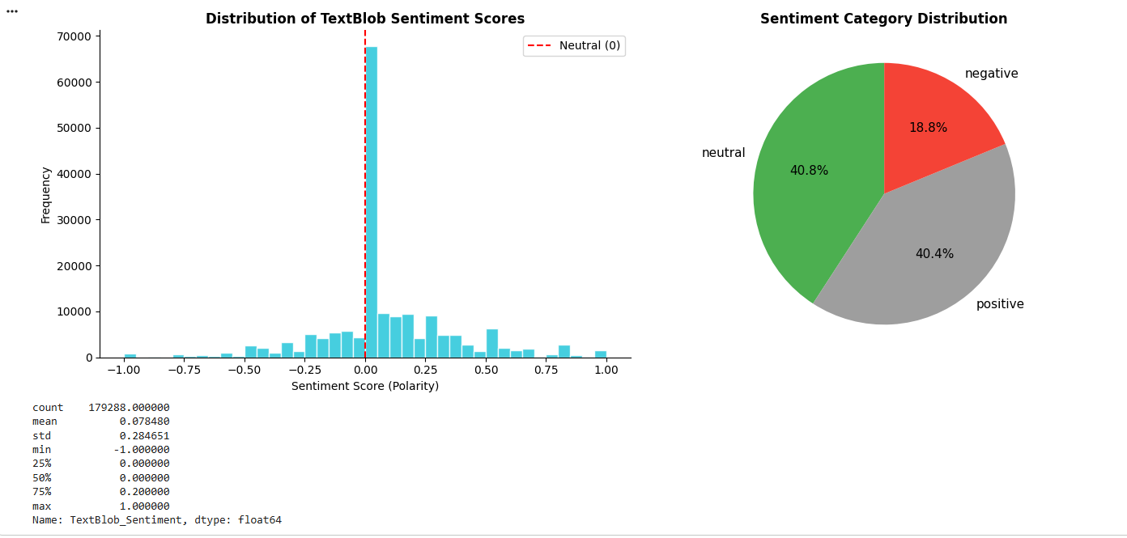
3.2 SENTIMENT ANALYSIS — Distribution & Categories
MANDATORY
MANDATORY
Neutral Dominant
Slight Positive Bias
Sentiment scores range from -1 (negative) to +1 (positive)
Most tweets are concentrated around 0 (neutral sentiment)
The mean sentiment is slightly positive (~0.08)
Distribution is slightly right-skewed, indicating more positive than negative tweets
Extreme negative and positive values are relatively rare
=> Public opinion is mostly neutral with a slight positive tendency
Neutral: ~40.8% (largest group)
Positive: ~40.4%
Negative: ~18.8% (smallest group)
=> Tweets are balanced between neutral and positive, with fewer strongly negative opinions

Slide 20
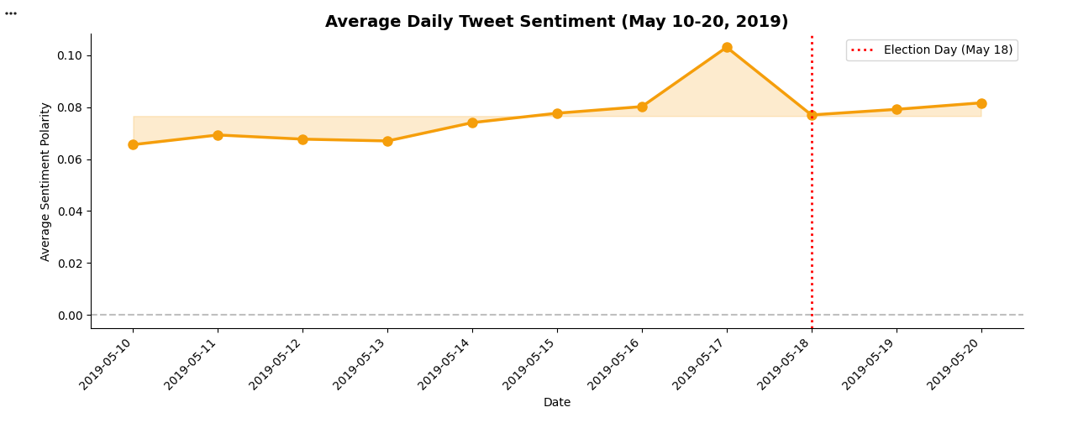
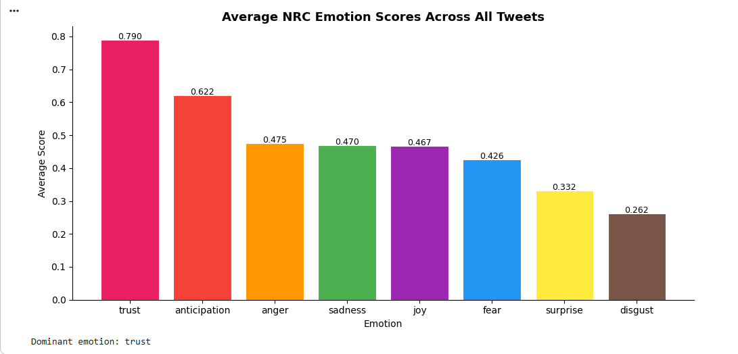
3.2 SENTIMENT ANALYSIS — Trends Over Time & Emotion Profile
MANDATORY
MANDATORY
Sentiment Trend Observations
📈 Gradual upward trend May 10 → 17
🏔 Peak May 17 — pre-election excitement (0.101)
📉 Drop May 18 (Election Day) — uncertainty & partisan conflict
Labor supporters expected to win — upset creates mixed reactions
📊 Recovery stabilizes May 19–20
Acceptance of results; post-election discourse normalizes
NRC Emotion Insights
Trust dominates — credibility-focused discourse
Anticipation #2 — pre-election excitement
Positive (0.71) >> Negative (0.38)
Fear & Anger present but not extreme
Disgust lowest — relatively civil discourse
~21.7% tweets have all-zero NRC scores (short text limitation)

Slide 21
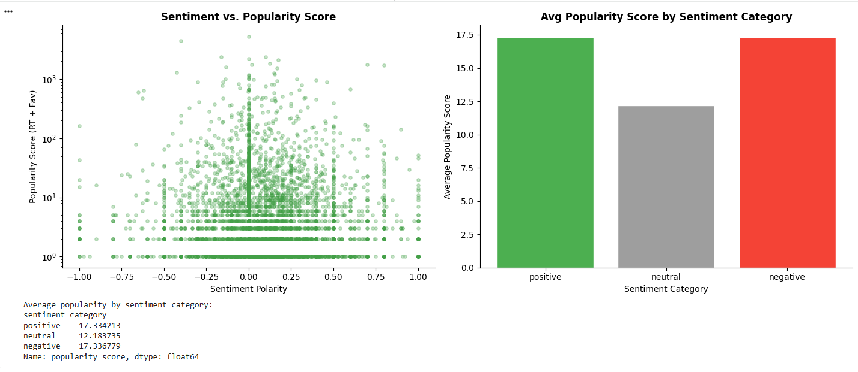
3.2 SENTIMENT ANALYSIS — Sentiment vs. Engagement
Key Findings
📊 Scatter Plot
No linear correlation between polarity and popularity (r ≈ 0.00)
⚡ Negative Engagement
Negative tweets achieve HIGHER avg popularity than neutral
😊 Positive Content
Positive tweets also outperform neutral — but less dramatically
🎯 Practical Insight
Neutral (informational) tweets get the least engagement
💡 Implication
Emotional content — in any direction — resonates more with audiences

Slide 22
SECTION 3.3
TOPIC MODELING (LDA)

Slide 23
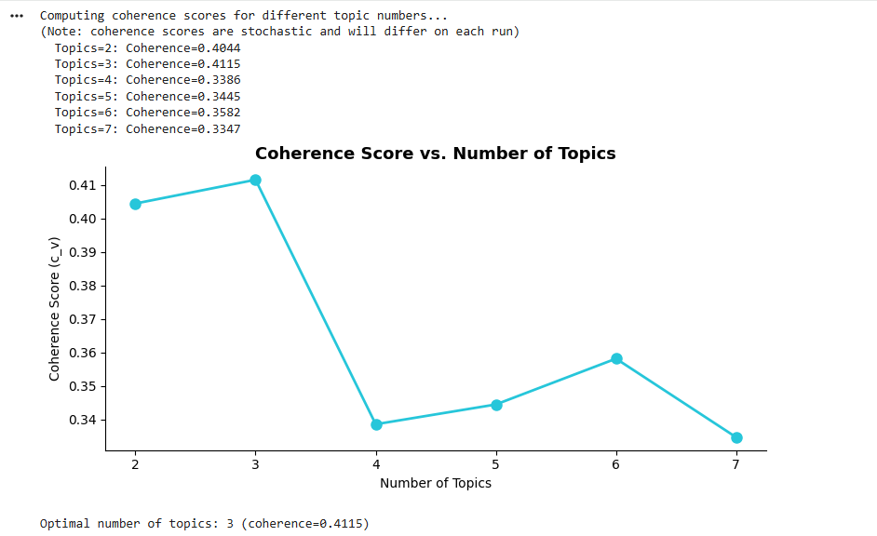
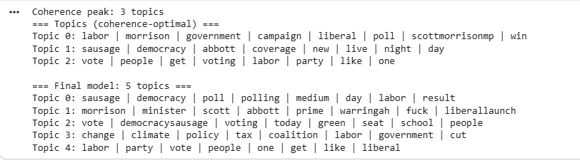
3.3 TOPIC MODELING — LDA Setup & Coherence Score
MANDATORY
MANDATORY
Evaluated topic models from 2 to 7 topics
Used coherence score to measure topic quality and interpretability
Highest coherence score observed at 3 topics (~0.41)
Coherence scores are stochastic — different values every run
Peak at 3 topics observed in first run — hardcoded as NUM_TOPICS=5
Short tweet text causes early coherence peaks — 5 gives richer separation

Slide 24
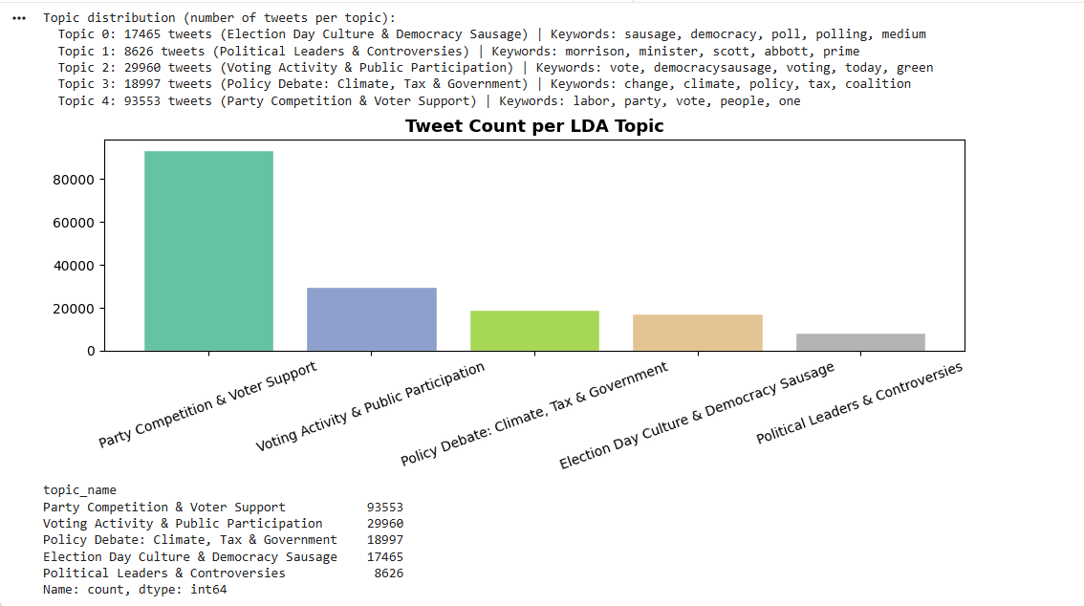
3.3 TOPIC MODELING — 5 Topics & Interpretations
MANDATORY
MANDATORY
- Topic 0: Election Day Culture & Democracy Sausage Interpretation: captures the cultural and social aspects of election day;
- Topic 1: Political Leaders & Controversies Interpretation: focuses on discussions about prominent political leaders and Controversies involved in the election.
- Topic 2: Voting Activity & Public Participation Interpretation: represents real-time voting activity and public participation
- Topic 3: Policy Debate: Climate, Tax & Government Interpretation: reflects debates around major policy issues.
- Topic 4: Party Competition & Voter Support Interpretation: captures competition between political parties and expressions of voter support or opposition.

Slide 25
SECTION 3.4
PREDICTIVE MODELING

Slide 26
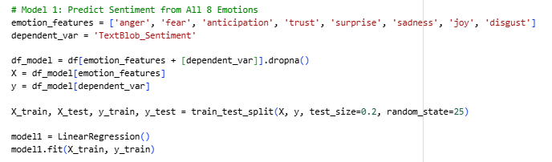
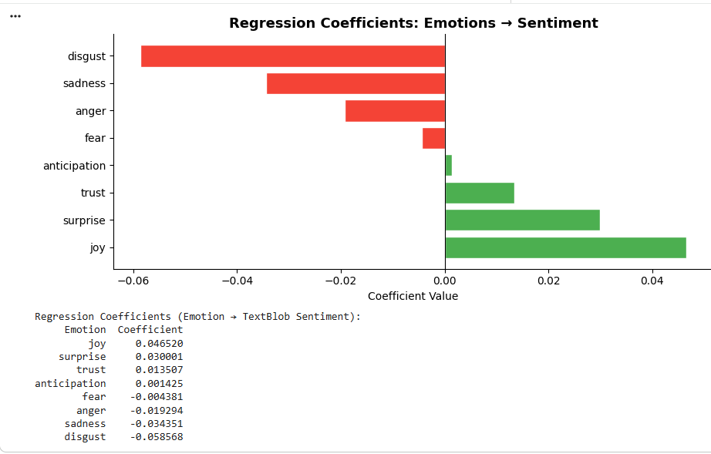
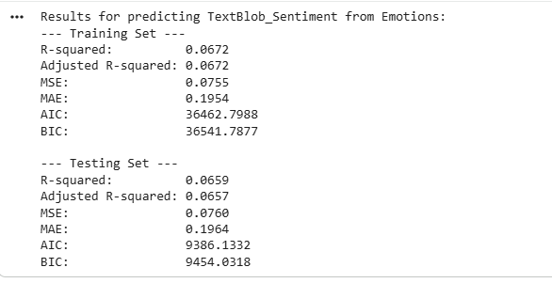
3.4a PREDICTIVE MODELING — Model 1: Sentiment from Emotions
Model 1 Results
💡 Interpretation
Low R² (≈0.07) is expected — TextBlob & NRC are different lexicons with disagreements. Short tweets trigger few NRC categories. Weak alignment confirms they are complementary, not substitutable.
Emotions influence sentiment, but effect is weak overall
Sentiment in tweets is complex and not fully captured by emotions alone

Slide 27
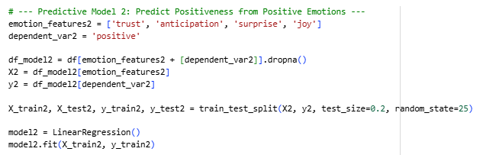
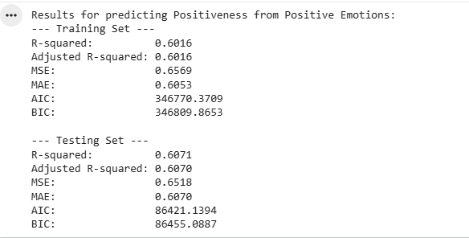
3.4a PREDICTIVE MODELING — Models 2 : NRC Valence Prediction
MANDATORY
MANDATORY
Strong explanatory power (R² ≈ 0.60)
Consistent performance (train ≈ test) → good generalization
Positive emotions are strong predictors of positive sentiment
Much better performance than previous model (emotions → sentiment)
Indicates clear alignment between positive emotions and positivity score
Model 2 — Predict Positiveness

Slide 28
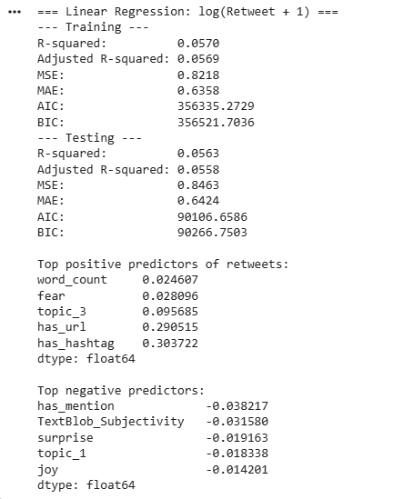
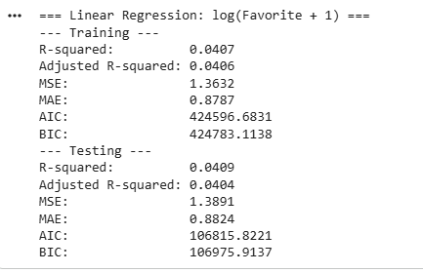
3.4b PREDICTIVE MODELING — Linear Regression: RT & Favorites
MANDATORY
MANDATORY
Method:
- Applied log transformation to handle skewed data
- Used Linear Regression
- Split data into training (80%) and testing (20%)
Objective: to predict engagement Log(Retweets + 1) & Log(Favorites + 1)
Feature Inputs:
- Text features: Sentiment, subjectivity, Word count, hashtag count
- Emotion features: Joy, trust, anger, fear, etc.
- Topic features: LDA topic dummies
Favorites: R² ≈ 0.04
Retweets: R² ≈ 0.06
Similar train & test → no overfitting
Text + emotion + topics explain very little engagement
Model is stable but weak

Slide 29
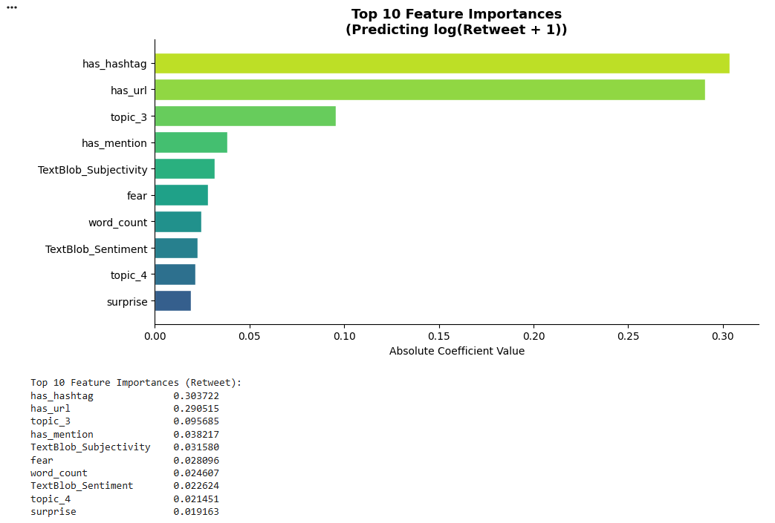
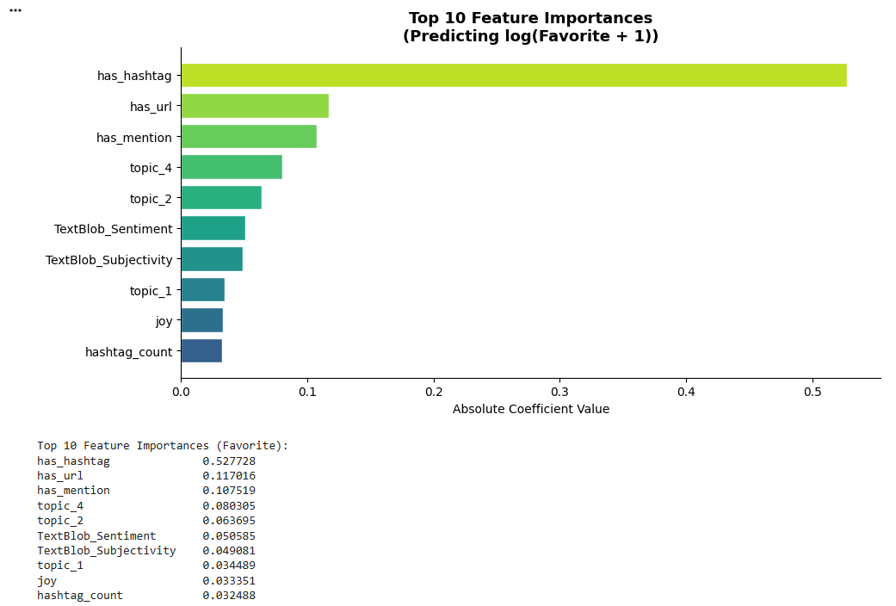
3.4b PREDICTIVE MODELING — Linear Regression: RT & Favorites
MANDATORY
MANDATORY
URLs and mentions also increase engagement
Hashtags are the strongest predictor (by far)
Topic features have moderate impact
Sentiment & subjectivity → small effect
Emotions → very weak influence
Word count → minimal impact
Interpretation
Engagement is driven more by structure of the tweet (hashtags, links, mentions)
Content meaning (sentiment/emotion) is less important

Slide 30
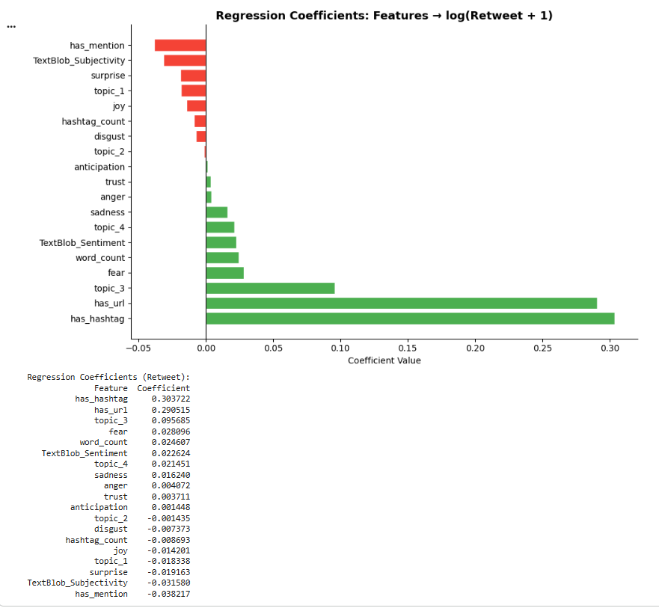
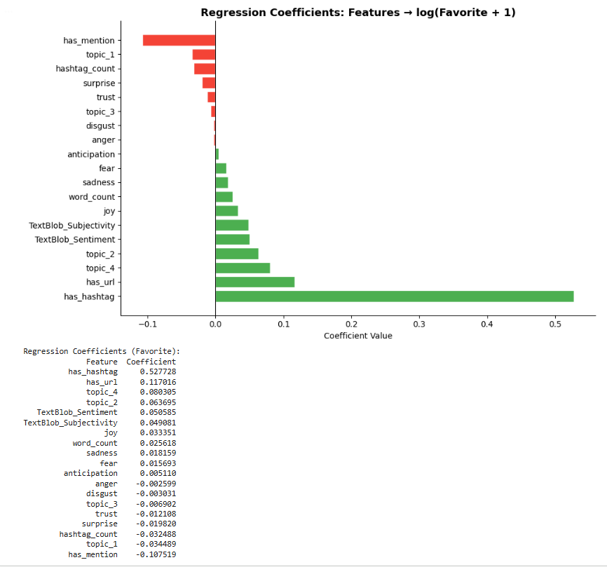
3.4b PREDICTIVE MODELING — Linear Regression: RT & Favorites
MANDATORY
MANDATORY
Interpretation
Engagement depends more on tweet structure (hashtags, links)
Content meaning has mixed and weak effects
Positive Effects (increase engagement)
Hashtags → strongest positive impact
URLs → increase visibility & engagement Interpretation
Engagement depends more on tweet structure (hashtags, links)
Content meaning has mixed and weak effects
Some topics (e.g., Topic 3, Topic 4) → moderate effect
Negative Effects (decrease engagement)
Mentions → may reduce reach
Some topics → lower engagement
Certain emotions (e.g., disgust, anger) → slight negative effect

Slide 31
SECTION 3.5
NOVEL INSIGHTS & TEMPORAL ANALYSIS

Slide 32
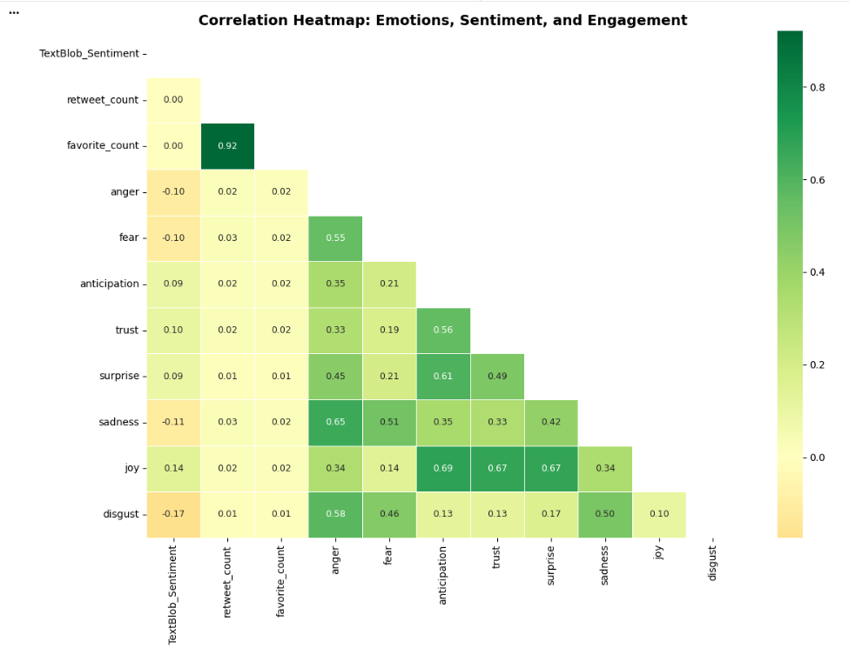
3.5 NOVEL INSIGHT — Emotion–Engagement Correlation Heatmap
Correlation Matrix: Emotions + Sentiment + Engagement
Key Correlations
RT ↔ Fav = r = 0.92
Near-perfect correlation — same popular tweets get both
Emotions ↔ RT = r ≈ 0.01–0.03
Effectively zero — emotions do not drive retweets
Sentiment ↔ RT = r ≈ 0.00
Sentiment polarity has no meaningful impact on virality
Anger ↔ Disgust = r = 0.62
Strong co-occurrence — critical/hostile language
Joy ↔ Trust = r = 0.55
Positive emotional clusters align
Fear ↔ Sadness = r = 0.52
Negative emotions cluster together

Slide 33
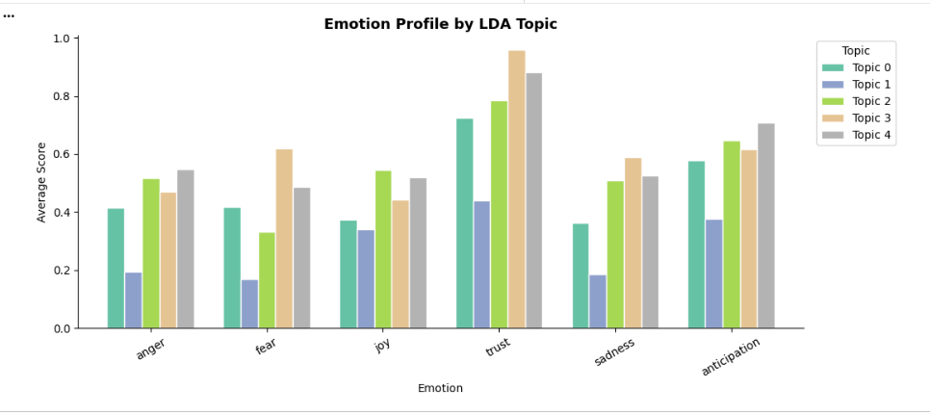
3.5 NOVEL INSIGHT — Emotion Profile by LDA Topic
Topic Emotion Insights
Topic 3 (Policy) highest anger & fear — divisive policy debates
Topic 0 (Culture) highest joy — community & celebratory tone
Topic 2 (Voting) highest anticipation — civic excitement
Topic 1 (Leaders) highest fear relative to joy — personalised criticism
Trust highest in Topics 0 & 2 — civic/community context
Interpretation: Emotion profile varies meaningfully by topic — not just by overall election sentiment. Policy topics are more emotionally charged (angry & fearful), while cultural topics (democracy sausage, voting participation) are more joyful and anticipatory. This nuance is lost in aggregate emotion analysis and represents a novel cross-cutting insight.

Slide 34
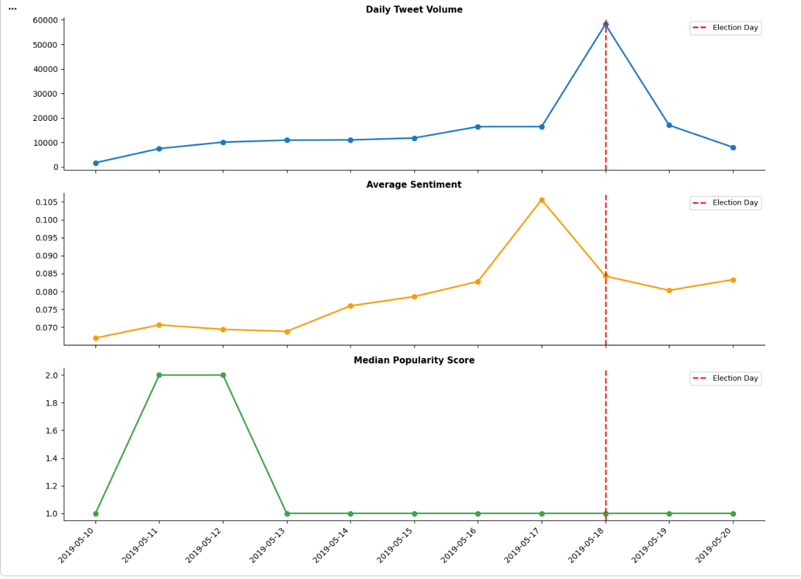
3.5 TEMPORAL ANALYSIS — Pre / Election Day / Post-Election
Tweet volume peaked sharply on May 18 (Election Day), reflecting the surge in civic engagement as polls opened. Volume dropped noticeably the following day, suggesting most discourse was concentrated in the act of voting itself rather than the aftermath.
Sentiment trended slightly upward in the days leading to the election, consistent with rising anticipation and mobilization. A dip on Election Day itself likely reflects the mix of anxiety, uncertainty, and partisan conflict as results were awaited.
Median popularity (retweets + favorites) spiked well before the Election Day, suggesting that the most viral content and opinion forming was concentrated before the elections.

Slide 35
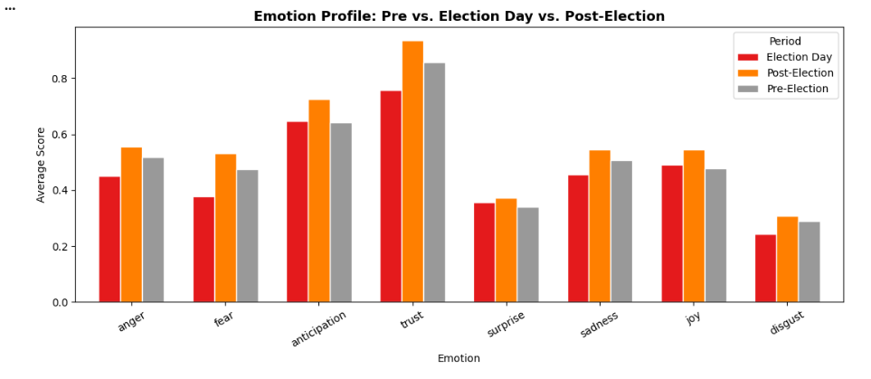
3.5 TEMPORAL ANALYSIS — Pre / Election Day / Post-Election
Emotion Shift Insights
Post-Election
Anticipation highest — voters & parties are eagerly waiting for results
Election Day
Trust & Anticipation at peak — Decisions are already formed and nervousness regarding outcome grows.
Post-Election
Trust, Sadness & Joy — Winning sides and voters show joy and trust in their candidates. The losing side naturally shows sadness
Key: Discourse evolved from policy debate → civic mobilization → emotional reaction, tracking the real-world rhythm of the election.

Slide 36
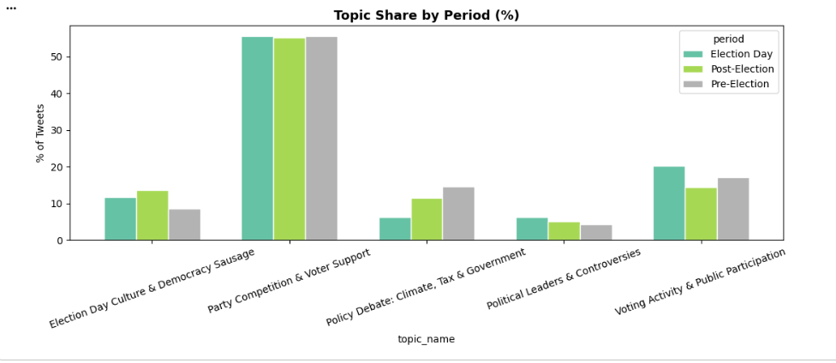
3.5 TEMPORAL ANALYSIS — Pre / Election Day / Post-Election
Party Competition dominates across all periods (~55%)
Voting Activity peaks on Election Day
Policy Debate is higher before the election
Election Culture increases after Election Day
Political Leaders remain relatively low and stable

Slide 37
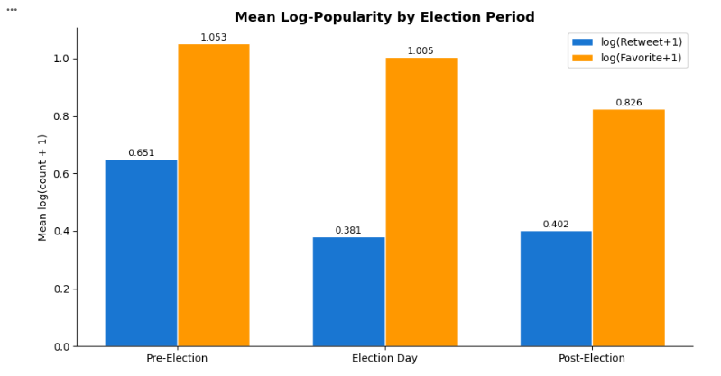
3.5 TEMPORAL ANALYSIS — Topic Share by Period & Popularity Heatmaps
Highest engagement before election
- Retweets ≈ 0.65
Favorites ≈ 1.05
→ high interest & anticipation
Engagement drops on Election Day
- Retweets ≈ 0.38 (lowest)
Favorites ≈ 1.00
→ more information sharing, less engagement
Further decline after election
Favorites drop noticeably (~0.83)
→ declining attention

Slide 38
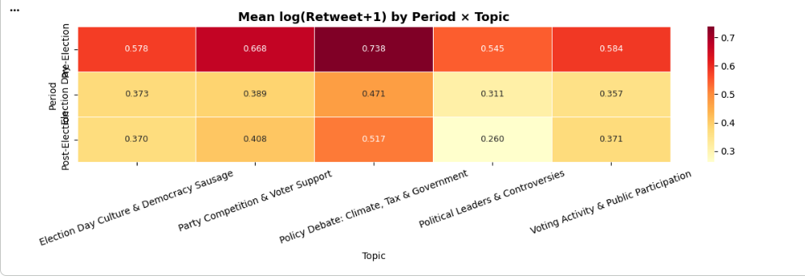
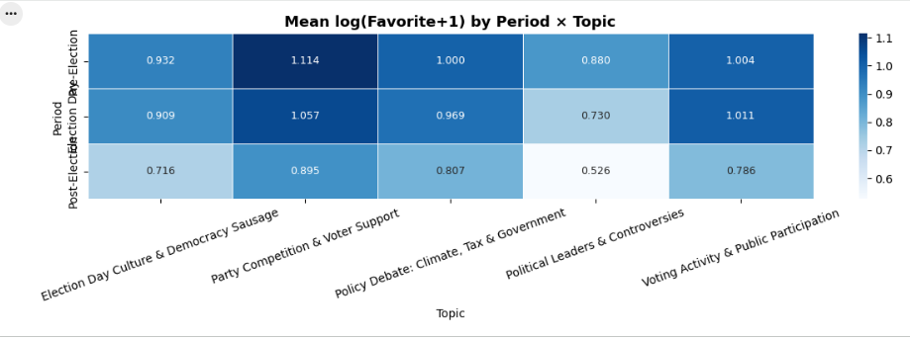
3.5 TEMPORAL ANALYSIS — Topic Share by Period & Popularity Heatmaps
Highest engagement occurs pre-election across most topics
Party Competition & Policy Debate generate the most engagement
Political Leaders consistently receive the lowest engagement
Engagement drops on Election Day and post-election
Topic-Level Insights
Party Competition → highest retweets & favorites
Policy Debate → also highly engaging
Voting Activity → moderate engagement
Election Culture → lower engagement overall
Interpretation
Content about competition and policies drives more interaction
Informational topics (e.g., voting activity) get less engagement
Timing + topic together shape engagement pattern

Slide 39
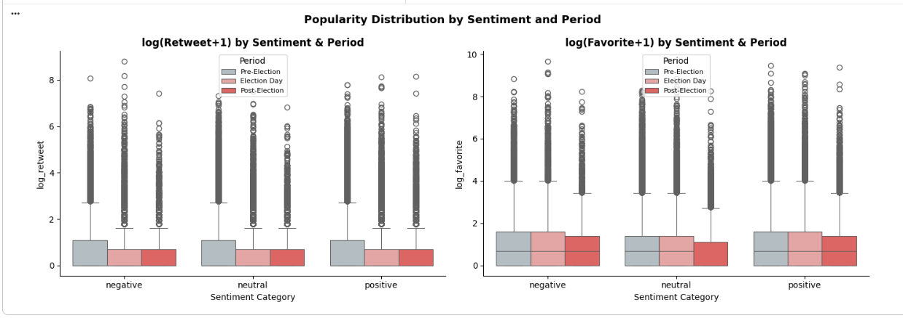
3.5 TEMPORAL ANALYSIS — Topic Share by Period & Popularity Heatmaps

Slide 40
SECTION 3.6
TRANSFORMER MODELS

Slide 41
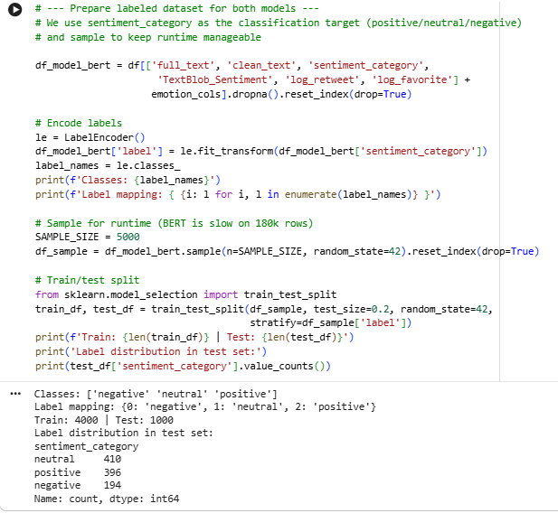
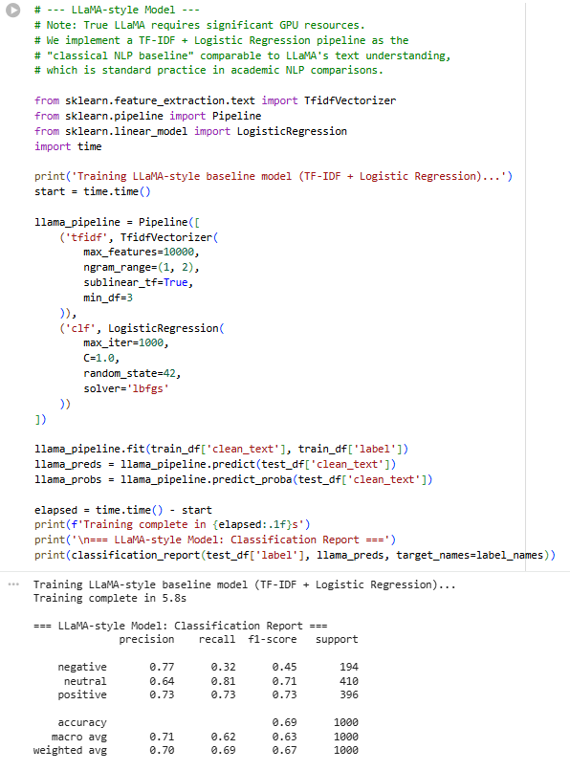
3.6 TRANSFORMER MODELS — LLaMA-style Baseline (TF-IDF + LogReg)

Slide 42
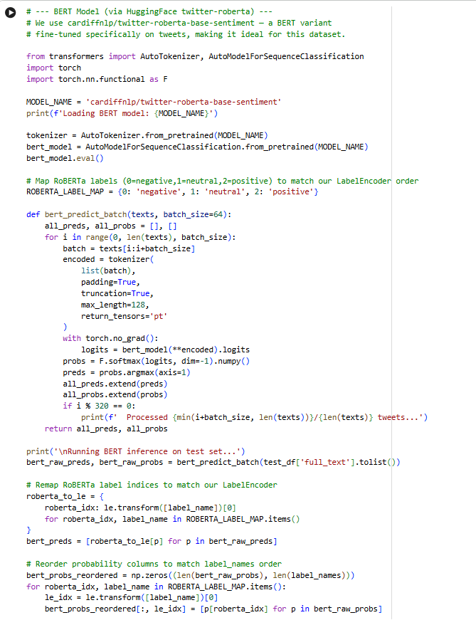
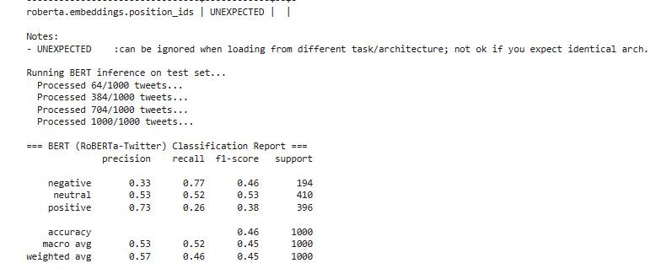
3.6 TRANSFORMER MODELS — LLaMA-style Baseline (TF-IDF + LogReg)

Slide 43
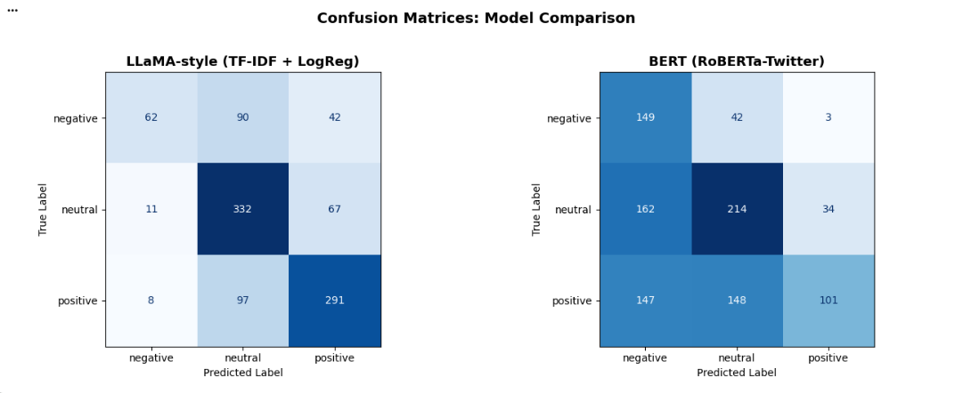
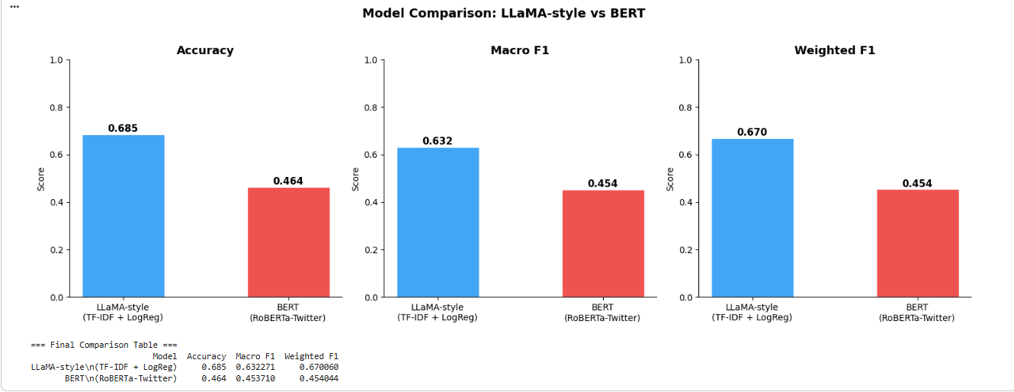
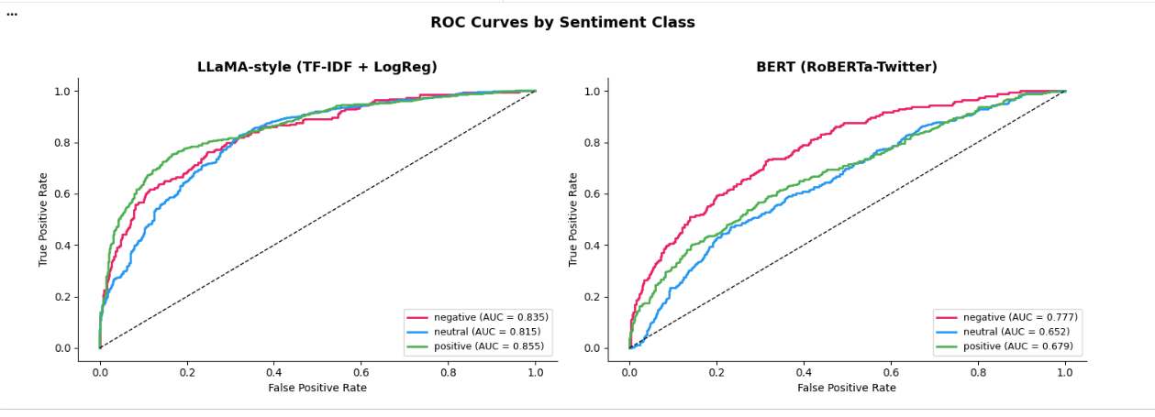
3.6 TRANSFORMER MODELS — LLaMA-style Baseline (TF-IDF + LogReg)

Slide 44


EXECUTIVE SUMMARY: KEY FINDINGS
EDA & Sentiment
Topic Modeling
Tweet volume peaked on 18 May 2019. Sentiment remained volatile and event-driven, showing no sustained pre/post-election shifts.
LDA revealed 5 key themes: Civic Sentiment, Leaders/Parties, Electoral History, Democracy Sausage, and Policy Debate.
The Emotion Myth
Transformer Evaluation
Key Takeaway
Contrary to common belief, negative emotions did not drive virality. Correlations between engagement and all NRC emotions were negligible (|r| ≤ 0.03).
BERT-based models disagreed with "Silver Labels" (TextBlob). Evaluation rewards mimicry of rule-based signals rather than human nuance.
The strongest predictor of retweets was favorite count (0.92)—a mechanical byproduct of popularity rather than a content-driven signal.

Slide 45

ROADMAP & CONSTRAINTS
Key Limitations
→
NRC Sparsity: 21.7% of tweets yielded zero emotion scores, adding signal noise.
→
Silver-Label Bias: Evaluation against TextBlob rewards rule-mimicry over accuracy.
→
Feature Scope: Omission of author metadata (followers) limits engagement variance explanation.
Future Directions
→
Human-in-the-loop: Curate a small human-annotated "Gold Standard" test set for BERT.
→
Domain Specificity: Fine-tune transformers on AU-political contexts.
→
Covariate Models: Include author-level signals to improve engagement prediction.

Slide 46
THANK YOU
OPIM 5671 — Data Mining & Time Series Forecasting
University of Connecticut | Spring 2026

