Slide 1
Barplots -Liver

Slide 8
WAT

Slide 13
Webgestalt

Slide 14
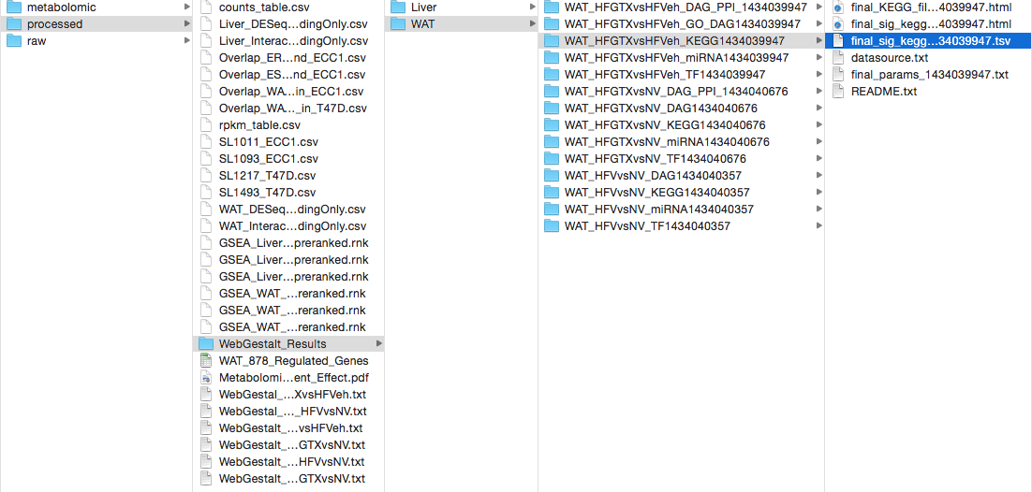

Slide 15
Metabolomic analysis

Slide 16
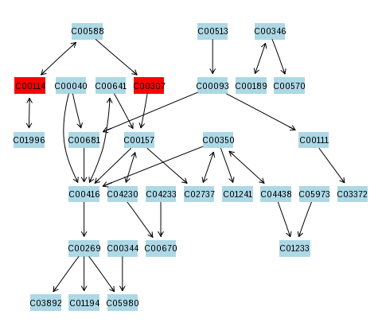
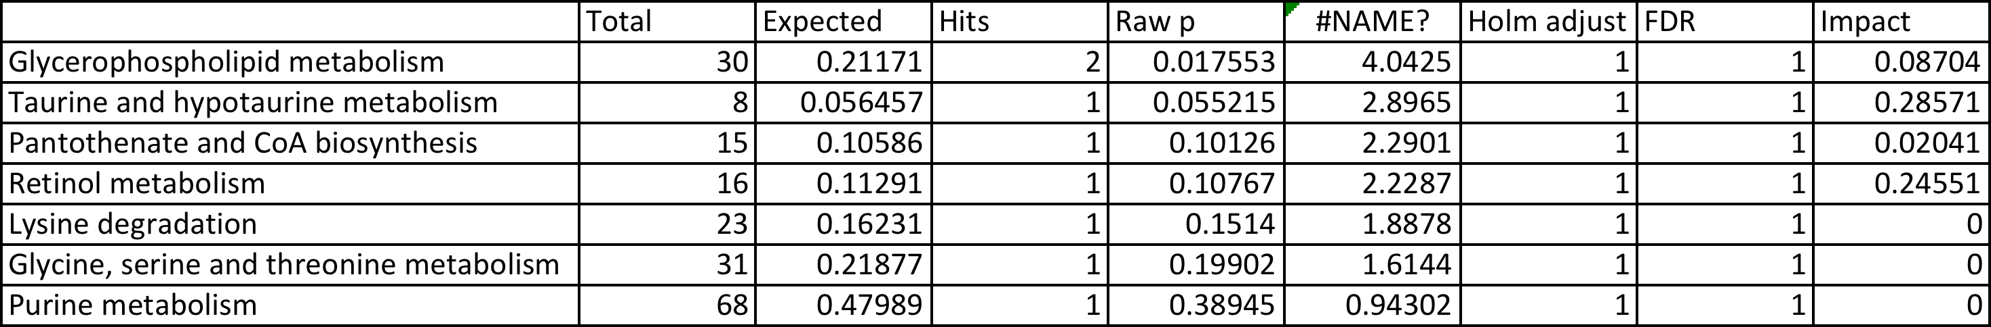
Biochemicals | q-value
1-linoleoyl-GPE (18:2)* | 0.0221
1-palmitoyl-2-linoleoyl-GPG (16:0/18:2) | 0.0221
1-palmitoyl-GPE (16:0) | 0.0221
arabonate/xylonate | 0.0221
cytidine-5'-diphosphoethanolamine | 0.0221
glycerophosphoinositol* | 0.0221
N1-methyladenosine | 0.0221
N6-carbamoylthreonyladenosine | 0.0221
xanthosine | 0.0221
5-methyltetrahydrofolate (5MeTHF) | 0.0229
erythronate* | 0.0240
pantothenate | 0.0240
stearidonate (18:4n3) | 0.0256
1-palmitoyl-GPI (16:0)* | 0.0407
allantoin | 0.0407
choline | 0.0407
hypotaurine | 0.0407
palmitoylcholine | 0.0407
tricosanoyl sphingomyelin (d18:1/23:0)* | 0.0448
2-palmitoleoyl-GPC (16:1)* | 0.0473
cytidine 5'-diphosphocholine | 0.0473
4-hydroxy-nonenal-glutathione | 0.0495
isoleucine | 0.0495
pipecolate | 0.0495
retinal | 0.0495
HFDTX vs HFDVeh

