Slide 1



RETAIL SALES & REVENUE ANALYSIS
In 10/2024
PRESENTED BY:
PRESENTED TO:
Trinh Quang Tri
Sales Manager

Slide 2


Agenda
01 | Objectives and Goals
02 | Business Health
03 | Growth Drivers and Risks
04 | Strategic Actons
05 | Summary

Slide 3




Objectives and Goals
Goal # 1
Goal # 2
Goal # 3
Evaluate
Overall Business Health
Identify
Key Growth Drivers
and Risks
Propose
Specific Strategic Actions for the Next Month

Slide 4

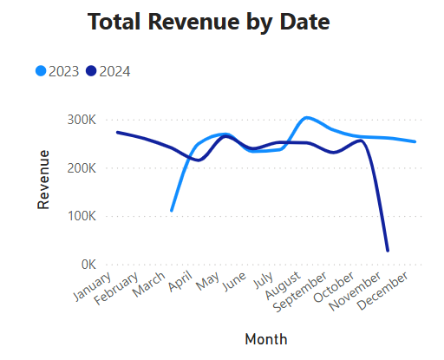
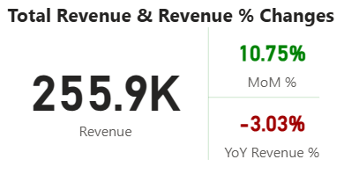
Business Health
Short-Term Gain vs. Long-Term Pain
This month's revenue hit $255.9K, a strong +10.75% increase from the previous month, indicating positive short-term momentum.
However, revenue is down -3.03% compared to the same time last year. This is part of a persistent negative trend that poses a long-term strategic risk.

Slide 5

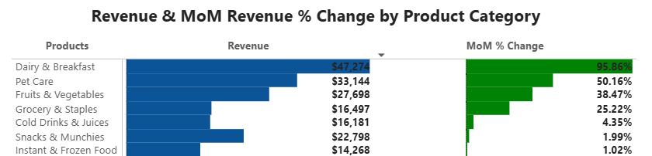
Growth Drivers
and Risks
By Categories
The Growth Drivers
Dairy & Breakfast
Pet Care
Fruits & Vegetables
Grocery & Staples
Top Performer with $47.2K revenue, showing outstanding +95.86% MoM growth. | A strong contender with $33.1K revenue and +50.16% MoM growth. | Solid growth at +38.47% MoM. Customer demand for fresh products is increasing. | Demonstrates stable potential with a +25.22% MoM growth.

Slide 6
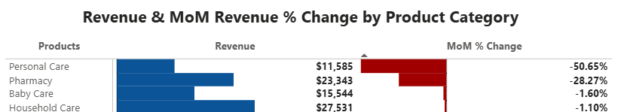
Growth Drivers
and Risks
By Categories
Key Risks
Personal Care
Pharmacy
Household Care
Baby Care
Biggest risk category, with a significant month-over-month (MoM) decline of -50.65%. | With a -28.27% MoM decrease. This is a considerable risk that demands our full attention. | Although the drop is only -1.10%, this is a normal fluctuation and require only routine monitoring. | A small decline of -1.60% suggests this category is not a major risk at present.

Slide 7
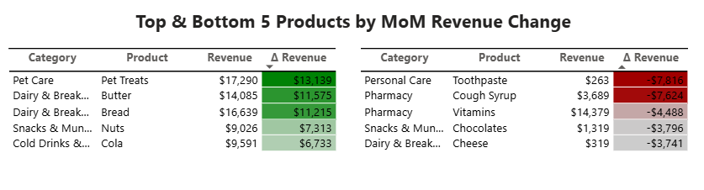
Growth Drivers
and Risks
By Products
Butter and Bread are the two main growth drivers of Dairy & Breakfast , contributing a combined + $22,790 to revenue. This confirms that the category's growth is not random but comes from the strong performance of its core products.
Pet Treats contributed + $13,139 to revenue, showing that this product is the main growth driver.
Although the MoM growth of Cold Drinks & Juices is not as high as the top two, Cola making it into the top 5 growing products (contributing + $6,733) shows it is a key product lifting the entire category.
Toothpaste is the main culprit, with a sharp revenue drop of - $7,816. This indicates that the Personal Care's issue is concentrated in one specific product.
Cough Syrup and Vitamins are the two products with a combined revenue decrease of - $12,112. This confirms that the Pharmacy category's problem is not just with one product but a broader trend.
Despite being a primary growth category, Dairy & Breakfast still has hidden risks. The revenue decline of - $3,741 for Cheese shows that even within strong categories, some products are struggling.

Slide 8




Strategic Actions
Long-Term Strategy
Competitive Research
Market Needs Assessment
Root Cause Identification
Conduct a thorough analysis of our main competitors' pricing, marketing, and product portfolio strategies.
Survey customer behavior to understand if our products are still meeting current market demands.
Identify the core reasons through deeper data-driven research

Slide 9
Strategic Actions
Short-Term Strategy
Maximize Growth in Our Top Categories
Dairy & Breakfast:
Launch a targeted marketing campaign on social media to highlight the success of key products like Butter and Bread.
Pet Care:
Partner with pet influencers to promote Pet Treats and other top-performing products.
Grocery & Staples:
Introduce special bundle deals (e.g., "Family Meal Bundles") to boost the +25.22% month-over-month growth.
Intervene to Stop Revenue Decline
Personal Care:
Conduct a quick market analysis to identify why products like Toothpaste are losing traction.
Pharmacy:
Initiate a promotional campaign with targeted discounts on underperforming products like Cough Syrup and Vitamins.
Household Care:
Action: Review pricing strategies and product placement to address the slight -1.10% month-over-month decline before it becomes a larger problem.

Slide 10

Summary
Business Health
While we celebrate a strong short-term recovery with a +10.75% month-over-month (MoM) revenue increase, this masks a persistent negative trend, with revenue down -3.03% year-over-year (YoY).
Growth Drivers and Risks
Growth Drivers: Growth is primarily fueled by outstanding performance in Dairy & Breakfast (MoM growth of +95.86%) and Pet Care (MoM growth of +50.16%).
Major Risks: Urgent intervention is required for Personal Care, which saw a significant MoM decline of -50.65%, and Pharmacy, with a
-28.27% MoM decrease.
Strategic Actions
We propose a two-pronged strategy: (1) Amplify growth in top-performing categories through targeted investment and marketing, and (2) Mitigate risks by conducting a root-cause analysis to address the decline in at-risk categories.

Slide 11

Thank you

