Slide 1



DATA MANAGEMENT FOR DATA SCIENCE – HOMEWORK 1 & 2
SPOTIFY DATASET JANUARY 2021
Leonardo Masci
Alessandro Quattrociocchi

Slide 2
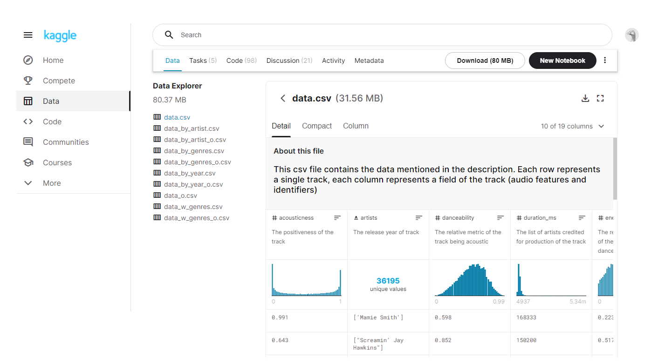
Preprocessing
Cleaning up the name of the songs and artists by removing unnecessary brackets
Removing songs and artists that used an alphabet different from the latin one

Slide 3
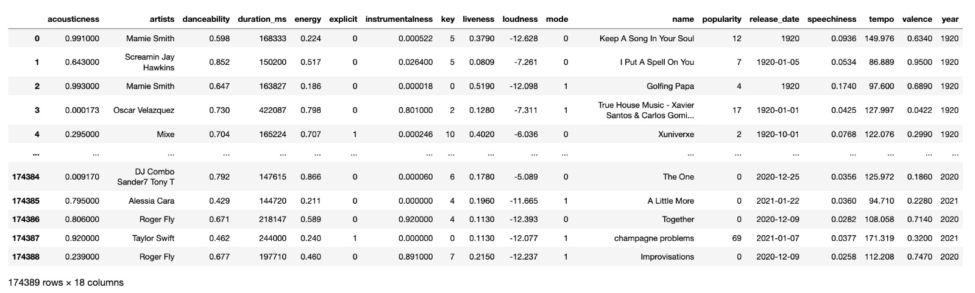
The Tables
Songs

Slide 4
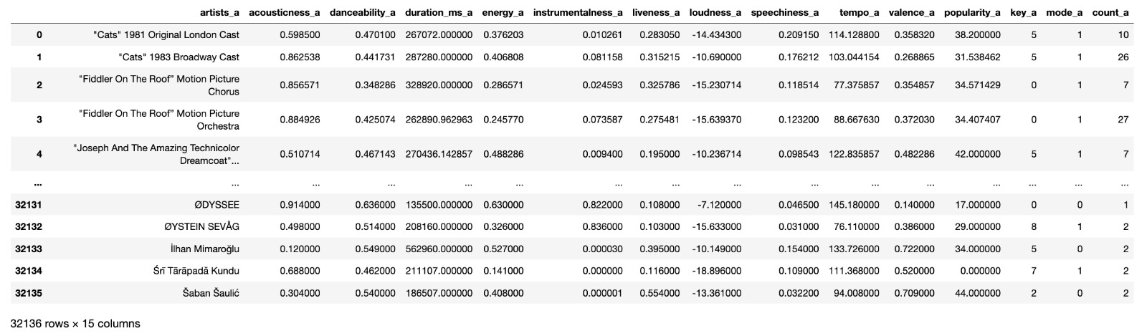
Artist

Slide 5
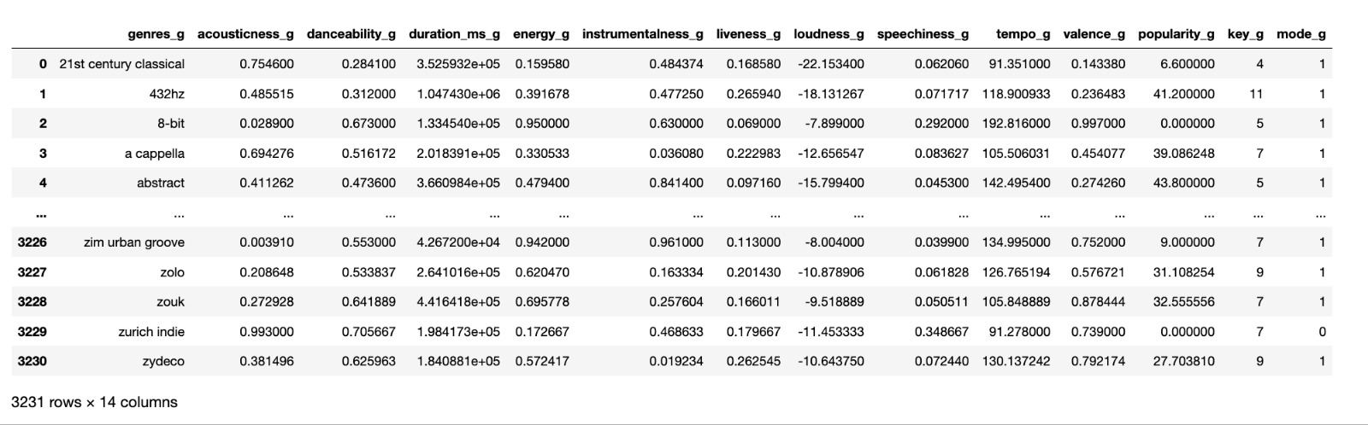
Genres

Slide 6
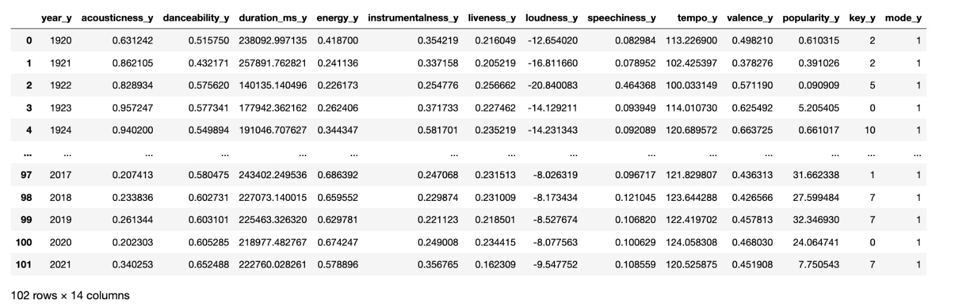
Year

