Slide 1



DATA MANAGEMENT FOR DATA SCIENCE – HOMEWORK 3
SPOTIFY DATASET JANUARY 2021
Leonardo Masci
Alessandro Quattrociocchi

Slide 2
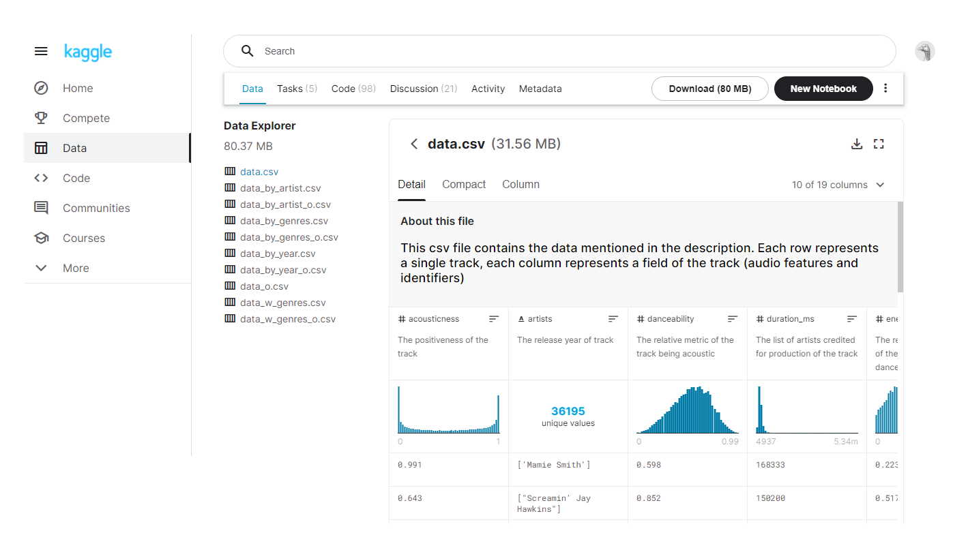
Preprocessing
Cleaning up the name of the songs and artists by removing unnecessary brackets
Removing songs and artists that used an alphabet different from the latin one

Slide 3
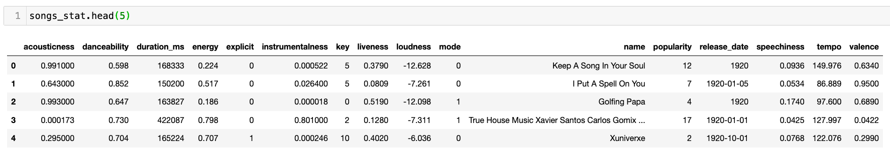
The Tables
Songs statistics

Slide 4
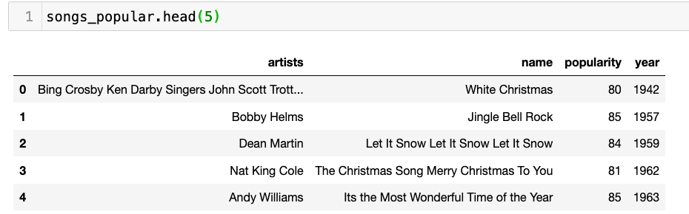
Songs popular

Slide 5
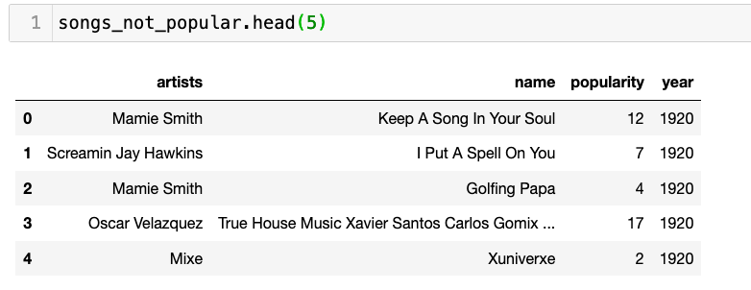
Songs not popular

Slide 6
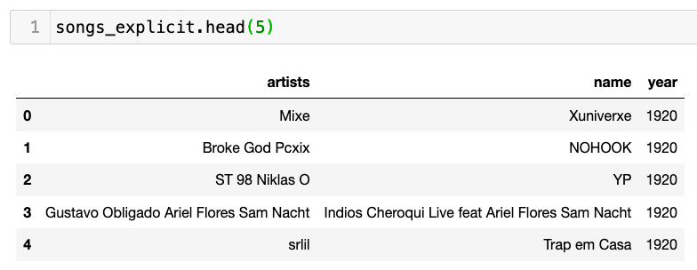
Songs explicit

Slide 7
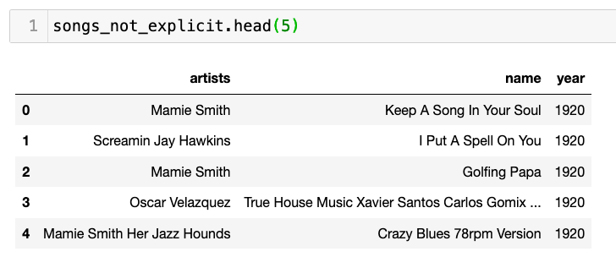
Songs not explicit

Slide 8
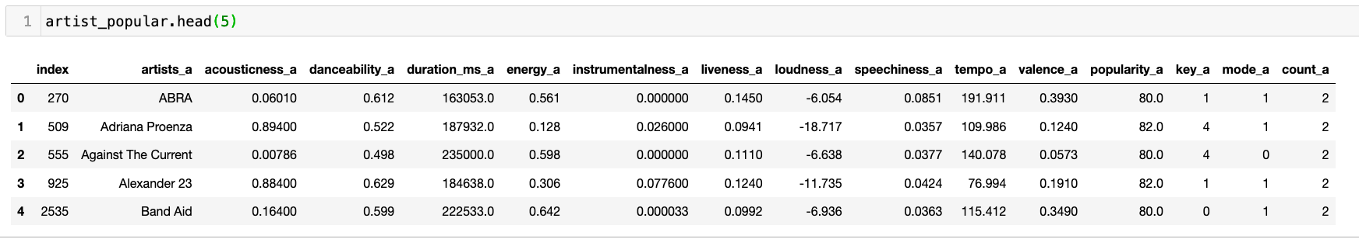
Artist popular

Slide 9
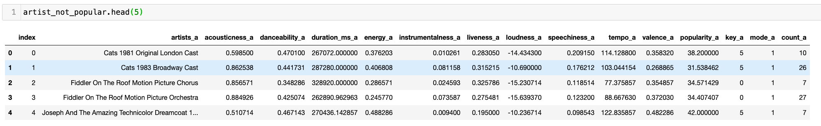
Artist not popular

Slide 10
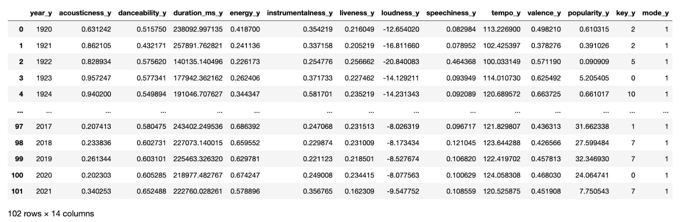
Year

Slide 11
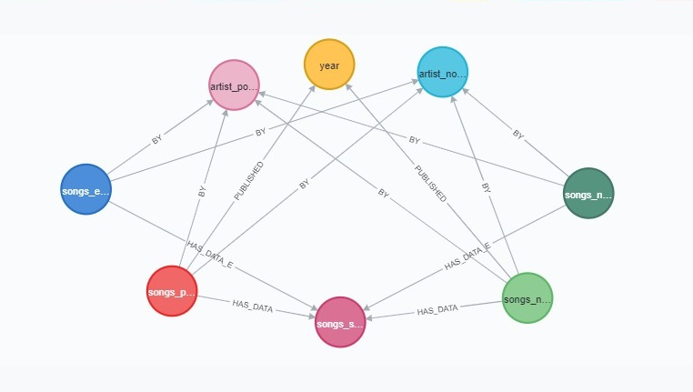
Neo4j schema

