Slide 1
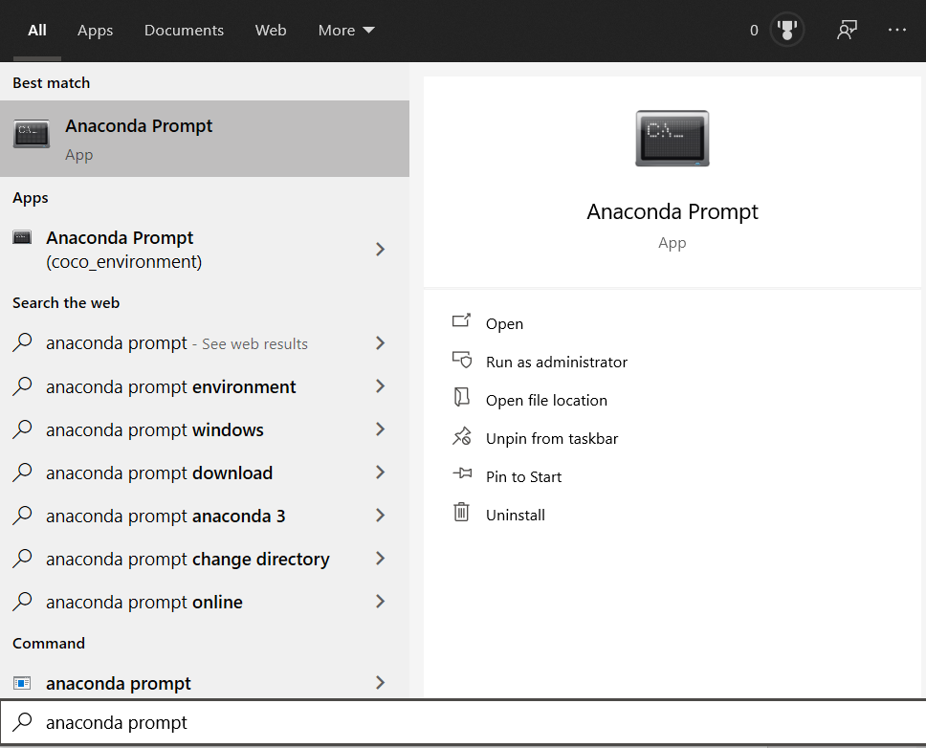
Installing Anaconda
Installation of Anaconda (or Miniconda) (https://www.anaconda.com/products/individual), which are both distribution software for Python.
Once Anaconda is installed, open “Anaconda Prompt.”

Slide 2
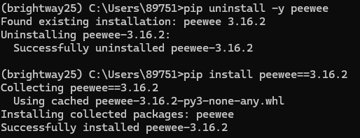
Create virtual environment
Download the ‘brightway25_env.yml’ from GitHub, then run:
conda env create -f env_bw25.yml --solver libmamba
conda activate brightway25
pip uninstall -y peewee
pip install peewee==3.16.2
jupyter lab

