Slide 1



QSafe
Threat-aware quantum-secure communication for biomedical networks
Biomedical endpoint
Trust boundary
Secure cloud
TRACK 2 · QUANTUM CRYPTOGRAPHY & COMMUNICATION
Classical threat intelligence + quantum-channel evidence
TEAM:
Roopa Gayatri
Vishal Singh
Sabyasaachi Pradhan
Notes:
Open with the one-line idea: QSafe combines classical network evidence and quantum-channel evidence to make an explainable security decision.

Slide 2
The Threat Outlives the Session
The security lifetime of biomedical data can be much longer than the transport session.
Encrypted session
Eavesdropper
Hospital
Cloud
01
02
03
Long-lived data
Harvest now
Decrypt later
Medical records, telemetry, identity, research.
Attackers can store encrypted traffic today.
Future quantum systems change the threat model.
Patient data must stay secret for decades.
Security has to survive a changing adversary — not just today’s attacker.
Notes:
Establish the problem: sensitive data can outlive the cryptography protecting the channel. The phrase harvest now, decrypt later motivates the quantum layer.

Slide 3


Quantum Changes the Rules
Two very different foundations for security.
Security from hard math
Security from physics
Depends on problems that are difficult for an attacker to compute.
Measurement disturbs unknown states. Unknown states cannot be copied perfectly.
Future quantum computers
Measure → it changes
THE SHIFT
From “hard to solve” → “impossible to observe invisibly.”
Notes:
Contrast computational security with the physical disturbance of quantum states. This is the reason BB84 is relevant to the problem.

Slide 4
BB84 in One Picture
Random choices create the key; the public channel reveals only basis information.
FOUR STATES
A
QUANTUM CHANNEL
B
Z basis
|0⟩
|1⟩
|ψ⟩ → |ψ⟩
X basis
|+⟩
|−⟩
Alice
Bob
Public channel · bases only, never bits
Random bit + random basis
1
2
3
4
5
Random bit
Random basis
Transmit
Compare bases
Keep matches
Matching bases → sifted key
Notes:
Walk through the five BB84 steps in one sentence. Emphasize that the classical public channel reveals basis choices, not the key bits.

Slide 5
One Bit at a Time
Sifting keeps only positions where Alice and Bob used the same basis.
Position | 1 | 2 | 3 | 4 | 5 | 6 | 7 | 8
Alice bit | 0 | 1 | 1 | 0 | 1 | 0 | 0 | 1
Alice basis | Z | X | X | Z | X | Z | X | Z
Bob basis | Z | Z | X | X | X | Z | Z | Z
Match | ✓ | ✕ | ✓ | ✕ | ✓ | ✓ | ✕ | ✓
Sifted key | 0 | – | 1 | – | 1 | 0 | – | 1
≈ 50%
survive sifting
Matching bases become the sifted key.
Sift first
QBER next
Demonstration: 8 transmissions → 5 matching positions in this example.
Notes:
Use the table to explain sifting visually, then transition immediately to QBER: after the key candidates are selected, we test whether Alice and Bob disagree on those positions.

Slide 6

The Qiskit Circuit
Qiskit → Aer → QBER
Built from the same BB84 implementation used by QSafe.
BB84 circuit
ALICE
CHANNEL
BOB
X / H
ID gate + depolarizing noise
H if X basis
prepare bit + basis
then measure
Notes:
Point to the actual circuit asset. Do not explain every gate — just map the three zones to Alice, channel noise, and Bob.

Slide 7
Eve Leaves Fingerprints
Intercept-resend turns a hidden attacker into measurable disturbance.
1
Eve guesses the basis
2
Wrong basis → random result
3
Bob sees an error
eavesdropper circuit
25%
ideal intercept–resend error at 100% interception
Notes:
Clarify that 25% is the ideal BB84 intercept-resend expectation, not a promise that every finite simulation produces exactly 25%.

Slide 8
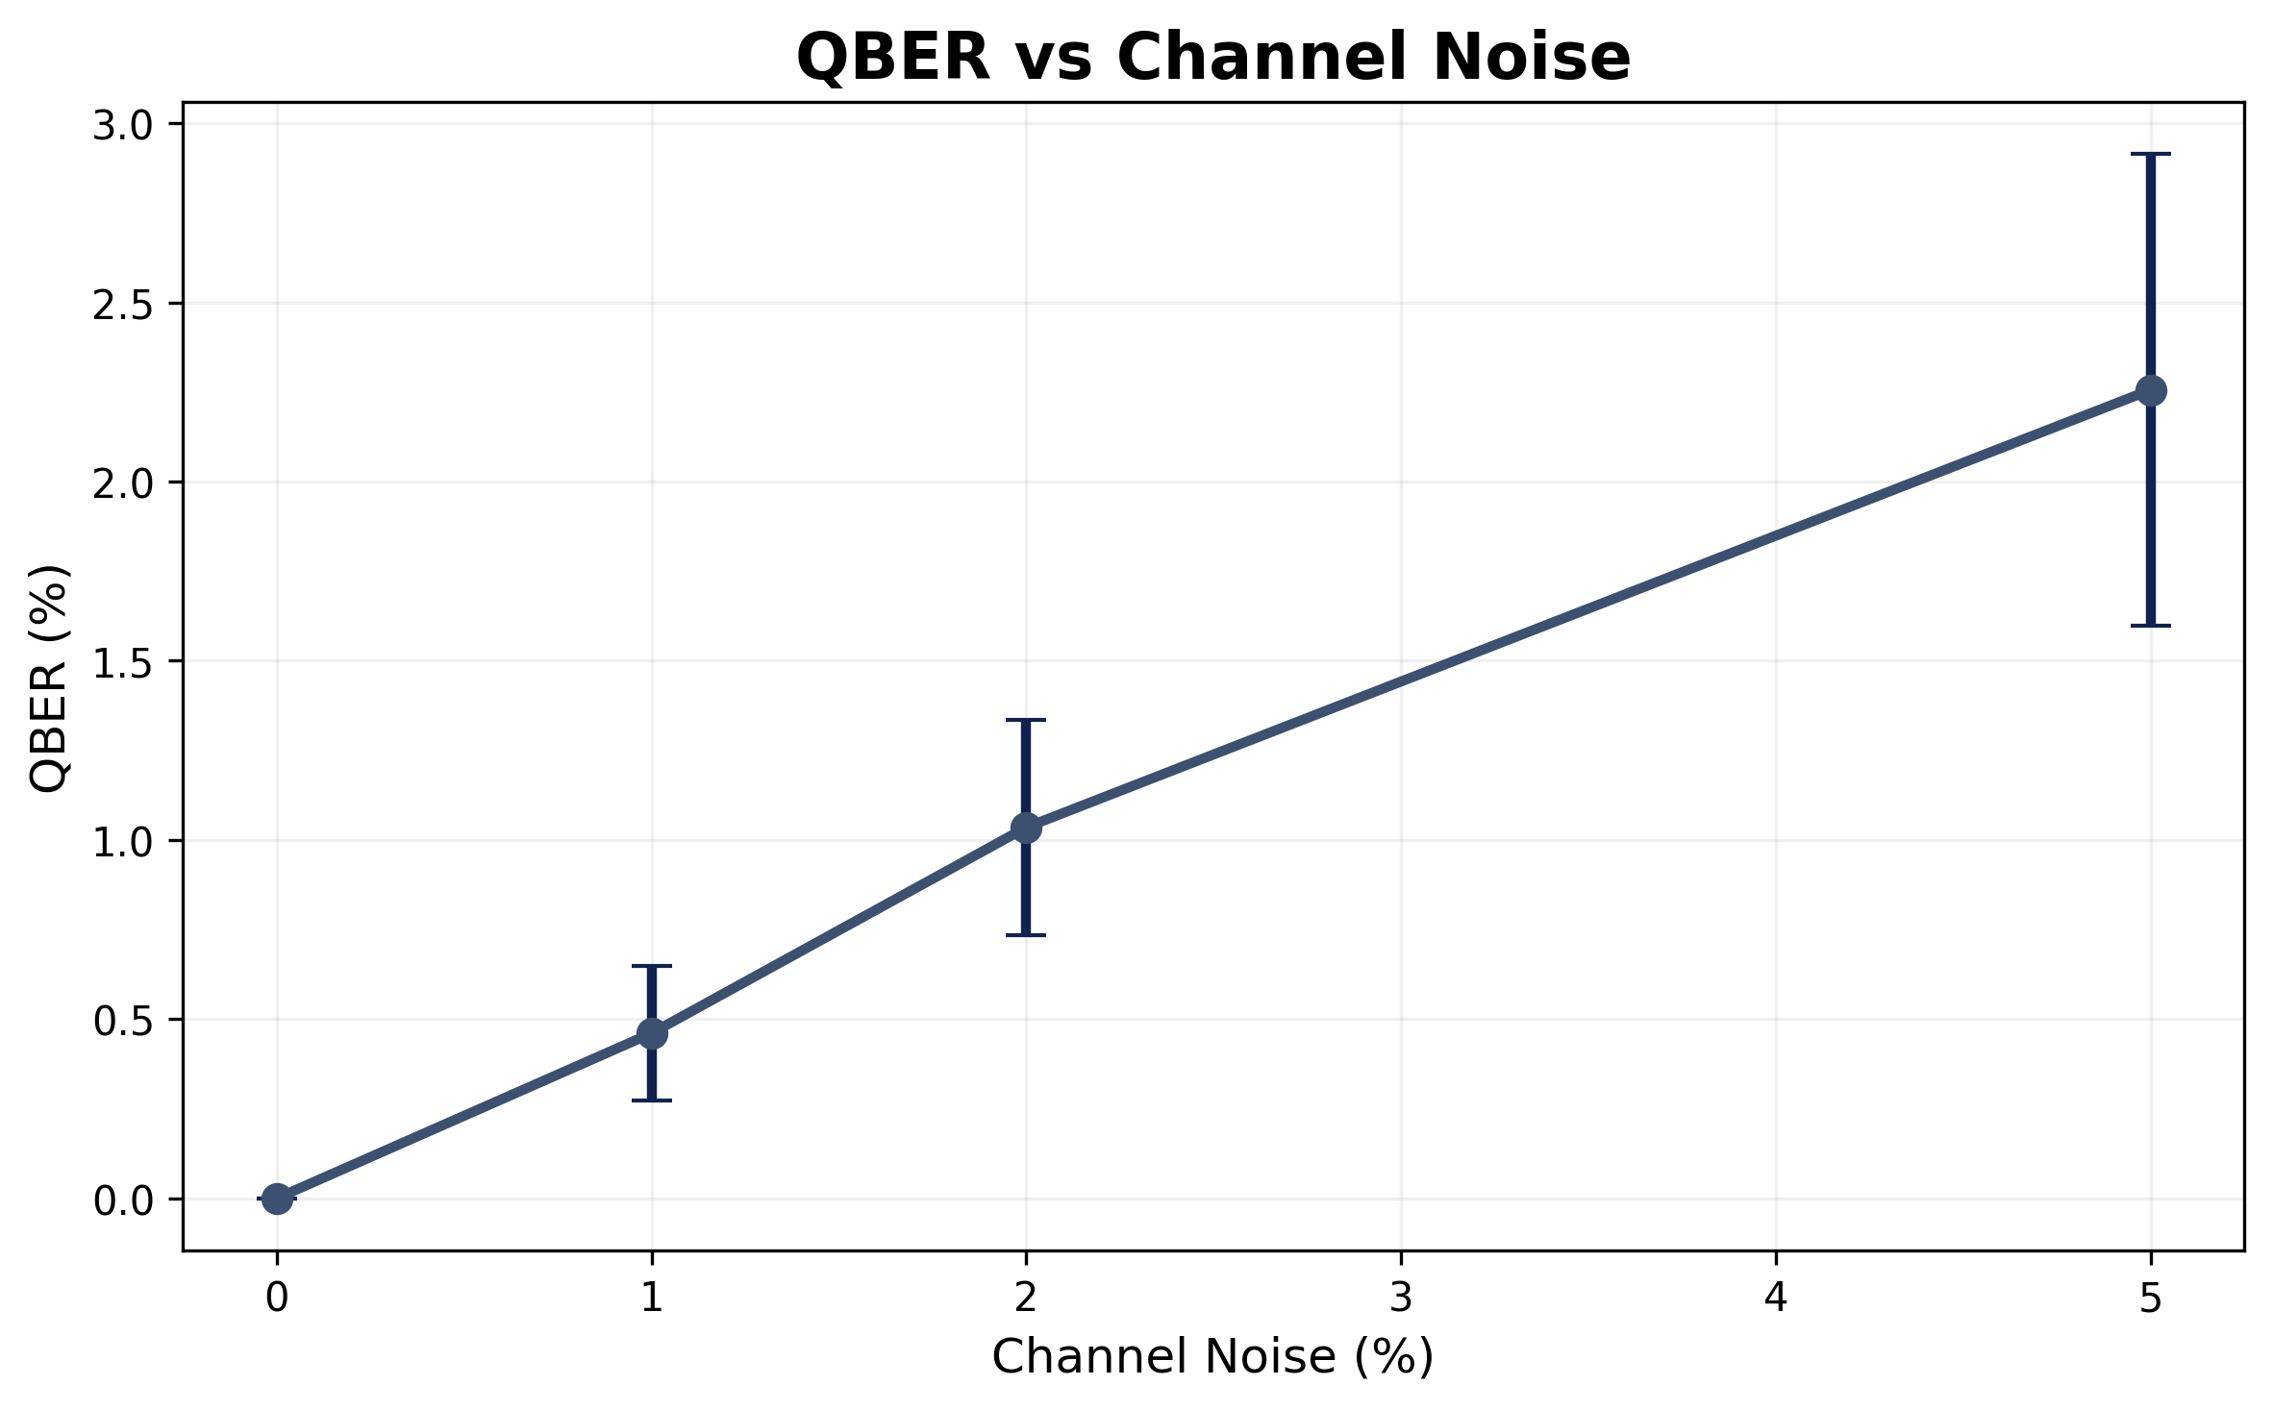
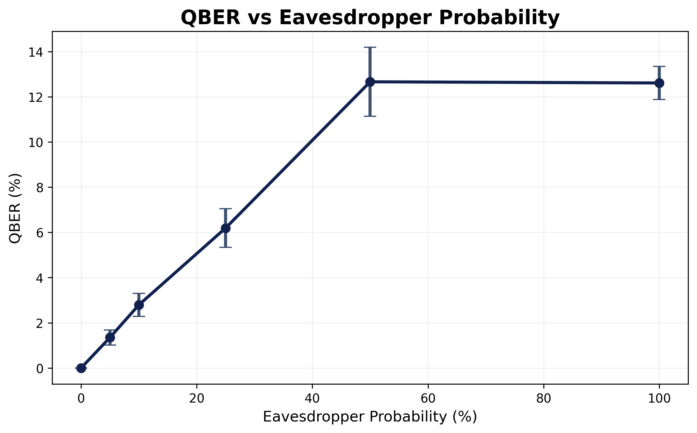
QBER Reveals the Disturbance
QBER rises with both channel noise and eavesdropping; error bars show trial variation.
docs/qber_vs_noise.png
docs/qber_vs_eve.png
QBER vs noise plot
QBER vs Eve plot
Noise ↑ → QBER ↑
Eve ↑ → QBER ↑
Plot mean ± 1σ from repeated trials. Experiment design: 10 trials × 1,000 bits per configuration.
Notes:
Let the graphs carry the evidence. Mention the trend, the error bars, and that finite-sample variation is visible. Avoid claiming an exact proportional law until the regenerated plots confirm it.

Slide 9
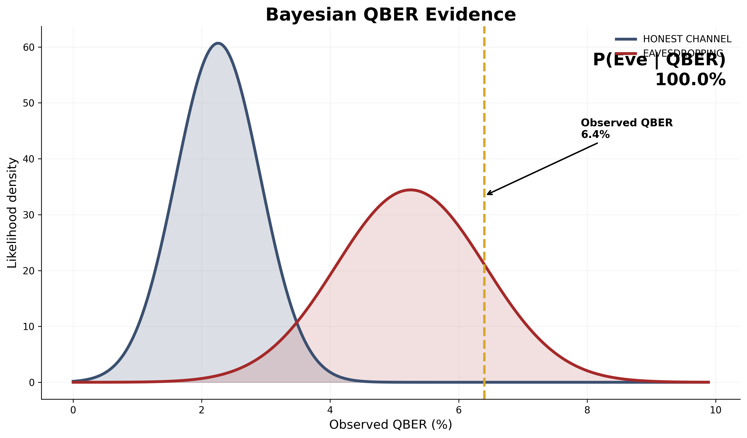
QBER Is Evidence, Not Alarm
Noise and eavesdropping can both raise QBER — Bayes compares the explanations.
P(Eve | QBER)
Which story fits better?
Observed QBER
6.4%
Estimated noise
5.0%
Not a fixed rule:
Bayes figure
“QBER > X ⇒ reject”
Notes:
Explain the novelty: QBER is evidence, not a binary alarm. QSafe compares experimentally calibrated honest and attack distributions, then estimates P(Eve).

Slide 10
A Second Security Sensor
Classical ML reads the network; the quantum layer reads the channel.
NSL-KDD
Preprocess
LightGBM
Threat probability
HELD-OUT KDDTEST+
78.6%
96.9%
64.6%
77.5%
96.0%
96.5%
ACCURACY
PRECISION
RECALL
F1
ROC-AUC
PR-AUC
High precision limits false attack alerts; recall remains visible as the trade-off.
NSL-KDD is a network-intrusion dataset; biomedical networks are our application context.
IMPORTANT
Notes:
Explain that the network layer is a second sensor. Show the metrics honestly. Mention the dataset limitation so judges do not mistake NSL-KDD for clinical patient data.

Slide 11
Two Signals, One Decision
The core QSafe workflow fuses network threat evidence with quantum-channel evidence.
Network data
ML
Threat P
Policy → API → Dashboard
traffic
LightGBM
classical evidence
BB84
QBER + Bayes
P(Eve)
final decision
qubits
quantum evidence
DECISION MATRIX
Quantum clean
Quantum Eve
Neither layer alone is enough.
Network normal
ACCEPT
REJECT
Network attack
MONITOR
REJECT
Notes:
This is the core slide. Walk from the two evidence streams into one policy and then show the matrix. Make clear why neither sensor alone is sufficient.

Slide 12
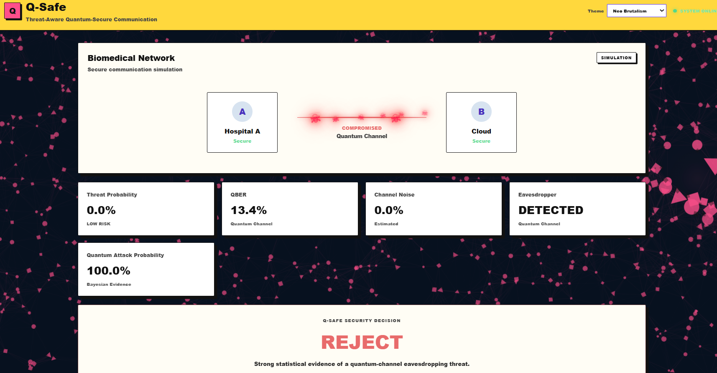
See It Live
CALM
Accept
ALERT
Monitor
WRATH
Reject
RECOMMENDED LIVE SEQUENCE
1 Normal
2 Channel noise
3 Network attack
4 Eavesdropper
5 Combined
Notes:
Do not explain the dashboard first. Click through the scenarios and narrate the evidence → decision chain.

Slide 13

What We Delivered
A simulation-driven research proof of concept, built end to end.
Qiskit BB84
Bayesian evidence
NEXT
Real hardware
Healthcare traffic
Error correction + privacy amplification
More attack types
Classical baseline
Working dashboard
Quantitative experiments
Live demo
Simulation only
No quantum advantage claimed
QSafe is a proof-of-concept research platform, not a deployed clinical security system.
Notes:
End the technical story by stating exactly what was built and what was not claimed.

Slide 14

Thank You
QSafe
Threat-aware quantum-secure communication for biomedical networks
Insert GitHub QR code
Repository link
Questions?
DON’T TRUST ONE SIGNAL. FUSE THE EVIDENCE.
[Team names]
Notes:
Close on the core idea and stop. Do not add another explanation after “Questions?”

Slide 15
Where BB84 Stops
BACKUP
Use only if a judge asks about the scope of full QKD.
IMPLEMENTED IN QSAFE
OUT OF SCOPE
Quantum transmission
Sifting
QBER test
Error correction
Privacy amplification
Alice → Bob
keep matching bases
compare sifted bits
not implemented here
not implemented here
WE ARE HERE
QSafe focuses on detection and adaptive decision-making after QBER measurement.
Notes:
Use only when asked about complete QKD.

Slide 16
Bayesian Evidence
BACKUP
The posterior equation and prior sensitivity.
50%
Default prior
P(Q | E) · P(E)
P(E | Q) =
5%
Lower prior
P(Q | E) P(E) + P(Q | H) P(H)
1%
Strict prior
Q = observed QBER H = honest channel E = Eve hypothesis
The calibrated distributions come from the repeated QBER experiment matrix.
Notes:
Show the posterior equation and how the prior changes the result. The calibrated distributions come from the repeated QBER experiment matrix.

Slide 17
Policy Thresholds
BACKUP
Simple, interpretable policy logic.
Low quantum evidence
Elevated evidence
High evidence
Network risk | Quantum evidence | Decision
Normal | Clean | ACCEPT
Attack | Clean | MONITOR
Normal | Eve | REJECT
Attack | Eve | REJECT
Notes:
Show the four policy cases; each decision traces back to the two evidence streams.

Slide 18
Seven Models Compared
BACKUP
Validation comparison, not the final held-out test result.
Model | Accuracy | Precision | Recall | F1 | ROC-AUC
LightGBM | 99.94% | 99.94% | 99.94% | 99.94% | 99.999%
HistGradientBoosting | 99.93% | 99.94% | 99.91% | 99.93% | 99.999%
CatBoost | 99.93% | 99.96% | 99.89% | 99.92% | 99.998%
XGBoost | 99.92% | 99.91% | 99.93% | 99.92% | 99.999%
RandomForest | 99.91% | 99.95% | 99.86% | 99.90% | 99.999%
ExtraTrees | 99.87% | 99.91% | 99.82% | 99.86% | 99.991%
LogisticRegression | 97.18% | 97.64% | 96.26% | 96.95% | 99.637%
From project model-selection experiments. Final held-out KDDTest+ numbers appear on slide 10.
Notes:
Validation comparison only; the final held-out KDDTest+ numbers appear on slide 10.

