Slide 1
History of Bitcoin
Where do we come from?
Bas Wisselink
15-02-2018

Slide 2
Historical Perspective
You have to know where you come from in order to know where to go

Slide 3
Timeline
~ 1990 – Start of the movement from cash to digital
1991 - Digicash – David Chaum
1992: Start of the Cypherpunks. Publication of “A Cypherpunk’s Manifesto”.
1997: Hashcash – Adam Back
1998: B-Money – Wei Dai
2005: BitGold – Nick Szabo
2008: Bitcoin – Satoshi Nakamoto

Slide 4
Problems with Digital Cash
Identity becomes the new money
Full traceability of all personal transactions
Full unit of account control to the monetary sovereign
Payment blockades and confiscation become easier
Total elimination of the informal shadow economy
Near absolute efficiency in tax collection
Source: https://www.slideshare.net/jonmatonis/bitcoin-cash-becoming-digital

Slide 5

David Chaum - Digicash
Originator: David Chaum
1982: paper “Blind Signatures for Untraceable Payments” → anonymous or pseudonymous
Founds Digicash in 1990
Digicash goes bankrupt in 1998, bought out in 2002
Digicash focuses on making transactions anonymous.
The consideration was that having digital payments would lead to undesirable ability to have insight into people’s spendings and thus private life.

Slide 6
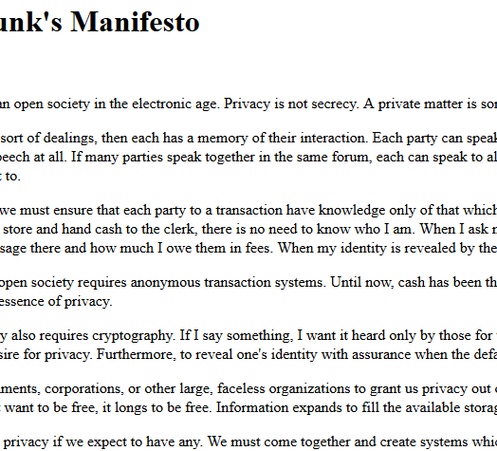
A Cypherpunks Manifesto
Originator: Eric Hughes, 1993
“Privacy is not secrecy.”
“…privacy in an open society requires anonymous transaction systems.”
“Privacy in an open society also requires cryptography”
“For privacy to be widespread it must be part of a social contract.”
Source: https://www.activism.net/cypherpunk/manifesto.html

Slide 7
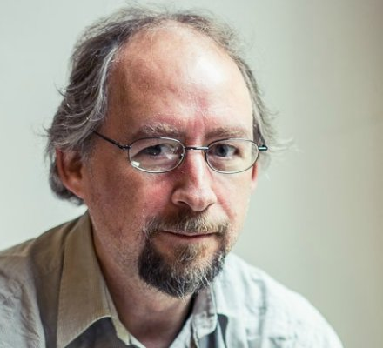
Adam Back - Hashcash
Originator: Adam Back
1997: creation of Hashcash, “A partial hash collision based postage scheme”
Spam prevention system by making a sender do easily verifiable computations (hashing)
Paper explicitly referenced possible outlawing of Digicash
Hashcash becomes the basis of Mining algorithm.

Slide 8

Wei Dai – B-Money
Originator: Wei Dai
1998: creation of B-Money
B-Money introduces
Public Key pseudonyms
Creation of Money using hashcash
Two possible ways of keeping Ledger
All participants check (PoW)
Servers put up collateral ((D)PoS)
Missing: A way to control Money Creation
Proposes a few ways that are still centralised

Slide 9
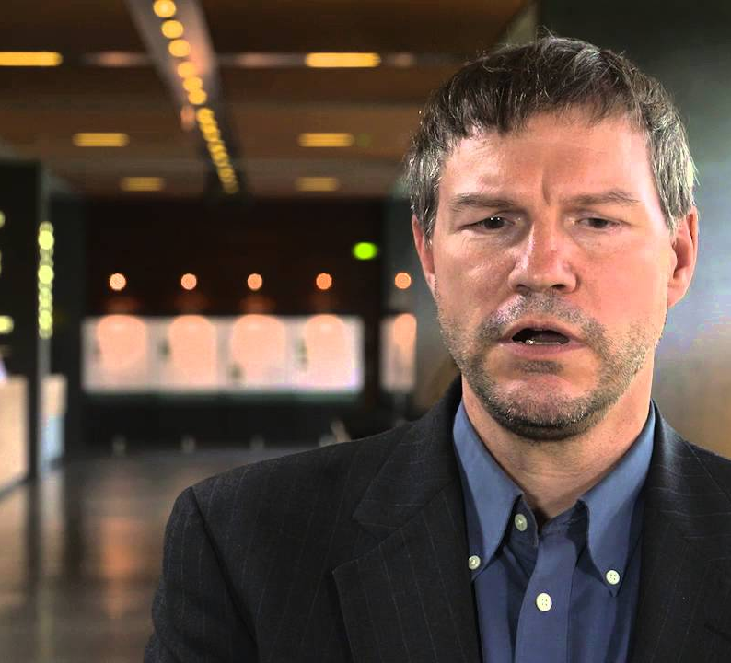
Nick Szabo - BitGold
Originator: Nick Szabo
1998: inception of Bit Gold
Bit Gold introduces
Timestamping
Creation of Money using hashcash
Missing: incentives to keep nodes honest
Missing: A way to keep tokens fungible (no agreed way to set difficulty. One token might be made with significantly more difficulty than the other)

Slide 10

Satoshi Nakamoto - Bitcoin
Originator: Satoshi Nakamoto
2008: inception of Bitcoin
2009: Implementation of Bitcoin
Bitcoin uses
Public Key pseudonyms
Timestamping
Creation of Money using hashcash
Roles for nodes: miners are kept honest (difficulty adjustment). Hashing is metric
Merkle trees for transaction “batching”

Slide 11
Summary
Who sends? → David Chaum, eventually Digicash, starting 1981
What do I send? → Wei Dai, b-money, but also Hal Finney RPOW and Nick Szabo Bit Gold. Proposed in the period 1997 (hashcash) – 2005.
When do I send? → Satoshi Nakamoto, Bitcoin. Solves the way coin supply cannot be inflated as well as PoW being reused by adding blocks and roles in the network.

Slide 12
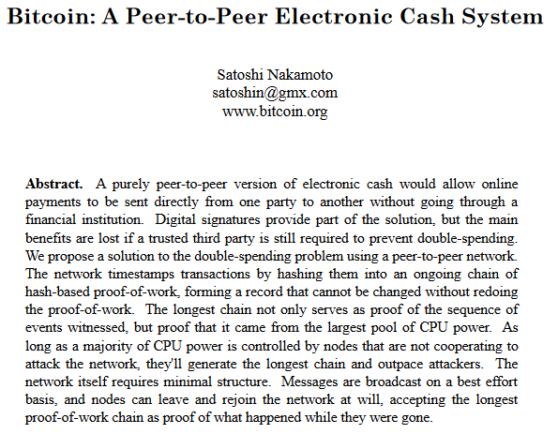
Whitepaper
Source: https://bitcoin.org/bitcoin.pdf

Slide 13
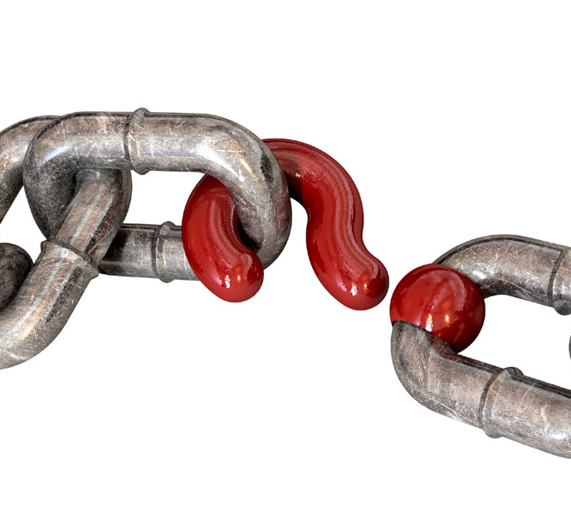
Acknowledge History and Background
Bitcoin did not “start” in 2008 or 2009
Bitcoin (and by extension all blockchains) are part of a much larger movement
They are a technological manner to solve a social and political problem
They will evolve, but this should not mean deny their origins.

Slide 14
Historical Perspective
Bitcoin is a solution to a very specific problem. It may have political ramifications, but it is an engineering solution

Slide 15
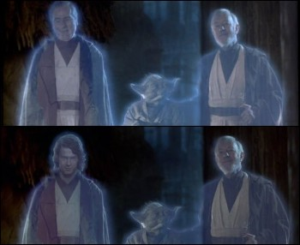
Retconning blockchain
There is a tendency to project one’s ideals and ideology onto Bitcoin and blockchain
“Fast” Transactions (define fast in context)
Various new definitions of forks
Social agenda (whichever) (ie. define “fair”)
Desirability of various features (define social contract of choice)
Governance (define what is governance)
None of these are aims of Bitcoin

Slide 16
We need to learn to define in order to talk
The cryptocurrency space is rife with vague and confusing definitions: cash, currency, fast, secure etc.
In order to talk about these things, we need to define these terms clearly, either on a per debate basis, or in general terms in context
If we do not, we will continue to be vulnerable to social attacks by bad actors who want to confuse our discourse with confusing statements, inciting discord instead of honest disagreements
We can always disagree once we have clear definitions. There is no need at all to be in agreement of aims. However, in order to test our systems, we need to be completely open and clear about what the testing parameters are.
Without that clarity, we are bound to clash without any constructive dialogue.

Slide 17
Sources
Untraceable Electronic Cash, David Chaum: http://blog.koehntopp.de/uploads/chaum_fiat_naor_ecash.pdf
Blind Signatures for Untraceable Payments, David Chaum: http://www.hit.bme.hu/~buttyan/courses/BMEVIHIM219/2009/Chaum.BlindSigForPayment.1982.PDF
A Cypherpunk’s Manifesto, Eric Hughes: https://www.activism.net/cypherpunk/manifesto.html
hash cash postage implementation, Adam Back: http://www.hashcash.org/papers/announce.txt
B-Money, Wei Dai: http://www.weidai.com/bmoney.txt
Reusable Proofs of Work, Hal Finney: https://web.archive.org/web/20071222072154/http://rpow.net/
Secure Property Titles with Owner Authority, Nick Szabo: http://nakamotoinstitute.org/secure-property-titles/#selection-6.0-6.1
Bit Gold, Nick Szabo: https://unenumerated.blogspot.nl/2005/12/bit-gold.html
Bitcoin Whitepaper, Satoshi Nakamoto: https://bitcoin.org/bitcoin.pdf
Various posts by Samuel Falkon: https://www.linkedin.com/in/samuel-falkon-467a878b/detail/recent-activity/posts/
Bitcoin and the Rise of the Cypherpunks, Coindesk: https://www.coindesk.com/the-rise-of-the-cypherpunks/
BITCOIN: POLITICAL ATTACK VECTORS AND COMMON MISCONCEPTIONS, Giacomo Zucco: https://youtu.be/jgwW7XZCKPU

Slide 18
Bas Wisselink
Email: bwisselink@blockchainworkspace.com
Twitter: @DamelonBCWS
https://baswisselink.com
https://www.blockchainworkspace.com

Slide 19

License
This work is licensed under a Creative Commons Attribution-Share Alike 4.0 license
https://creativecommons.org/licenses/by-sa/4.0/

Slide 20
Bas Wisselink
15-02-2018

