Slide 1
Automotive UI
Heartbeat Sensor

Slide 2

Introduction
Notes:
Our project will concentrate on showing patient medical information on the dashboard as well as easing the communication between paramedics and hospital.
At the first place, I chose DS18B20 (Temperature Sensor) to work on this project. However, I found working on measuring the pulse is more interesting and I may learn a lot of from it. That’s why I decided to choose heartbeat measuring is my hardware platform.

Slide 3
Budget
SEN-11574: $48.43
ADS1015: $33.89
10 copies of PCB: $38.67
Enclosure: $34.00

Slide 4
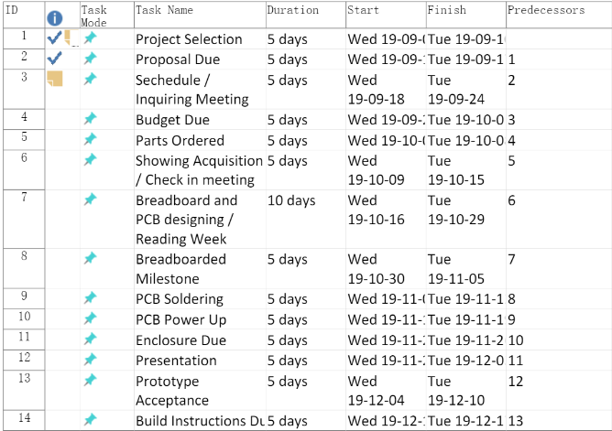
Schedule

Slide 5
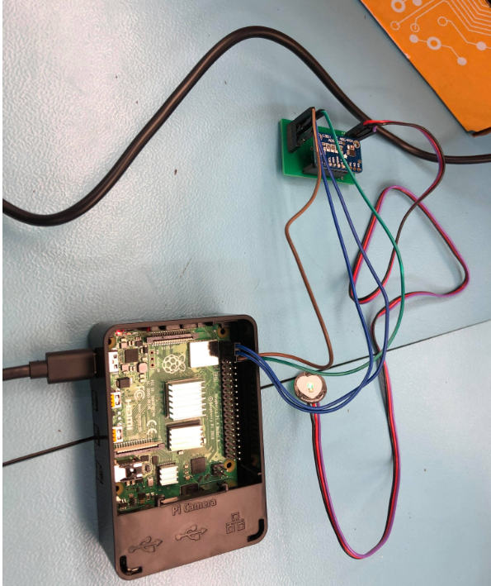
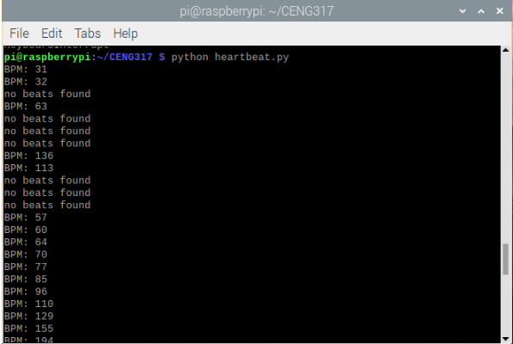
Images

Slide 6
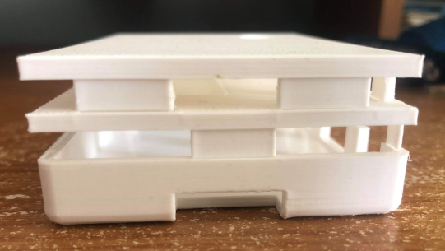
Images

Slide 7
Knowledge
Electric Circuits – TECH 101
Digital Fundamentals - TECH 103
Technical C – TECH 153
Introduction of Software Engineering – CENG 216
Embedded Systems – CENG 252

Slide 8
Thank you for your attention
Q&A

