Slide 1
Sync OPX with External Devices for NV Experiments

Slide 2
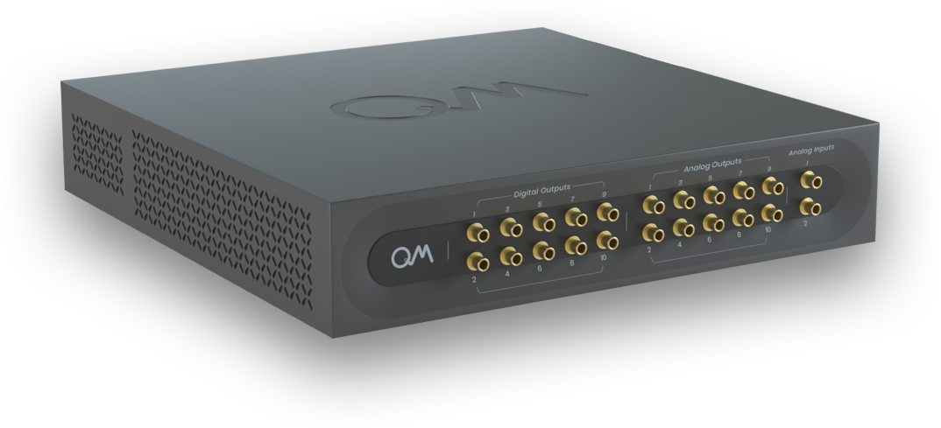

Slide 3
Triggers external
devices

Slide 4

Play(digital marker, element)
Triggers external
devices

Slide 5
Play(digital marker, element)
Gets external
trigger
Triggers external
devices

Slide 6
Play(digital marker, element)
Wait_for_trigger(element)
Gets external
trigger
Triggers external
devices

Slide 7
Play(digital marker, element)
Wait_for_trigger(element)
Gets external
trigger
IO values
Triggers external
devices

Slide 8
Play(digital marker, element)
Wait_for_trigger(element)
set_IO()
get_IO()
Gets external
trigger
IO values
Triggers external
devices

Slide 9
Play(digital marker, element)
Wait_for_trigger(element)
set_IO()
get_IO()
pause()
resume()
Gets external
trigger
IO values
Triggers external
devices

Slide 10
Play(digital marker, element)
Wait_for_trigger(element)
set_IO()
get_IO()
pause()
resume()
Gets external
trigger
IO values
Measure analog
signal
Triggers external
devices

Slide 11
Play(digital marker, element)
Wait_for_trigger(element)
set_IO()
get_IO()
pause()
resume()
Measure(…, time_tagging())
Gets external
trigger
IO values
Measure analog
signal
Triggers external
devices

Slide 12
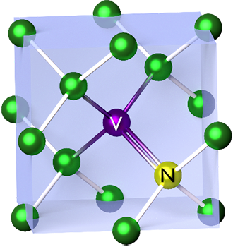

Widefield ODMR - Setup
Laser
AOM
Camera

Slide 13


Widefield ODMR - Setup
AOM RF
AMP
Laser
AOM
Camera

Slide 14

Widefield ODMR - Setup
IQ
MIXER
LO
AOM RF
MW
AMP
AMP
Laser
AOM
Camera

Slide 15
Widefield ODMR Setup
Qua - Easy and Flexible
IQ
MIXER
LO
AOM RF
MW
AMP
AMP
Laser
AOM
Camera

Slide 16
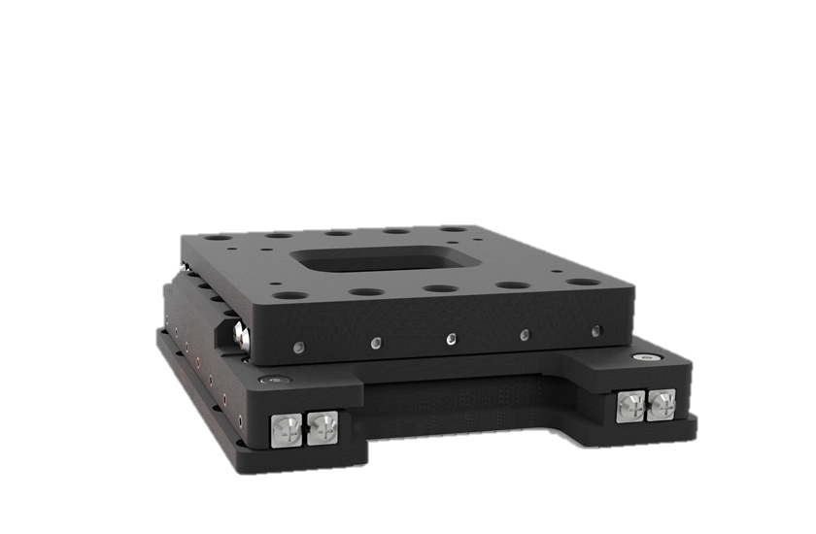
G2 with a confocal setup
IQ
MIXER
LO
AOM RF
MW
AMP
AMP
Laser
AOM
y
x

Slide 17
G2 with a confocal setup
IQ
MIXER
LO
AOM RF
MW
AMP
AMP
Laser
AOM
y
x

Slide 18
G2 with a confocal setup
Repeat Nx * Ny times
Run Qua Program
pause
resume
Measure g2
Move Stage to new location

Slide 19
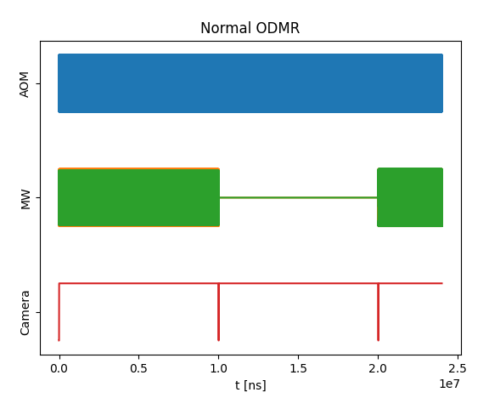
Widefield ODMR
Simple CW ODMR, measuring for 10ms with MW and 10ms without

Slide 20
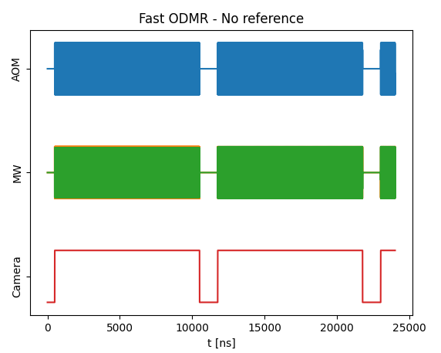
Widefield ODMR
If it has high enough FPS, can do quick measurement without reference.
Frequency change is ~200ns long. 1us added for clarity.

Slide 21
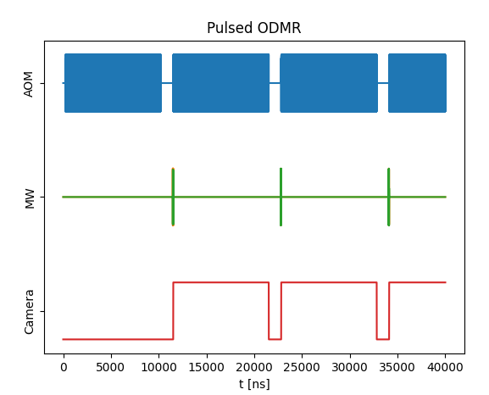
Widefield ODMR
Pulsed ESR

