Slide 1
Breakout sessions

Slide 2
This workshop is part of a collaboration with the CQE.
The goal of the breakout session is to give you a feel of real work in QUA.
QUA & the OPX simulator and the QUA libraries will be open sourced soon.
Please feel free to reach out, we’re always happy to speak about physics (or anything)
We’re hiring!
gal@quantum-machines.co

Slide 3
Agenda
You need a python environment with numpy, matplotlib and our QM package. See _START_HERE notebook for details on installing the QM python package.
Download the notebooks zip file.
There are 5 “gentle introduction” notebooks with exercises. I encourage you to start there. They aren’t long and will get you to a good familiarity with the language.
There are 3 paper implementations: one on quantum dots, one on superconducting qubits and optimal control and quantum key distribution using color centers and photonic qubits. Pick one or all, to your liking.
Zoom + Discord for help

Slide 4

Simulator IPs
Last Name | IP
Lin | "3.22.167.124"
Glachman | "3.21.171.156",
Cao | "18.222.28.156",
Larson | "3.19.242.129",
Zhao | "13.59.138.198",
G Menon | "3.15.28.254",
Singh | "3.17.25.110",
Bernien | "3.134.83.173",
Sobel | "18.222.197.213",
Shinbrough | "3.133.58.208",
Pegahan | "3.14.11.60",
Yue | "18.220.71.241",
Cortes | "3.21.168.148",
Luo | "3.138.110.56",
Frenkel | "18.218.54.161",
Wang | "18.216.7.242",
Agrawal | "3.21.76.41",
Li | "18.222.231.170",
Yao | "18.222.141.2",
Singh | "3.137.142.52",
 | "3.142.73.126",
To connect to your cloud server, you need to change the IP used when opening a connection to the quantum machine manager.
Each participant has an IP allotted.

Slide 5

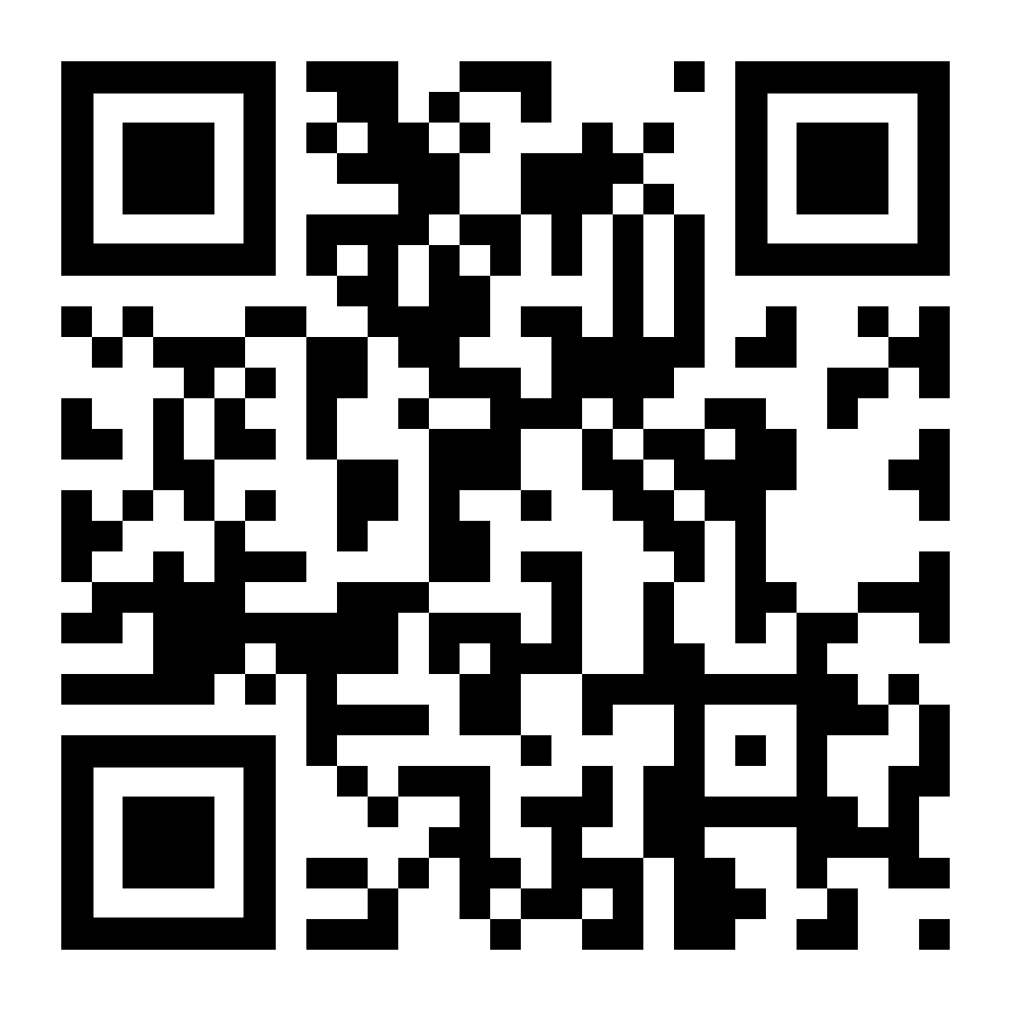
Join discord: https://discord.gg/AmD9u9Zf
Download the notebooks:

