Slide 1
Short-Term Interest Rate Modeling
Faculty of Economic Science
Coursework, 3 year
2023
Vasily Yanin
Supervisor: Jean-Francois Mehdi Jabir

Slide 2
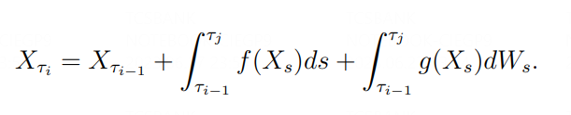
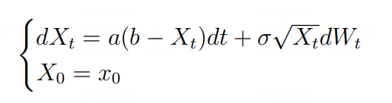

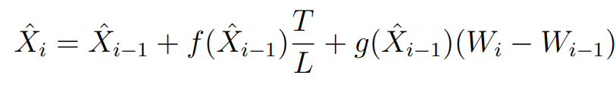
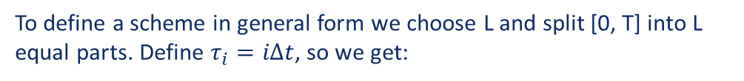
Introduction
Stochastic Processes
Short-term Interest Rate Modeling
Short-term Interest Rate Modeling
The aim of the project is to simulate short-term interest rate curve
We believe that CIR process explains the behavior of the interest rate curve
Have to find scheme to simulate CIR process:
To define a scheme in general form we choose L and split [0, T] into L equal parts. Define $τ_{i}=iΔt$, so we get:
Now we can define the scheme as a discrete stochastic process:

Slide 3
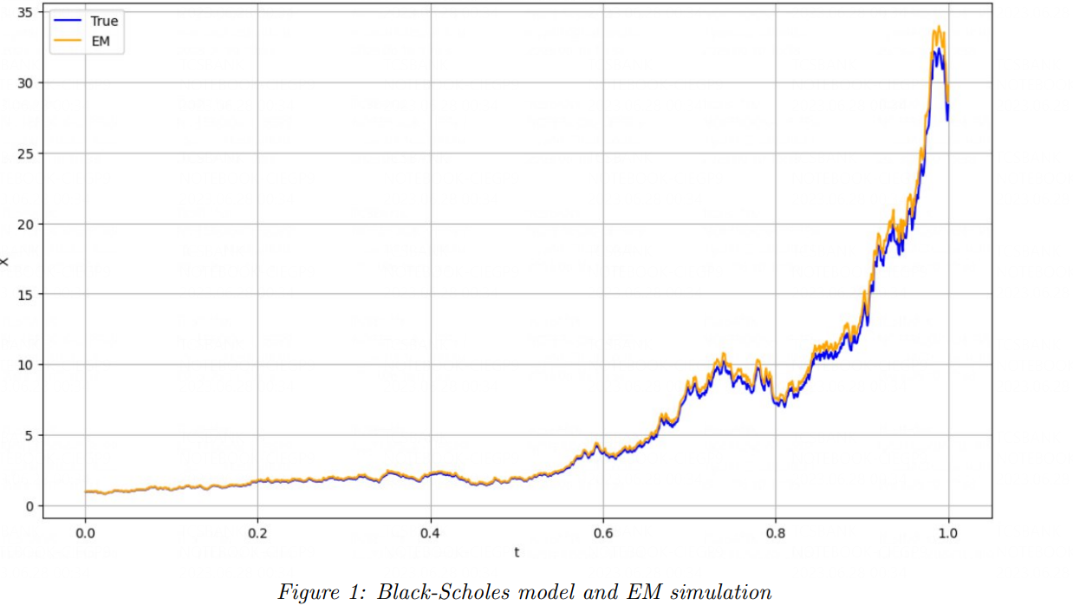
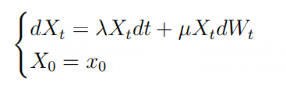

Euler-Maruyama (EM) scheme
Stochastic Processes
Short-term Interest Rate Modeling
Short-term Interest Rate Modeling
We can try to simulate Black-Scholes differential equation with
EM scheme:
The exact solution is

Slide 4
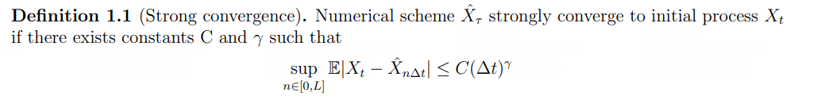
Strong convergence
Stochastic Processes
Short-term Interest Rate Modeling
Short-term Interest Rate Modeling
We have to specify a numeric criteria to measure similarity between the scheme and original process. If condition below is satisfied we will say that the scheme converges to initial process with convergence rate $γ$.

Slide 5
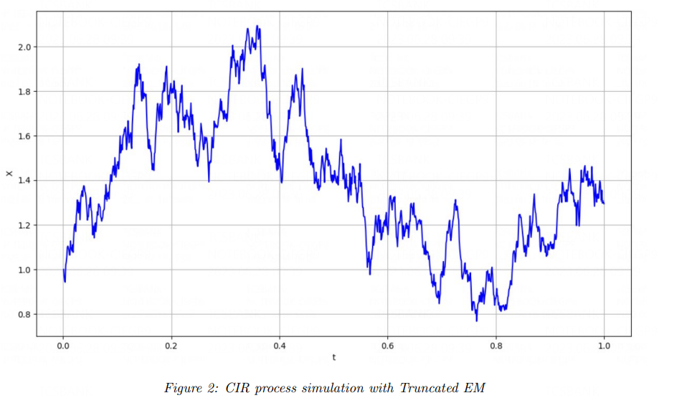

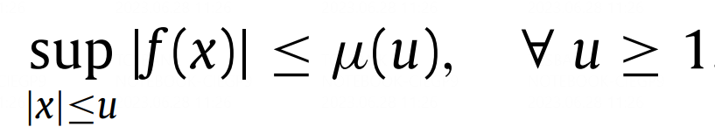


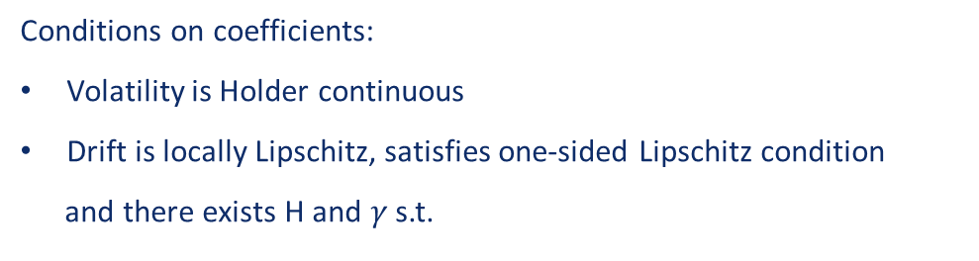
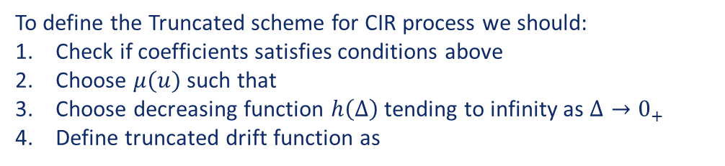
Truncated EM
Stochastic Processes
Short-term Interest Rate Modeling
Short-term Interest Rate Modeling
Conditions on coefficients:
Volatility is Holder continuous
Drift is locally Lipschitz, satisfies one-sided Lipschitz condition
and there exists H and $γ$ s.t.
for any real x, y.
To define the Truncated scheme for CIR process we should:
Check if coefficients satisfies conditions above
Choose $μ(u)$ such that
Choose decreasing function $h\left(Δ\right)$ tending to infinity as $Δ→0_{+}$
Define truncated drift function as
Finally, we get the convergence rate of:

Slide 6
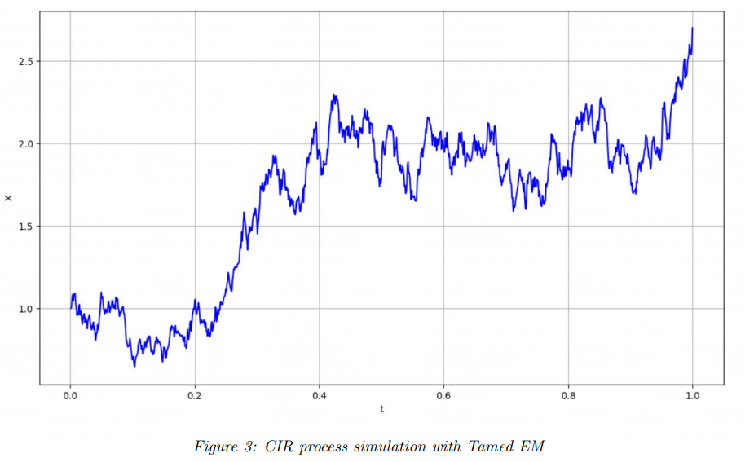
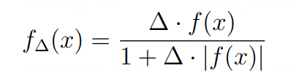

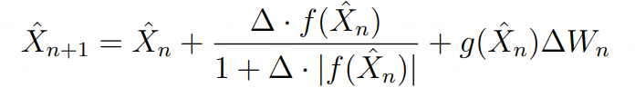
Tamed EM
Stochastic Processes
Short-term Interest Rate Modeling
Short-term Interest Rate Modeling
Conditions on coefficients:
Volatility is globally Lipschitz continuous (Problem #1)
Drift satisfies one-sided Lipschitz condition and it’s derivative
should have at least polynomial growth (Problem #2)
Since assumptions on coefficients are not satisfied, formally we can not use this scheme for CIR process. But it doesn’t mean we can’t try..
Tame the drift function and define the scheme:
Finally, we get the convergence rate of:

Slide 7
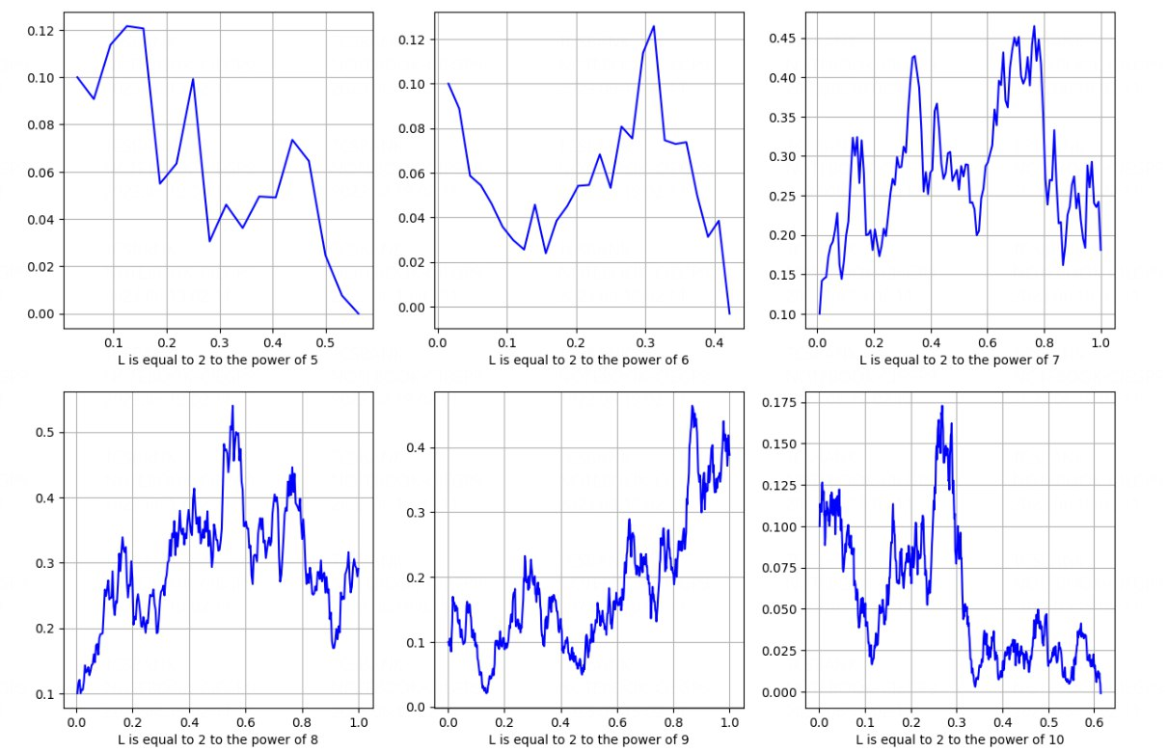
CIR simulations with Tamed EM for different L
Stochastic Processes
Short-term Interest Rate Modeling
Short-term Interest Rate Modeling

Slide 8
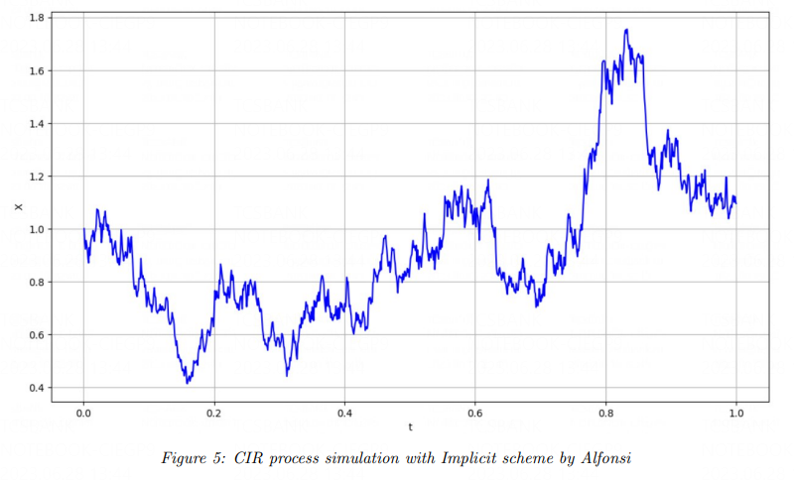
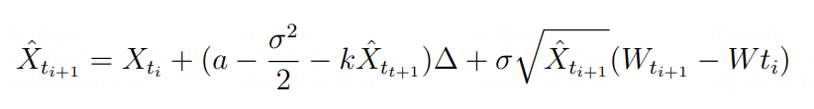
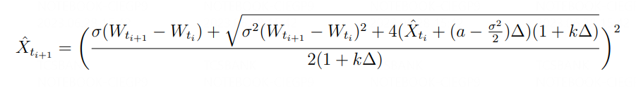
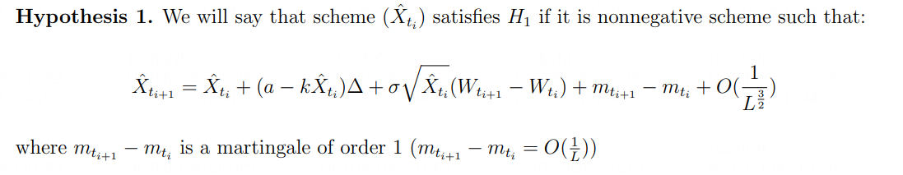
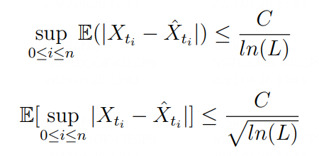

Implicit scheme by Alfonsi
Stochastic Processes
Short-term Interest Rate Modeling
Short-term Interest Rate Modeling
Idea: let’s expand Euler scheme and solve a quadratic equation
Equation above is complicated enough, so let’s expand it using hypothesis on the scheme:
Finally, we get the convergence rate of:
The final scheme:

Slide 9
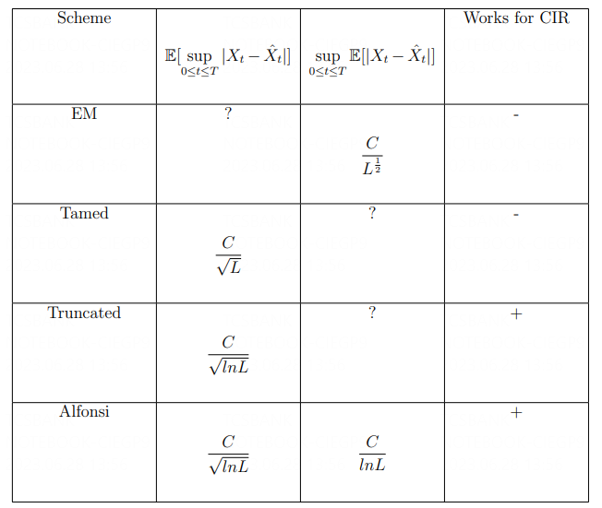
Conclusion
Stochastic Processes
Short-term Interest Rate Modeling
Short-term Interest Rate Modeling
EM scheme fails to simulate a lot of processes, but it gives us space to modification
Tamed scheme is made to simulate processes with polynomial coefficients
Truncated and Alfonsi’s schemes converges faster and can be used to simulate CIR

Slide 10
Future plans
Stochastic Processes
Short-term Interest Rate Modeling
Short-term Interest Rate Modeling
Where are processes but CIR that we can use for short-term interest rate curve modeling
Extensions of Tamed scheme
Parameter estimation on real data
Estimate quality of model’s predictions

