Slide 1

Portfolio Website Presentation

Slide 2
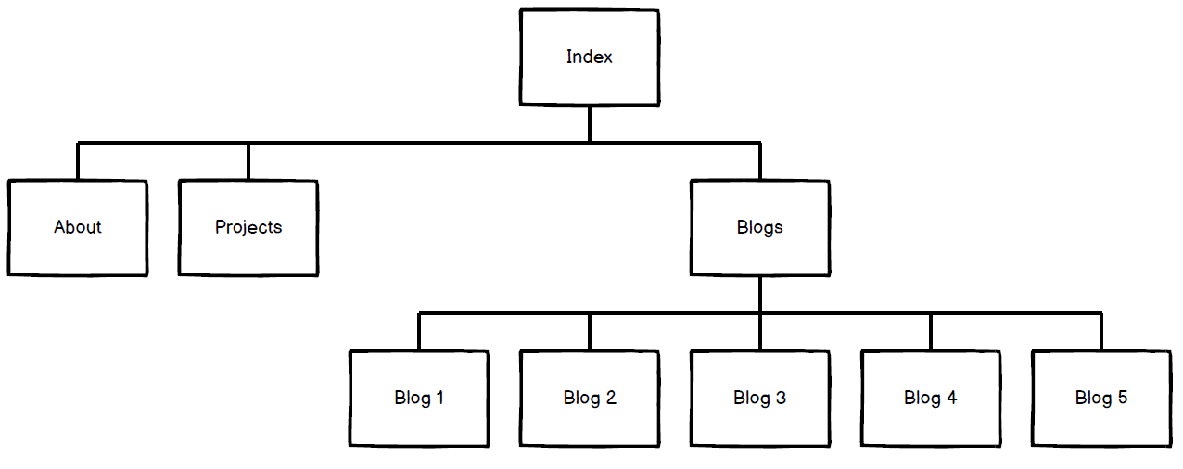
Sitemap

