Slide 1

Portfolio Website Presentation

Slide 2
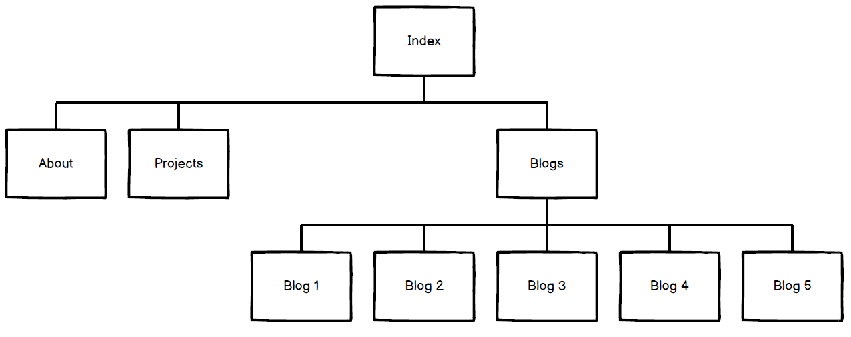
Sitemap

Slide 3
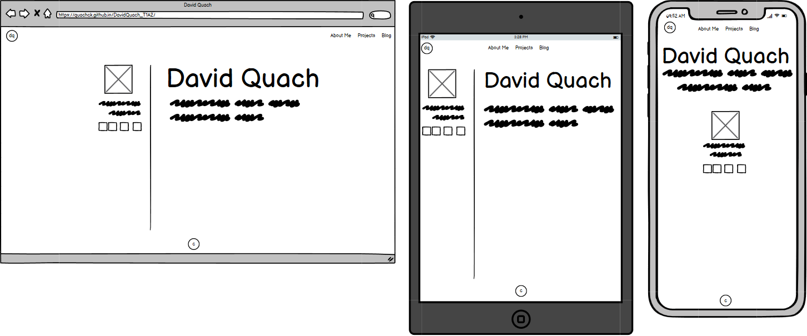
Wireframes – Index Page

Slide 4

Index Page

Slide 5
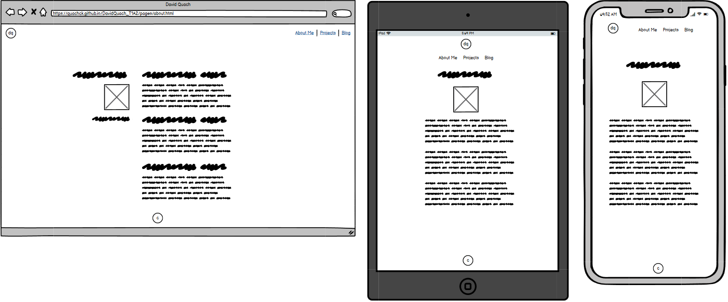
Wireframes – About Page

Slide 6

About Page

Slide 7
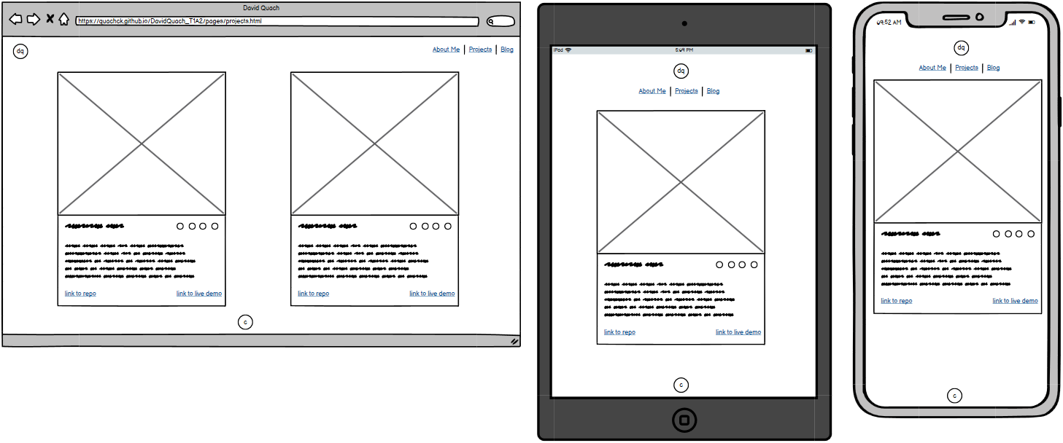
Wireframes – Projects Page

Slide 8
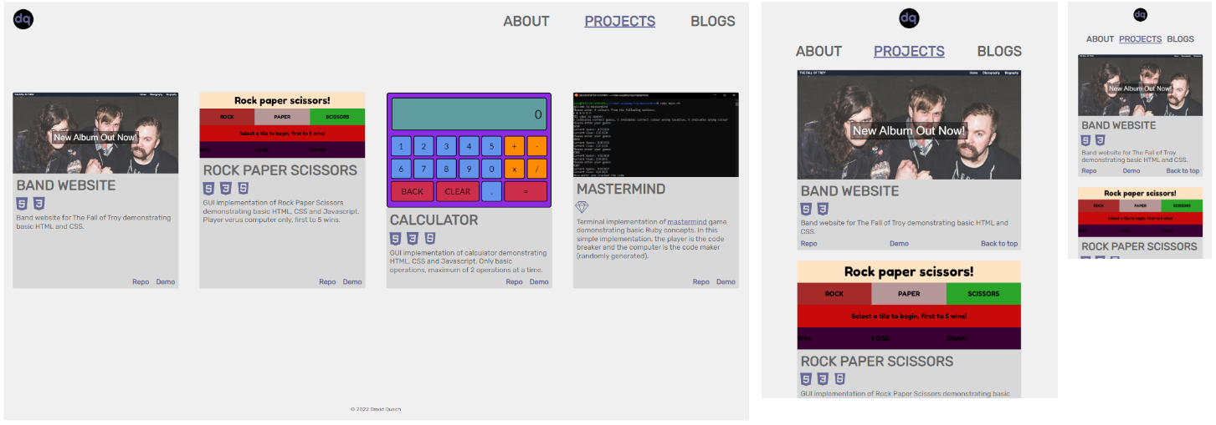
Projects Page

Slide 9
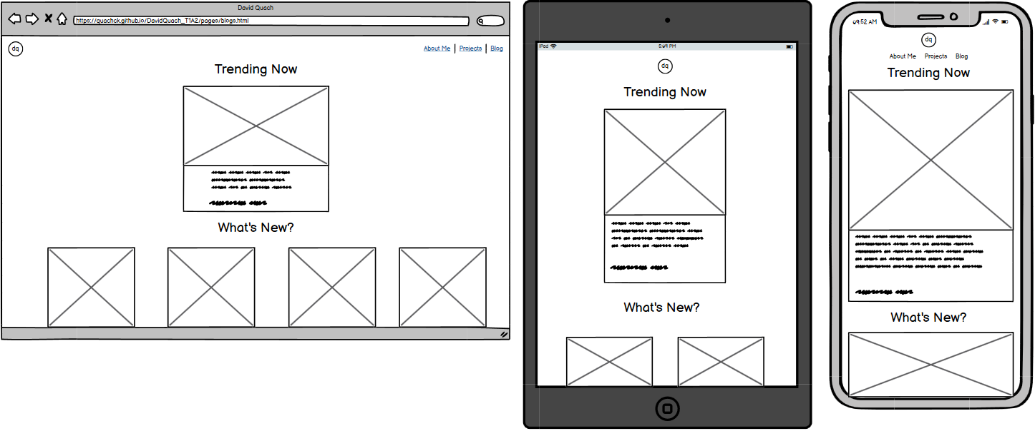
Wireframes – Blogs Page

Slide 10

Blogs Page

Slide 11
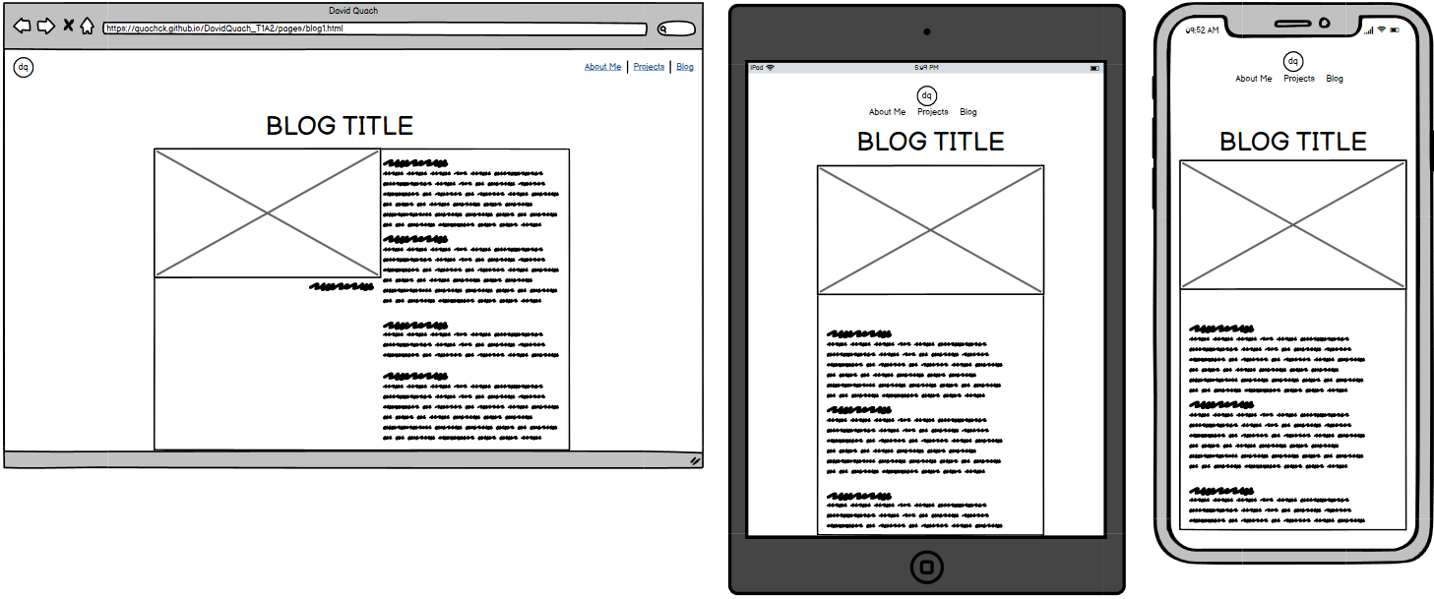
Wireframes – Blog Post Page

Slide 12

Blog Post Page

