Slide 1
To what extent did the British colonization help Egypt gain independence?
By: Ethan, Rayed and Ishan

Slide 2
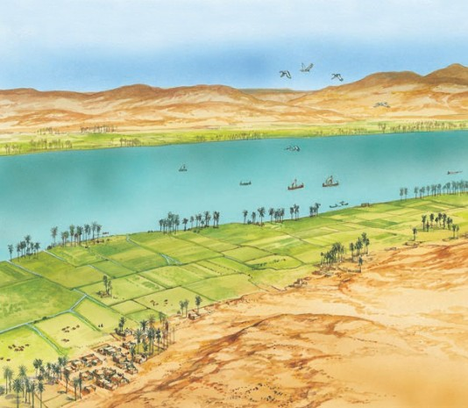
Egypt before the Ottomans
Egypt is a very old nation, dating back to tens of thousands of years ago. The first main events of Egypt being taken over by other countries would be in 30 BC in which it was annexed by Rome- until 619 at which point control switched over to several dynasties. This remained until 1517, at which point the Ottomans took over.
Early Egyptian life focused very much on farms near the Nile river.

Slide 3
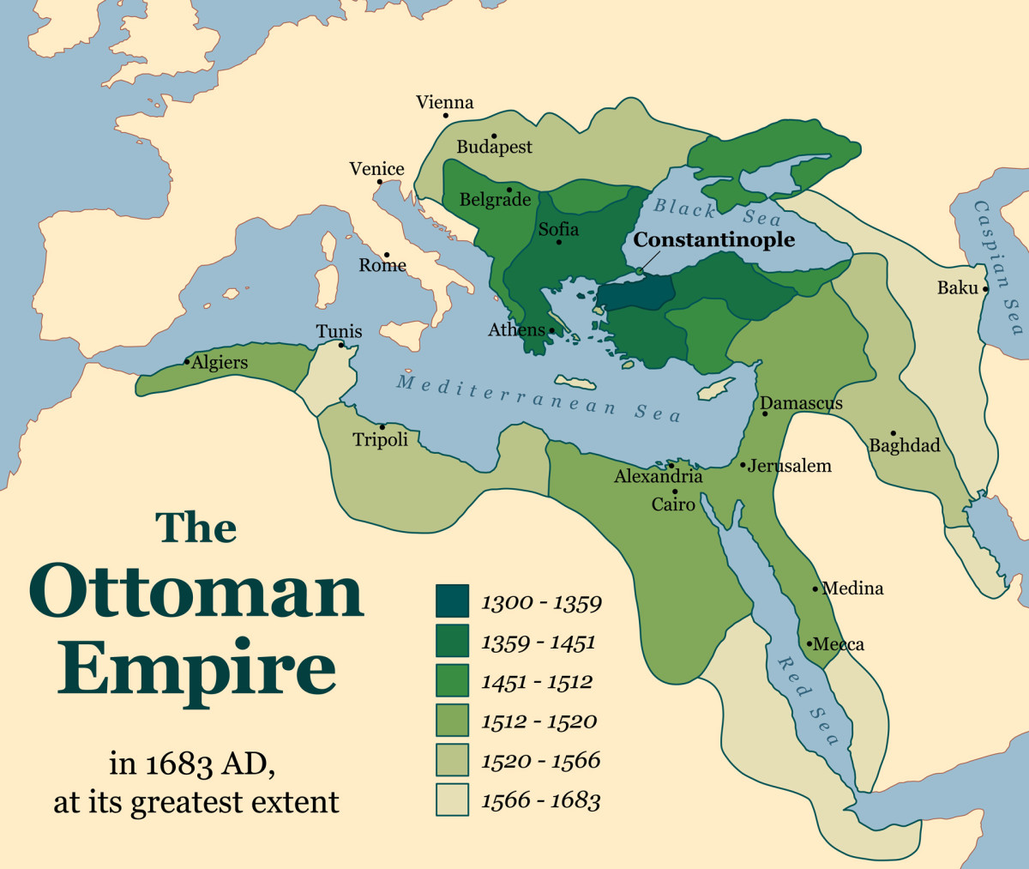
Egypt under the Ottoman rule
The Ottomans did not attempt Ottomanize the education system or culture, instead they allowed the Egyptians to follow their own culture and use their own education system. They let it remain autonomous while they continued to conquer and rule over new areas. Even after leaving, the Ottomans influence and legacy affect Egypt for centuries afterwards.
The Ottomans were very busy with taking over land.

Slide 4
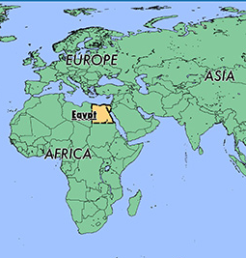
The French Colonization of Egypt
The French invaded Egypt in 1798 for its agricultural aspects, the commercial aspects (much trading is done over Egypt) as well as the strategic advantage over the English they would have. They succeeded and for the next years, Egypt was ruled over by the French. The Egyptians did not enjoy French rule for several reasons and even tried to start a revolution at one point.
Egypt functioned as a gateway from Europe to Asia for the British, a reason that the French wanted it.

Slide 5
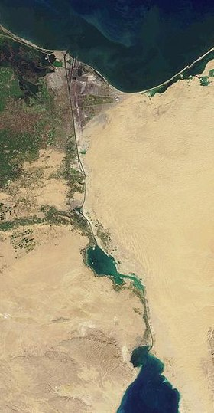
The British Colonization of Egypt
The British saw Egypt and wanted to take it for control of the Suez Canal and to keep their investments they had in it safe, as the country was on the brink of a civil war. A battle occurred and they took over the country. They took the country over, began to ran it without worries on the legal aspects, and enjoyed it. Even after they got independence, they continued to remain in the country for several reasons such as a military base.
The Suez Canal was heavily invested by other countries to due its benefits for trade.

Slide 6
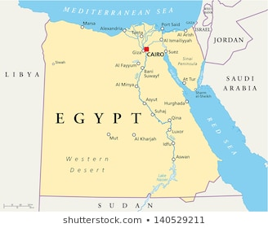
Independence-Ethan
Nationalist movements led to the rise of a desire for independence. Demonstrations and protests continued to occur. Violent clashes with police and overwhelming support led to Britain declaring Egypt to be independent. However, Egypt still had many trials to overcome- especially after having such complicated relations with other countries due to being ruled by such a large number of different parties.
Egypt’s modern borders (notice that the bottom of it has 2 different borders because it is disputed area)

Slide 7
Conclusion
British colonization was simply another colonization in Egypt’s lifespan. It helped deal with the effects of other colonization's such as the French and Ottoman, but Egypt may have been better off alone too. It may have lead to the independence of the nation quicker than if it was still under French rule because of how much Egyptians hated the British rule, but they hated the French too. However, they were given independence without a large-scale battle with many causalities. In the end, there is no way to be sure- but is likely that British rule slightly aided in the independence of Egypt.

Slide 8
Bibliography
Egypt - The French Invasion and Occupation, 1798-1801, countrystudies.us/egypt/20.htm.
“Egypt Eyalet.” Wikipedia, Wikimedia Foundation, 10 Mar. 2020, en.wikipedia.org/wiki/Egypt_Eyalet.
Study.com, Study.com, study.com/academy/lesson/egypt-under-european-rule-summary-timeline.html.
" The New African State Of South Sudan. ." Gurtong.net. N. p., 2020. Web. 30 Mar. 2020.

