Slide 1
Intro to shiny Apps
QIB Data Science group
A. Ponsero
The code, presentation and tutorial for this workshop is accessible at:
https://github.com/quadram-institute-bioscience/datasciencegroup/

Slide 2
Introduction: What is a Shiny App ?
Intro to Shiny – QIB 2024

Slide 3

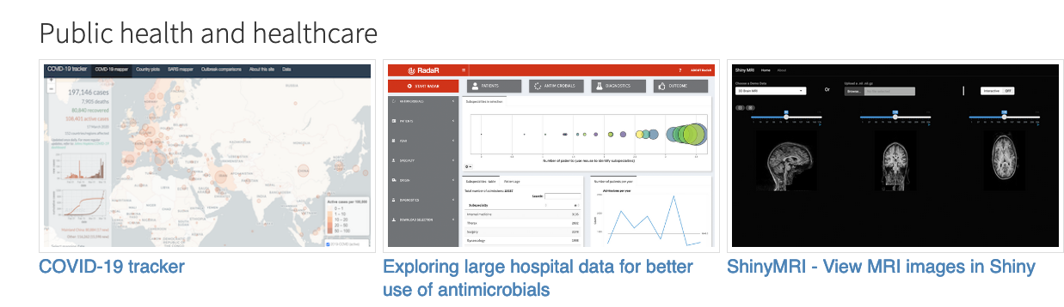
What is a Shiny App?
Shiny is
an R package
to build interactive web applications
Shiny can be used:
In a standalone apps on a webpage
Embed in R Markdown documents
In a Shiny Dashboard
Shiny App Gallery:
https://shiny.rstudio.com/gallery/
Intro to Shiny – QIB 2024

Slide 4
Why do I want a Shiny App?
Shiny Apps allows for
Interactive visualizations
Users can explore the datasets
Shiny Apps are:
Easy to build if you know R
Reactive layout that is easily portable to any screen
Not too painful to deploy (especially on Shinyapps.io)
Intro to Shiny – QIB 2024

Slide 5
Overview of this workshop
1 – Architecture of a Shiny app
Global overview of a Shiny App
First step in running an App on RStudio
2 – Create the user interface
User Interface layout and main areas
Dealing with images, HTML elements and widgets
3 – Make your app reactive
The Shiny Server function
Reactive values and events
4 – Deploy your app online
Make your app live on Shinyapps.io
Goal: Creation and deployment of the Ramen Rating app
Intro to Shiny – QIB 2024

Slide 6
Part 1: Architecture of a Shiny App
Intro to Shiny – QIB 2024

Slide 7
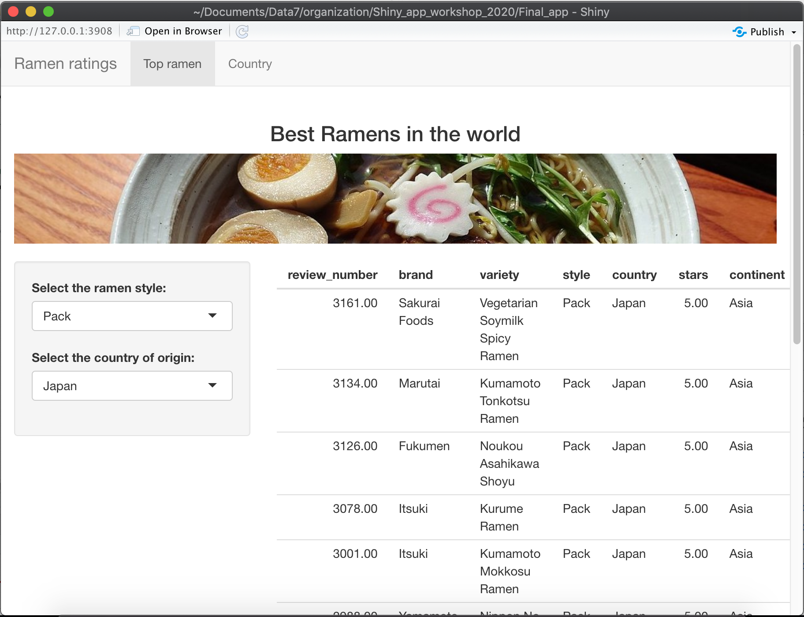

The Architecture of a Shiny App
User Interface
Server
Intro to Shiny – QIB 2024

Slide 8

The Architecture of a Shiny App
User Inputs
Updates the interface
User Interface
Server
HTML page directly generated by R
Locally : your own laptop
Deployed : Web server
Intro to Shiny – QIB 2024

Slide 9
The Architecture of a Shiny App
Ui function
Creates the User interface
App.R
Server function
Specify the server behavior to user inputs
Shiny App script
Always named app.R
Intro to Shiny – QIB 2024

Slide 10
The Architecture of a Shiny App
Ui function
Creates the User interface
App.R
Note: It used to be recommended to store the UI and Server as two separate scripts.
Server function
Specify the server behavior to user inputs
Shiny App script
Always named app.R
Intro to Shiny – QIB 2024

Slide 11
The Architecture of a Shiny App
Ui function
Creates the User interface
App.R
Server function
Specify the server behavior to user inputs
Shiny App script
Always named app.R
Example of a simple App in Iris_app folder
Intro to Shiny – QIB 2024

Slide 12
The Ramen Rating Shiny App
The dataset for this app is derived
from the Ramen Rating dataset
Intro to Shiny – QIB 2024

Slide 13
Part 2: User Interface
Intro to Shiny – QIB 2024

Slide 14
UI:
Define Layouts to organize your app
Include HTML elements
Shiny tags
HTML()
IncludeHTML()
Add widgets for user inputs
Intro to Shiny – QIB 2024

Slide 15
Part 3: Server side
Intro to Shiny – QIB 2024

Slide 16
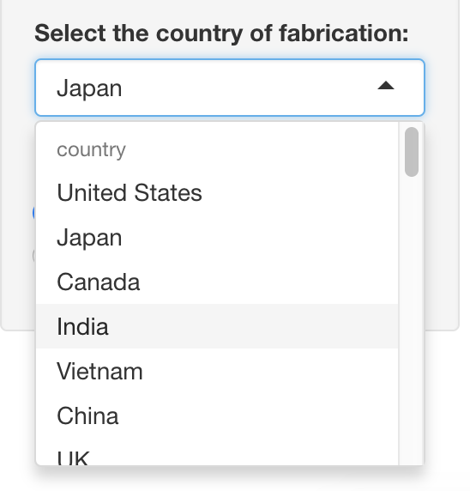
Cascade of updates: Case 1
Input$country = Japan
Intro to Shiny – QIB 2024

Slide 17
Cascade of updates: Case 1
Input$country = India
Intro to Shiny – QIB 2024

Slide 18
Cascade of updates: Case 1
Input$country = India
# Title main area
# ----------------------------------
output$toptitle <- renderText({
paste("Best ramens in ", input$country)
})
The renderText function invalidated
Intro to Shiny – QIB 2024

Slide 19

Cascade of updates: Case 1
Input$country = India
# Title main area
# ----------------------------------
output$toptitle <- renderText({
paste("Best ramens in ", input$country)
})
The renderText function updated
Intro to Shiny – QIB 2024

Slide 20
Cascade of updates: Case 2
Input$country = Japan
Intro to Shiny – QIB 2024

Slide 21
Cascade of updates: Case 2
Input$country = India
Intro to Shiny – QIB 2024

Slide 22
Cascade of updates: Case 2
# ----------------------------------
# Reactive elements
display_dataset <- reactive({
ramen_ratings %>% filter(style %in% input$style & country == input$country)
})
Input$country = India
Display_dataset reactive element is invalidated
Intro to Shiny – QIB 2024

Slide 23
Cascade of updates: Case 2
# ----------------------------------
# Reactive elements
display_dataset <- reactive({
ramen_ratings %>% filter(style %in% input$style & country == input$country)
})
Input$country = India
Display_dataset reactive element is re-run
Intro to Shiny – QIB 2024

Slide 24
Cascade of updates: Case 2
# ----------------------------------
# Reactive elements
display_dataset <- reactive({
ramen_ratings %>% filter(style %in% input$style & country == input$country)
})
Input$country = India
# ----------------------------------
# Table output
output$top3 <- renderTable({
display_dataset() %>% arrange(desc(stars, review_number)) %>% slice(1:3) %>% select(-continent, -review_number)
})
renderTable element is invalidated
Intro to Shiny – QIB 2024

Slide 25
Cascade of updates: Case 2
# ----------------------------------
# Reactive elements
display_dataset <- reactive({
ramen_ratings %>% filter(style %in% input$style & country == input$country)
})
Input$country = India
# ----------------------------------
# Table output
output$top3 <- renderTable({
display_dataset() %>% arrange(desc(stars, review_number)) %>% slice(1:3) %>% select(-continent, -review_number)
})
renderTable element is
re-run
Intro to Shiny – QIB 2024

Slide 26
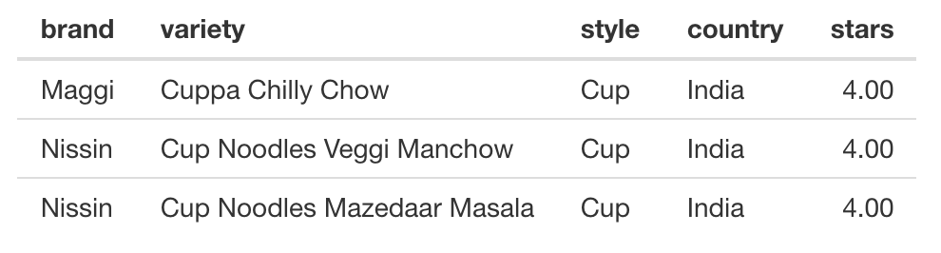
Cascade of updates: Case 2
# ----------------------------------
# Reactive elements
display_dataset <- reactive({
ramen_ratings %>% filter(style %in% input$style & country == input$country)
})
Input$country = India
# ----------------------------------
# Table output
output$top3 <- renderTable({
display_dataset() %>% arrange(desc(stars, review_number)) %>% slice(1:3) %>% select(-continent, -review_number)
})
Intro to Shiny – QIB 2024

Slide 27
Cascade of updates: Case 3
Input$country = Japan
Intro to Shiny – QIB 2024

Slide 28

Cascade of updates: Case 3
Input$country = India
Input$go=0
Intro to Shiny – QIB 2024

Slide 29
Cascade of updates: Case 3
# Title main area
# ----------------------------------
ntext <- eventReactive(input$go, {
input$country
})
Input$country = India
eventReactive element is invalidated
Input$go=1
Intro to Shiny – QIB 2024

Slide 30
Cascade of updates: Case 3
# Title main area
# ----------------------------------
ntext <- eventReactive(input$go, {
input$country
})
Input$country = India
eventReactive element is re-run
Input$go=1
Intro to Shiny – QIB 2024

Slide 31
Cascade of updates: Case 3
# Title main area
# ----------------------------------
ntext <- eventReactive(input$go, {
input$country
})
Input$country = India
output$toptitle <- renderText({
paste("Best ramens in ", ntext())
})
renderText element is
invalidated
Input$go=1
Intro to Shiny – QIB 2024

Slide 32
Cascade of updates: Case 3
# Title main area
# ----------------------------------
ntext <- eventReactive(input$go, {
input$country
})
Input$country = India
output$toptitle <- renderText({
paste("Best ramens in ", ntext())
})
renderText element is
re-run
Input$go=1
Intro to Shiny – QIB 2024

Slide 33
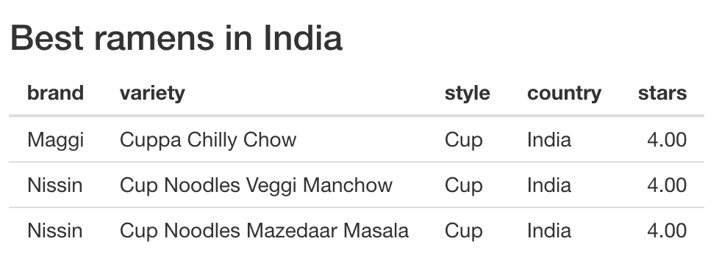
Cascade of updates: Case 3
# Title main area
# ----------------------------------
ntext <- eventReactive(input$go, {
input$country
})
Input$country = India
output$toptitle <- renderText({
paste("Best ramens in ", ntext())
})
renderText element is
re-run
Input$go=1
Intro to Shiny – QIB 2024

Slide 34
Final thoughs: Want more Shiny in your life?
Intro to Shiny – QIB 2024

Slide 35
To go further:
Get inspiration from the Shiny Gallery
https://shiny.rstudio.com/gallery/
Shiny provides good tutorials (video and articles)
https://shiny.rstudio.com/tutorial/
Mastering Shiny book by Hadley Wickham:
https://mastering-shiny.org
To create interactive documents in Rmarkdown using Shiny
https://posit.co/blog/interactive-documents-an-incredibly-easy-way-to-use-shiny/
Intro to Shiny – QIB 2024

