Slide 1

CAPSTONE PROJECT Predicting Student Dropout Risk Using Machine Learning
Presented By
Student Name: SUHAN AKTAR MAZUMDER
College Name: GURUCharAN COLLEGE
Department: COMPUTER SCIENCE
Email ID: SUHANKTAREDU@GMAIL.COM
AICTE Student ID: STU663709e41ddaa1714883044

Slide 2
OUTLINE
Problem Statement
Proposed System/Solution
System Development Approach
Algorithm & Deployment
Result
Conclusion
Future Scope
References

Slide 3
Problem Statement
In colleges and universities, student dropout is a serious issue that affects academic success rates and institutional performance. It's often hard to predict who might drop out until it’s too late. Teachers and staff usually don’t have the tools or data to identify struggling students early. This project focuses on finding a way to spot students who are at risk of dropping out using patterns in their academic and background data, so colleges can support them in time.

Slide 4
Proposed Solution
To help identify students who might drop out, I built a machine learning model using real academic data. The system looks at things like grades, course details, and student background to predict the chances of a student dropping out. I used a logistic regression model, which turned out to be a good fit for this kind of problem. The idea is that, with this kind of tool, colleges could spot students at risk early and offer help before it’s too late.
Uses past student data (grades, demographics, etc.)
Predicts dropout risk with ~86% accuracy
Helps institutions act before students drop out

Slide 5
System Approach
The system was developed using Python in a Jupyter Notebook environment. I used pandas for handling the dataset, scikit-learn for building the machine learning model, and matplotlib/seaborn for basic visualizations. The data came from a public dataset that includes student academic records and background details. After cleaning and preparing the data, I trained a logistic regression model to predict whether a student is likely to drop out.
Tools used: Python, pandas, scikit-learn, Jupyter Notebook
Dataset: Student dropout dataset from Kaggle
Approach: Data cleaning → model training → evaluation

Slide 6
Algorithm & Deployment
Algorithm Selection:
I used Logistic Regression because it’s a simple and effective model for binary classification. It was a good fit for predicting dropout (yes/no) based on student data.
Data Input:
The model takes 34 input features, including student age, past grades, scholarship info, course type, and more.
Training Process:
The dataset was split into 80% training and 20% testing. I trained the model using scikit-learn with default parameters, and set the maximum iterations to 1000 to ensure it converges.
Prediction Process:
Once trained, the model predicts whether a student is likely to drop out. It returns 1 for dropout and 0 for non-dropout. I evaluated its predictions using accuracy, precision, recall, and a confusion matrix.

Slide 7
Result
The model achieved an accuracy of 86.3% on the test set. It was able to correctly identify most of the students who were at risk of dropping out.
Out of 885 students in the test data:
233 actual dropouts were correctly predicted
531 non-dropouts were also correctly predicted
I also plotted a confusion matrix to visualize the results, which shows how many correct vs incorrect predictions were made.

Slide 8
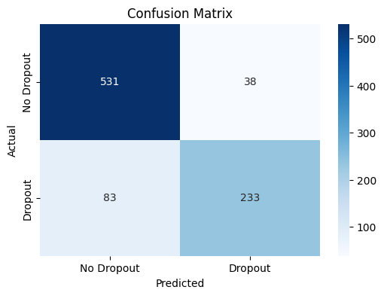
Result

Slide 9
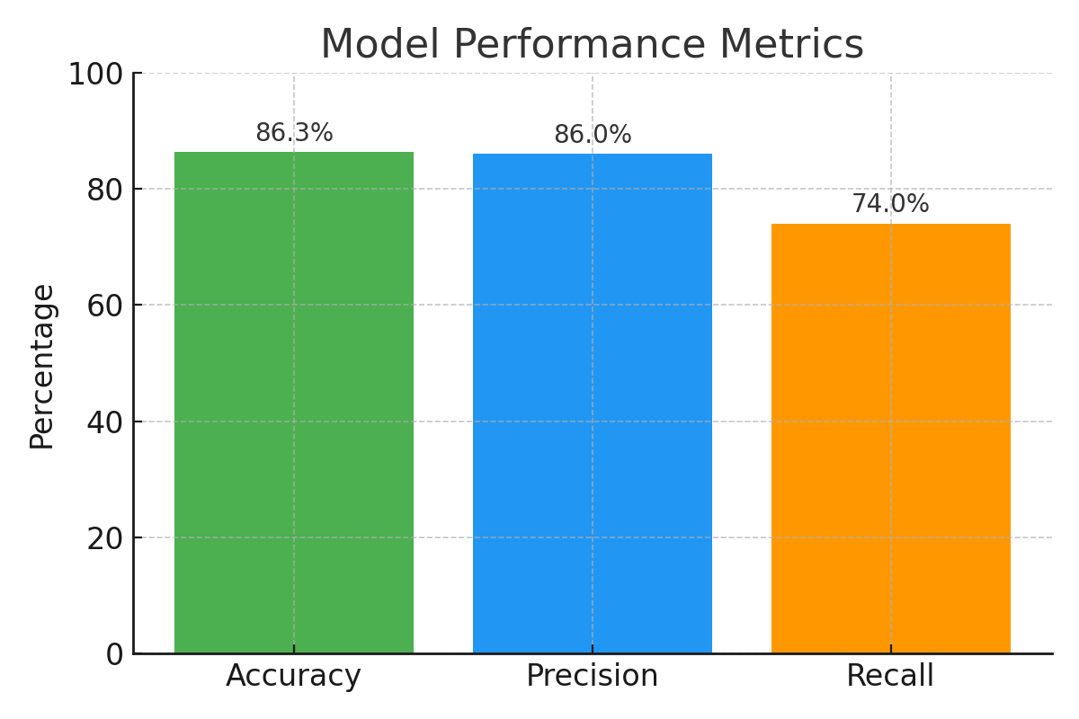
Result

Slide 10
Conclusion
The model successfully predicts whether a student is at risk of dropping out, with an accuracy of 86.3%. Logistic regression worked well with the given dataset and helped identify patterns in academic and background features. This kind of system can help colleges take early action to support students who might otherwise leave.

Slide 11
Future scope
While the current model performs well, it can be improved by using more advanced algorithms like Random Forest or XGBoost. In the future, it could be turned into a web-based tool for college staff to upload student data and get real-time dropout risk analysis. Adding more features like attendance records, online activity, or behavioral data could make predictions even more accurate.

Slide 12
References
Kaggle Dataset: The Portuguese Student Dropout Prediction Dataset
scikit-learn documentation: https://scikit-learn.org
matplotlib & seaborn for visualization

Slide 13
Thank you

