Slide 1
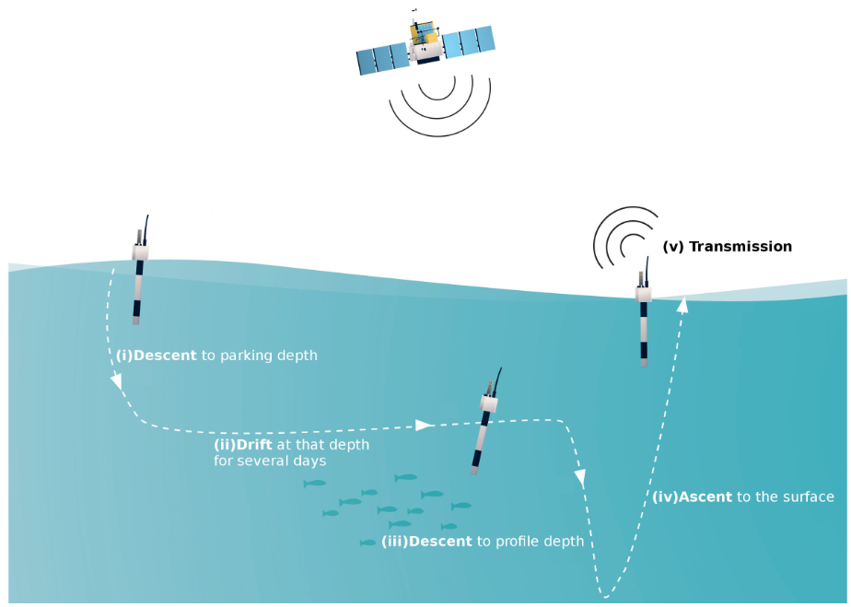
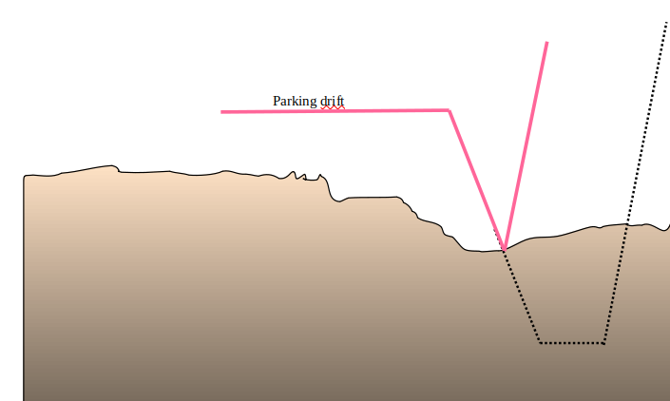


Deep arvor groundings when descending to profile depth
ARVOR-DEEP monitors itself for possible grounding on the seabed. During descent to parking depth, if the pressure remains unchanged for too long, despite of pumping actions, grounding is flagged, and time & pressure are saved.
The present pressure is then substituted for the profile starting pressure, and the float start its ascent.
Parking depth
Typical Argo & Deep-Argo cycle (courtesy of Euro-Argo).
(X. Andre et al., 2020)
Grounding
Profile starting depth

