Slide 1
Statistics Simplified: Explore, Analyze, Visualize
Presented by: Quaid Khalid

Slide 2
What is Statistics?
Collecting, analyzing, interpretation, presentation, and organization of data.
What statistics can do?
How likely is someone to purchase a product? Are people more likely to purchase it if they can use a different payment system?
How many sizes of jeans need to be manufactured so they can fit 95% of the population? Should the same number of each size be produced?
A/B testing: Which ad is more effective in getting people to purchase a product?

Slide 3
Types of Statistics
Descriptive Stats
describe and summarize data like mean, median, mode of population, it works for population.
Inferential Stats
use a sample of data to make inferences about a large population like A/B testing etc

Slide 4
Types of Data
Numerical data (Quantitative)
Continuous: that can be measured e.g. airplane speed, distance, time
Discrete: that can be counted, e.g. No of pets
Categorical data (Qualitative)
Nominal (unordered): like Marital status, married or unmarried
Ordinal(ordered): grades like A, B+, B, C+, C, D+, D, F

Slide 5
Why does data types matter?
To know what kind of summary statistics applied
Visualize data correctly
For numerical data → mean, median, scatter plot
For categorical → mode, bar plot

Slide 6
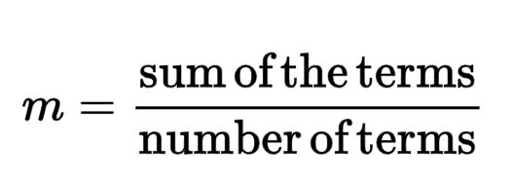
Summary Statistics
Mean
Median
50% < median < 50%
Mode
Most frequent value in data

Slide 7
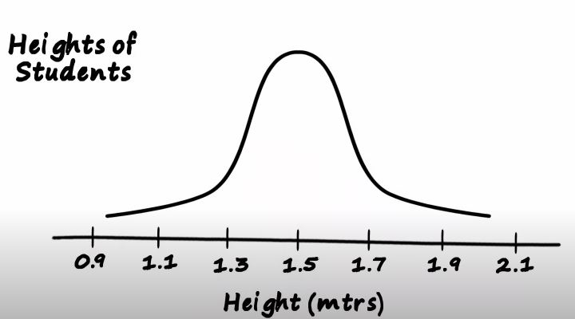
Distribution of data and skewness
Normal Distribution

Slide 8
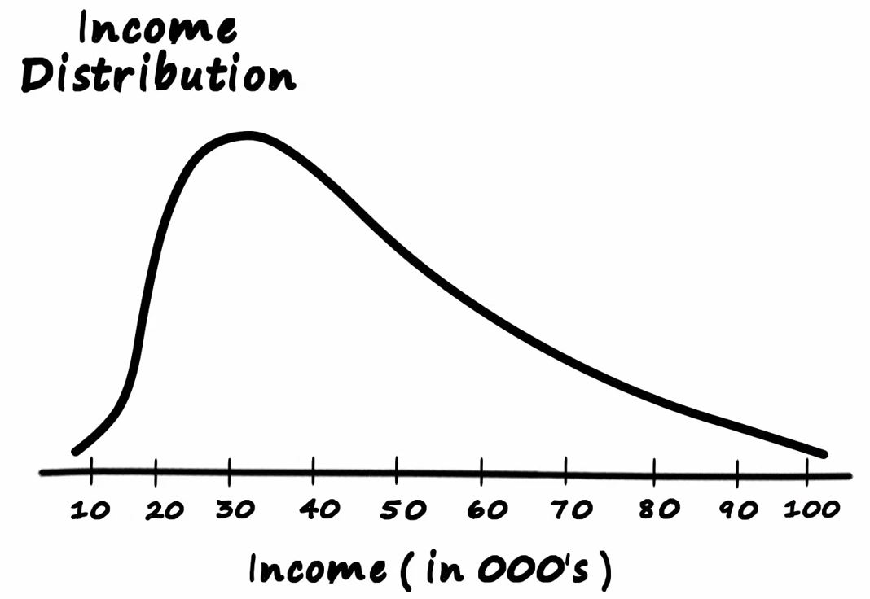
Positively Skewed

Slide 9
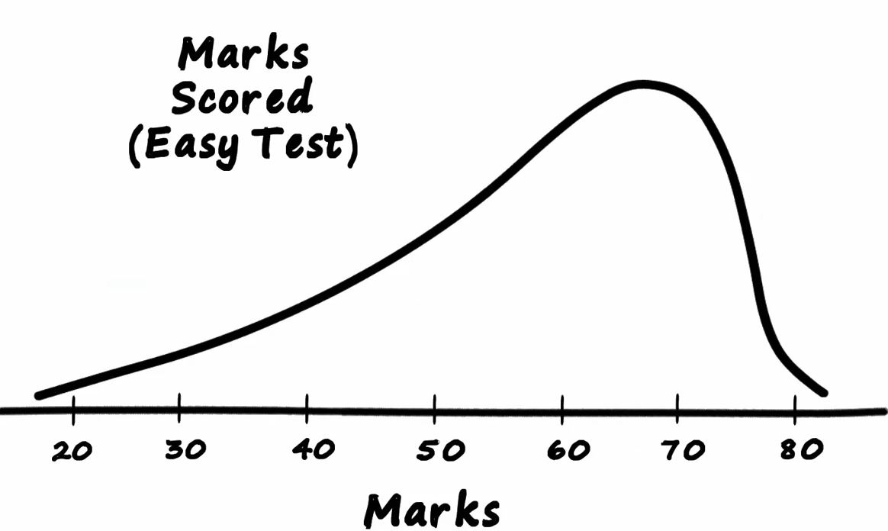
Negative Skewed

Slide 10
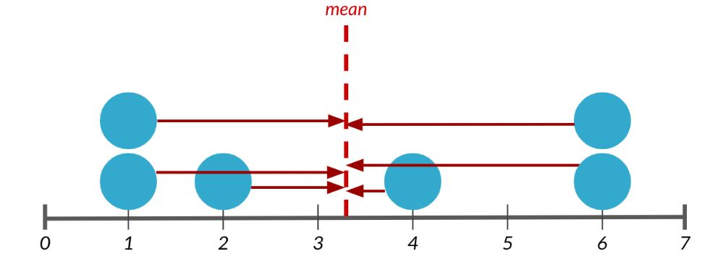
Measure of Spread
Variance
Average distance from each data point to the data’s mean
Higher the variance, more spread data is
Standard Deviation
Square root of variance

Slide 11
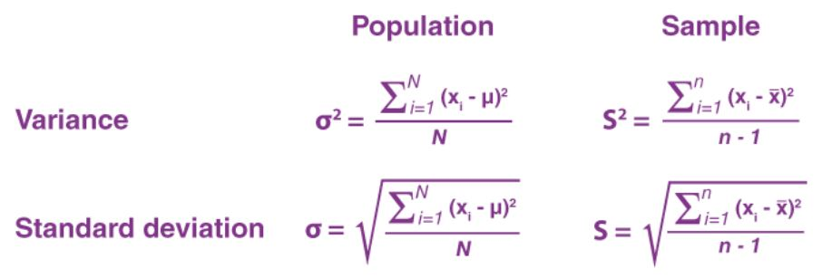

Slide 12
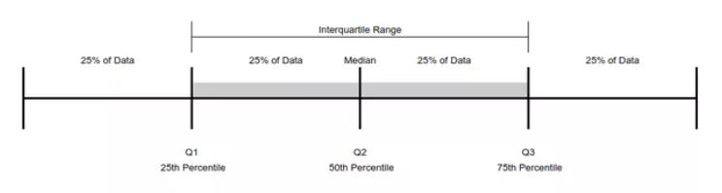
Quartiles
Quartiles divide a set of numbers into four equal parts. The first quartile is the middle term between the median and the first term, the second quartile is the median, and the third quartile is the middle term between the median and the last term.
also called percentiles

Slide 13
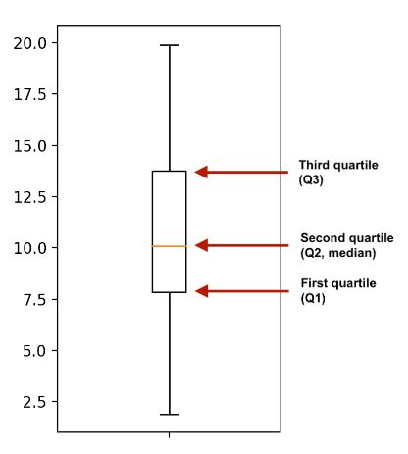
Interquartile Range
The interquartile range (IQR) is the difference between the lower and upper quartile. It is a measure of the spread of the data and the width of the “box” on a box plot.
Distance between the 25th and 75th
percentile
Height of the box in a box plot

Slide 14

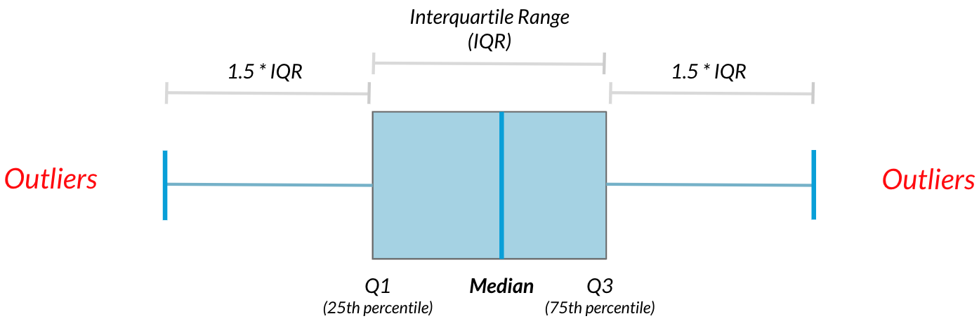
Outliers
An outlier is a data point that differs significantly from other observations
But how we know that difference?

