Slide 1

Extended Berkeley Packet Filter (ebpf)
The New Swiss Knife for Cybersecurity Education
Si Chen and Liu Cui
Computer Science Department
West Chester University of Pennsylvania
{schen, lcui}@wcupa.edu

Slide 2
Presentation Outline
Introduction
Background
System Overview
Comparison
Lab Examples

Slide 3
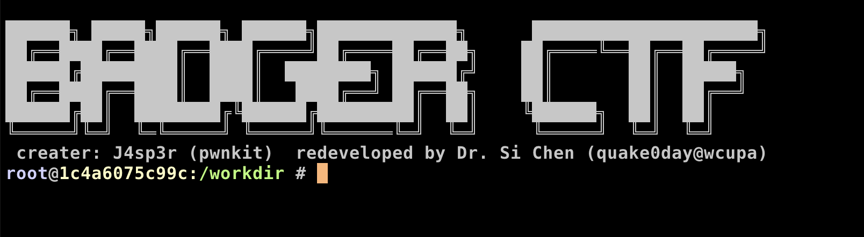
Introduction
It is very challenging to do hands-on projects involving complex Linux kernel modification in cybersecurity courses, such as pawning a Linux kernel and hooking system calls.
To solve this problem, we have developed a cybersecurity learning system named BadgerCTF+.
Leverages the Extended Berkeley Packet Filter (eBPF) technology to support just-in-time kernel hooking.
With BadgerCTF+, we can develop various hands-on cybersecurity labs, including system calls and processes hijacking, attacking interrupts, and kernel tracing.
Notes:
which leverages the Extended Berkeley Packet Filter (eBPF) technology to support just-in-time kernel hooking. eBPF is a kernel technology that allows programs to run in the kernel land without changing the kernel source code or adding additional modules.
While the BadgerCTF+ was initially developed for cybersecurity courses, it can also be used for network courses to learn how Internet technologies work, such as network monitoring, route tracing, Border Gateway Protocol (BGP), packet inspection, and network performance analysis.

Slide 4
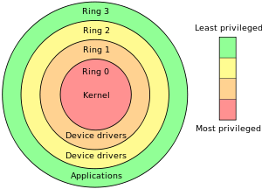
The “Ring”
System Call →
WinAPI (Windows)

Slide 5
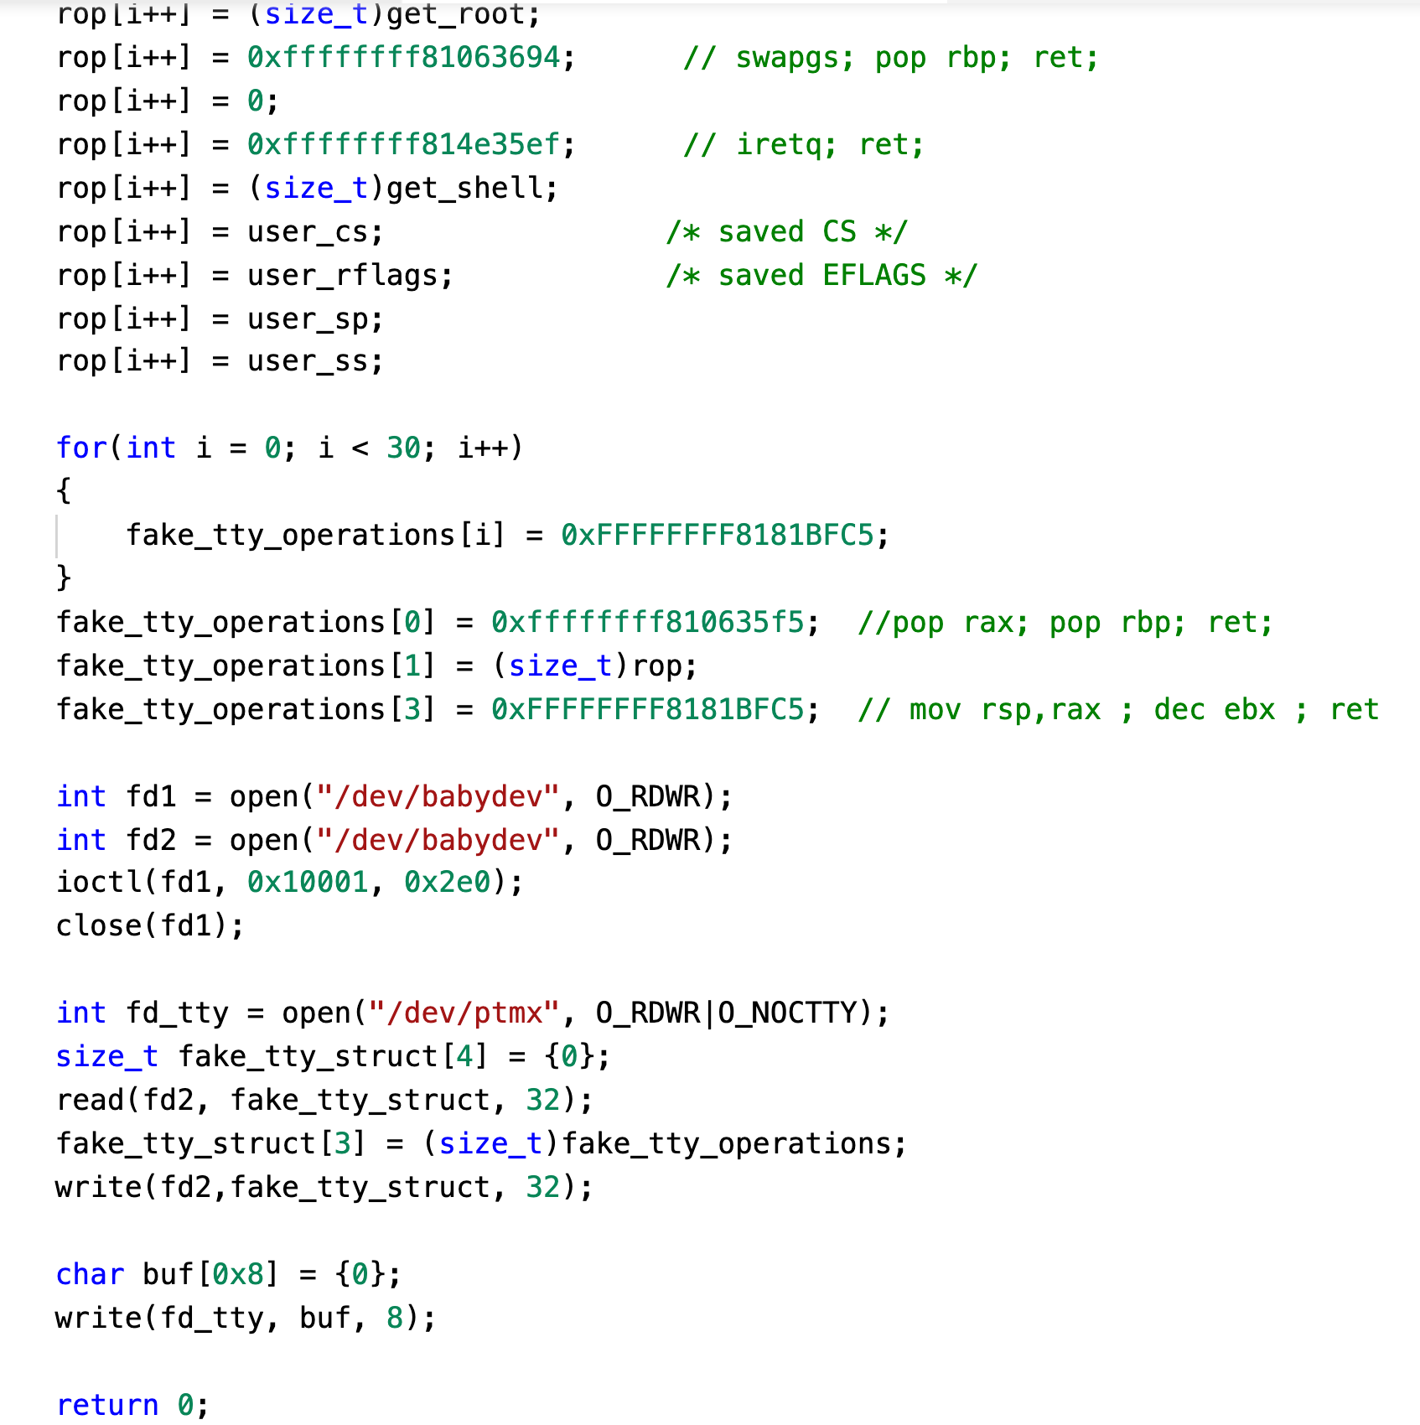
Background
The kernel programming projects provide crucial hands-on experience for helping the student understand operating system concepts and advanced cybersecurity topics such as system calls, process hook, interrupt, and kernel memory management.
Developing a pedagogically-effective programming project in the context of a complex Linux kernel codebase can be a challenge:
Linux kernel has been developed and maintained for more than 30 years and is already settled in design.
The sheer size of the kernel system makes it difficult to understand.
The production operating systems are also not primarily designed as teaching tools -- any changes students make might break the whole system
Notes:
However, developing a pedagogically-effective programming project in the context of a complex Linux kernel codebase can be a challenge.

Slide 6
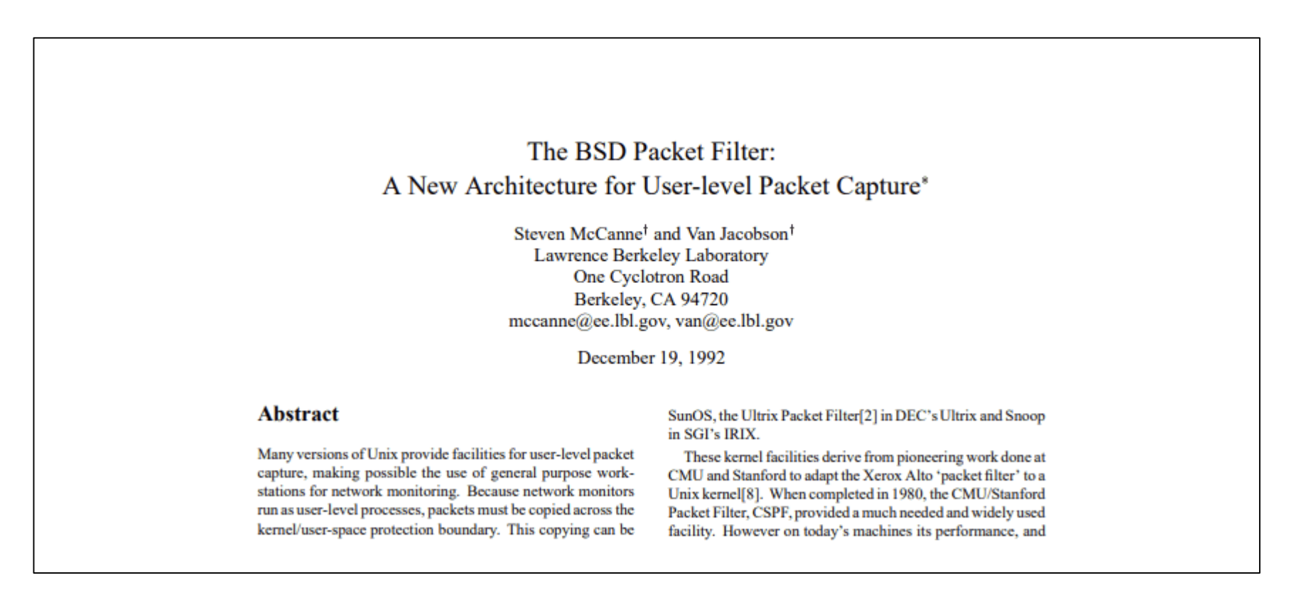
Background
Berkeley Packet Filter (BPF) was first developed in 1992. It is a virtual machine (VM) in the Linux kernel, allowing a privileged user to load and run bytecode safely in the kernel and monitor some chosen events.
Since version 3.18 of the Linux kernel, the BPF VM has been extended with a new name eBPF(extended BPF). In order to trigger a BPF program, one needs to attach it to one or more probes (e.g., kprobe or uprobe).

Slide 7
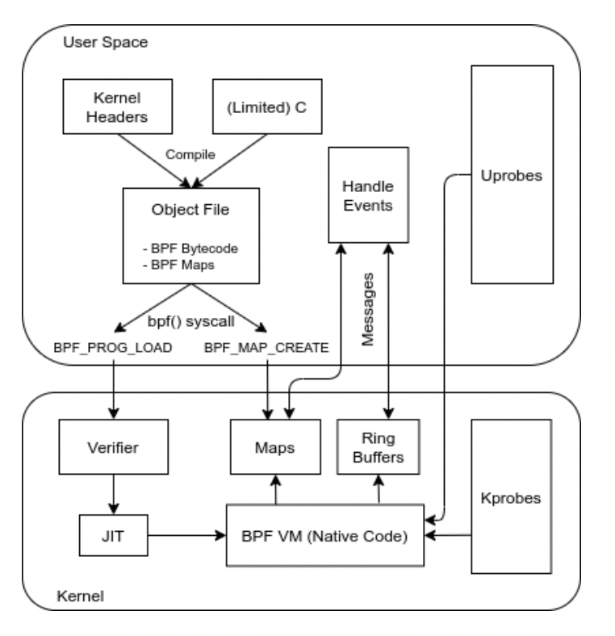
Background
We maintain that eBPF is a natural fit for a cybersecurity learning system, for several reasons:
Hooking is done in the kernel space, thus is able to hook high privilege processes.
The verifier automatically verifies the eBPF code before being inserted to the kernel, and prevent programming errors which may cause kernel crashes, hangs, or instability.
eBPF programs can be triggered by user or kernel land probes, allowing a single mechanism to intercept all system events.
eBPF is able to provide context about the events, including arguments, process id, user id, timestamp and more.
eBPF supports event filtering in the kernel, saving the need to send and parse irrelevant event in the userspace (ring 3).
It is possible to use eBPF to read and write data from kernel space to user space memory, hence arguments can be read and even changed.
System overhead is relatively small as all the eBPF code are compiled to native code and are running inside kernel space.
eBPF is now maintained as part of the Linux kernel and new features are constantly being added to it.

Slide 8
System Overview
The core part of the BadgerCTF+ system is a pre-configured docker container. Users (student and teacher) can connect to the BadgerCTF+ system via a secure shell (SSH) program.
Once connected via SSH, the BadgerCTF+ system will automatically spawn a new container and let the user attach to it. To make sure user’s homework can be saved and synchronized, BadgerCTF+ will automatically mount user’s home folder to the container. Once user disconnect via SSH, that container will be destroyed.

Slide 9
System Overview
We use eBPF to build several kernel related security labs. These Linux kernel programming labs are developed via pseudo-C code and compiled into eBPF byte code via LLVM compiler. Student and teacher do not need to use eBPF directly, instead, they can use the Python script as an abstraction layer to interact with the built-in eBPF program.

Slide 10
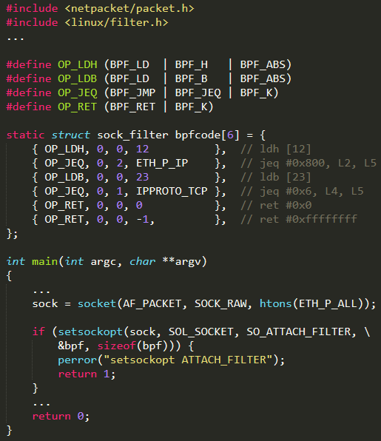
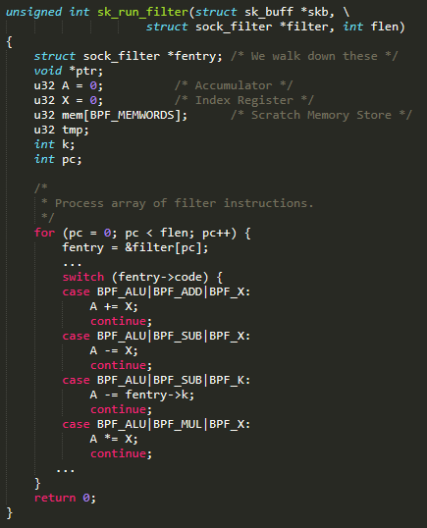
System Overview
filter program@ring3
filter program@ring0
Notes:
Our lab’s Python script will create a new system-level hook to gather information in the kernel land. Once the desired hook has been identified, the eBPF program can be loaded into the Linux kernel via the eBPF system call. This is typically done using one of the available eBPF libraries. As our lab program is loaded into the Linux kernel, it passes through two steps before being attached to the request hook:
Verification: As shown in Figure 2, the verification process ensures that the eBPF program is safe to run. The verifier will validate that the program meets several conditions, including:
The process loading the eBPF program holds the required privileges (Note that inside the BadgerCTF+ docker container, users have the root privileges by default).
The program does not crash the system.
The program does not contain any infinite loop and always runs to completion.
JIT Compilation: The Just-in-Time (JIT) compilation process translates the generic bytecode of the program into the machine specific instruction set to optimize the overall running performance of the program. This makes our eBPF programs run as efficiently as natively compiled kernel code or as code inserted as a Loadable Kernel Module (LKM).

Slide 11
System Overview
Our lab’s Python script will create a new system-level hook to gather information in the kernel land. Once the desired hook has been identified, the eBPF program can be loaded into the Linux kernel via the eBPF system call. This is typically done using one of the available eBPF libraries. As our lab program is loaded into the Linux kernel, it passes through two steps before being attached to the request hook:
Verification: the verification process ensures that the eBPF program is safe to run. The verifier will validate that the program meets several conditions.
JIT Compilation: The Just-in-Time (JIT) compilation process translates the generic bytecode of the program into the machine specific instruction set to optimize the overall running performance of the program.
Notes:
Our lab’s Python script will create a new system-level hook to gather information in the kernel land. Once the desired hook has been identified, the eBPF program can be loaded into the Linux kernel via the eBPF system call. This is typically done using one of the available eBPF libraries. As our lab program is loaded into the Linux kernel, it passes through two steps before being attached to the request hook:
Verification: As shown in Figure 2, the verification process ensures that the eBPF program is safe to run. The verifier will validate that the program meets several conditions, including:
The process loading the eBPF program holds the required privileges (Note that inside the BadgerCTF+ docker container, users have the root privileges by default).
The program does not crash the system.
The program does not contain any infinite loop and always runs to completion.
JIT Compilation: The Just-in-Time (JIT) compilation process translates the generic bytecode of the program into the machine specific instruction set to optimize the overall running performance of the program. This makes our eBPF programs run as efficiently as natively compiled kernel code or as code inserted as a Loadable Kernel Module (LKM).

Slide 12
System Overview
To return the result back to user space (ring3), our system utilized a concept named eBPF maps.
eBPF maps allows sharing date between our lab’s eBPF kernel programs and also between kernel (ring0) and user-space (ring3) applications.
The eBPF maps are generic data structure for storage of different data types and are treated as binary blobs. We specify the size of the key and the size of the value at map-creation time inside our lab’s eBPF program.
The map handles are file descriptors and multiple maps can be created and accessed by multiple users/programs at the same time.
eBPF maps

Slide 13
Comparison of Techniques for Teaching Linux Kernel
 | Monitor all system interactions | No system modification | No application modification | Easy to develop | Safe
Loadable Kernel Module (LKM) | N | N | Y | N | N
Application Modification | N | Y | N | N | N
Library Injection | N | Y | Y | Y | N
Kernel eBPF (BadgerCTF+) | Y | Y | Y | Y | Y
 | Table 1: Comparison of Techniques for Teaching Linux Kernel
Comparison of Techniques for Teaching Linux Kernel
By relying on the eBPF technology of the Linux kernel, BadgerCTF+ achieves some of the desired requirements. BadgerCTF+ is able to trace almost any part of the Linux system kernel. It can log Linux API, native library functions, system calls and internal kernel functions. By collection all context levels of an application in a unified manner, BadgerCTF+ is able to provide a bunch of programming interface which can be directly used by the student for secondary development.
Notes:
By relying on the eBPF technology of the Linux kernel, BadgerCTF+ achieves some of the desired requirements. BadgerCTF+ is able to trace almost any part of the Linux system kernel. It can log Linux API, native library functions, system calls and internal kernel functions. By collection all context levels of an application in a unified manner, BadgerCTF+ is able to provide a bunch of programming interface which can be directly used by the student for secondary development.

Slide 14
Lab Examples: Detecting Kernel Rootkit
A kernel rootkit is a malicious software that runs inside the kernel space to create a backdoor to a system without being detected.
It can be de deployed onto a system via a worm, or an attacker can use a kernel vulnerability.
Because kernel rootkit involves compromising the kernel, they can basically do anything, including avoiding detection by other software.
A common technique of Linux kernel rootkit is to overwrite the function addresses inside the syscall table.
Syscalls are the main way userland applications interact with the kernel and underlying hardware. By hooking (or ‘altering’) the syscall table, rootkit can change the data reported by the kernel to hide anything incriminating, such as its own process or a network connection to a command and control (C&C) server.

Slide 15
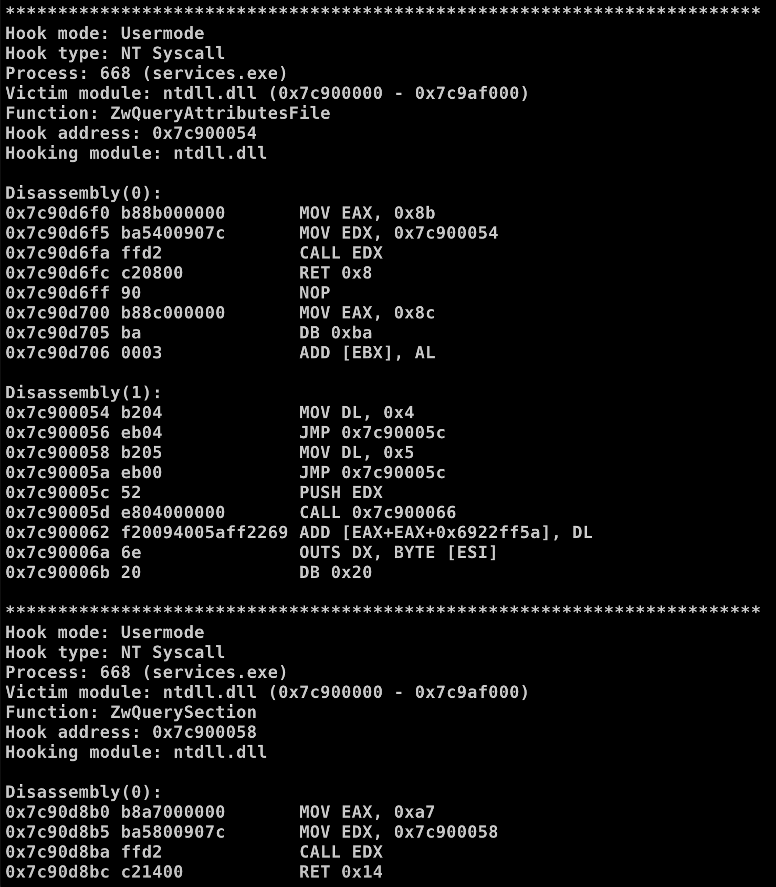
Lab Examples: Detecting Kernel Rootkit
For CSC 471: modern malware analysis class. The topics is for detecting kernel rootkit.
It is difficult to teach topics like kernel rootkit due to it complex nature.

Slide 16
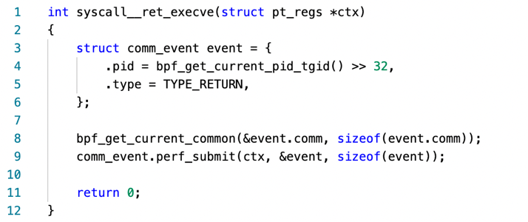
Lab Examples: Detecting Kernel Rootkit
The eBPF programs used in our cybersecurity lab are event-driven and it will be triggered when the kernel or an application passes a certain hook point. There are several pre-defined hooks which include system-calls, function entry/exit, kernel tracepoints, and network events.
If a predefined hook does not exist for a particular need, we should use kernel probe (kprobe) or user probe (uprobe) to attach eBPF programs and retrieve the data

Slide 17
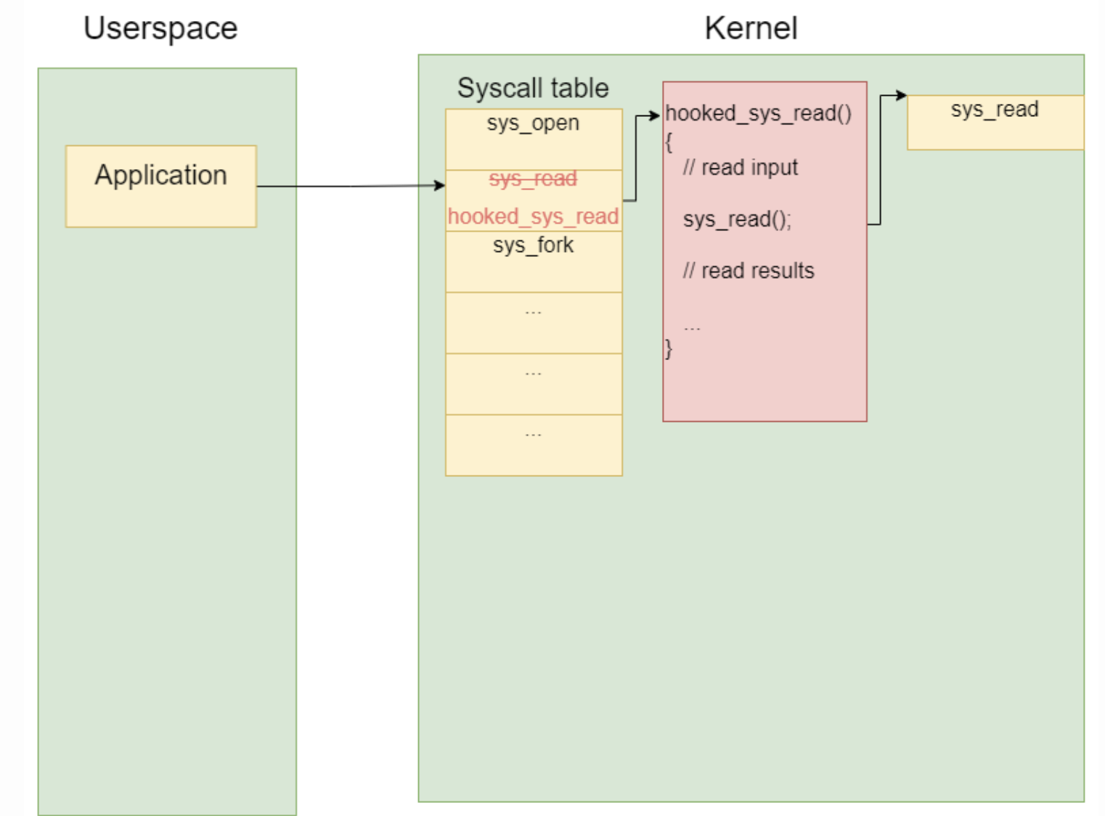

Slide 18
Lab Examples: Detecting Kernel Rootkit
We will attach a kprobe to the Kill syscall function. Since eBPF has the ability to record stack traces of a function call and shows what functions were called in both user space and the kernel space, we can therefore detect when a function or syscall has been hooked by monitoring any suspicious function insertion.
Our eBPF lab program is able to record the stack trace from all Kill syscalls and print it out afterward.

Slide 19
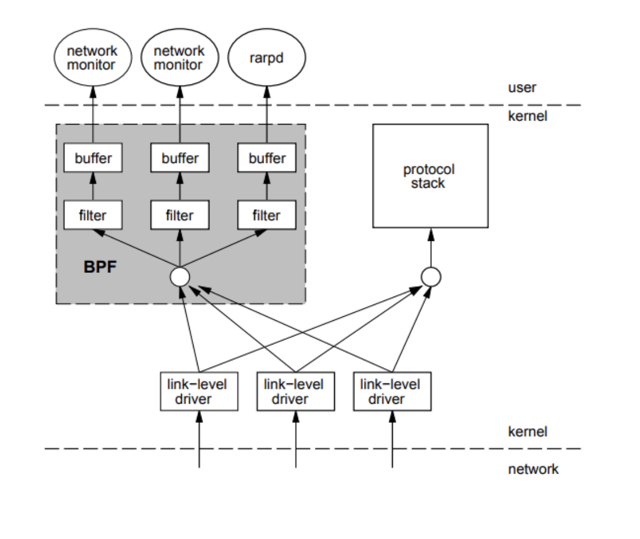
Lab Examples: Use eBPF in network class
Socket filtering
With eBPF, network traffic can be filtered by query name, DNS name, and address.
Students provide programs of the “BPF_PROG_TYPE_XDP” type to a network interface. Then, the kernel will execute the programs on received packets before networking stack starts processing them.
TCP Congestion Control
TCP congestion control using eBPF is adopted.
TCP Tahoe algorithm is explained in detail with implementation, and other TCP congestion control algorithms such as new Reno and Vegas are provided. Students choose at least two TCP congestion algorithms to implement and compare the performance different network traffic setting. Then, students write a lab report to explain the observation
Notes:
Before badgerCTF+ is implemented, the three-way handshake, re-transmission, and TCP header information are examined by students using Wireshark. The TCP congestion control is only introduced in the lecture, without a comparison among different TCP congestion control algorithms.

Slide 20

Q & A

