Slide 1

Classifying Chess Players with Fuzzy Clustering
Analysis in Fuzzy Data Using Eco Code
Si Chen, Yiming Cheng

Slide 2
Our Goal
Classify chess players according to their styles by analyzing the opening of multiple games(ECO) .
Our Approach
Using fuzzy clustering analysis.
Our Result
Players are classified into 3 groups. They are; aggressive player, defensive player or positional player.

Slide 3
ECO Code
Encyclopaedia of Chess Openings
1
ECO is a classification system for the opening moves in a game of chess.
2
There are five main categories, "A" to "E", each of which is divided into one hundred sub-categories.
3
These codes are in crisp data form but results can be in crisp or fuzzy data form.

Slide 4
Cluster Analysis
A method for clustering a data set into groups of similar objects
Hard Clustering
Data is divided into distinct clusters, where each data element belongs to exactly one cluster.
Soft Clustering (Fuzzy Clustering)
Data elements can belong to more than one cluster, and associated with each element is a set of membership levels.

Slide 5

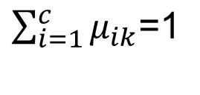
Cluster Analysis
Hard partition of data set
Fuzzy partition of data set
However, they both obey this rule.

Slide 6
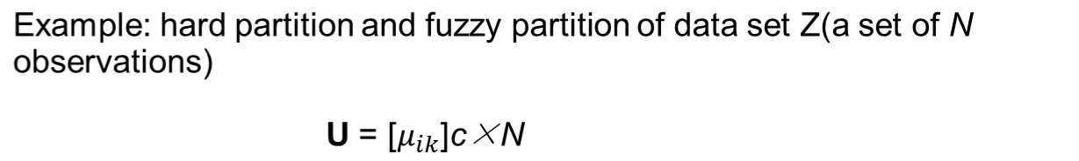

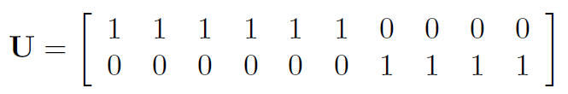
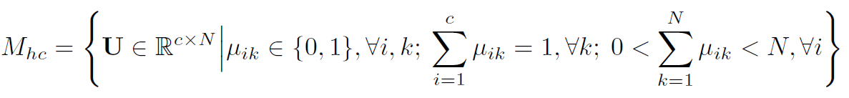

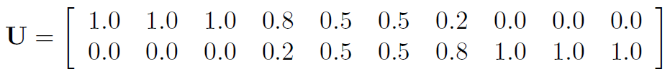
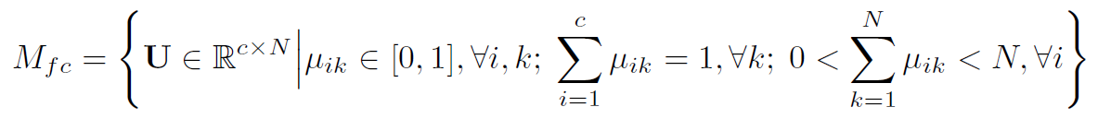
Cluster Analysis

Slide 7
Fuzzy Clustering
Disadvantages of Hard clustering:
When an object roughly falls between two clusters Ai and Aj , it has to be put into one of these clusters. Also,outliers have to be put in some cluster. This is undesirable.
In many situations, fuzzy clustering is more natural than hard clustering. it provides more detailed information on the data.

Slide 8

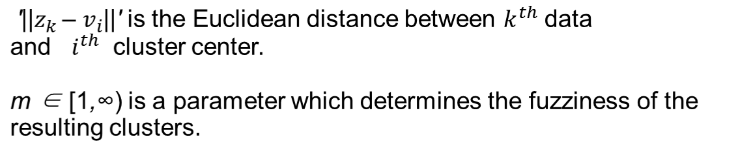
Fuzzy C-means Clustering
FCM
The FCM algorithm is one of the most widely used fuzzy clustering algorithms. This technique was originally introduced by Professor Jim Bezdek in 1981.
In the fuzzy c-means clustering method, we try to minimize the cost function called the fuzzy c-means functional,

Slide 9
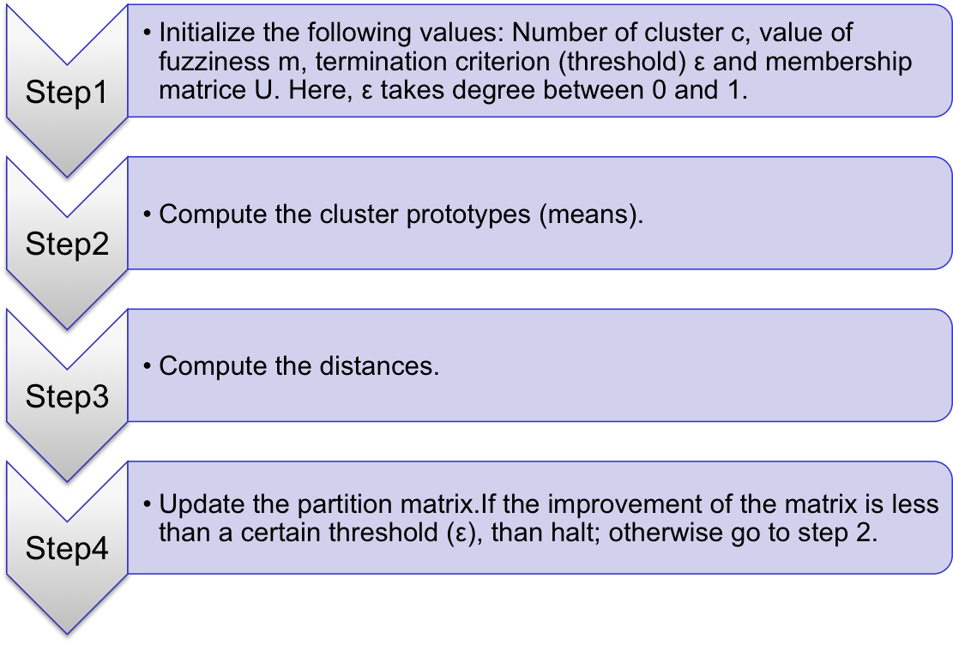
Fuzzy C-means Clustering
Algorithm

Slide 10
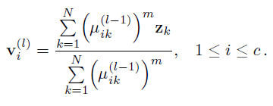
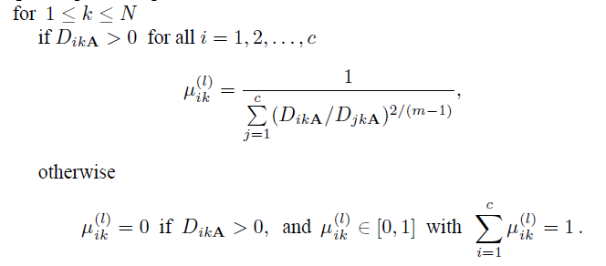
Fuzzy C-means Clustering
Compute the cluster prototypes (means).

Slide 11
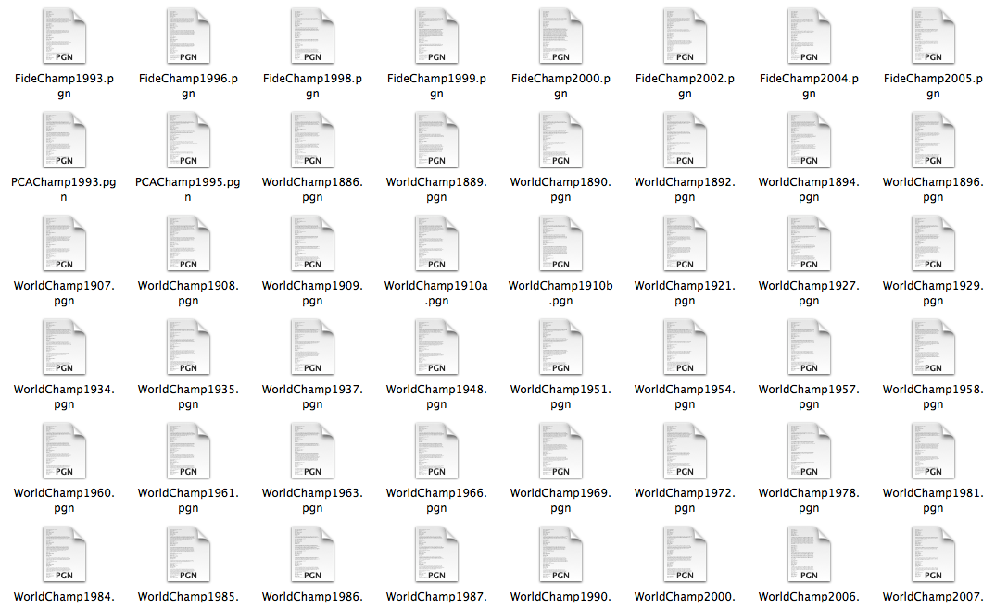
Experiment Setup

Slide 12
PGN
pypgn package
Moves
Player Name
Result
Eco.py
ECO Code
Save or Update
Text File
Convert.py
CSV File
R with e1071 package
Final Fuzzy Clustering Result

Slide 13
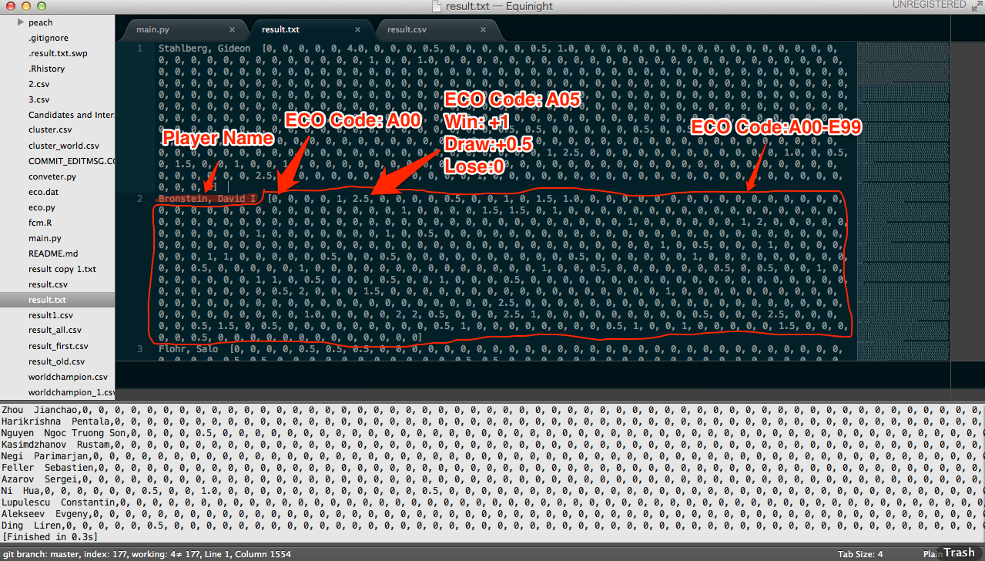
Every player has games both white and black. So we calculated results for white and black separately.

Slide 14
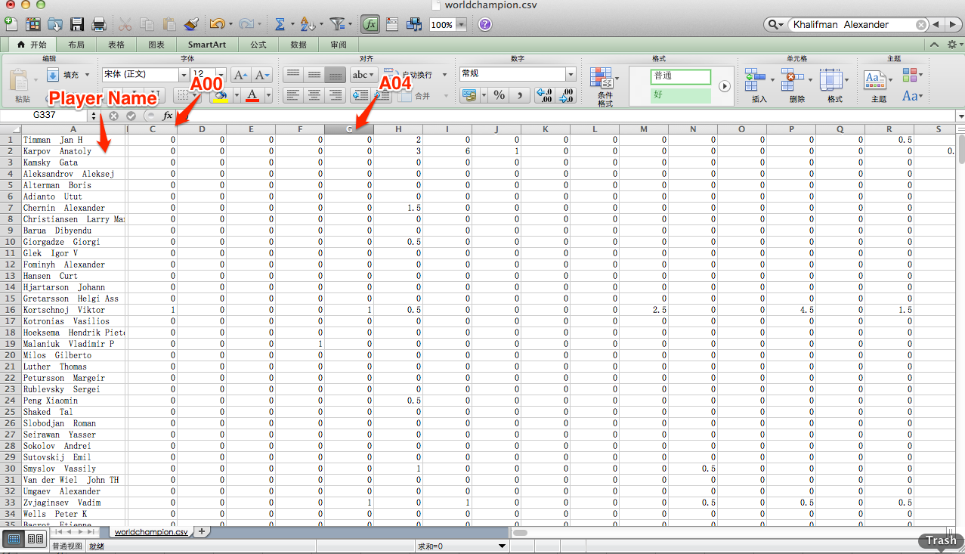

Slide 15
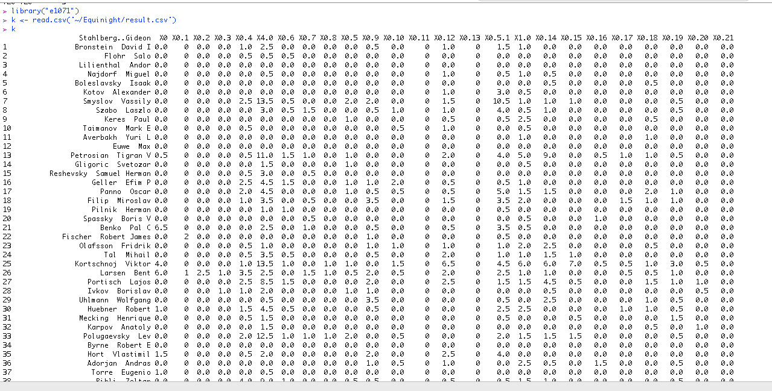
Load CSV (R)

Slide 16
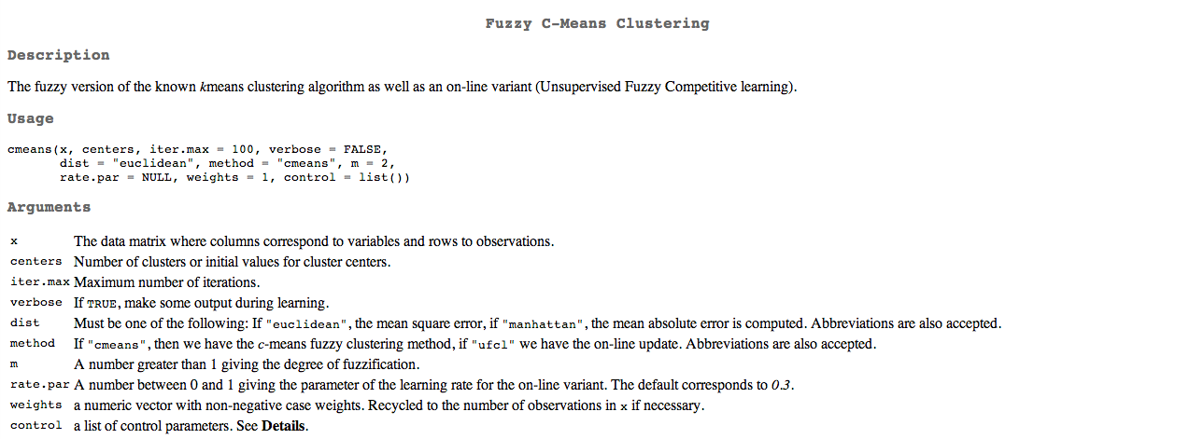

Slide 17
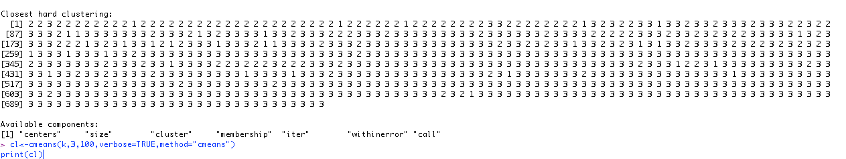
Closest Hard Clustering:
http://rss.acs.unt.edu/Rdoc/library/e1071/html/cmeans.html

Slide 18
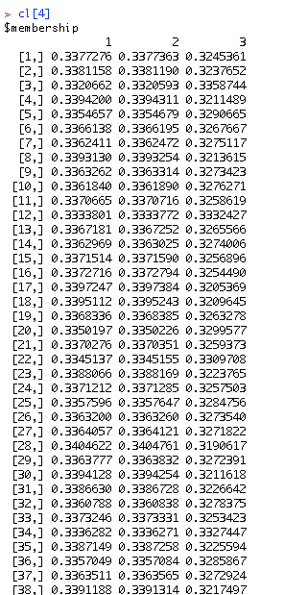

Slide 19
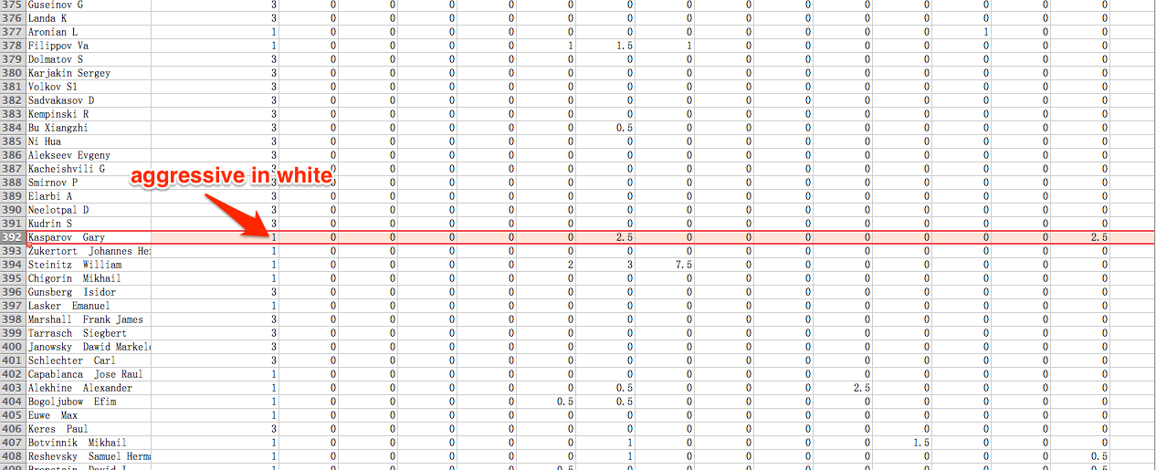
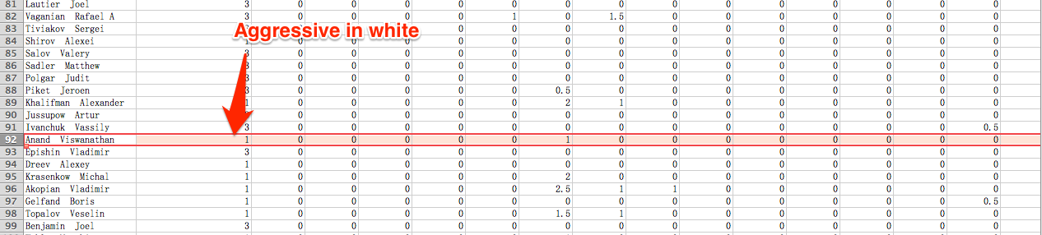
Result

Slide 20
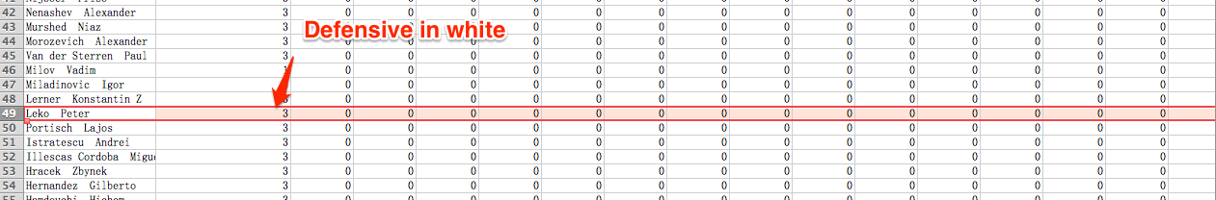
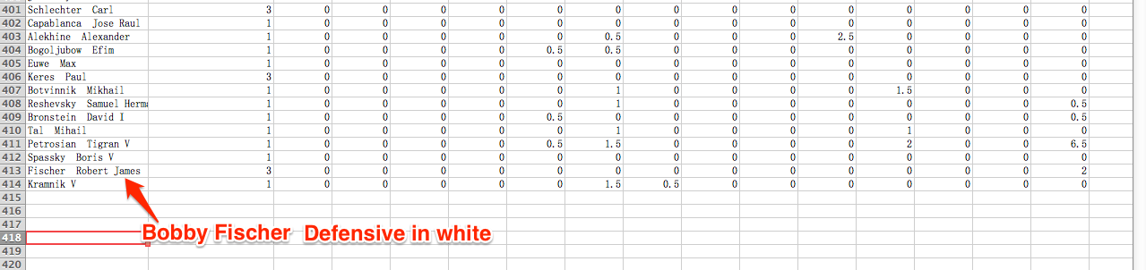

Slide 21
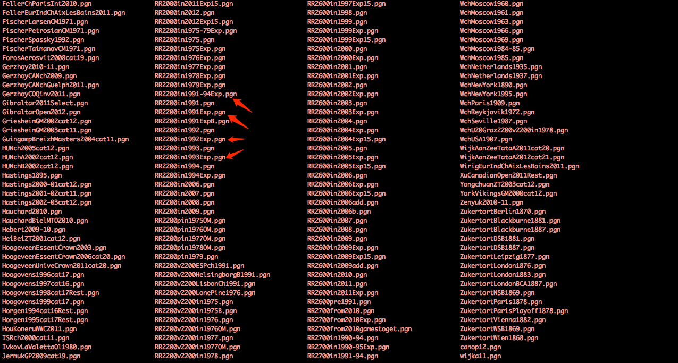

Slide 22
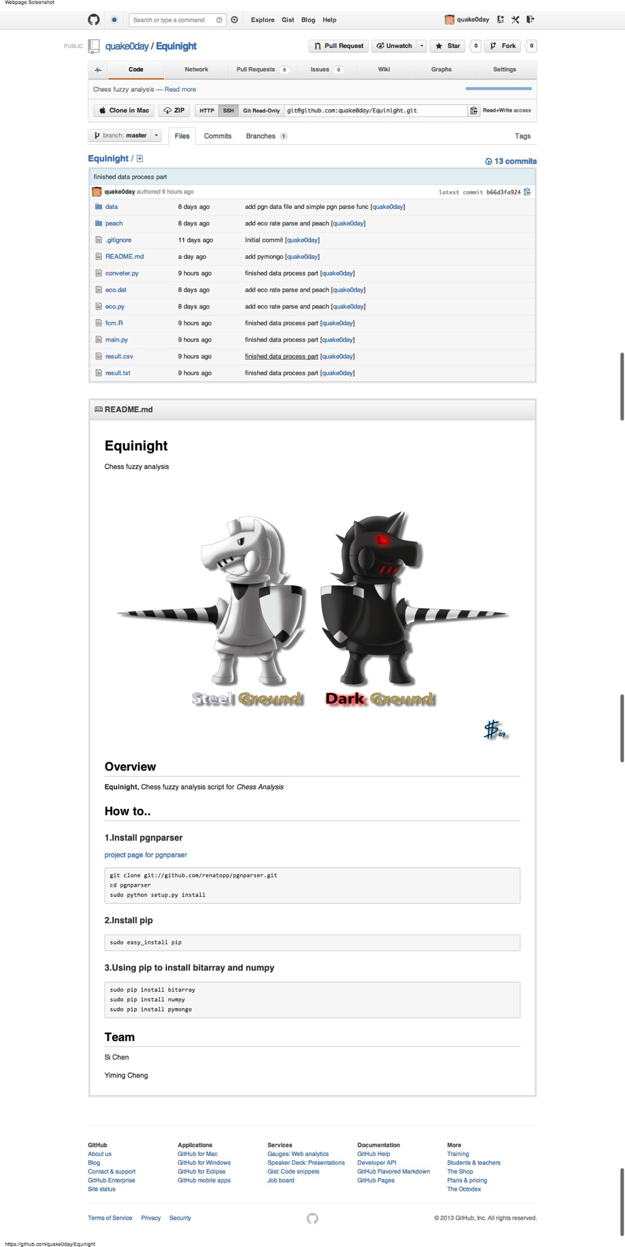
https://github.com/quake0day/Equinight

Slide 23
Thank you !

